Slide 1
Fog And Edge: SmartPark
Jeevanjot Singh
24231584

Slide 2


✅ FUNCTIONAL REQUIREMENTS
Term | Explanation
mTLS | Mutual TLS - both client & server authenticate with certificates[AWS Certs]
QoS 1 | Quality of Service "At Least Once" - guarantees message delivery
Device Shadow | AWS IoT Core's virtual copy of device state (last known values)
Sliding Window | Fog node keeps last 3 readings (15 seconds) for averaging
Bandwidth Optimization | Only sending to cloud when score changes >10% (84% cost reduction)
FaaS | Function as a Service - Lambda (if you add it for alerts)
Time-Series DB | DynamoDB optimized for sequential sensor data (timestamp sort key)
Auto-scaling | DynamoDB PAY_PER_REQUEST scales capacity automatically
Pub/Sub | Publish/Subscribe - IoT Core pattern (topics: sensors/+/raw)
CICD deployment | GitHub Actions → Elastic Beanstalk

Slide 3
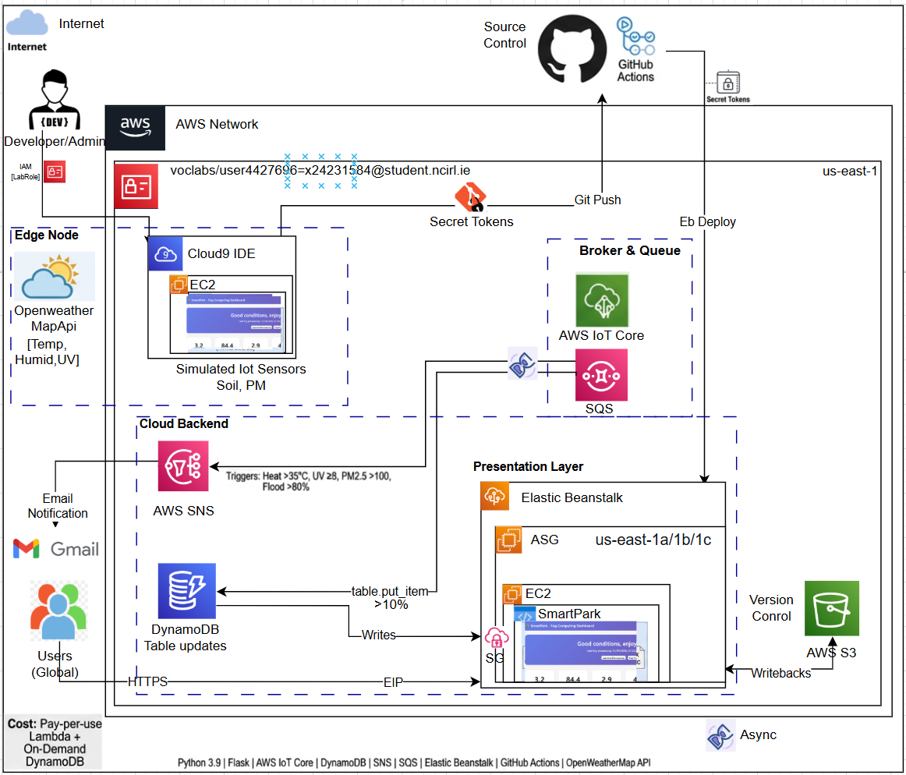
HLD

Slide 4
⚡ NON-FUNCTIONAL REQUIREMENTS
 | Requirement | Target | How You Achieved It
 | Latency | <100ms edge processing | Fog node local calculation
 | Availability | 99.9% | AWS SLA for IoT Core + DynamoDB
 | Scalability | 1000+ parks | DynamoDB PAY_PER_REQUEST auto-scales
 | Cost efficiency | 84% cloud cost reduction | Bandwidth optimization (500K vs 31M messages)
 | Security | mTLS 1.3, X.509 | Certificate-based MQTT authentication
 | Maintainability | Modular code | Separate sensor functions, clear comments
 | Reliability | At-least-once delivery | MQTT QoS 1 (AT_LEAST_ONCE)
 | Decoupling | Async message processing | SQS queue between components
 | Fault tolerance | Retry on failure | DynamoDB + SQS built-in retries

Slide 5


Sensors
From OpenWeatherMap API (Real):
Temperature (°C) DHT22
Humidity (%) DHT22
UV Index SI1145
Wind Speed (m/s)
Simulated Manually:
Soil Moisture % (capacitive sensor simulation)
PM2.5 Air Quality (would need separate air quality API)
Battery level & signal strength (device metadata)

Slide 6
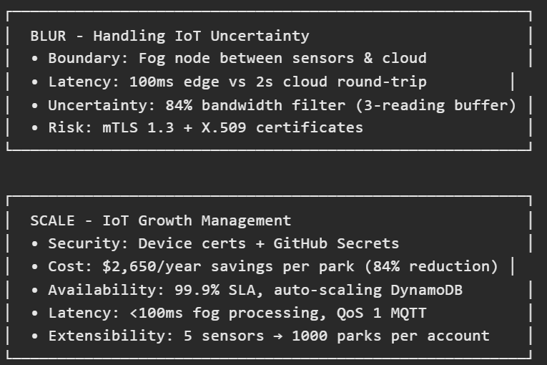
SMARTPARK: BLUR & SCALE PRINCIPLES

Slide 7
Challenges and Solutions
During implementation, several technical challenges emerged that required iterative problem-solving. First, the AWS IoT SDK's publish() method returns a tuple (future, packet_id) rather than a single object, which initially caused AttributeError when calling .result() directly—this was resolved by properly unpacking the tuple before awaiting the future.
Second, DynamoDB's strict typing rejected Python float values, necessitating conversion to Decimal types using a recursive float_to_decimal() helper function. Third, GitHub's secret scanning blocked commits containing hardcoded AWS credentials, requiring migration to GitHub Secrets for secure CICD authentication.
Finally, Elastic Beanstalk deployment failed due to version label length limits (100 characters), which was solved by using shorter labels based on GitHub run numbers rather than full commit SHAs. These experiences reinforced the importance of careful API documentation review and robust error handling in cloud-native applications.

Slide 8


Business Logic And Future Applications

