Slide 1

DEPARTMENT OF COMPUTER SCIENCE ENGINEERING
PRESIDENCY UNIVERSITY
Itgalpur,Rajanakunte ,Yelahanka,Bengaluru, Karnataka-560064
ATM MACHINE SYSTEM
A mini project report submitted by
JAGJEET SINGH (20181CSE0281)
JEEVANJOT SINGH (20181CSE0291)
KAARNIK JAMWAL (20181CSE0303)
as part of Lab based course Programming in Python, CSE 317
of
BACHELOR OF TECHNOLOGY
In
COMPUTER SCIENCE AND ENGINEERING
under the supervision of
PROF.SHWETA SINGH, Assistant Professor

Slide 2
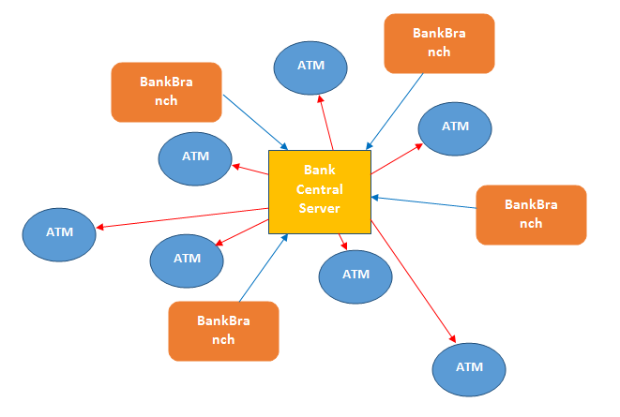
INTRODUCTION and AIM
The aim of ATM MACHINE SYSTEM project is to build a Python based ATM (Automated Teller Machine) system. The introduction of ATM’s by various banks have brought about freedom from the interminable queues in front of withdrawal counters at banks. This ATM Machine system requires the constant updating of records between the bank servers and a spread-out network of ATM’s.

Slide 3
INTRODUCTION AND AIM CONTD….
Security is the foundation of a good ATM system. This system will provide for secure authenticated connections between users and the bank servers. The whole process will be automated right from PIN (Personal Identification Number) validation to transaction completion ATM Machine System will enable two important features of an ATM, reduction of human error in the banking system and the possibility of 24 hour personal banking. The card details and PIN database will be a secure module that will not open to routine maintenance, the only possibility of access to this database will be through queries raised from an ATM in the presence of a valid bank ATM card.

Slide 4
Algorithm/ Step(Explain the different modules/functions used)
1. We have run the program in JetBrains PyCharm
2. Our project is based on ATM MACHINE SYSTEM.
3. We have used Graphical User Interface(GUI) using tkinter in our project.
4. The functions of ATM Machine System are:
Enter the correct account number and password to login.
Account Details : Name, Account Number and Type will be shown.
Deposit Money:this functions helps us to deposite the money.
Withdrawal Money:Through this function we can take our money from the machine.
Balance Enquiry : we get the mini statement of our account.
Quit: this function helps us to terminate the process.

Slide 5
Main function code
class Bank: def _init_(self,root): self.conn = sqlite3.connect("t.db", timeout=100) self.login = False self.root = root self.header = Label(self.root,text="PATIALA BANK",bg="#50A8B0",fg="white",font=("arial",20,"bold")) self.header.pack(fill=X) self.frame = Frame(self.root,bg="#728B8E",width=600,height=400) #Login Page Form Components self.userlabel =Label(self.frame,text="Account Number",bg="#728B8E",fg="white",font=ARIAL) self.uentry = Entry(self.frame,bg="honeydew",highlightcolor="#50A8B0", highlightthickness=2, highlightbackground="white") self.plabel = Label(self.frame, text="Password",bg="#728B8E",fg="white",font=ARIAL) self.pentry = Entry(self.frame,bg="honeydew",show="*",highlightcolor="#50A8B0", highlightthickness=2, highlightbackground="white") self.button = Button(self.frame,text="LOGIN",bg="#50A8B0",fg="white",font=ARIAL,command=self.verify) self.q = Button(self.frame,text="Quit",bg="#50A8B0",fg="white",font=ARIAL,command = self.root.destroy) self.userlabel.place(x=145,y=100,width=120,height=20) self.uentry.place(x=153,y=130,width=200,height=20) self.plabel.place(x=125,y=160,width=120,height=20) self.pentry.place(x=153,y=190,width=200,height=20) self.button.place(x=155,y=230,width=120,height=20) self.q.place(x=480,y=360,width=120,height=20)

Slide 6
self.frame.pack() def database_fetch(self):#Fetching Account data from database self.acc_list = [] self.temp = self.conn.execute("select name,pass,acc_no,acc_type,bal from atm where acc_no = ? ",(self.ac,)) for i in self.temp: self.acc_list.append("Name = {}".format(i[0])) self.acc_list.append("Account no = {}".format(i[2])) self.acc_list.append("Account type = {}".format(i[3])) self.ac = i[2] self.acc_list.append("Balance = {}".format(i[4])) def verify(self):#verifying of authorised user ac = False self.temp = self.conn.execute("select name,pass,acc_no,acc_type,bal from atm where acc_no = ? ", (int(self.uentry.get()),)) for i in self.temp: self.ac = i[2] if i[2] == self.uentry.get(): ac = True elif i[1] == self.pentry.get(): ac = True m = "{} Login SucessFull".format(i[0]) self.database_fetch() messagebox._show("Login Info", m) self.frame.destroy() self.MainMenu()

Slide 7
else: ac = True m = " Login UnSucessFull ! Wrong Password" messagebox._show("Login Info!", m) if not ac: m = " Wrong Acoount Number !" messagebox._show("Login Info!", m) def MainMenu(self):#Main App Appears after logined ! self.frame = Frame(self.root,bg="#728B8E",width=800,height=400) root.geometry("800x400") self.detail = Button(self.frame,text="Account Details",bg="#50A8B0",fg="white",font=ARIAL,command=self.account_detail) self.enquiry = Button(self.frame, text="Balance Enquiry",bg="#50A8B0",fg="white",font=ARIAL,command= self.Balance) self.deposit = Button(self.frame, text="Deposit Money",bg="#50A8B0",fg="white",font=ARIAL,command=self.deposit_money) self.withdrawl = Button(self.frame, text="Withdrawl Money",bg="#50A8B0",fg="white",font=ARIAL,command=self.withdrawl_money) self.q = Button(self.frame, text="Quit", bg="#50A8B0", fg="white", font=ARIAL, command=self.root.destroy) self.detail.place(x=0,y=0,width=200,height=50) self.enquiry.place(x=0, y=315, width=200, height=50) self.deposit.place(x=600, y=0, width=200, height=50) self.withdrawl.place(x=600, y=315, width=200, height=50) self.q.place(x=340, y=340, width=120, height=20)

Slide 8
self.frame.pack() def account_detail(self): self.database_fetch() text = self.acc_list[0]+"\n"+self.acc_list[1]+"\n"+self.acc_list[2] self.label = Label(self.frame,text=text,font=ARIAL) self.label.place(x=200,y=100,width=300,height=100) def Balance(self): self.database_fetch() self.label = Label(self.frame, text=self.acc_list[3],font=ARIAL) self.label.place(x=200, y=100, width=300, height=100) def deposit_money(self): self.money_box = Entry(self.frame,bg="honeydew",highlightcolor="#50A8B0", highlightthickness=2, highlightbackground="white") self.submitButton = Button(self.frame,text="Submit",bg="#50A8B0",fg="white",font=ARIAL) self.money_box.place(x=200,y=100,width=200,height=20) self.submitButton.place(x=445,y=100,width=55,height=20) self.submitButton.bind("<Button-1>",self.deposit_trans)

Slide 9
def deposit_trans(self,flag): self.label = Label(self.frame, text="Transaction Completed !", font=ARIAL) self.label.place(x=200, y=100, width=300, height=100) self.conn.execute("update atm set bal = bal + ? where acc_no = ?",(self.money_box.get(),self.ac)) self.conn.commit() def withdrawl_money(self): self.money_box = Entry(self.frame,bg="honeydew",highlightcolor="#50A8B0", highlightthickness=2, highlightbackground="white") self.submitButton = Button(self.frame,text="Submit",bg="#50A8B0",fg="white",font=ARIAL) self.money_box.place(x=200,y=100,width=200,height=20) self.submitButton.place(x=445,y=100,width=55,height=20) self.submitButton.bind("<Button-1>",self.withdrawl_trans) def withdrawl_trans(self,flag): self.label = Label(self.frame, text="Money Withdrawl !", font=ARIAL) self.label.place(x=200, y=100, width=300, height=100) self.conn.execute("update atm set bal = bal - ? where acc_no = ?",(self.money_box.get(),self.ac)) self.conn.commit()

Slide 10
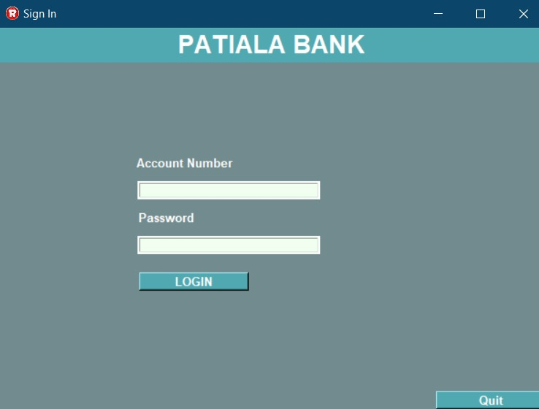
APPLICATION PREVIEW

Slide 11
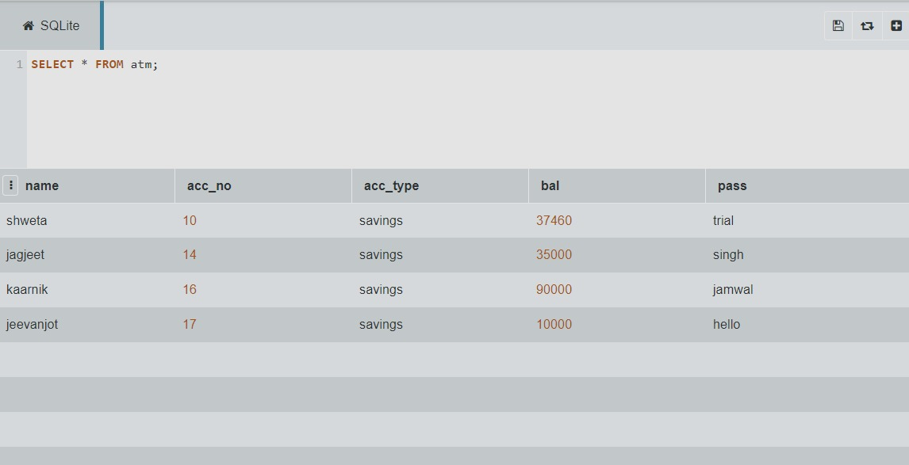
MYSQL DATABASE REGISTERED WITH CO

Slide 12
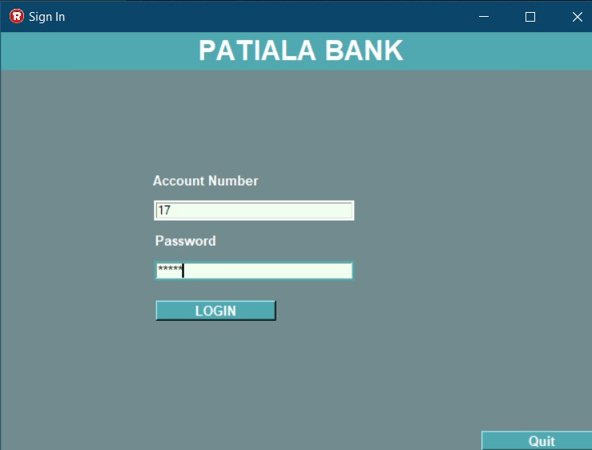
LOGGING IN BY ENTERING ACCOUNT NO AND PASSWORD

Slide 13
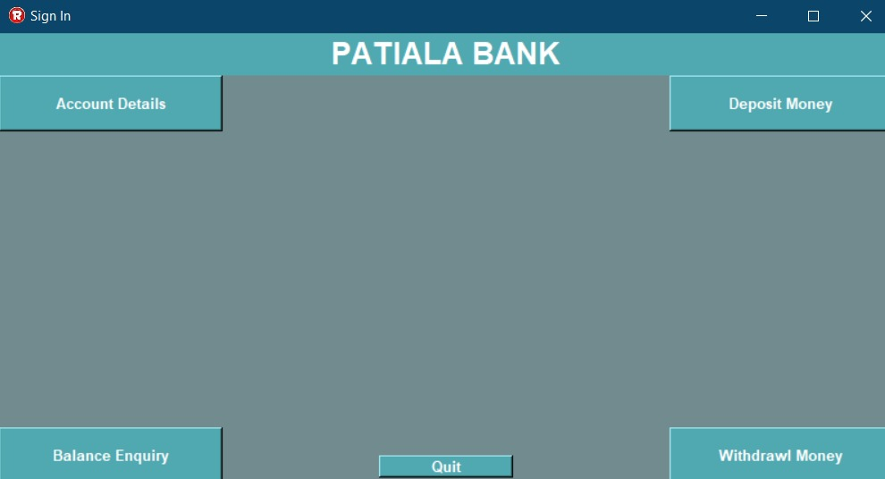
LOGGED IN SUCCESSFULLY

Slide 14
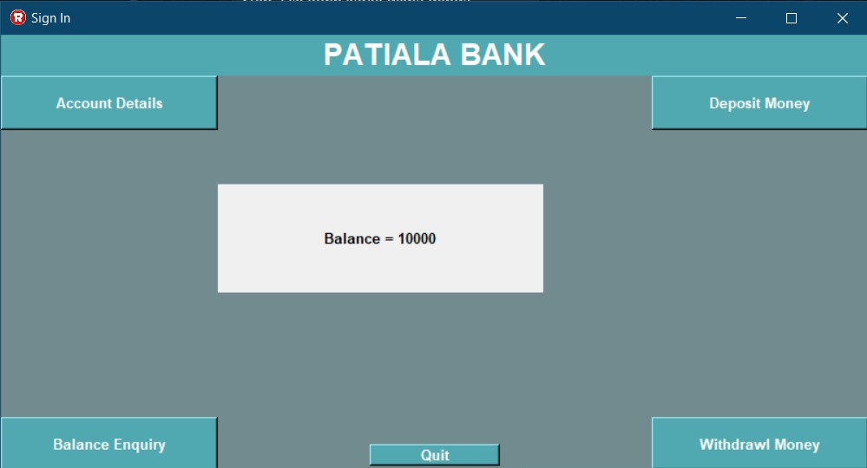
BALANCE ENQUIRY

Slide 15
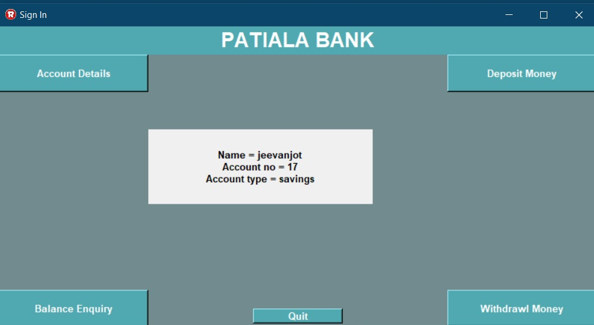
ACCOUNT DETAILS

Slide 16
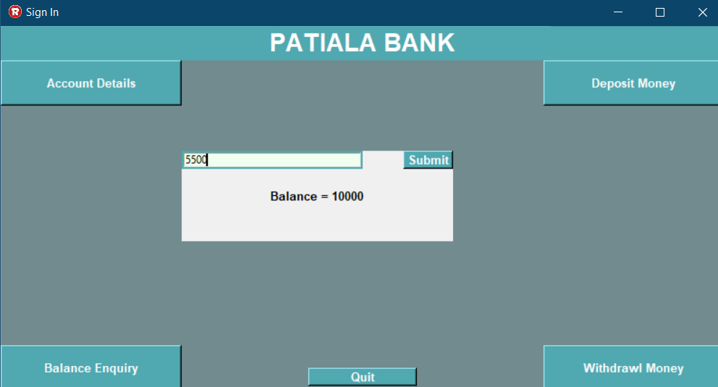
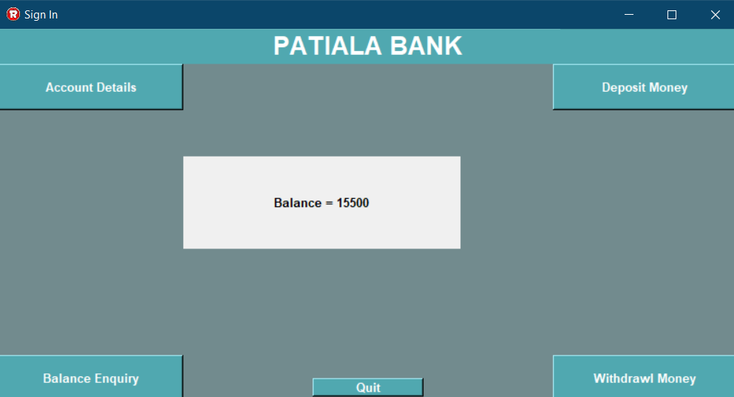
Money depositing preview
Depositing Money
Balance after Depositing money

Slide 17
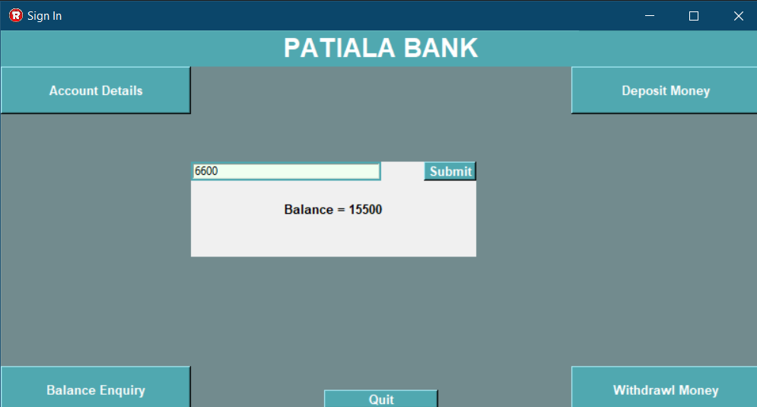
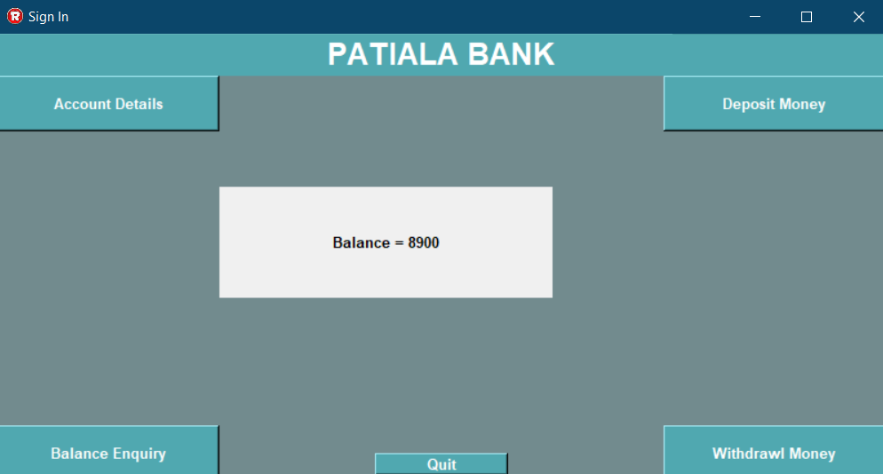
Money withdrawing preview
Withdrawing Money
Balance after Withdrawing Money

Slide 18
Future scope
The future of ATM will surely see a big curve in the coming years, but in which direction is still a big question.Before diving towards the conclusion let us see some important points published in a recent report by “cash product office” .
1) Cash is still the most used form of payment in retail, accounting for 40% of all transactions.
2) Cash is the most used payment for purchases under $50.
3) Low-income consumers are the biggest users of cash.
4) 40% of people 18-24 mainly use cash as their preferred form of payment.
5) Households earning under $25,000/year prefer to use cash to pay bills over any other form of payment.
6) Cash is the preferred back-up form of payment.
Referring to above points one can surely say that cash will continue to be in use in huge amounts which in turn will increase the demand of cards as one cannot afford to visit bank branch every time for cash. So basically ATM’s are not a thing of short run. So the question now arises will the use pattern of these machines change or not. Well, the use pattern can surely change. We could surely witness more secure, safer usage in the ATM’s. They can be even card less in near future as in his report, Bill verson said ATMs will adopt biometric identifiers like fingerprint and facial recognition to enable cardless usage. They'll also include "services as diverse as applying for loans, buying lottery tickets and dispensing foreign currency,"

Slide 19
Future scope continued…
So in short we would like to say Cash currency is needed the world over. And, especially for locations where a physical bank branch isn’t available, having an ATM to use for your banking needs is essential. . As a result, ATMs are catching on like wildfire.
Also some developed countries like USA have already started using the crypto currency ATMs and as we are expecting a increase in crypto currency in near future there is no way that ATMs number would go down.
It would not be wrong if we believe that ATMs will become the banks of the future as more branches close.
So at last, as far as the future scope of the ATMs is concerned, we would say that ATMs are here to stay and would not go anywhere in the near future as the need of these machines is very crucial in working of the banks as banks cannot physically transfer the cash to its every customer.
Also, it would not be wrong to say that as long as cash is in use ATMs will be in role.

Slide 20
Thank you!!!!

