Slide 1
BLUESTOCK FINTECH
Mutual Fund Analytics Platform
End-to-End Data Engineering, ETL Pipeline & Interactive Dashboard
Data Source: AMFI India · mfapi.in · NSE/BSE | 40 Schemes · 64,320 NAV Records · 32,778 Transactions
June 2026 | Capstone Project | Bluestock Fintech Pvt. Ltd.

Slide 2
PROBLEM STATEMENT & OBJECTIVES
THE PROBLEM
PROJECT OBJECTIVES
1. Data fragmentation — NAV, AUM, SIP flow across different formats with no unified database 2. No easy benchmark comparison for risk-adjusted returns (Sharpe, Alpha, Beta) 3. Limited visibility into investor behaviour by demographics and geography 4. Static monthly PDF reports with no drill-down or self-service capability
O1
ETL pipeline from AMFI raw data to SQLite
O2
Normalised 8-table star schema
O3
Comprehensive EDA — 15+ charts
O4
Risk metrics: Sharpe, Sortino, VaR, Max Drawdown
O5
Interactive 4-page Power BI dashboard
O6
Investor behaviour & cohort analytics
O7
Fund scorecard & recommender system

Slide 3
DATA SOURCES & DATASETS
40
10
64,320+
32,778
Real Fund Schemes
Datasets Provided
NAV Records
Transactions
Dataset | Rows | Description
01_fund_master.csv | 40 | 40 real AMFI schemes with fund house, category, expense ratio
02_nav_history.csv | 64,320 | Daily NAV Jan 2022–May 2026, anchored to real mfapi.in values
03_aum_by_fund_house.csv | 90 | Quarterly AUM (₹ Crore) for 10 fund houses, 2022–2025
04_monthly_sip_inflows.csv | 48 | Month-wise SIP inflow, accounts, and SIP AUM from AMFI
08_investor_transactions.csv | 32,778 | Simulated SIP/Lumpsum/Redemption for 5,000 investors
10_benchmark_indices.csv | 8,000+ | Daily Nifty 50, Nifty 100, BSE SmallCap, CRISIL indices

Slide 4
SYSTEM ARCHITECTURE & ETL PIPELINE
EXTRACT
AMFI CSVs · mfapi.in REST API · NSE/BSE Bhavcopy
TRANSFORM
Pandas cleaning · forward-fill weekends · date normalisation · schema mapping
LOAD
SQLite star schema · 8 tables · 64K+ rows · indexed on amfi_code & date_id
ANALYSE
Sharpe · Sortino · VaR/CVaR · CAGR · Max Drawdown · Cohort · HHI
VISUALISE
Power BI 4-page dashboard · slicers · drill-through · KPI cards
Star Schema: dim_fund · dim_date · fact_nav · fact_aum · fact_transactions · fact_performance · fact_portfolio · fact_sip_industry

Slide 5
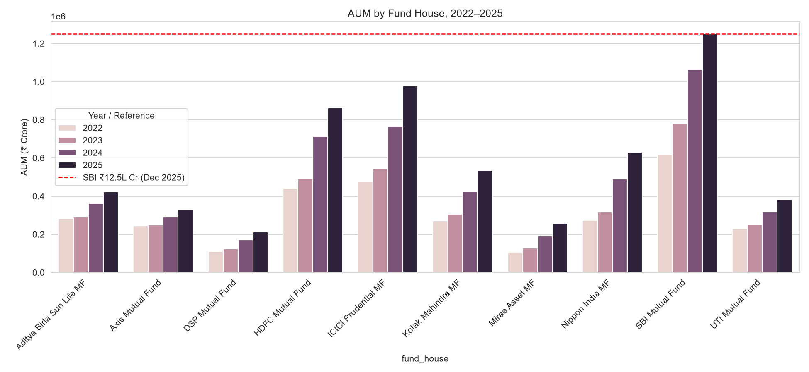
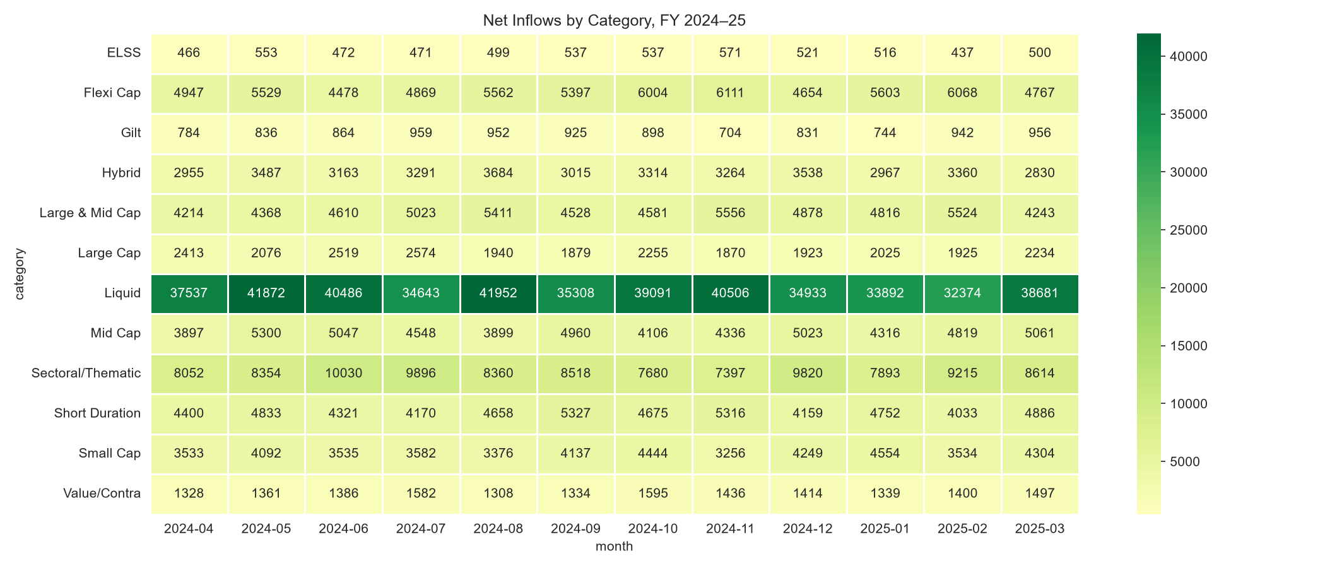
EDA HIGHLIGHTS — MARKET & INDUSTRY TRENDS
AUM Growth by Fund House (2022–2025)
Net Inflows by Category — FY 2024–25
SBI MF leads AUM at ₹12.5L Cr · Liquid category dominates inflows by a wide margin · All fund houses show consistent YoY AUM growth

Slide 6
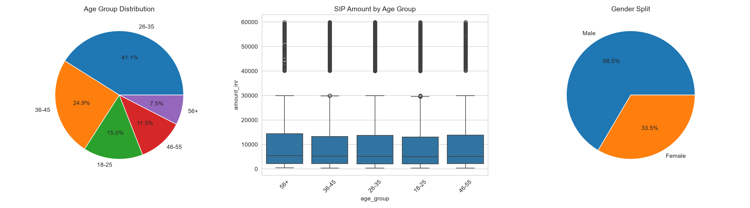

EDA HIGHLIGHTS — INVESTORS & SIP BEHAVIOUR
Investor Demographics: Age · SIP Amount · Gender Split
SIP Inflow Trend (₹ Crore)
41.1%
66.5%
₹31,002 Cr
~Even
Investors aged 26–35
Male investors
SIP ATH Dec 2025
T30 vs B30 split

Slide 7
PERFORMANCE METRICS — RISK-ADJUSTED RETURNS
TOP 5 FUNDS — SHARPE RATIO
MAXIMUM DRAWDOWN — WORST FALLS
Fund
Sharpe
SBI Small Cap Direct
-52.6%
Jan 2023 → Oct 2025
Mirae Asset Large Cap
1.07
Axis Small Cap
-51.7%
Kotak Flexicap
0.97
May 2025 → May 2026
ABSL Small Cap
-35.4%
Mirae Asset Tax Saver
0.92
Nov 2024 → May 2026
DSP Small Cap
-31.2%
ICICI Pru Midcap
0.88
May 2024 → Jan 2025
SBI Bluechip Regular
0.86
SBI Small Cap Reg
-28.7%
Rf = 6.5% (RBI repo rate) · Annualised with √252
Aug 2024 → May 2025
Small-cap funds show deepest drawdowns — consistent with higher volatility profile

Slide 8
PERFORMANCE METRICS — VaR, FUND SCORECARD & RECOMMENDER
95% VaR & CVaR
FUND RECOMMENDER — BY RISK APPETITE
(Riskiest Funds)
LOW RISK
ICICI Pru Liquid (Sharpe 7.68)
Kotak Liquid (6.18)
ABSL Liquid (5.14)
Fund
VaR
CVaR
SBI SC Direct
-2.69%
-3.24%
Axis SC
-2.62%
-3.17%
MODERATE RISK
HDFC Top 100 (Sharpe 1.06)
Mirae Asset Large Cap (1.06)
ICICI Pru Bluechip Direct (1.03)
ABSL SC
-2.60%
-3.25%
Nippon SC
-2.54%
-3.23%
HIGH RISK
Kotak Emerging Equity (0.96)
ICICI Pru Midcap (0.95)
SBI Small Cap Regular (0.94)
Ranked by Sharpe ratio within SEBI risk_grade matching investor risk appetite

Slide 9
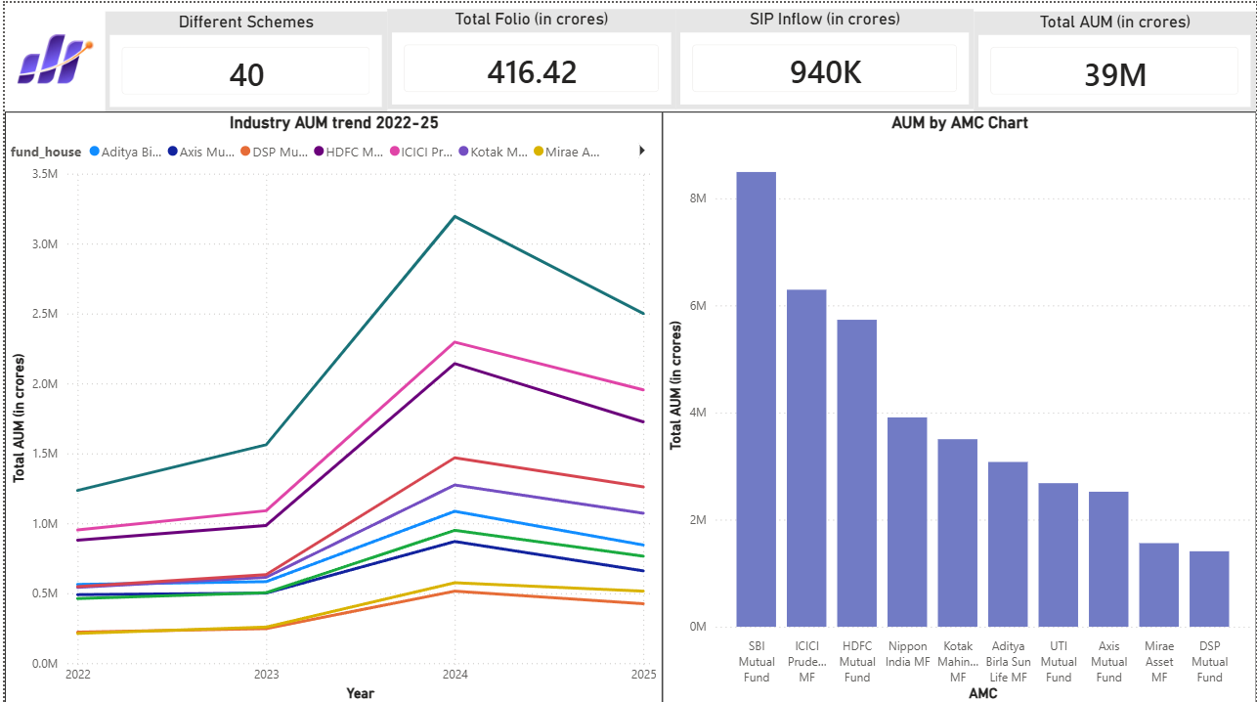
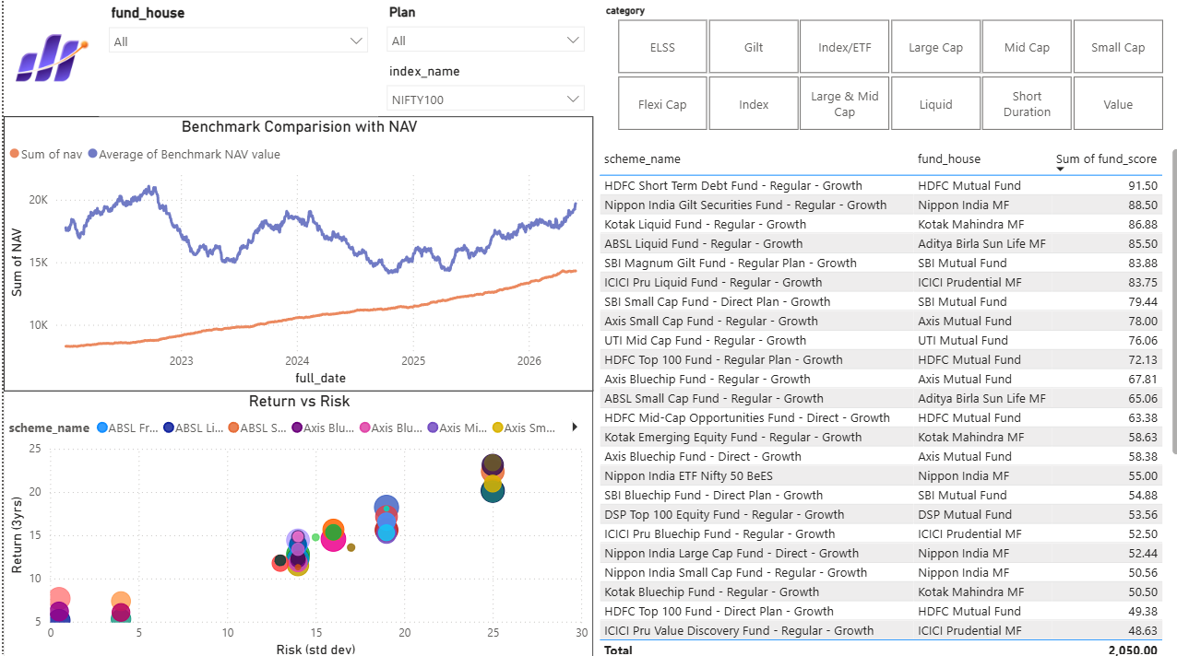
INTERACTIVE DASHBOARD — PAGES 1 & 2
Page 1 — Industry Overview: KPIs · AUM Trend · AUM by AMC
Page 2 — Fund Performance: Risk-Return Scatter · Scorecard · Benchmark NAV

Slide 10
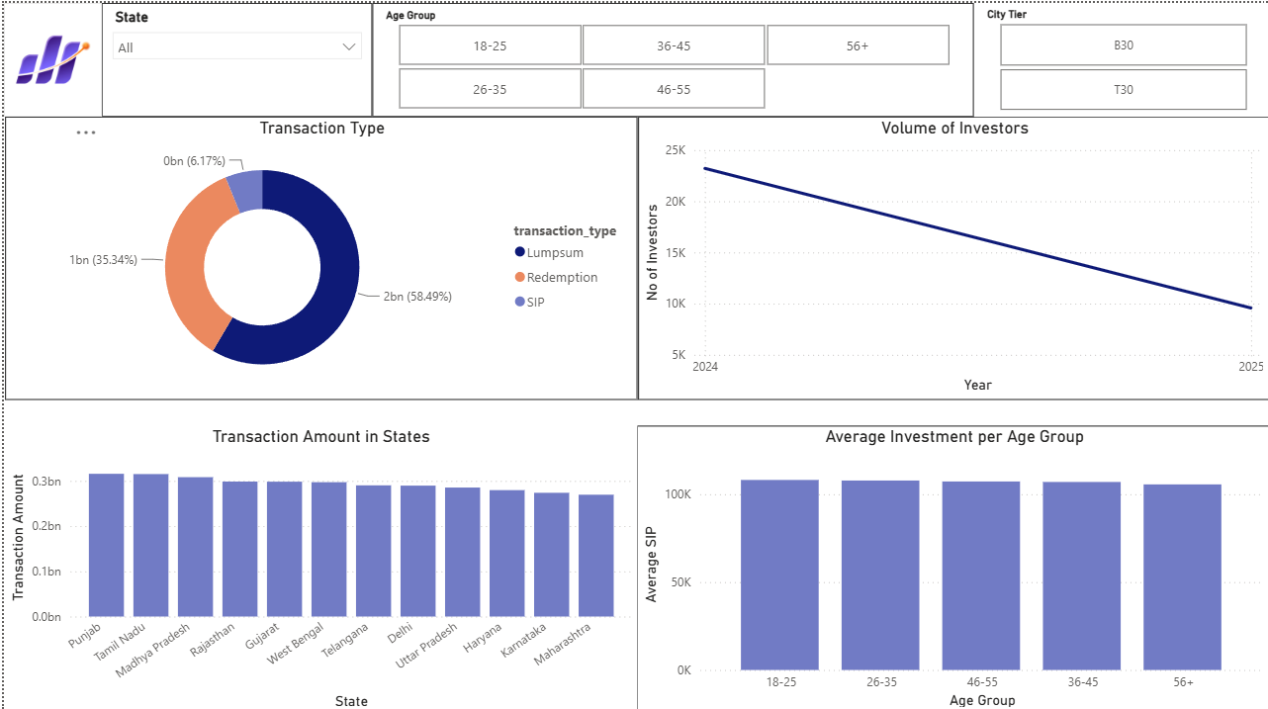
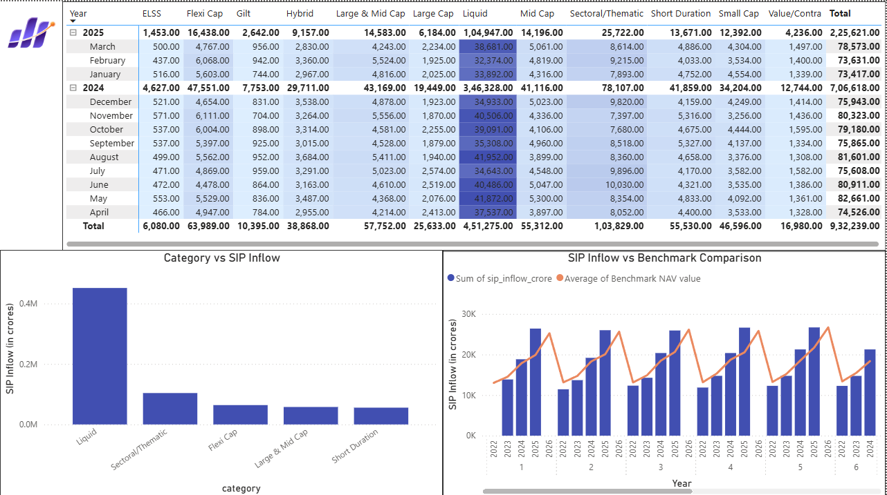
INTERACTIVE DASHBOARD — PAGES 3 & 4
Page 3 — Investor Analytics: State · Age Group · Transaction Type · City Tier
Page 4 — SIP & Market Trends: Dual-Axis · Category Matrix · Top 5 Inflow

Slide 11
KEY FINDINGS & RECOMMENDATIONS
🏆 SBI MF Industry Leader
📈 SIP Culture Deepening
⚠️ Small-Cap Risk Premium
Maintains highest AUM (₹12.5L Cr) across all years; ICICI Pru and HDFC follow. Gap widening YoY.
Monthly SIP inflows hit all-time high of ₹31,002 Cr in Dec 2025, growing exponentially post-Jul 2023.
Small-cap funds deliver highest 1yr returns but worst drawdowns (-52.6%) and VaR (-2.69%/day).
🎯 Best Risk-Adjusted Fund
🔍 Concentration Risk
🤝 Data Limitation Noted
Mirae Asset Large Cap tops Sharpe ranking at 1.07, delivering best return per unit of risk taken.
Axis Bluechip (HHI 2065) is most sector-concentrated; SBI Small Cap Regular (1074) most diversified.
NAV history and pre-supplied performance metrics were independently generated — alpha/beta analysis documented accordingly.

Slide 12
Thank You
Bluestock Fintech Pvt. Ltd. — Mutual Fund Analytics Capstone
40
8
15+
4
Schemes Tracked
DB Tables
EDA Charts
Dashboard Pages
Data: AMFI India · mfapi.in · NSE/BSE | Tools: Python · SQL · Power BI | June 2026

