Slide 1
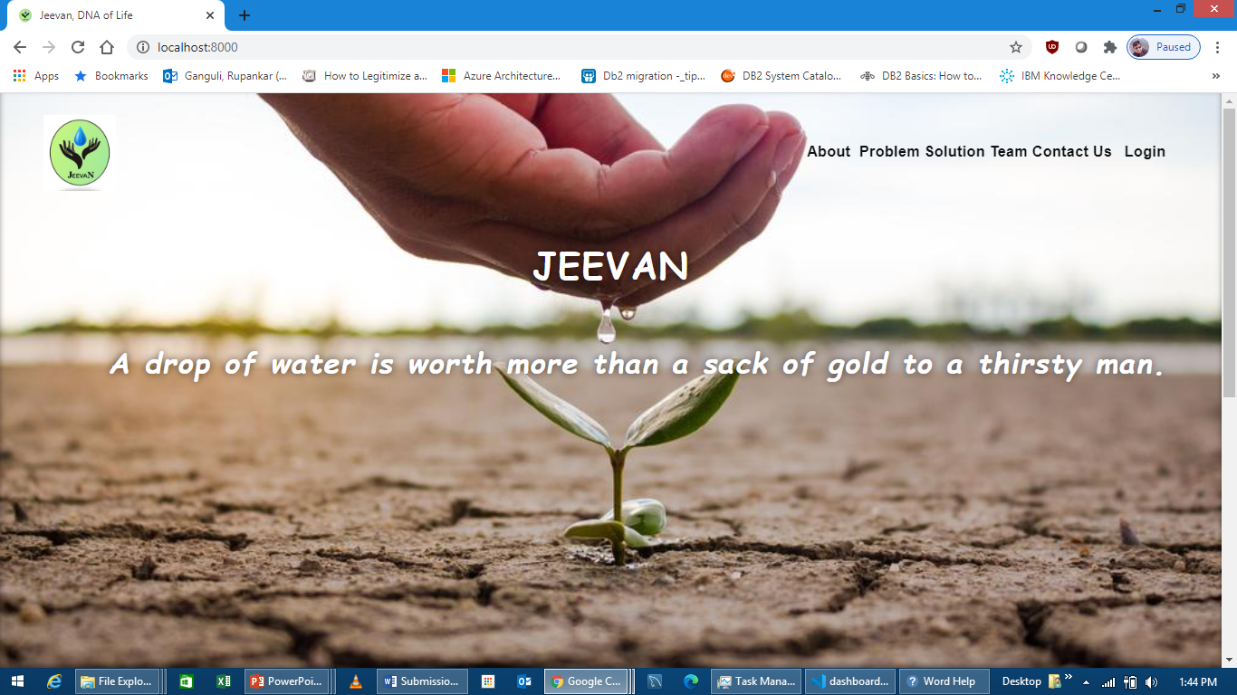
1. Go to any browser. Enter the application URL. You will be redirected to landing page of the application. You will have the login button in the top right corner. Click on Login button. It will be redirected to login page.

Slide 2
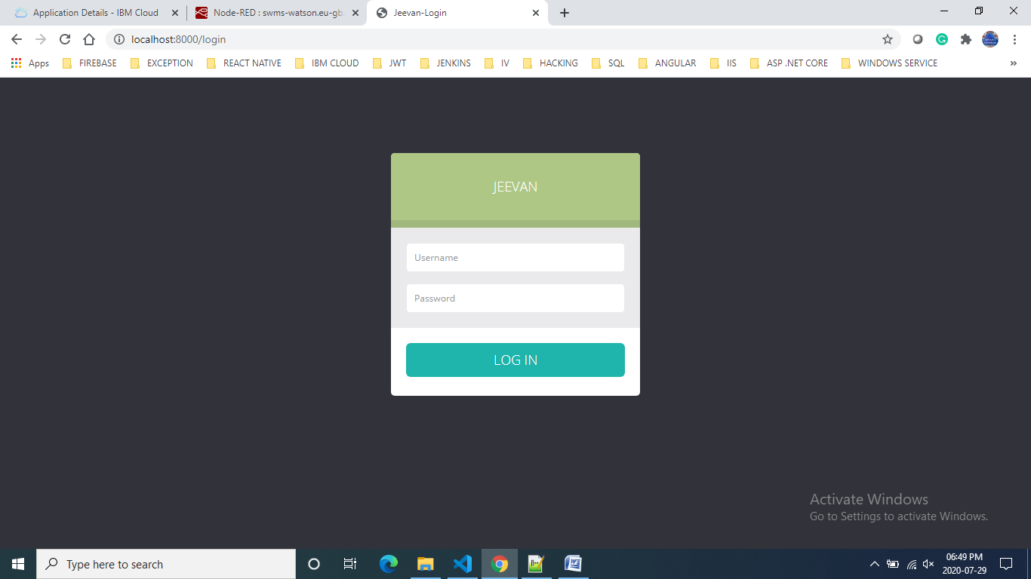
2. Enter your valid credential and click on Login button. You will be redirected to Dashboard page.

Slide 3
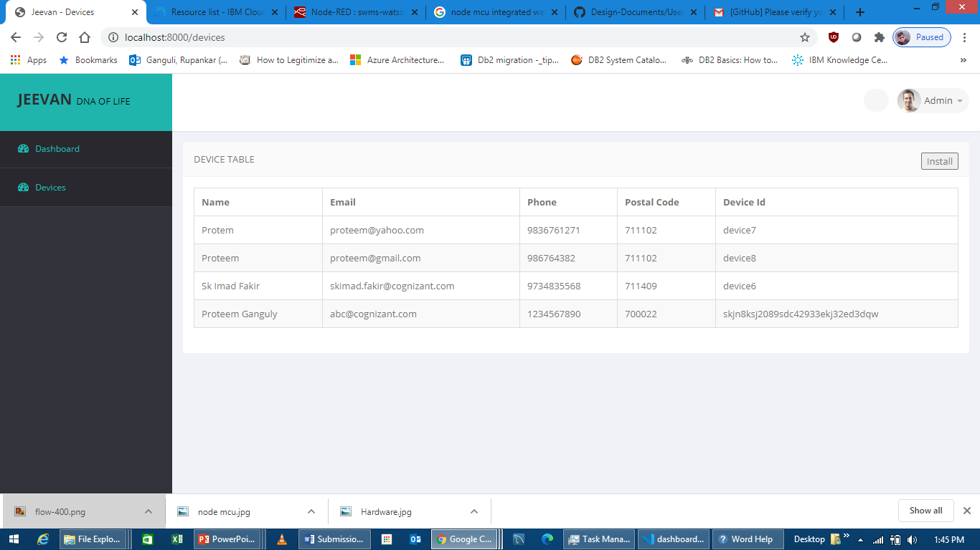
3. Click on the Devices tab from left menu bar. You will be redirected to Devices page. In the devices page, you will be able to see the device and customer information under Device Table.
4. To install new device, click on Install button. A pop-up will come to enter basic information of customer with device id(Will get from device).

Slide 4
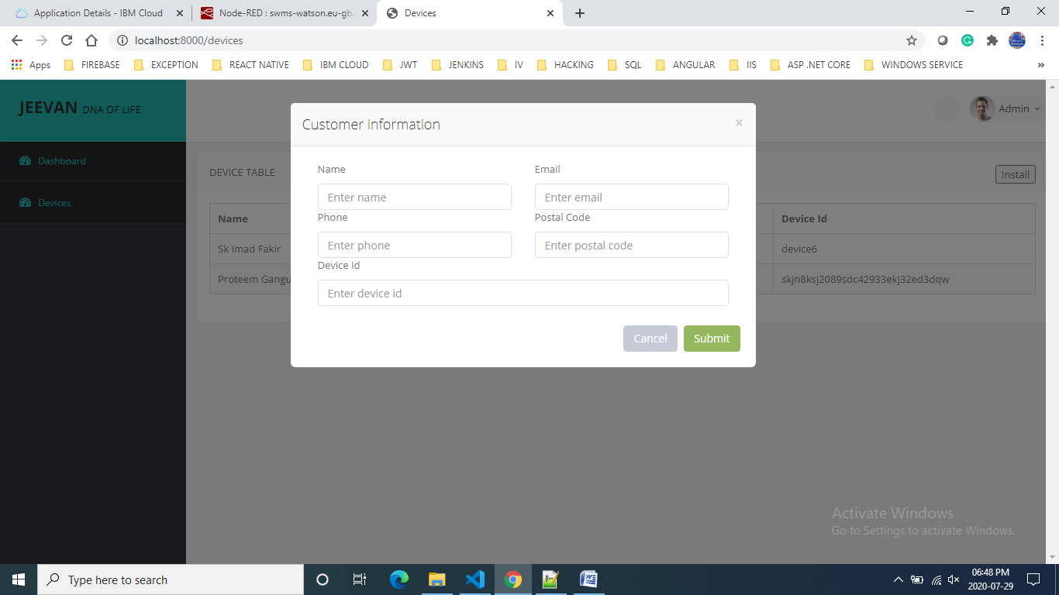
5. Enter the required fields and click on the Submit button. The device will be registered for the customer.

Slide 5
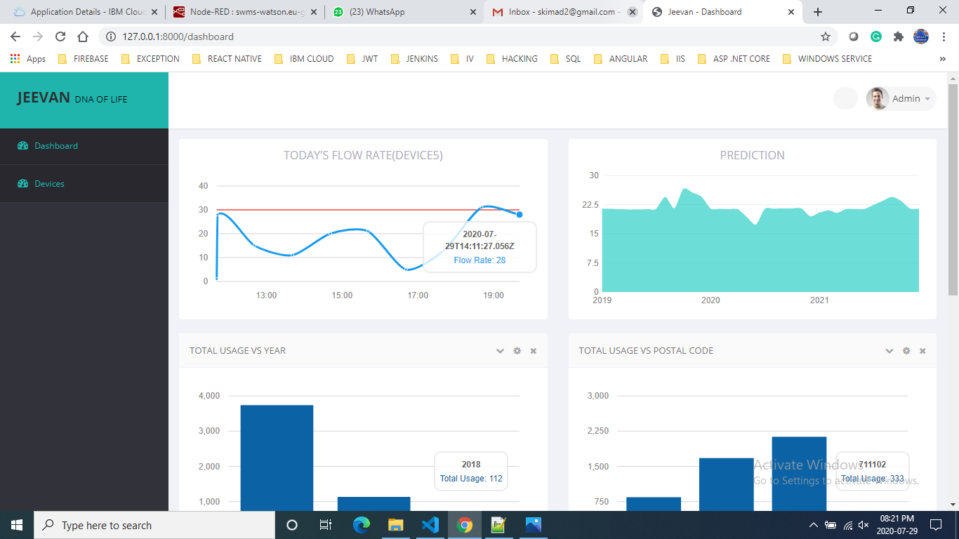
6. Click on the Dashboard tab from left menu bar. You will be able to see the graph for TODAY'S FLOW RATE for a particular device. The X axis is Time and Y axis is Flow Rate
7. Prediction graph, X axis is Year and Y axis is Prediction. In this graph you will see the future year prediction.

Slide 6
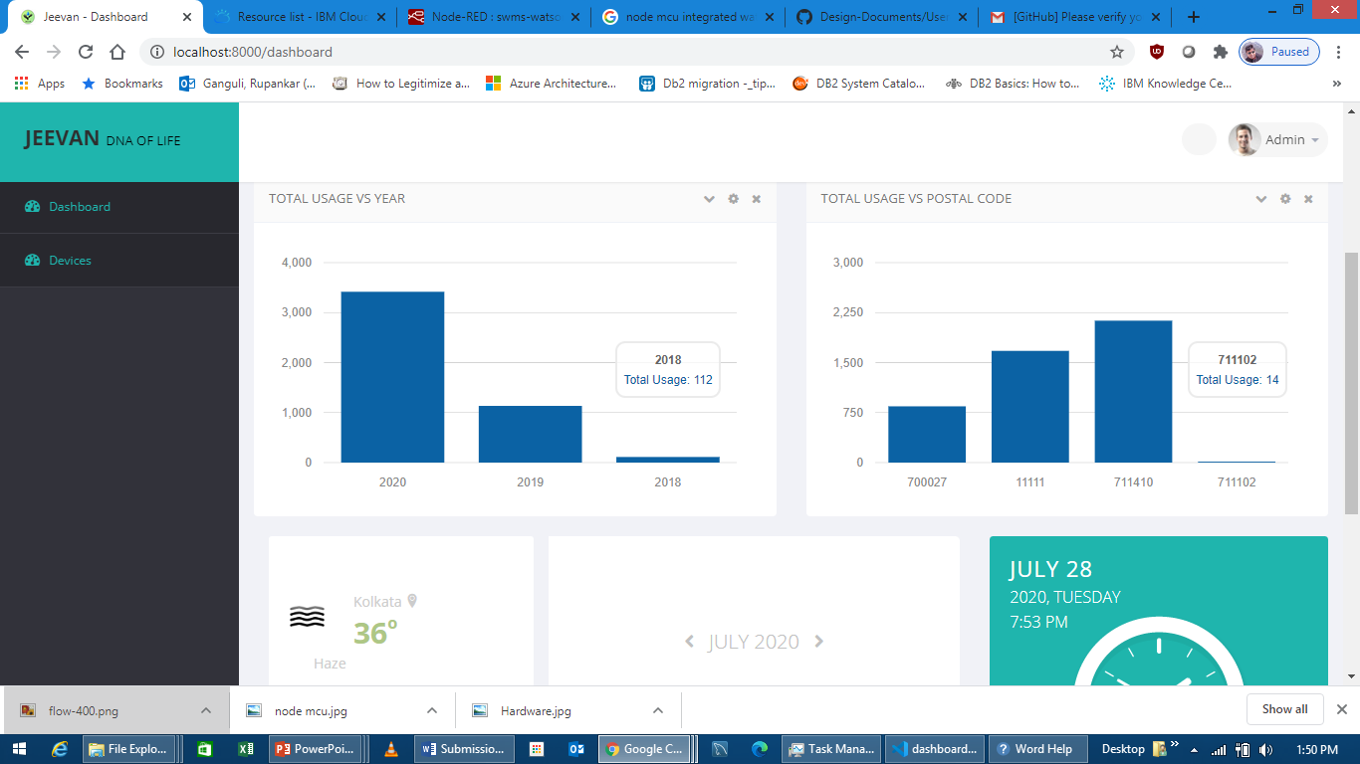
8. Total Usage VS Year graph, X axis is Year and Y axis is Total Usage. This graph indicates total water usage with respect to year.
9. Total Usage VS Postal Code graph, X axis is postal Code and Y axis is Total Usage. In this graph user will be able to see the total water usage in a postal code, where devices are installed.

Slide 7
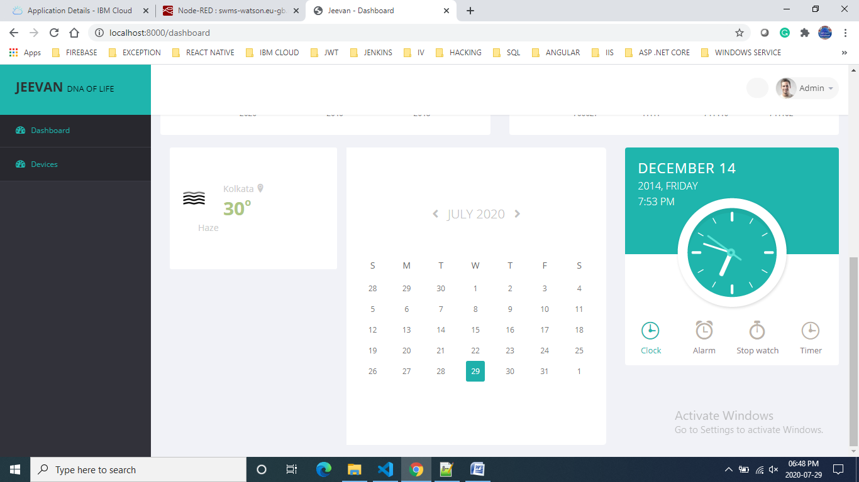
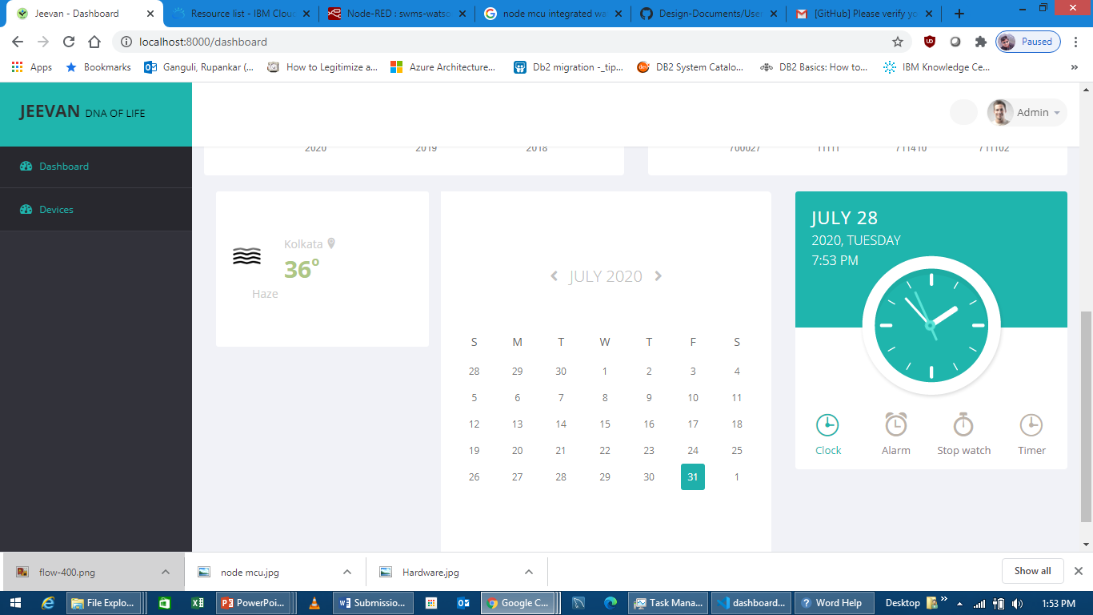
10. Also user will be able to see the calendar, clock and weather.

