Slide 1
Installing Operating Systems
🖥️
🍏
🐧
Windows
macOS
Linux
Jeevan Neupane
Class 11 · Shivapuri Secondary College

Slide 2
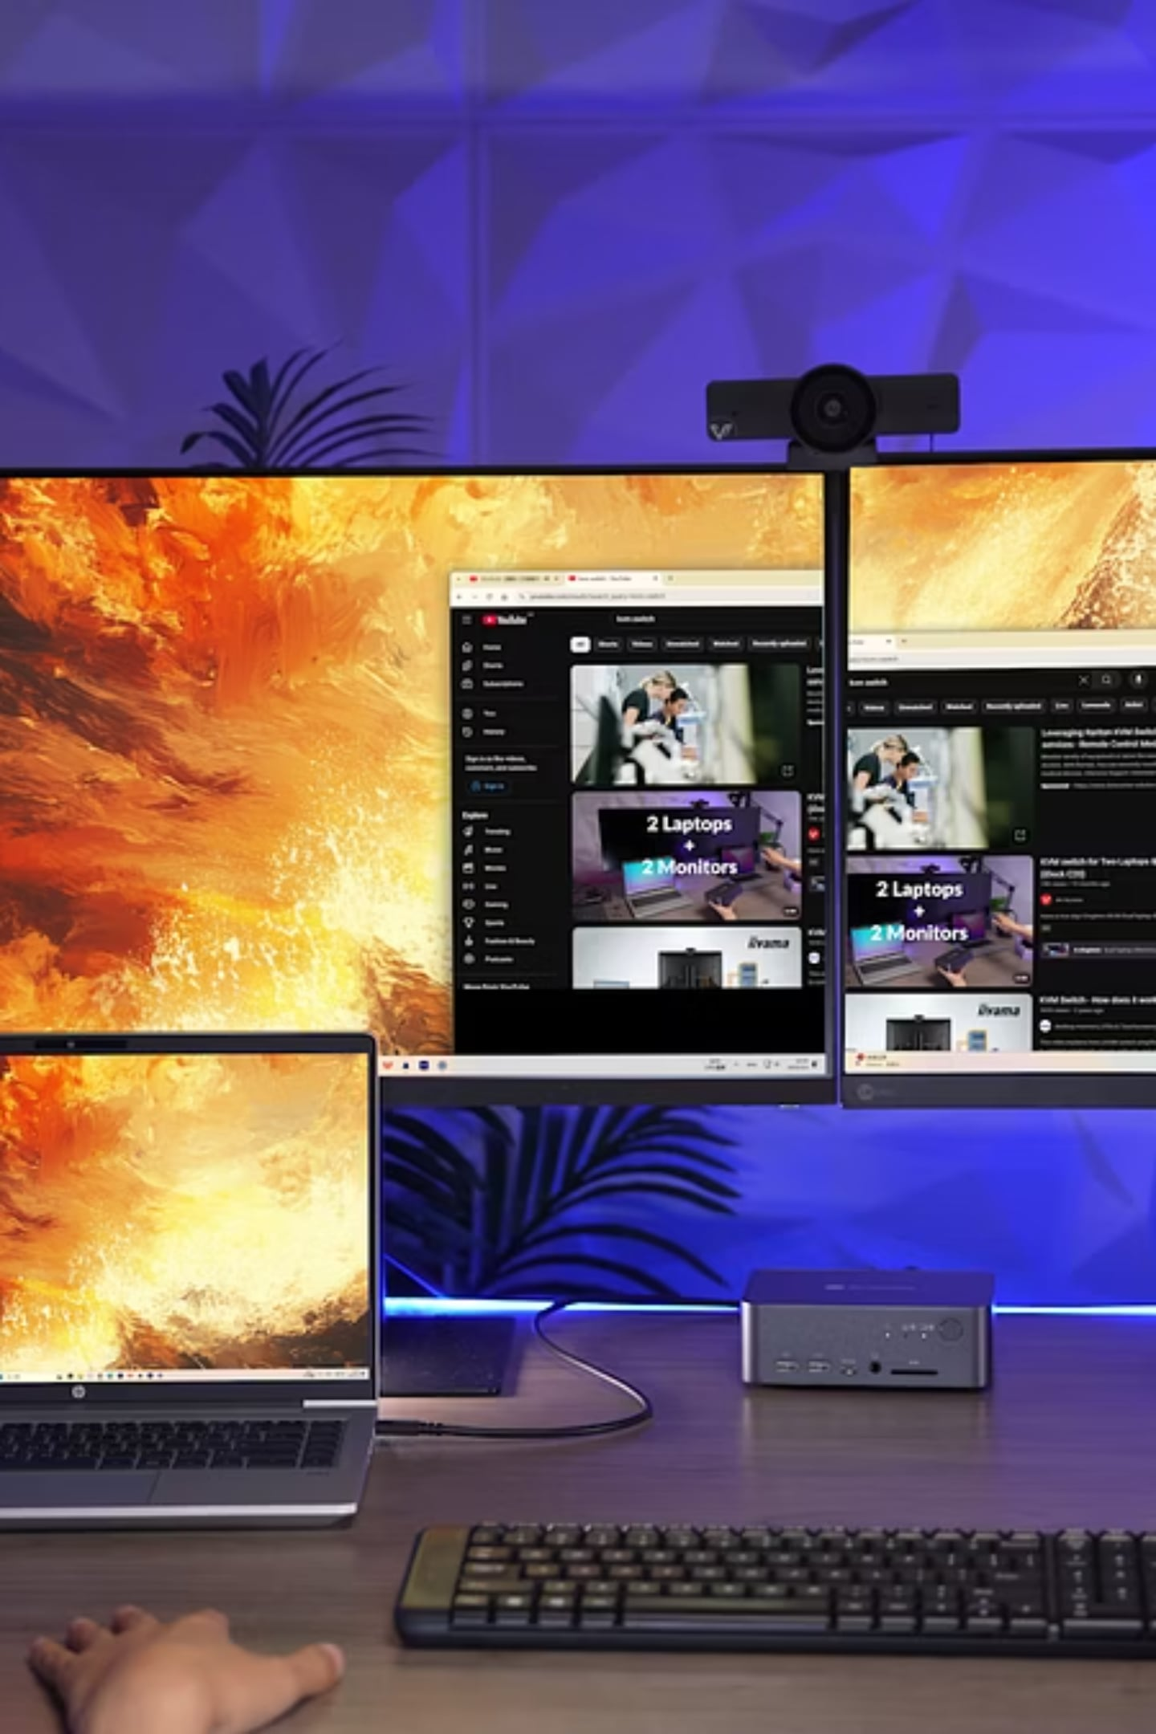
Installing Operating Systems
Windows 11 · macOS · Ubuntu · Arch Linux · Fedora · Debian — a hands-on guide from ISO to first boot.
BEGINNER TO INTERMEDIATE
6 OPERATING SYSTEMS COVERED

Slide 3





What You'll Need Before Starting
Bootable USB
Hardware
8 GB minimum
4 GB RAM · 64 GB storage
Internet
Backup
Required for updates & drivers
Full data backup before install
Universal steps: Download ISO → Write USB (Rufus / Etcher) → Set UEFI boot → Partition → Install → Post-setup.

Slide 4
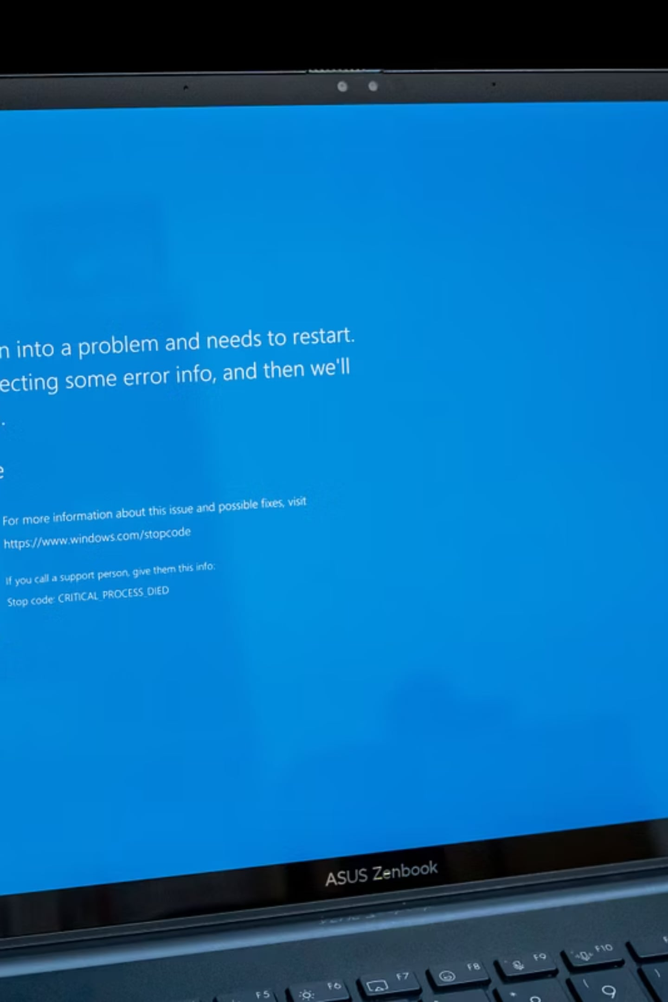
WINDOWS 11
DIFFICULTY: LOW
Windows 11 — Guided GUI Install
01
Download ISO
Microsoft website
02
Write USB
Rufus · 8 GB+
03
Boot & Partition
UEFI · Auto-partition
04
Setup & Update
Account · Drivers · Windows Update

Slide 5
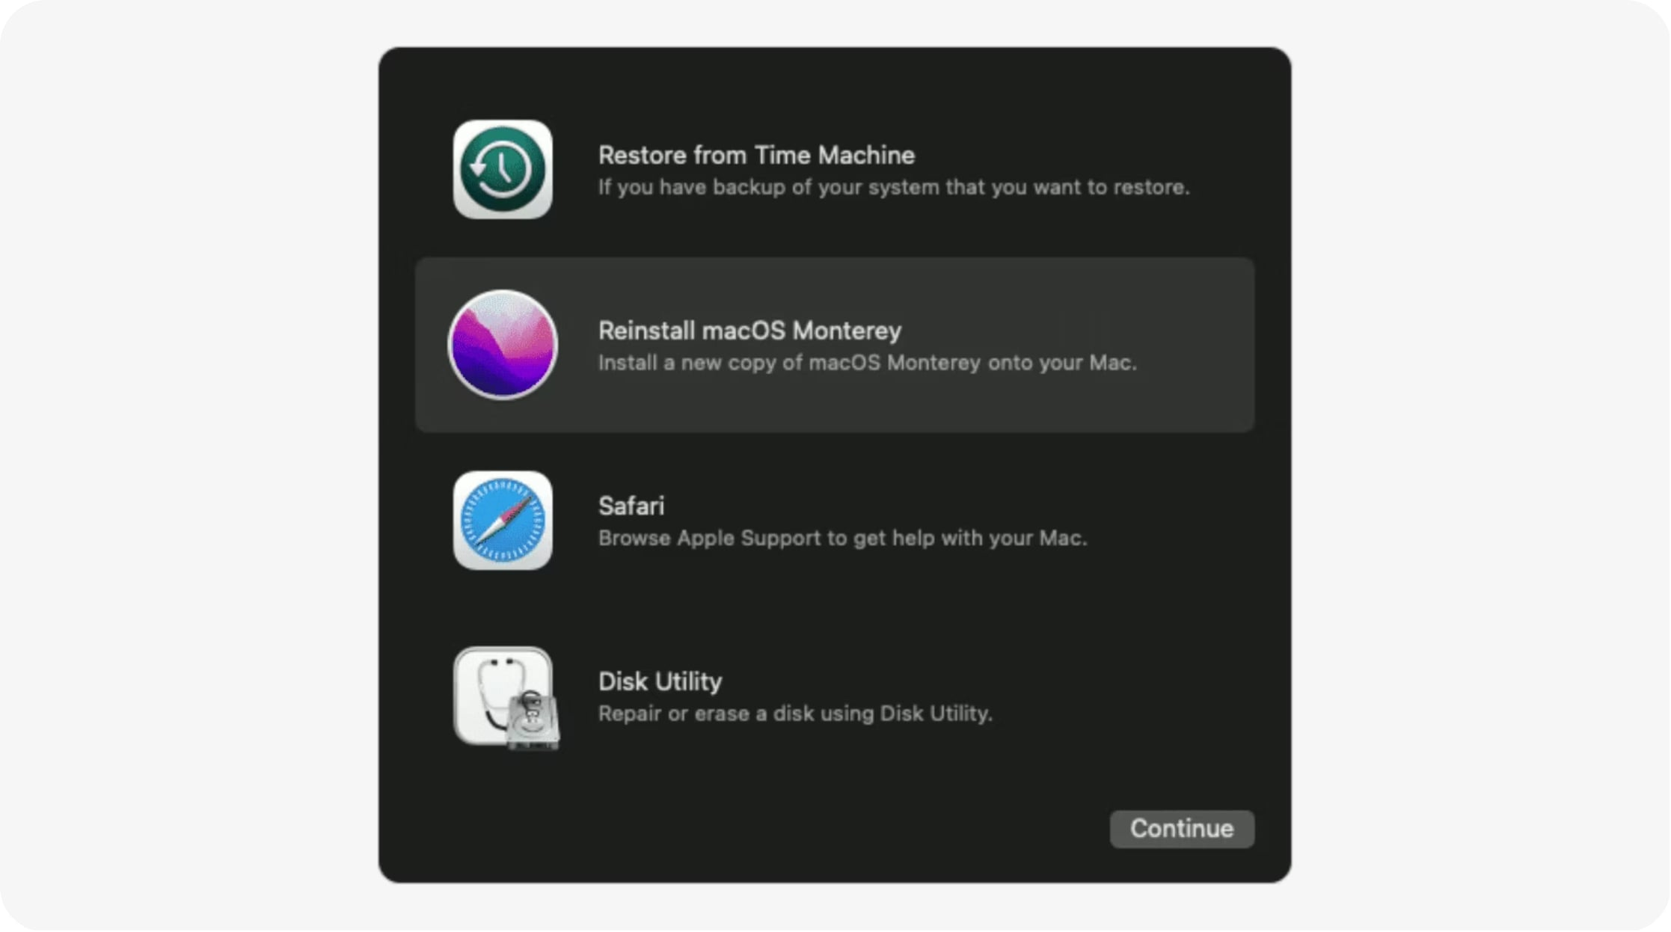
MACOS
DIFFICULTY: LOW
macOS — Apple Hardware Only
Recovery Mode: ⌘ + R at boot
Erase disk via Disk Utility
Reinstall macOS over internet
Apple ID & FileVault post-setup
Bootable USB: createinstallmedia in Terminal — 16 GB drive required.

Slide 6





UBUNTU
DIFFICULTY: MEDIUM-LOW
Ubuntu — Best Linux Starting Point
Download ISO
ubuntu.com
Write USB
Balena Etcher
Try or Install
Live session first
Partition
Erase or alongside
Post-Install
sudo apt update

Slide 7
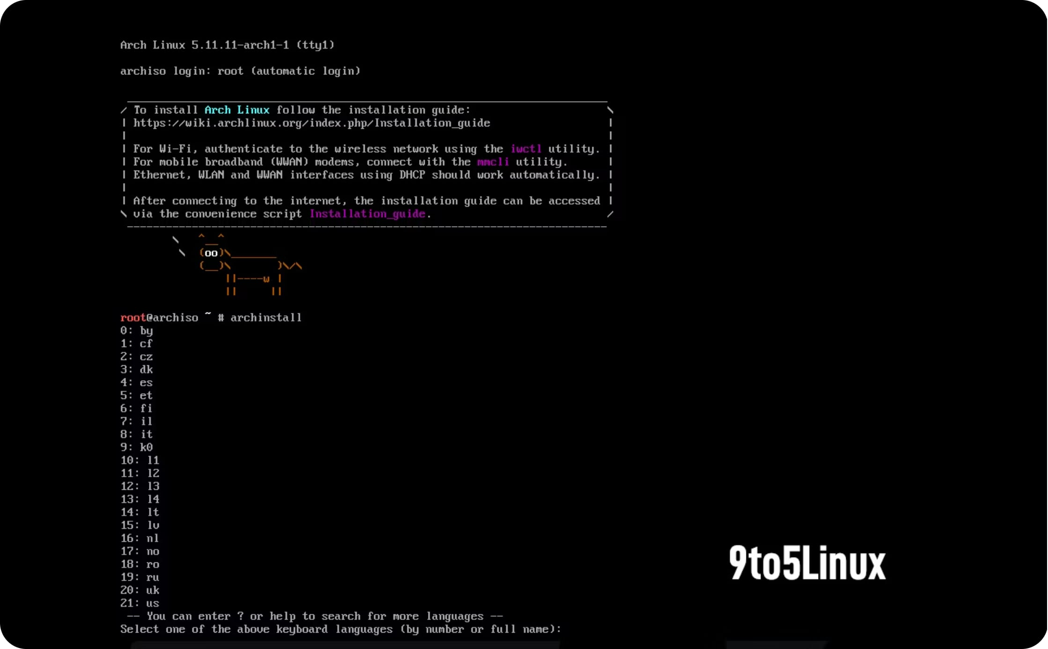

ARCH LINUX
DIFFICULTY: HIGH
Arch Linux — Build It Yourself
Terminal-only. You configure everything.
Partition manually
fdisk / mkfs
Install base system
pacstrap
Configure system
Fstab, locale, bootloader

Slide 8
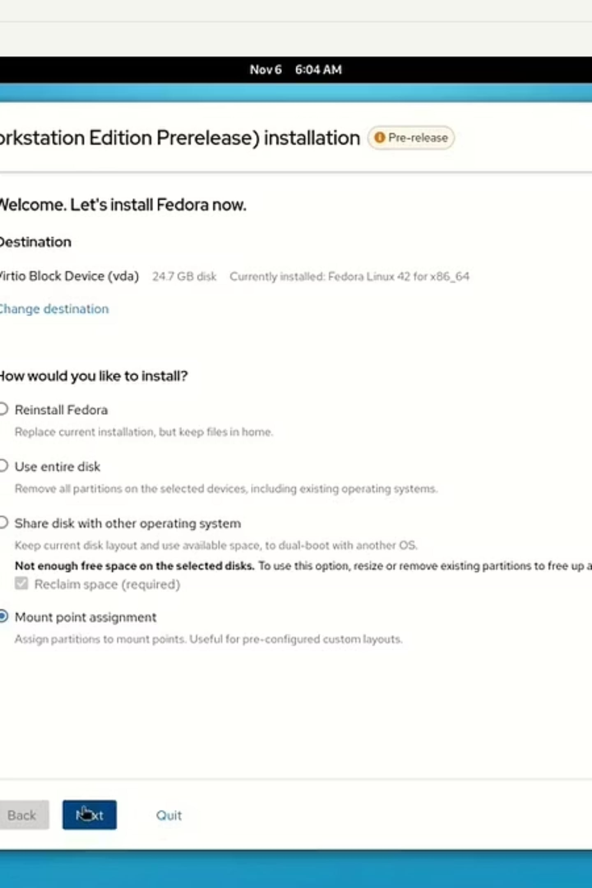
FEDORA
DIFFICULTY: MEDIUM
Fedora — Cutting-Edge, Polished
Download
Workstation ISO — getfedora.org
Anaconda Installer
GUI partitioner · LVM support
DNF Package Manager
sudo dnf update
SELinux Enabled
Security defaults on

Slide 9
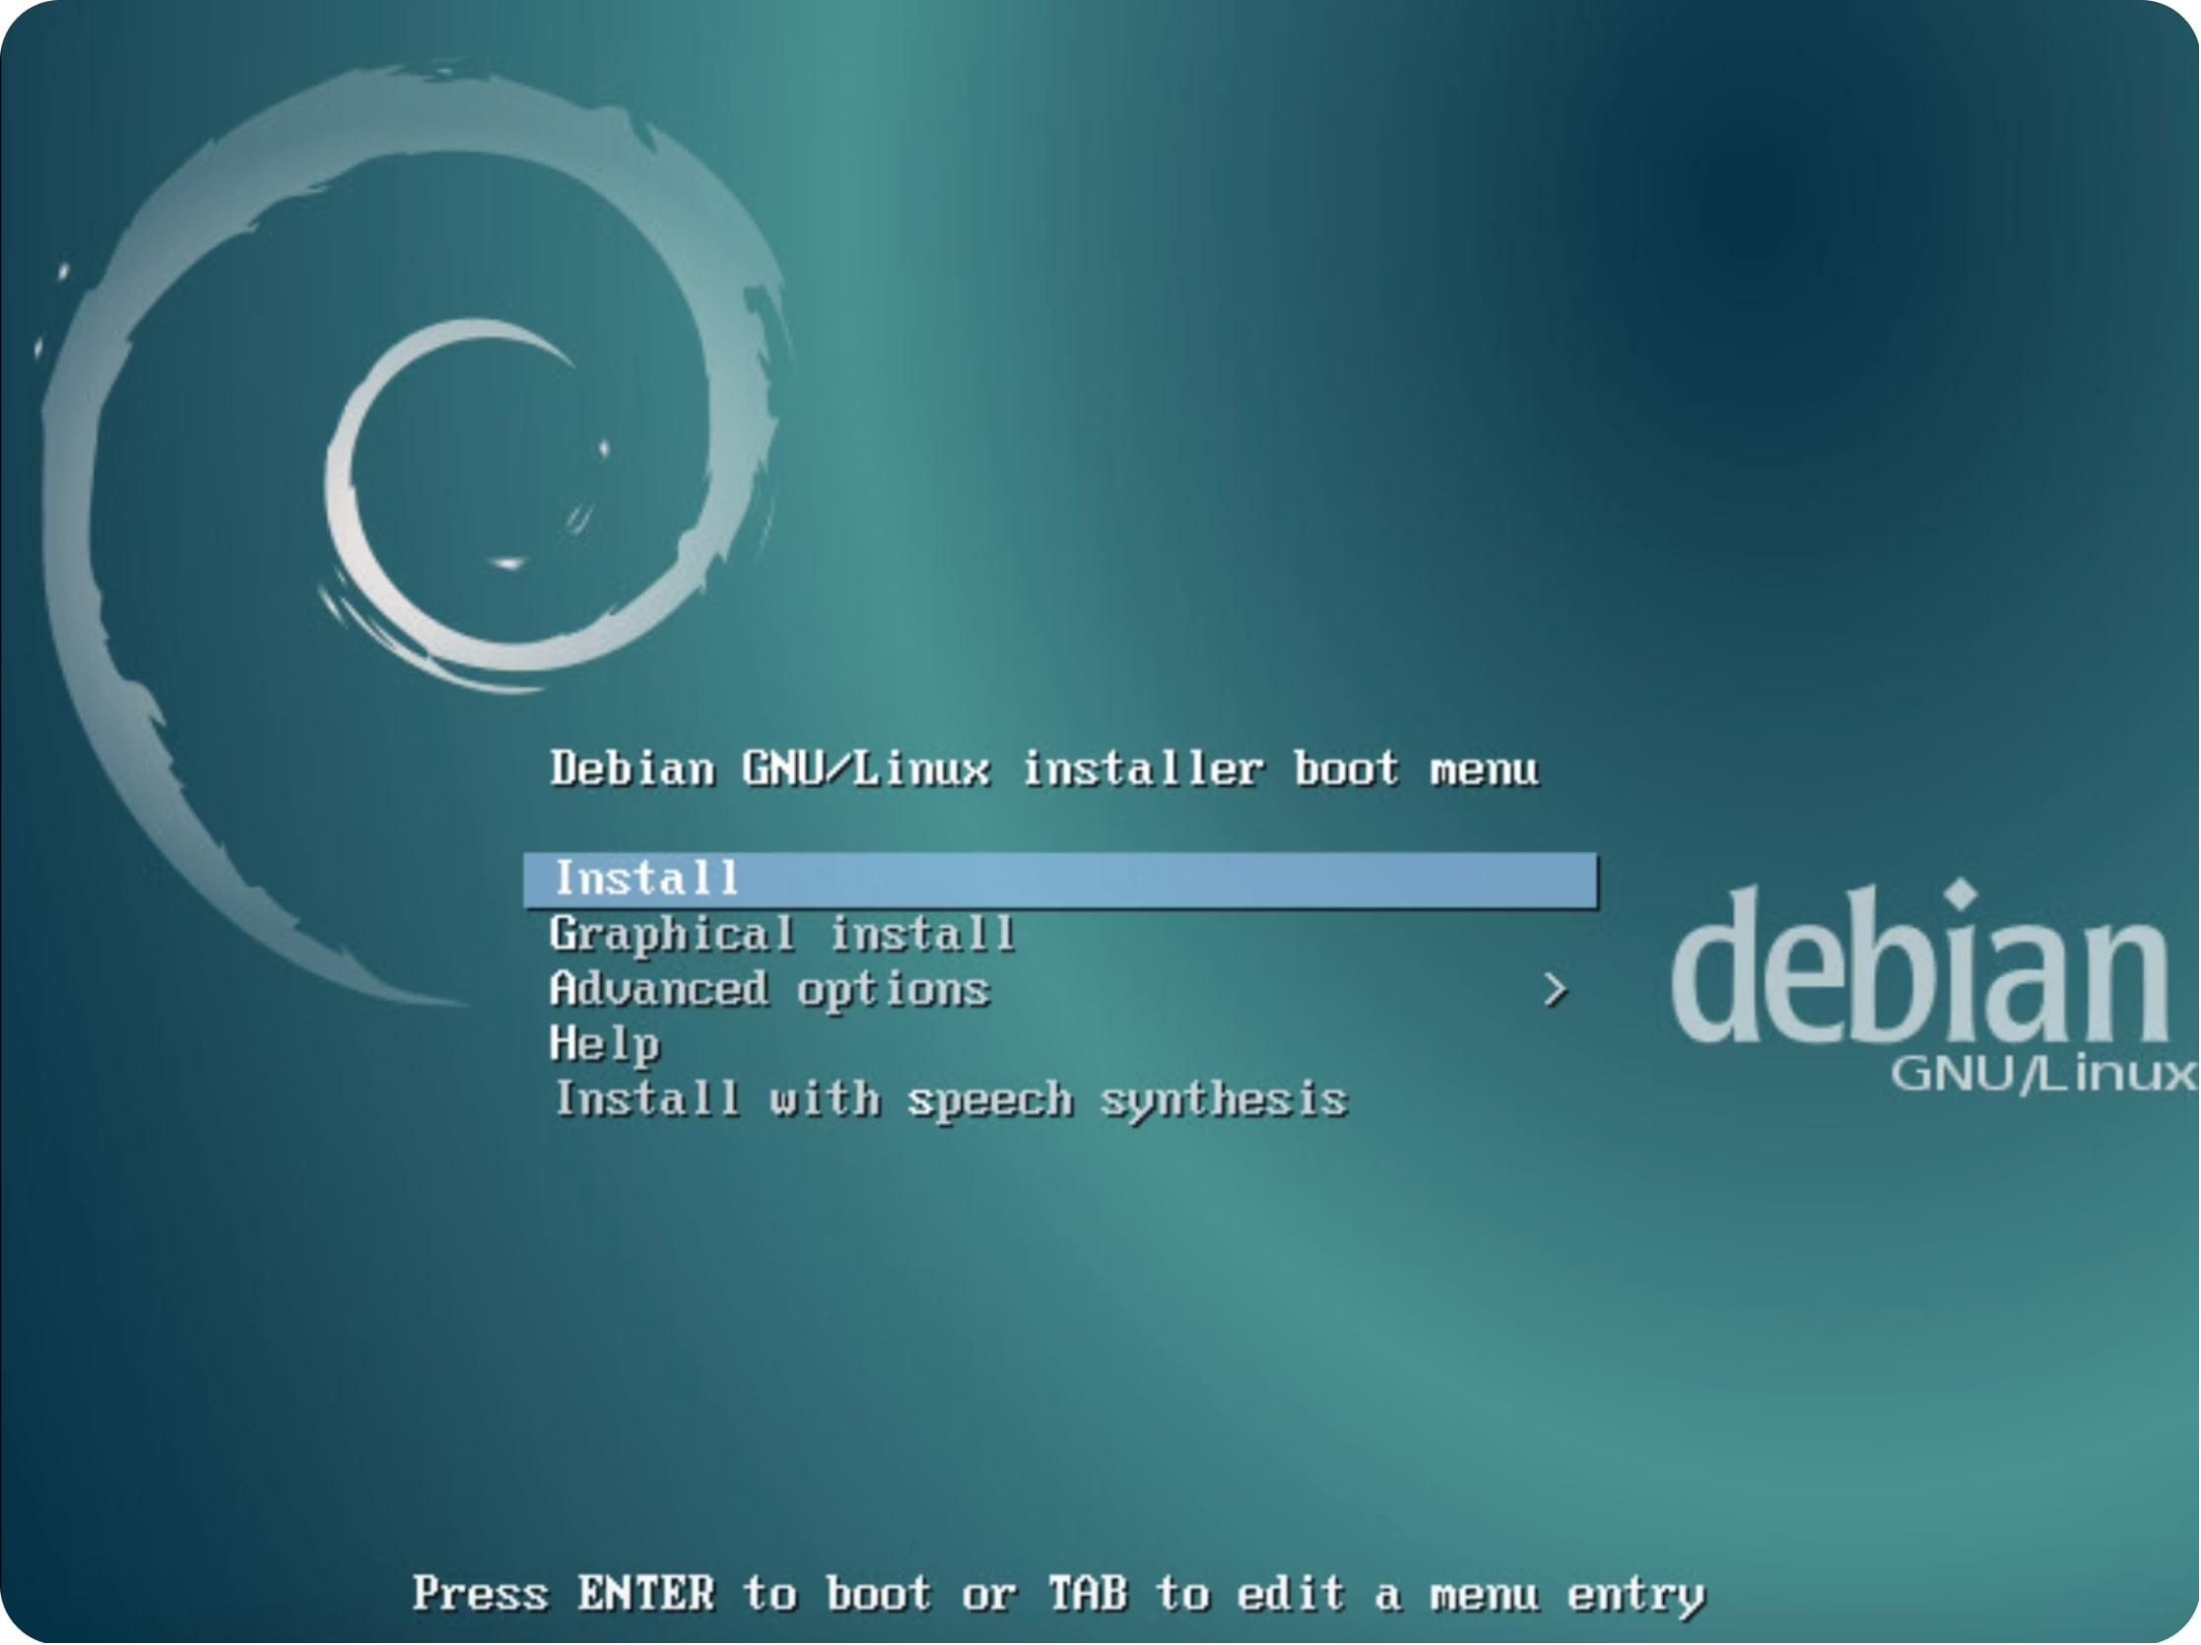
DEBIAN
DIFFICULTY: MEDIUM
Debian — Stable & Universal
Text-based or GUI installer
Manual partitioning common
Non-free firmware separate download
apt package management
Best for: Servers, stable workstations, learning Linux internals.

Slide 10
Difficulty & Time Comparison
OS
Difficulty
Install Time
CLI Required
Best For
Windows 11
Low
30–45 min
Minimal
General use
macOS
Low
30–60 min
Minimal
Apple hardware
Ubuntu
Medium-Low
20–40 min
Optional
Beginners
Fedora
Medium
25–45 min
Optional
Developers
Debian
Medium
40–60 min
Moderate
Servers
Arch Linux
High
1–3 hrs
Required
Advanced users

Slide 11





Installation Methods at a Glance
Fresh Install
Dual-Boot
Virtual Machine
Wipe disk, clean start
Share disk, choose at boot
VirtualBox / VMware — risk-free
Live / Persistent USB
WSL
Run Linux from USB
Linux on Windows — no dual-boot
Pro tip: Test in a VM before touching real hardware.

