Slide 1

SAMSUNG PRISM
Generative AI
Hackathon
3rd Edition 2026 – 27
Theme ID - 4 (Streaming live RAG)
Team Name - PROCASTO
College Name - Thapar Institute of Engineering and Technology
Member Name & Email 1 - Anmol Poddar, apoddar_be25@thapar.edu
Member Name & Email 2 - Jeevansh Bhatia, jeevanshbhatia650@gmail.com
Submission Github link - https://github.com/jeevanshbhatia650-rgb/PROCASTO_AI
Notes:
PROCASTO: a voice assistant for the smart home that answers from live device state and the right manual while you are still speaking. Theme 4, streaming live RAG.

Slide 2



Theme
Theme 4 · Streaming live RAG, applied to a Samsung SmartThings home
Answer a spoken question about your home from live device state and that model's manual, before the person finishes talking, and keep up when they change their mind.
Constraint 1 · Latency
Constraint 2 · Grounding
Constraint 3 · Interruption
Voice has a ~200 ms perceptual budget. A typical embed → search → generate pipeline starts after the question ends and takes 300–800 ms.
One answer needs live sensor state, the device's manual and the person's habits, without blending stale text into live readings.
“Actually, what about the dryer?” is a pivot, not a new conversation. Work already done should be kept.
Every design choice in PROCASTO answers at least one of these three.
Notes:
The problem, precisely: three constraints no existing system meets together. Latency, grounding in three different kinds of data, and interruption without starting over.

Slide 3




Existing Solutions & Gaps
Good at pieces of the problem; none meets all three constraints together
Solution
What it does
Gap
Smart-home apps
Show status and alerts
Tell you what, not why or what to do. No manual knowledge.
General voice assistants
Voice control and general Q&A
Not grounded in your model's manual. A correction usually restarts the request.
Standard RAG chatbots
Embed, vector search, generate
Start only after the question ends (~300–800 ms). Dense-only search misses codes like “E3”.
LLM with tool calling
Calls device and search tools
Tools run after the full question, often one after another. No built-in pause and resume.
The gap: nothing starts retrieving while you speak, grounds each answer in live state plus the exact manual, and survives a pivot without starting over.
Notes:
Existing tools each solve a slice. The gap is the combination: streaming, grounded, and interruptible.

Slide 4



Our Solutions & Architecture Diagram
Streaming answer path on top; the LangGraph diagnose-and-act agent below
STREAMING ANSWER PATH
3 agents, fanned out
Manual
Voice or text
Clause extractor
Query planner
BM25 + dense, RRF, cache
Evidence
Answer cards
Web Speech, word by word over a WebSocket
Stable after 2 partials; spots devices, intents, codes
Revisions, park & resume on a pivot
Preference
Live beats session beats manual
Cited · Gemini phrases one line · spoken
KV store · < 1 ms
Home State
SmartThings webhooks → live store
pushed snapshot · < 1 ms
Slow Thinker · session-intent prefetch
Devices push every change; no polling
While the answer is spoken, warm the domain
LANGGRAPH AGENT · DIAGNOSE & ACT
START
3 agents in parallel
Propose
Confirm
Act
fan out
latency = the slowest
Gemini via LangChain, rules fallback
interrupt · checkpointer saves state
CommandGate: allowlist, at most once
Notes:
Top: the streaming path. Clauses become retrieval tasks while the person is still talking; three agents run in parallel, each with the retrieval that suits its data. Bottom: the LangGraph agent that proposes a fix and waits for a yes before acting.

Slide 5
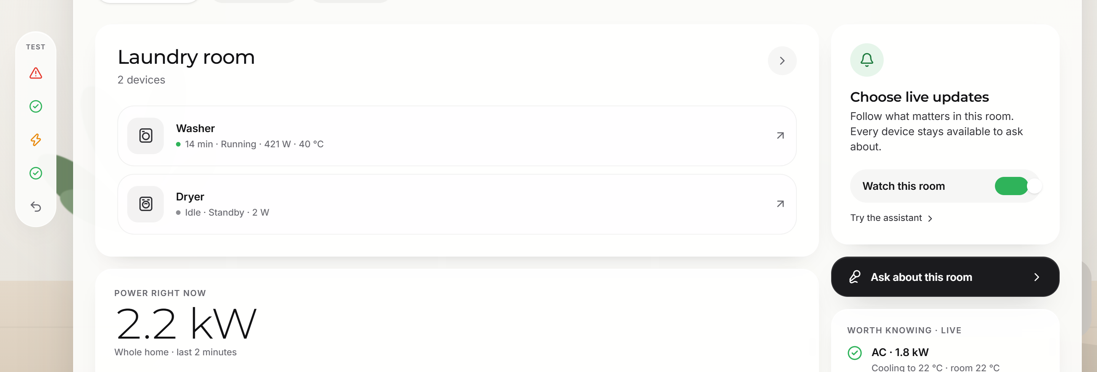
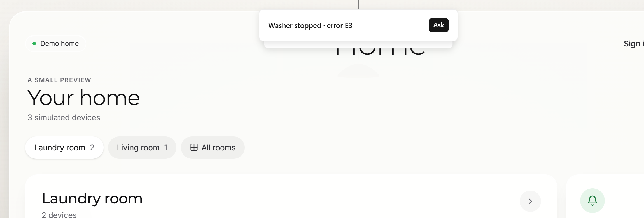
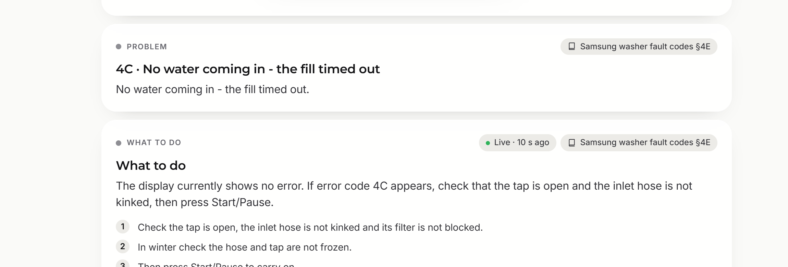
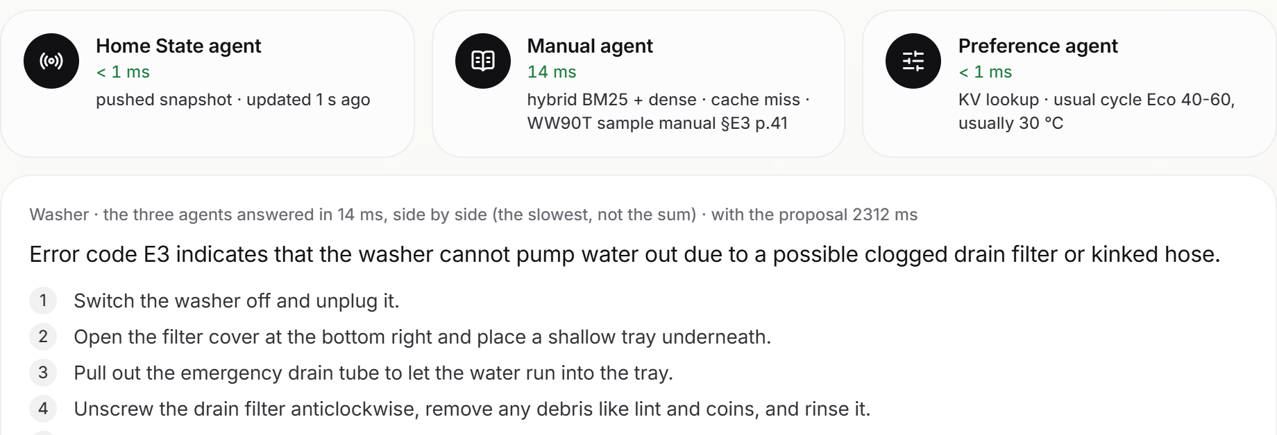
Demo & Product Walkthrough
Live: procasto.vercel.app/demo · no account needed: break a device, ask. Real screens from the app
1 · Home: one room at a time, live power
2 · A followed device breaks: alert with “Ask”
3 · The answer, cited to Samsung fault codes
4 · Diagnose & fix: 3 agents, then a yes
Notes:
Walkthrough: 1 the home in room focus with live power; 2 break the washer and the alert arrives; 3 ask 'what does 4C mean' and get the fix cited to the Samsung fault table; 4 the three agents diagnose the washer side by side and wait for a yes before restarting it.

Slide 6




Tools and tech stack used
Chosen for latency and honesty: small, fast pieces, each one tested
AI and retrieval
Backend
Frontend
Data, devices, security
LangGraph
Python 3.12 · FastAPI
React 19 · Vite · TypeScript
Supabase Auth · Postgres RLS
LangChain
asyncio fan-out
Tailwind 4 · Motion
SmartThings API + webhooks
Gemini 3.5 Flash-Lite
WebSockets streaming
Zustand store
Fernet-sealed tokens
fastembed · bge-small
Pydantic contracts
Web Speech API (voice)
157 Samsung fault codes (MIT)
BM25 + RRF (k = 60)
Docker, non-root
Remotion (the film)
pytest · vitest · Playwright
Semantic cache ≥ 0.60
Notes:
LangGraph and LangChain run the agent; Gemini only phrases and proposes, rules decide facts. Supabase for accounts with row-level security; SmartThings for real devices; everything tested in CI-style checks.

Slide 7




Impact & Use case
From “the panel shows a code” to “here is the fix, from your model's manual”
A fault at home
2.3 s
head start: retrieval begins before you finish speaking (scripted demo)
“What does 4C mean?” → meaning and fix steps, cited to the fault table.
Follow what matters
Alerts only for chosen devices, each with a one-tap “Ask”.
157
real Samsung washer fault codes, openly licensed (MIT)
Voice-first help
For anyone who can't read a tiny panel or a 60-page manual.
0
device changes without the person saying yes
Energy
Spots an AC drawing too much and suggests your usual setting.
Notes:
Who it helps: anyone with a smart appliance showing a code, people who need voice-first help, and anyone wasting energy. The numbers are measured on the demo, not projected.

Slide 8



Innovation highlights, results and limitations
Innovation
Results (measured)
Limitations (honest)
• Retrieval starts on stable clauses, mid-sentence
• 2.3 s head start on the scripted demo
• Not yet run on a real Samsung account (needs developer keys)
• Pivots park work; resume reuses fresh, refetches stale
• Three agents answer in ~15 ms, side by side
• Dryer and AC manuals are sample data; no open AC data exists
• 3 agents fanned out: time = slowest, not sum
• 4C, 5C, 9C1, UE… answered from real Samsung data
• Cache and preferences live in one server's memory
• Home state pushed by webhooks, never polled
• 310 backend + 55 frontend tests
• Gemini phrasing adds ~1.5–2 s; manual text shows first
• Hybrid BM25 + dense with an exact-code boost
• 27 real-browser checks, desktop and phone
• SmartThings API pricing changes from Oct 2026
• Semantic cache keyed by code; session-intent prefetch
Notes:
What is new, what we measured, and what we have not done yet. The limitations are real and listed on purpose.

Slide 9


What’s next
The architecture already has the seams for each of these
Next
Then
Later
→ Connect a real SmartThings account end to end
→ Bidirectional RAG: the model asks for missing context mid-answer
→ Proactive maintenance from usage patterns
→ Load the 84 collected ApplianceDB codes: dryer, fridge, dishwasher
→ Whole manual sections in long-context models
→ Wake word on the device
→ Redis and pgvector when there are many servers and manuals
→ Hindi and multilingual voice
→ Bixby and Alexa skills on the same engine
Notes:
Next: real Samsung account and more appliances. Then: bidirectional RAG and multilingual voice. Later: proactive help.

Slide 10



Brownie points slide( differentiation)
“Why not just an LLM with function calling?” Because these six things need to be true at once.
Starts before you finish
Pivots keep their work
The right retrieval per data
Retrieval runs on stable clauses: 2.3 s head start.
Park and resume: reuse what is fresh, refetch what is stale.
Push, hybrid search and a KV store, in parallel.
Every answer cites
Safe by design
Real data, honestly labelled
The live reading or the manual page; live beats manual.
Allowlisted actions only, nothing without a yes, at most once.
157 MIT-licensed Samsung codes; samples marked as samples.
Notes:
The differentiators, and the answer to 'why not function calling': streaming start, pivots that keep work, parallel retrieval matched to the data, citations, safety, and honest data.

Slide 11
Checklist- Updated on Public GitHub
Working prototype code, public GitHub repo: Y · https://github.com/jeevanshbhatia650-rgb/PROCASTO_AI
README with reproducible setup instructions: Y (make setup, make dev; tests: make test)
Demo video, max 5 minutes: Y · 92 s film (link: add YouTube/Drive link here)
Presentation file (PPT or PDF): Y · this deck, also in docs/ on GitHub
Notes:
Everything is on the public repo's main branch. Paste the uploaded film link before submitting.

Slide 12
Thank you
Team PROCASTO
Anmol Poddar · apoddar_be25@thapar.edu Jeevansh Bhatia · jeevanshbhatia650@gmail.com
https://github.com/jeevanshbhatia650-rgb/PROCASTO_AI
Organised by the Language AI Team and the PRISM Team, Samsung R&D Institute India
Notes:
Closing slide. Add the Google Form URL and a contact email before sharing. Edition 2 organising team for reference: Language AI - Sourabh Tiwari, Gaurav, Sanjeeth Pothireddy, Gorang Maniar; PRISM - Binny Lakra, Prakhar Chandrakar, Vishu Kumar; Kick-off and mentors - Giridhar Jakki, Deepraj Prabhakar Patkar (Language AI), Srimanu Prasad Nagaraju, Ashish Kumar (Tech Strategy).

