Slide 1


K. RAMAKRISHNAN COLLEGE OF ENGINEERING
(AUTONOMOUS), SAMAYAPURAM – TRICHY
DEPARTMENT OF CSE(ARTIFICIAL INTELLIGENCE AND MACHINE LEARNING)
AGC1341- CLOUD COMPUTING
CLOUD-BASED CAMPUS LOST & FOUND MANAGEMENT SYSTEM
PRESENTED BY
BALAMANIKANDAN (8115U24AM013)
JEEVA V (8115U24AM028)
SARAN M (8115U24AM047)
THIRUKKUMARAN S (8115U24AM059)

Slide 2
PRESENTATION OVERVIEW
Project Introduction
Objective
Problem Statement
Software and Hardware used
Existing and Proposed Comparison
Modules Used
Architecture Diagram
Output Screenshots
Conclusion and Future Scope
References

Slide 3
PROJECT INTRODUCTION
Cloud-Based Campus Lost & Found Management System is a web application designed to simplify and automate the process of reporting and recovering lost items on campus.
It manages lost item reports and student/owner information efficiently in a centralized system.
It records item found, claim, and return activities accurately.
It provides secure cloud access to authorized users from anywhere.

Slide 4
OBJECTIVE
Automate lost and found management activities by reducing manual work and streamlining routine campus recovery operations.
Manage lost, found, and claimed item records efficiently by maintaining accurate and organized information in a centralized system.
Provide quick item search and status tracking so users can easily find lost items and check their claim status.

Slide 5
PROBLEM STATEMENT
Traditional campus lost and found systems rely heavily on manual notice boards and registers, which increases the workload for staff and makes daily operations less efficient.
Searching, modifying, and updating item records can be time-consuming, especially when handling a large number of lost and found reports across campus.

Slide 6
SOFTWARE AND HARDWARE USED
Software | Purpose
HTML | Designing web pages
CSS | Styling the application
JavaScript | Client-side functionality
Python / Java / PHP | Backend development
MySQL / Cloud Database | Storing lost & found records
VS Code | Development environment
Web Browser | Accessing the application
Cloud Platform | Hosting the application and database
Hardware | Requirement
Processor | Intel Core i3 or above
RAM | Minimum 4 GB
Storage | Minimum 128 GB
Network | Internet connection
Client Device | Desktop/Laptop/Smartphone
Server | Cloud-based server

Slide 7
EXISTING AND PROPOSED COMPARISON
Existing System | Proposed Cloud-Based System
Mostly manual or local system | Cloud-based system
Data stored locally | Data stored in cloud
Limited accessibility | Accessible from anywhere
Manual record maintenance | Automated record management
Higher possibility of human errors | Reduced errors
Difficult to scale | Easily scalable

Slide 8
MODULES USED
1. User/Login Module
This module provides secure authentication for students, staff, and administrators.
Functions:
Student/user login
Admin/staff login
2. Item Reporting Module
Users can report items they have lost or found on campus.
Functions:
Report lost item Report found item
Attach photo and Edit or delete report

Slide 9
MODULES USED
Functions:
Report lost item Report found item
Attach photo and Edit or delete report
3. Item Search & Matching Module
This module lets users search reported items and matches lost items with found ones.
Functions:
Search by category/location
View matches and Filter results

Slide 10
MODULES USED
4. Claim Verification Module
This module manages the process of verifying and releasing claimed items.
Functions:
Submit ownership proof
5. Cloud Database Module
This module stores all lost and found application data in a cloud database.
It can store:
User and item information
Claim history and notifications

Slide 11
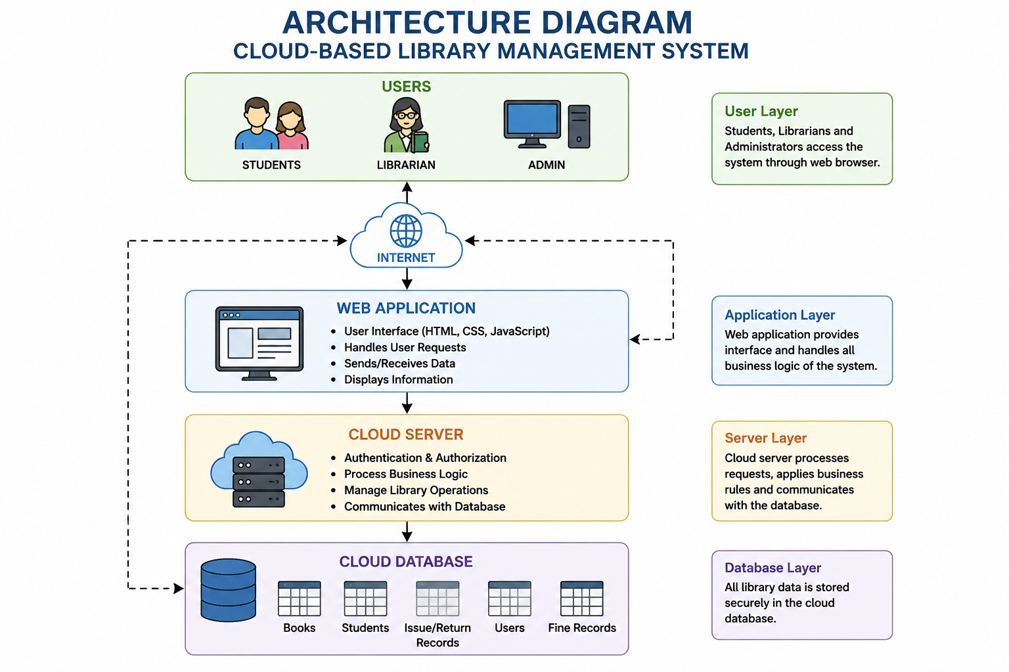
ARCHITECTURE DIAGRAM

Slide 12
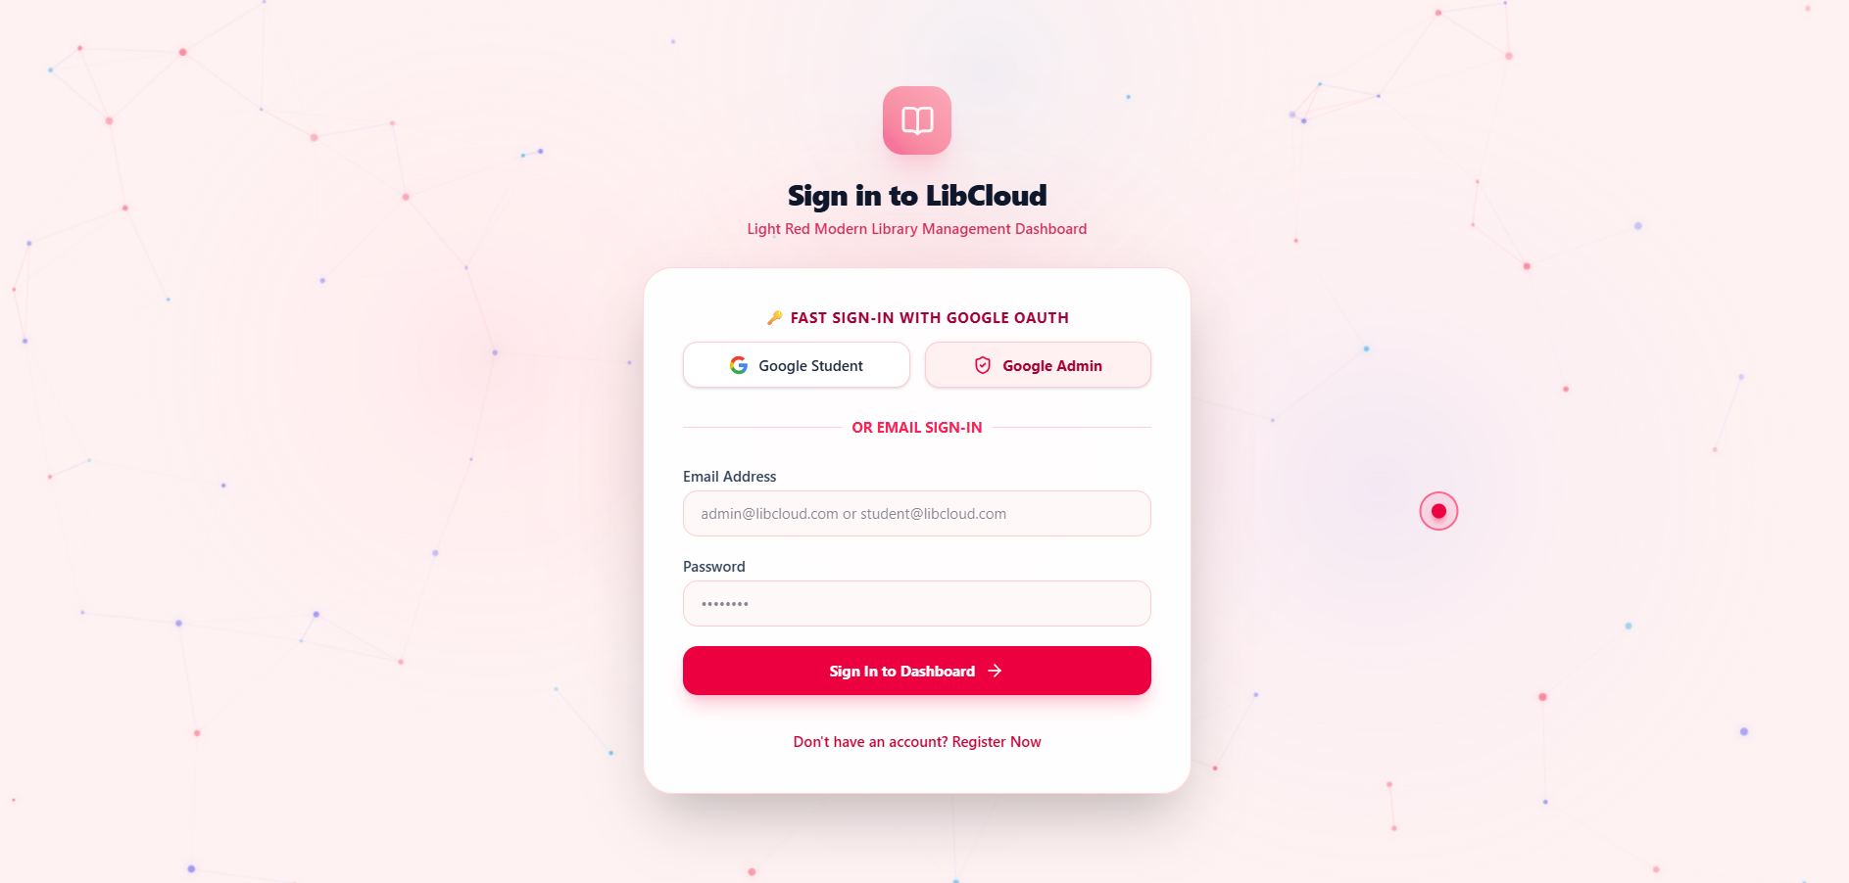
OUTPUT SCREENSHOTS

Slide 13
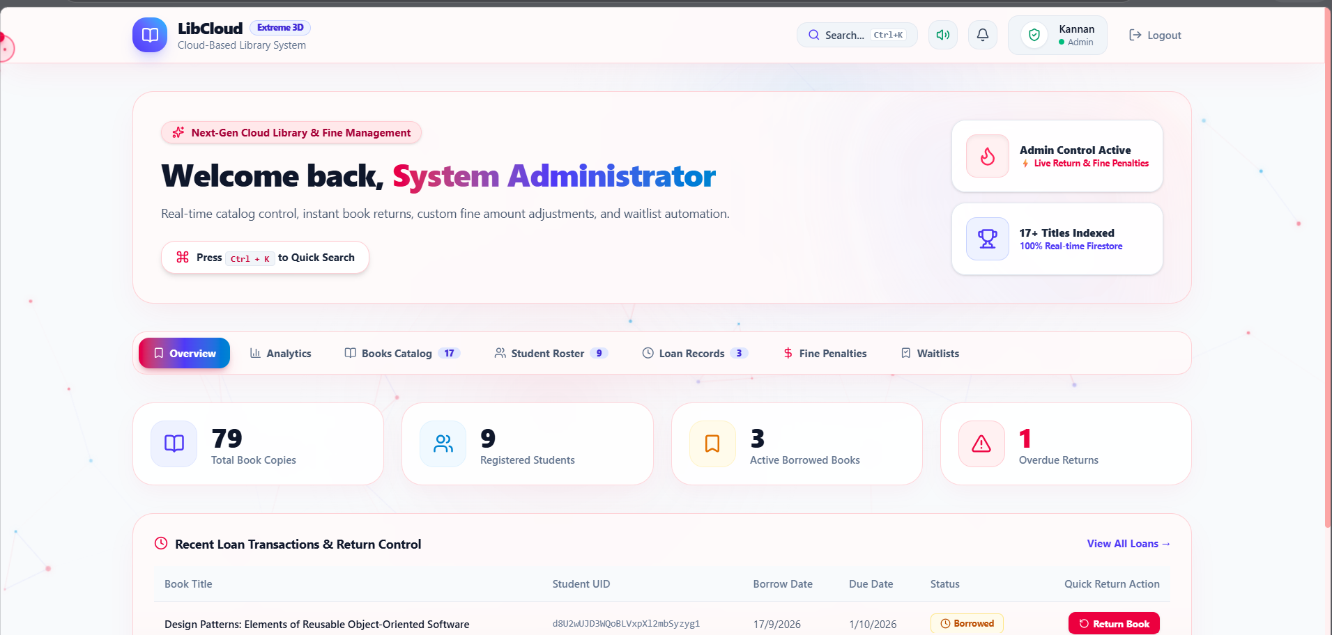
OUTPUT SCREENSHOTS

Slide 14
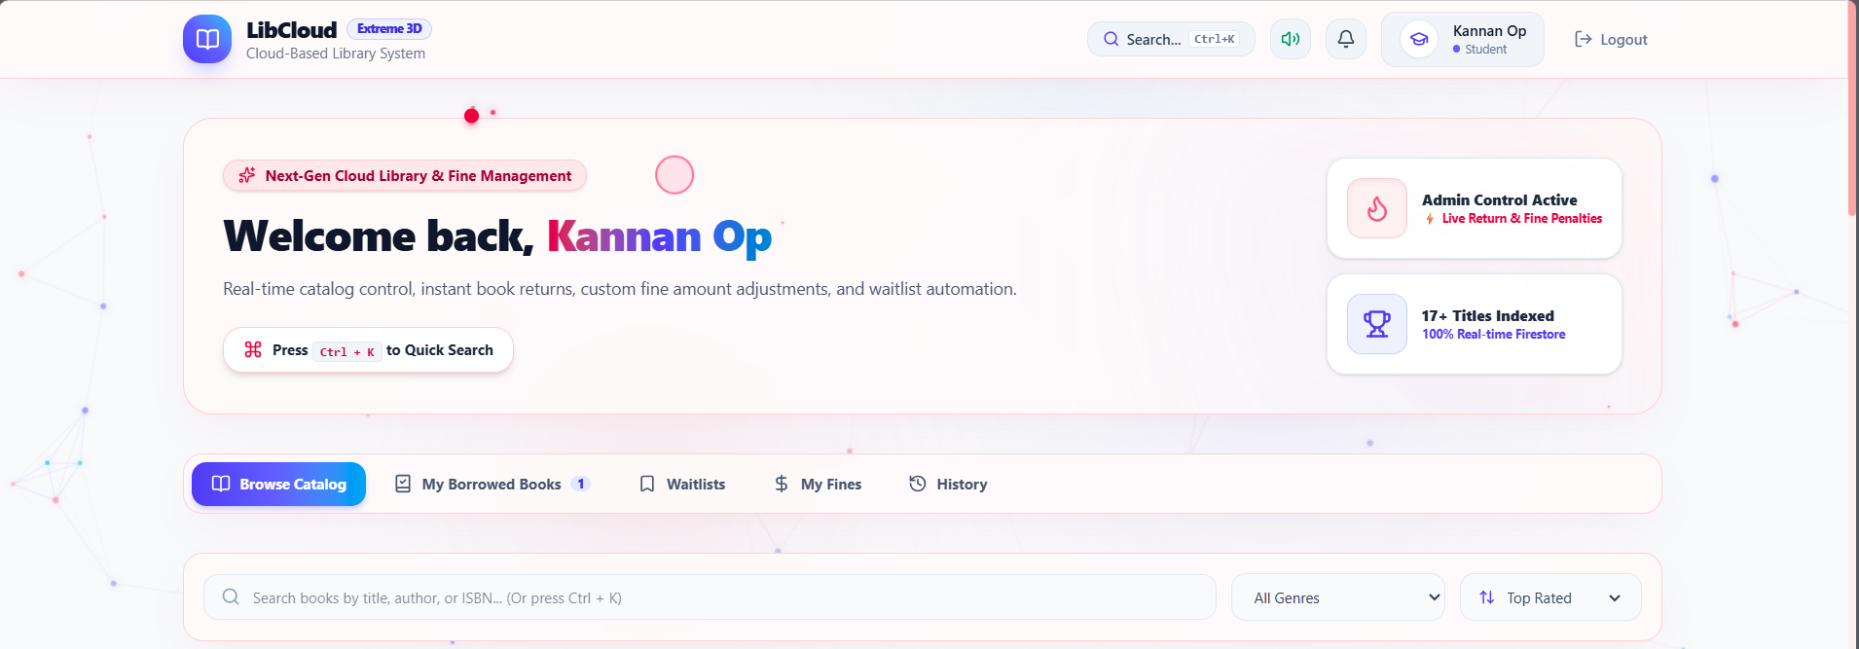
OUTPUT SCREENSHOTS

Slide 15
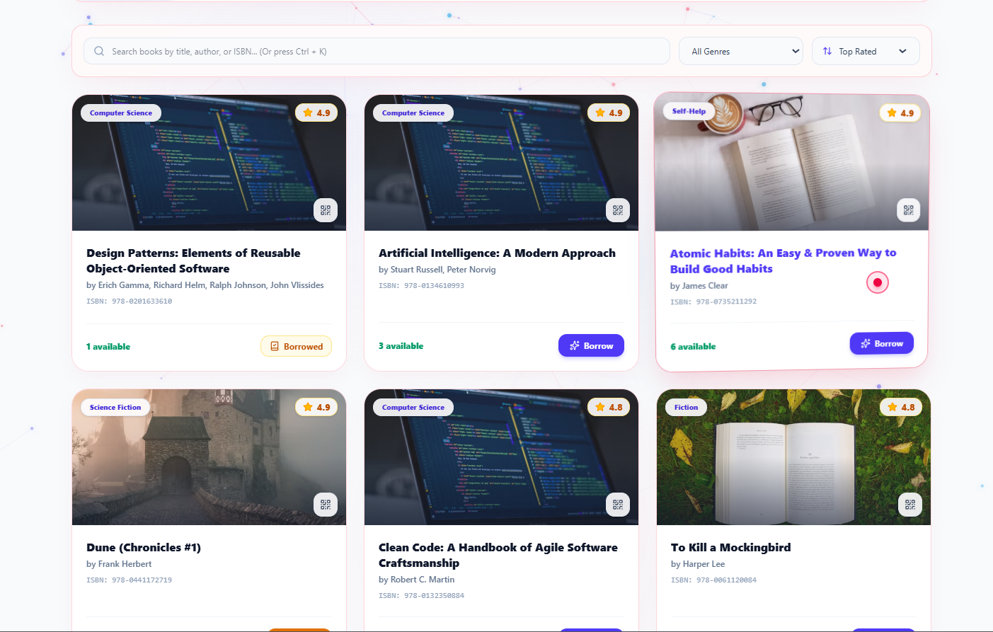
OUTPUT SCREENSHOTS

Slide 16
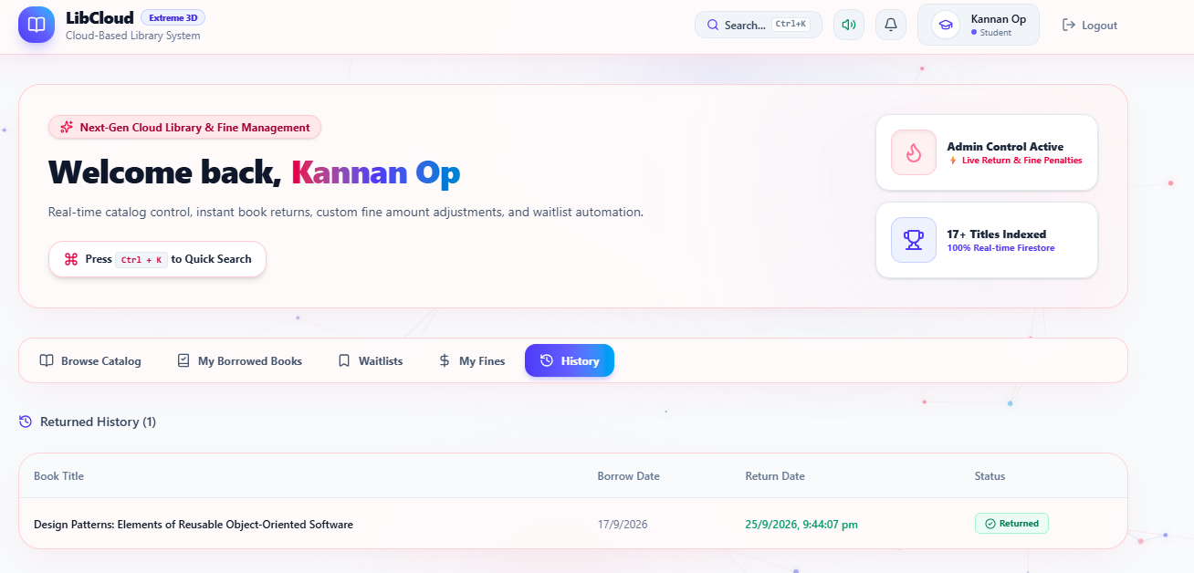
OUTPUT SCREENSHOTS

Slide 17
CONCLUSION AND FUTURE SCOPE
Makes locating and reclaiming lost items faster and easier.
Provides centralized and accessible data.
Reduces missed matches and manual paperwork.
Future scope includes mobile apps, QR codes and AI recommendations.

Slide 18
REFERENCES
MDN Web Docs – https://developer.mozilla.org
AWS Cloud Computing Documentation – https://aws.amazon.com/documentation
MySQL Reference Manual – https://dev.mysql.com/doc
Erl, T. (2013). Cloud Computing: Concepts, Technology & Architecture. Prentice Hall.

Slide 19


