Slide 1








AI Banking Based Fraud Detection
Presented by: Jeevesh - 2674192
© Mphasis 2025 Proprietary and confidential information
19-05-2026
‹#›

Slide 2

Team Introduction
Areas | Answers
Team Name: | AI / ML Team
Batch / Area of Training: | Tower E – FedEx Hall
Internship Start Date: | 13ᵗʰ March, 2026
Internship Location | Global Village Tech Park, Bengaluru
Team Members: | Self (Individual)
© Mphasis 2025 Proprietary and confidential information
‹#›

Slide 3
Problem Statement
Questions | Answers
What problem are you trying to solve? | Traditional banking fraud detection systems fail to identify evolving fraud patterns in real time, leading to financial losses, delayed response, and high false-positive rates.
Please define the identified business need and importance to business | Need: An AI-powered real-time fraud detection platform capable of identifying suspicious transactions instantly. Importance: Reduces fraud losses, improves customer trust, automates incident response, and minimizes manual investigation effort.
Who is affected by this problem? What improvements are assumed to be brought by implementation? | Affected: Banking customers, fraud analysts, compliance teams, and financial institutions. Improvements: Faster fraud detection, reduced false positives, automated escalation, secure OTP verification, and improved operational efficiency.
What made you choose this problem? | Digital banking transactions are increasing rapidly, making fraud prevention a critical challenge. I wanted to build an intelligent and scalable AI-driven security solution with real-world impact.
© Mphasis 2025 Proprietary and confidential information
‹#›

Slide 4
Solution Overview/ Idea
Questions | Answers
Please provide short description of the solution | An AI-powered fraud detection system that analyzes banking transactions in real time using machine learning and multi-criteria risk evaluation. The system automatically classifies transactions as SAFE, RISKY, or FRAUD and triggers OTP verification or escalation workflows accordingly.
What are the key objectives you are planning to achieve | • Detect fraudulent transactions in real time • Reduce false positives and financial losses • Automate OTP verification workflows • Enable zero-touch fraud escalation using Jira & SNS • Build a scalable and serverless security platform
How does your solution achieve to address the problem statement? | The solution combines AWS serverless architecture, SageMaker ML inference, rule-based risk evaluation, OTP verification, and automated escalation pipelines to identify suspicious transactions instantly while minimizing manual intervention and improving fraud response efficiency.
© Mphasis 2025 Proprietary and confidential information
‹#›

Slide 5
Solution Overview/ Idea
Questions | Answers
Please explain the technology stack selected. | • Frontend: React + JavaScript • Backend: Python (AWS Lambda) • Database: Amazon DynamoDB • AI / ML: Amazon SageMaker • Notifications: Amazon SES + SNS • API Layer: AWS API Gateway • Storage: Amazon S3
Please provide justification on why your approach is best. | The solution is fully serverless, scalable, and event-driven. AWS services provide high reliability and low operational overhead, while AI-driven fraud evaluation improves detection accuracy and reduces false positives. Automated OTP verification and escalation workflows minimize manual intervention and improve response time.
What is the state you were able to achieve? | A fully functional real-time fraud detection system with ML-based transaction analysis, OTP verification, Jira ticket automation, SNS fraud alerts, and a React-based frontend.
© Mphasis 2025 Proprietary and confidential information
‹#›

Slide 6
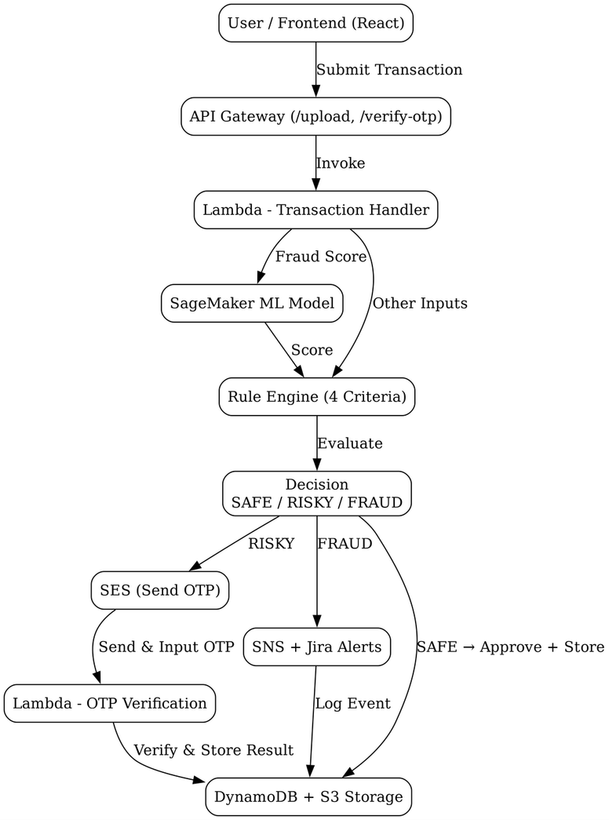
Solution Implementation
Block Diagram
© Mphasis 2025 Proprietary and confidential information
‹#›

Slide 7
Solution Implementation
Major components / modules
The system is built using scalable, serverless, and event-driven components enabling real-time fraud detection, automated security workflows, and intelligent transaction monitoring.
    Fraud Detection Engine
    Evaluates transactions using SageMaker ML inference and multi-criteria rule evaluation.
    API Gateway & Lambda Processing
    Handles transaction upload, OTP verification, and backend orchestration using AWS Lambda.
    OTP Verification Module
    Generates secure OTPs, sends them through Amazon SES, and verifies risky transactions
    Automated Escalation Pipeline
    Creates Jira tickets and sends SNS alerts automatically for fraudulent transactions.
    Data Persistence Layer
    Stores transaction records, OTP lifecycle data, audit logs, and fraud results in DynamoDB and Amazon S3.
    Decision Engine
    Classifies every transaction into SAFE, RISKY, or FRAUD based on ML score and rule evaluation.
© Mphasis 2025 Proprietary and confidential information
‹#›

Slide 8
Solution Implementation
Technologies or tools used
Built on a serverless, scalable AWS architecture with AI-driven intelligence.
Frontend: React + JavaScript
Backend: Python (AWS Lambda)
Database: Amazon DynamoDB
AI / ML: Amazon SageMaker
Notifications: Amazon SES + SNS
Storage: Amazon S3
API Layer: AWS API Gateway
Issue Tracking: Jira REST API
© Mphasis 2025 Proprietary and confidential information
‹#›

Slide 9
Three Key Features
Questions | Answers
Please elaborate Feature1: | Name: AI-Powered Fraud Detection Engine Business description: Evaluates banking transactions in real time using machine learning and multi-criteria risk analysis. Achievements: • Real-time fraud detection • Reduced false positives • Intelligent risk classification (SAFE / RISKY / FRAUD)
Please elaborate Feature2: | Name: OTP Verification System Business description: Automatically generates and verifies OTPs for risky transactions using Amazon SES and DynamoDB. Achievements: • Secure transaction verification • 40-second OTP validation window • Reduced unauthorized transaction approvals
© Mphasis 2025 Proprietary and confidential information
‹#›

Slide 10
Three Key Features
Questions | Answers
Please elaborate Feature3: | Name: Automated Fraud Escalation & Alerts Business description: Automatically blocks fraudulent transactions and triggers Jira ticket creation with SNS fraud alerts. Achievements: • Zero-touch fraud escalation • Real-time incident notifications • Faster fraud investigation workflow
© Mphasis 2025 Proprietary and confidential information
‹#›

Slide 11
Outcomes
Questions | Answers
Business impact | • Real-time fraud detection with reduced manual monitoring • Improved banking security using AI-driven risk analysis • Enhanced customer trust through secure transaction verification
Achieved Technical benefits | • Scalable serverless architecture using AWS • Real-time ML inference using Amazon SageMaker • Automated OTP verification and fraud escalation workflows
Cost/time/value improvements | • Reduced fraud investigation time • Lower operational overhead through automation • Faster response to suspicious transactions
Key Metrics | • 3-tier risk classification system • 40-second OTP verification window • 100% serverless deployment
© Mphasis 2025 Proprietary and confidential information
‹#›

Slide 12


THANK YOU
Important Confidentiality Notice
This document is the property of, and is proprietary to Mphasis, and identified as “Confidential”. Those parties to whom it is distributed shall exercise the same degree of custody and care afforded their own such information. It is not to be disclosed, in whole or in part to any third parties, without the express written authorization of Mphasis. It is not to be duplicated or used, in whole or in part, for any purpose other than the evaluation of, and response to, Mphasis’ proposal or bid, or the performance and execution of a contract awarded to Mphasis. This document will be returned to Mphasis upon request.
© Mphasis 2025 Proprietary and confidential information
19-05-2026
‹#›

