Slide 1
Identification of Fake News in online News Media

Slide 2
Data Used
Dataset name | NELA-GT-2019
Formats | sqlite,JSON
No. of articles | 1118821
No. of sources | 261
Collection period | 2019-01-01 to 2019-12-31

Slide 3
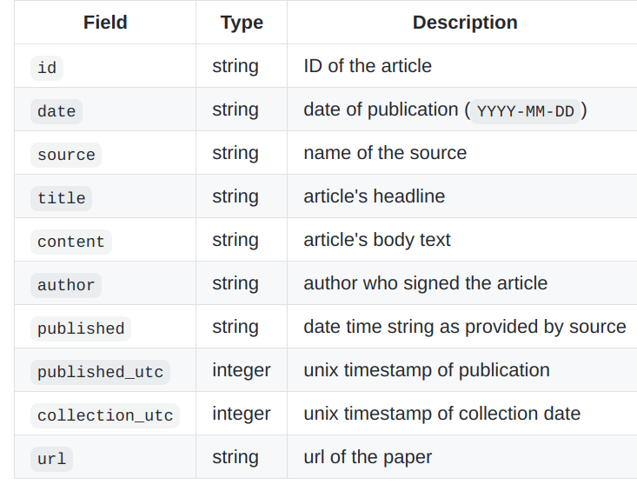

Slide 4
Labels on NELA-GT DATASET
Reliable | Class 0
Mixed | Class 1
Unreliable | Class 2

Slide 5
Preprocessing on NELA-GT DATASET
Dropping Columns : [id,date,source,author,url,published,published_utc,collection_utc]
Dropping Rows have Label : Mixed
Converting data to lower case to maintain uniformity
'

Slide 6
Data Used
Dataset name | AAAI-Constraint Covid Dataset
No. of articles | 6420
Data Description | Id , Article(English)
Label | Fake,Real

Slide 7
Models Applied on NELA-GT-2019:
Approach Used : Uni-gram(TF-IDF) , Bi-gram(TF-IDF) , Word2Vec
Methodology : Prediction done on : Articles , Titles

Slide 8
BaseLine model on NELA-GT Articles:
Model (Uni-gram) | F1 Score | Accuracy
Naive Bayes Model | 0.69 | 0.78
Linear Classifier | 0.87 | 0.88
Bagging Model | 0.78 | 0.83
Boosting Model | 0.88 | 0.89
SVM Model | 0.90 | 0.90

Slide 9
BaseLine model on NELA-GT Articles
:
Model(Bi-gram) | F1 Score | Accuracy
Naive Bayes Model | 0.70 | 0.79
Linear Classifier | 0.82 | 0.85
Bagging Model | 0.81 | 0.85
Boosting Model | 0.87 | 0.88
SVM Model | 0.84 | 0.87

Slide 10
Models Applied on AAAI-Constraint Covid Dataset:
Approach Used : Uni-gram(TF-IDF) , Bi-gram(TF-IDF) ,Word2Vec
Methodology : Prediction done on : Articles , Titles

Slide 11
Preprocessing on Covid DATASET
Encoding the Labels.
Converting data to lower case to maintain uniformity
'

Slide 12
BaseLine model on COVID Articles:
Model (Uni-gram) | F1 Score | Accuracy
Naive Bayes Model | 0.90 | 0.89
Linear Classifier | 0..91 | 0.90
Bagging Model | 0.90 | 0.89
Boosting Model | 0.91 | 0.90
SVM Model | 0.92 | 0.91

Slide 13
BaseLine model on COVID Articles:
Model (Bi-gram) | F1 Score | Accuracy
Naive Bayes Model | 0.58 | 0.51
Linear Classifier | 0.62 | 0.54
Bagging Model | 0.18 | 0.49
Boosting Model | 0.06 | 0.48
SVM Model | 0.54 | 0.52

Slide 14
BaseLine model on NELA-GT Articles:
Vectorization Technique: Word2Vec
Model | F1 Score | Accuracy
Linear Classifier | 0.81 | 0.83
Bagging Model | 0.96 | 0.96
SVM Model | 0.85 | 0.86

Slide 15
BaseLine model on NELA-GT Titles
:
Model (Uni-gram) | F1 Score | Accuracy
Naive Bayes Model | 0.71 | 0.78
Linear Classifier | 0.78 | 0.82
Bagging Model | 0.79 | 0.82
Boosting Model | 0.77 | 0.81
SVM Model | 0.80 | 0.83

Slide 16
BaseLine model on NELA-GT Titles:
Model (Bi-gram)(on Titles) | F1 Score | Accuracy
Naive Bayes Model | 0.69 | 0.78
Linear Classifier | 0.69 | 0.78
Bagging Model | 0.71 | 0.70
Boosting Model | 0.71 | 0.78
SVM Model | 0.72 | 0.79

Slide 17
BaseLine model on NELA-GT Articles:
Deep Learning Techniques:
Model | Vocabulary Size | Accuracy | F1 Score
LSTM (Stratified Sampling) | 1000 | 0.88 | 0.69
LSTM (with 2 more layer bi directional layer and dropout) (Stratified Sampling) | 1000 | 0.88 | 0.69
LSTM (Stratified Sampling) | Unbounded | 0.90 | 0.77
LSTM (with 2 more layer bi directional layer and dropout)(Stratified Sampling) | Unbounded | 0.91 | 0.79
LSTM (Stratified Sampling) | Unbounded | 0.87 | 0.87
LSTM (with 2 more layer bi directional layer and dropout)(Stratified Sampling) | Unbounded | 0.87 | 0.87

Slide 20
Transformer models:

Slide 21
Transformer model on NELA-GT titles:
Model | Accuracy | F1 score
bert-base-uncased | 0.861 | 0.856
distilbert-base-uncased | 0.860 | 0.848
textattack/roberta-base-SST-2 | 0.873 | 0.866
google/electra-base | 0.865 | 0.861
xlnet-base-cased | 0.858 | 0.852

Slide 22
Transformer model on NELA-GT articles(511 tokens):
Model | Accuracy | F1 score
bert-base-uncased | 0.782 | 0.702
textattack/roberta-base-SST-2 | 0.805 | 0.744
google/electra-base | 0.865 | 0.861

Slide 23
Cascading Transformer model on NELA-GT articles:
Model | Accuracy | F1 score
bert-base-uncased | 0.889 | 0.881
textattack/roberta-base-SST-2 | 0.920 | 0.905
google/electra-base | 0. | 0.861

Slide 24
Transformer model on covid dataset:
Model | Accuracy | F1 score
bert-base-uncased | 0.966 | 0.962
distilbert-base-uncased | 0.960 | 0.957
textattack/roberta-base-SST-2 | 0.978 | 0.975
google/electra-base | 0.977 | 0.972
xlnet-base-cased | 0.955 | 0.948

Slide 25
BanFake dataset
Dataset name | BanFakeNews
Formats | csv
No. of authentic news | 3964
No. of fake news | 3238
Published at | LREC 2018

Slide 26
Transformer model on BanFakeNews dataset:
Model | Accuracy | F1 score
bert-base-multilingual-cased | 0.54 | 0.52
xlm-roberta-base | 0.55 | 0.54
sagorsarker/bangla-bert-base | 0.58 | 0.58

Slide 27
Cascading Transformer model on BanFakeNews dataset:
Model | Accuracy | F1 score
bert-base-multilingual-cased | 0.60 | 0.59
xlm-roberta-base | 0.66 | 0.64
sagorsarker/bangla-bert-base | 0.65 | 0.64

Slide 28
Models Applied:
Model | F1 Score | Accuracy
BERT
MLP | Memory Error | Memory Error

Slide 29
Findings:
DATASET | MODEL | ACCURACY
NELA-GT-2019 | Bagging (Word2vec) | 0.96
AAAI-Constraint Covid Dataset: | roberta-base | 0.978

Slide 30
Future work:
Implementing the paper: Hierarchical Transformers for Long Document Classification
Longformers
Trying to include both the title and article information through multi layer perceptron.

Slide 31
THANKYOU
Presented By:
Tathagata Raha (2018114017)
Aayush Upadhaya (2019202010)
Jeevesh Kataria (2019201058)
Pramud Bommakanti (2020900011)

