Slide 1
Identification of Fake News in online News Media

Slide 2
Data Used
Dataset name | NELA-GT-2019
Formats | sqlite,JSON
No. of articles | 1118821
No. of sources | 261
Collection period | 2019-01-01 to 2019-12-31

Slide 3
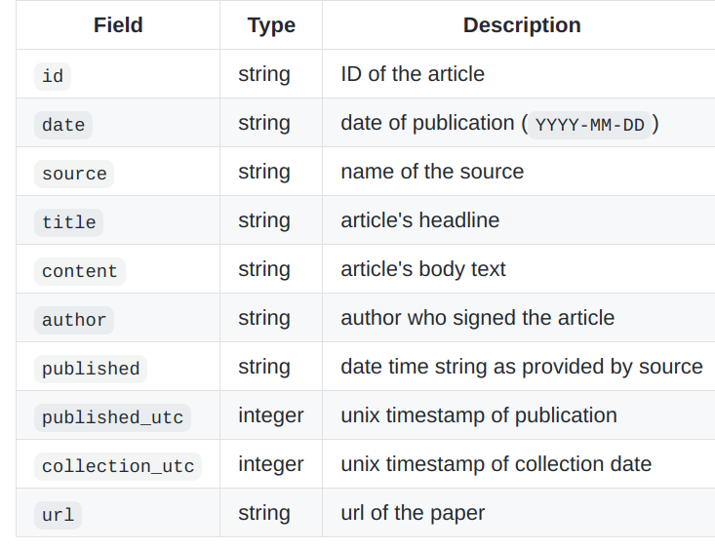

Slide 4
Labels
Reliable | Class 0
Mixed | Class 1
Unreliable | Class 2

Slide 5
Baseline Models Applied:
Model | F1 Score | Accuracy
Naive Bayes Model(Unigram) | 0.69 | 0.78
Naive Bayes Mode l(Bigram) | 0.70 | 0.79

Slide 6
Baseline Models Applied:
Model | F1 Score | Accuracy
Linear Classifier(Unigram) | 0.87 | 0.88
Linear Classifier(Bigram) | 0.82 | 0.85

Slide 7
Baseline Models Applied:
Model | F1 Score | Accuracy
Bagging Model(Unigram) | 0.78 | 0.83
Bagging Model (Bigram) | 0.81 | 0.85

Slide 8
Baseline Models Applied:
Model | F1 Score | Accuracy
Boosting Model(Unigram) | 0.88 | 0.89
Boosting Model (Bigram) | 0.87 | 0.88

Slide 9
Baseline Models Applied:
Model | F1 Score | Accuracy
SVM Model(Unigram) | 0.90 | 0.90
SVM Model (Bigram) | 0.84 | 0.87

Slide 10
Models Applied:
Model | F1 Score | Accuracy
RNN
LSTM

Slide 11
Models Applied:
Model | F1 Score | Accuracy
BERT
MLP

