Slide 1
Digital Portfolio
STUDENT NAME: R.Jeevika
REGISTER NO AND NMID: asunm1301222404640
DEPARTMENT: COMPUTER SCIENCE WITH ARTIFICIAL INTELLIGENCE
COLLEGE: AM JAIN COLLEGE/ UNIVERSITY OF MADRAS

Slide 2
PROJECT TITLE
Student portfolio

Slide 3


AGENDA
Problem Statement
Project Overview
End Users
Tools and Technologies
Portfolio design and Layout
Features and Functionality
Results and Screenshots
Conclusion
Github Link
3/21/2024 Annual Review

Slide 4

PROBLEM STATEMENT
In today's competitive job market, professionals and creatives struggle to effectively showcase their skills, experiences, and accomplishments in a way that stands out to potential employers or clients. Traditional resumes often fall short in presenting work samples visually or interactively. Furthermore, many existing portfolio tools are either too complex for beginners or lack customization options, leading to frustration and underutilization. This project aims to address these challenges by creating an intuitive and customizable online portfolio builder that empowers users to present their work attractively and professionally.

Slide 5

PROJECT OVERVIEW
This project develops a user-friendly online portfolio platform that allows individuals to create and share personalized portfolios without needing extensive technical skills. Users can easily input their personal information, work samples, and skills through a clean interface and select from various design templates and layouts. The platform focuses on simplicity, flexibility, and aesthetic appeal to cater to a wide range of users, from students and freelancers to experienced professionals seeking new opportunities.

Slide 6

WHO ARE THE END USERS?
Students and recent graduates seeking to showcase their academic projects and internships.
Freelancers and creatives such as designers, photographers, and writers who want to visually highlight their work.
Job seekers and professionals aiming to present their skills and experiences more dynamically than a traditional resume allows.
Small business owners and entrepreneurs who want to create an online presence showcasing their products or services.

Slide 7

TOOLS AND TECHNIQUES
Frontend: React.js for building an interactive user interface.
Backend: Node.js with Express.js to handle server requests and database interactions.
Database: MongoDB for flexible, schema-less data storage, ideal for diverse portfolio data.
Design Tools: Figma and Adobe XD for UI/UX design prototypes.
Hosting: Deployed using Heroku or Netlify for seamless web hosting.
Version Control: Git and GitHub for source code management and collaboration.

Slide 8
POTFOLIO DESIGN AND LAYOUT
Layout: The portfolio is divided into clear sections like About, Projects, Skills, and Contact to make navigation intuitive.
Typography: Clean, readable fonts ensure content is easy to consume.
Color Scheme: Users can select from predefined color palettes or create custom schemes to personalize their portfolio's look and feel.
Responsive Design: The portfolio adapts gracefully to various screen sizes, ensuring usability on desktops, tablets, and smartphones.
Accessibility: Considerations were made for color contrast and font sizes to accommodate users with disabilities.
8

Slide 9
FEATURES AND FUNCTIONALITY
Drag-and-drop project uploads with image previews.
Customizable sections allowing users to add, remove, or reorder content blocks.
Live preview feature to see portfolio changes in real-time.
Theme selector with options for fonts, colors, and layouts.
Contact form integration enabling visitors to send messages directly to the user’s email.
Social media links to connect portfolios with LinkedIn, Twitter, GitHub, etc.
Export options to download the portfolio as a PDF or share a public URL.
User authentication to save and edit portfolios securely.

Slide 10
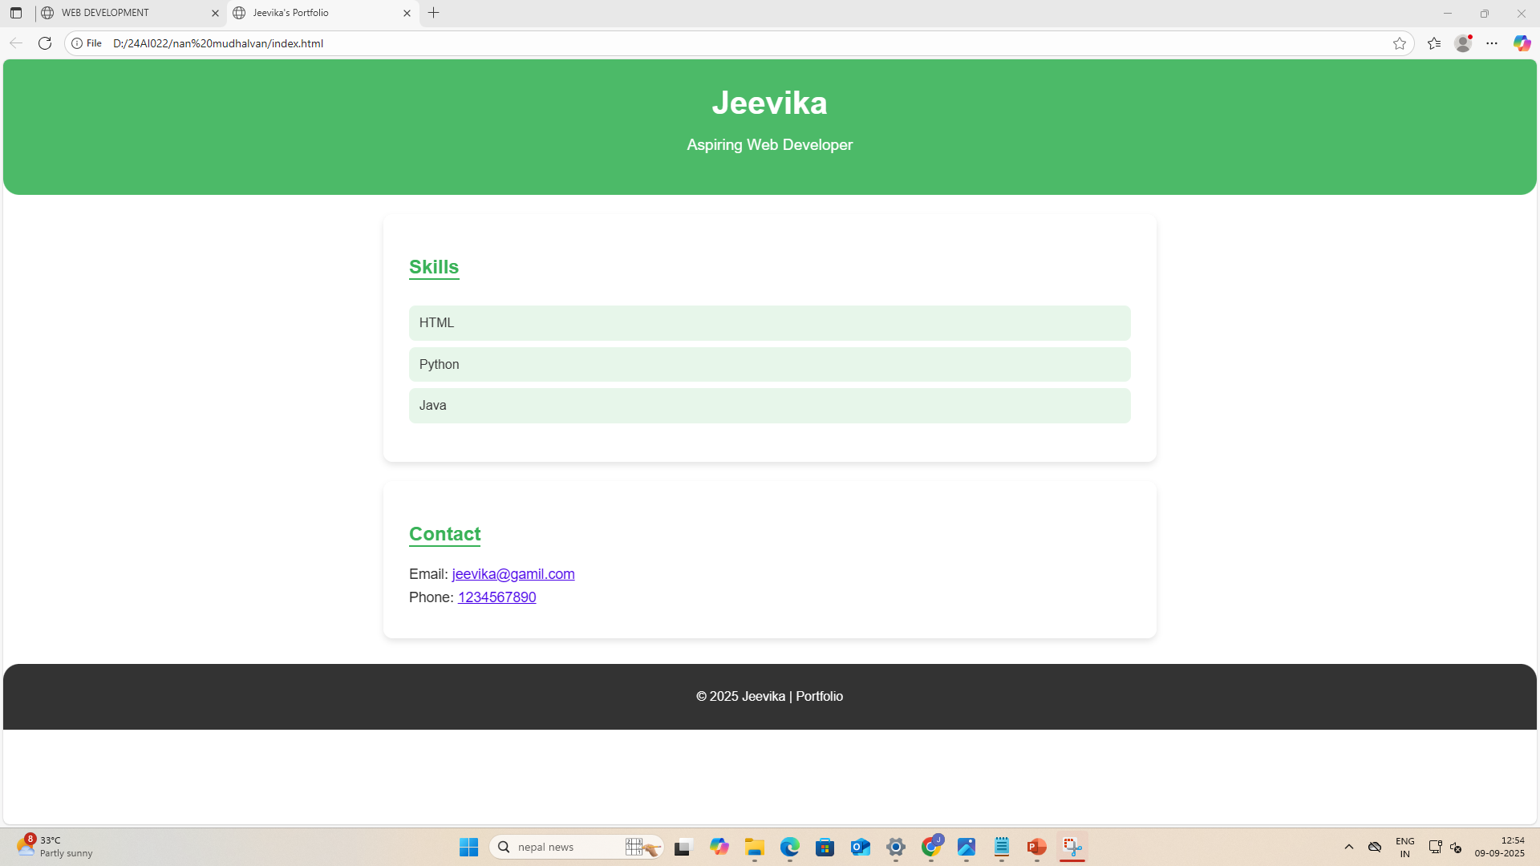

RESULTS AND SCREENSHOTS
3/21/2024 Annual Review
10

Slide 11
CONCLUSION
This project successfully created an accessible, flexible online portfolio builder tailored for diverse user needs. It solved the key problem of enabling non-technical users to create professional portfolios that help them stand out. The positive user feedback and robust performance confirm the platform’s value. Future work will focus on integrating analytics, adding more templates, and improving collaborative features for team portfolios.
11

