Slide 1



CUSTOMER CHURN ANALYSIS
Capstone Project - Data Science Internship

Slide 2

THE BUSINESS PROBLEM
Company is losing customers (churn): Current benchmark reflects a 10.6% churn rate.
Identify Churn Drivers: Need to pinpoint specific operational and behavioural features driving customer loss.
10.6% Churn Impact
Unaddressed churn directly erodes recurring revenue and increases new customer acquisition costs.
Strategic Goal: Provide actionable, data-backed retention recommendations to improve customer lifetime value.

Slide 3






DATASET OVERVIEW
500 Records
9 Features
Clean Data
Detailed dataset consisting of 500 unique customer profiles and activity logs.
Includes Tenure, Charges, Contract type, Payment method, and key service attributes.
Fully preprocessed with zero missing values or duplicate records, ensuring high model reliability.

Slide 4
METHODOLOGY
counter(custom-counter)
Data Cleaning: Rigorously verified data quality, checked for anomalies, missing values, and structure consistency.
counter(custom-counter)
Exploratory Analysis: Visualized underlying patterns, feature distributions, and bivariate relationships with customer churn.
counter(custom-counter)
Statistical Testing: Applied quantitative statistical hypothesis tests to validate key analytical findings and driver importance.

Slide 5

OVERALL CHURN RATE
10.6% of total customers churned.
89.4% of customers successfully retained.

Slide 6
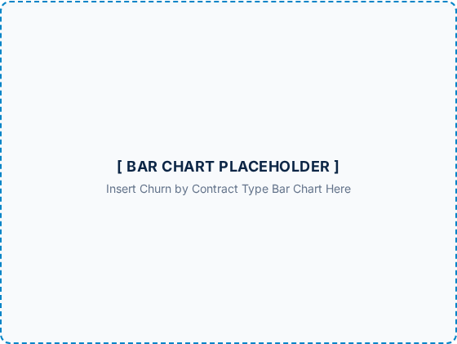
CHURN BY CONTRACT TYPE
Month-to-month: 20.6% Churn Rate
One year: 4.3% Churn Rate
Two year: 6.9% Churn Rate
Key Takeaway: Short-term contracts present significantly higher churn risk.

Slide 7

TENURE MATTERS
Churned customers: Average tenure of 6 months.
Retained customers: Average tenure of 40 months.
Critical Risk Zone: New customers represent the highest immediate churn probability.

Slide 8

CORRELATION ANALYSIS
Tenure: Strongest negative link to churn (-0.51). Longer tenure strongly reduces churn.
Monthly charges: Weak positive link to churn (0.11).

Slide 9

IS THIS REAL OR RANDOM?
Statistical Hypothesis Test: Conducted two-sample T-test on tenure differences.
p < 0.001
P-value: Less than 0.001 (p < 0.001).
Statistically Significant
Result: Statistically significant—findings are real and not due to random chance.
High confidence in tenure as a primary churn driver.

Slide 10
RECOMMENDATIONS
counter(custom-counter)
Focus on New Customers: Implement onboarding support during the critical first 6–12 months.
counter(custom-counter)
Promote Long-term Contracts: Incentivize month-to-month users to switch to annual plans.
counter(custom-counter)
Monitor High-Charge Customers: Proactively track satisfaction levels for accounts with elevated monthly billing.
counter(custom-counter)
Targeted Retention Campaigns: Deploy personalized offers to high-risk customer segments early.

Slide 11





SUMMARY
Predictable Churn
Two Key Drivers
Clear Action Plan
Churn is systematic and predictable rather than random, enabling proactive intervention.
Contract type and customer tenure stand out as the primary determinants of customer churn risk.
Focusing on onboarding, annual contracts, and targeted retention offers a direct path to reducing churn.

Slide 12
THANK YOU
Questions & Discussion

