Slide 1
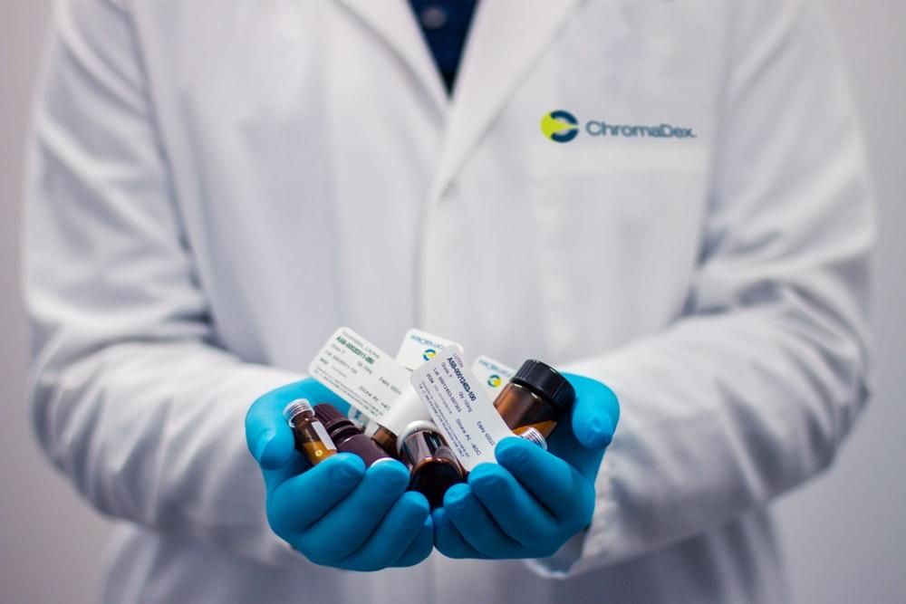
MEDIC - EYE

Slide 2

ABSTRACT
ABSTRACT
Implementation of modern technology in healthcare is hardly seen in cities and in rural areas it is still a question.
To make the situation convenient in both cities and rural areas and to make work simpler and efficient for the chemist and the consumer we have developed an idea where the medicine is placed in a conveyor belt which is combined with data matrix code scanner that scans the required specifications.
Implementation of modern technology in healthcare is hardly seen in cities and in rural areas it is still a question.
To make the situation convenient in both cities and rural areas and to make work simpler and efficient for the chemist and the consumer we have developed an idea.

Slide 3
OBJECTIVE
OBJECTIVE
In this paper, We have developed an idea to make the situation convenient in both cities and rural areas and to make work simpler and efficient for the chemist and the consumer ,where the code scanner scans the required specifications especially for the expiry date and dosage.
In this paper, We have developed an idea to make the situation convenient in both cities and rural areas and to make work simpler and efficient for the chemist and the consumer ,where the code scanner scans the required specifications especially for the expiry date and dosage.

Slide 4
METHODOLOGY
METHODOLOGY
The preliminary stage of our project idea is to reduce the manual time taken to verify the drug specifications .
The chemist places the medicine in a conveyor belt which is combined with a data matrix code scanner that scans the required specifications and a screen displays the same.
The preliminary stage of our project idea is to reduce the manual time taken to verify the drug specifications .
The chemist places the medicine in a conveyor belt which is combined with a data matrix code scanner that scans the required specifications and a screen displays the same.

Slide 5

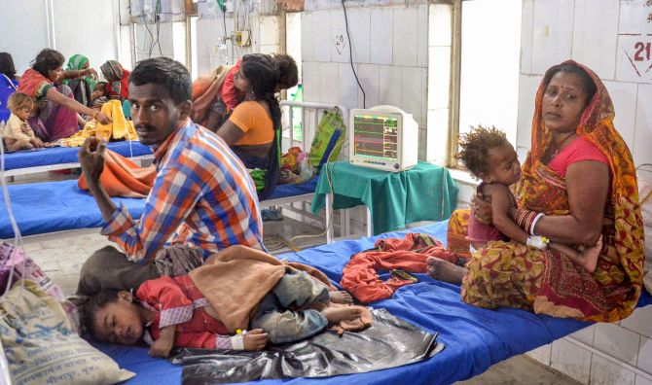

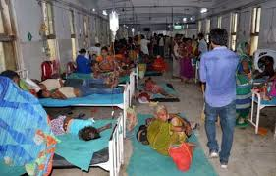

SURVEY
SURVEY

Slide 6
BLOCK DIAGRAM
MEDICINE
CODE SCANNER
NO
TRASH
CONVEYOR BELT
YES
CONSUMER

Slide 7
WORKING
WORKING
The functioning of our prototype is based on image processing.
Image compression or coding is carried out when the scanner scans the data matrix code.

Slide 8
The drug specifications will be manipulated with the image processing by image compression technique.

Slide 9
FUTURE DEVELOPMENTS…
FUTURE DEVELOPMENTS…
In future we intend to imply the same in grocery stores to check the expiry date of packed food products even before taking the products to the billing counter.
In future we intend to imply the same in grocery stores to check the expiry date of packed food products even before taking the products to the billing counter.

Slide 10
CONCLUSION
CONCLUSION
The device is designed and will be implemented in pharmaceuticals and it will be a contribution to the medical and health care with the help of modern technology
The device is designed and will be implemented in pharmaceuticals and it will be a contribution to the medical and health care with the help of modern technology.

Slide 11
There is a revolution in movement…Yes, The movement is Medicine !!
There is a revolution in movement…Yes, The movement is Medicine !!

Slide 12
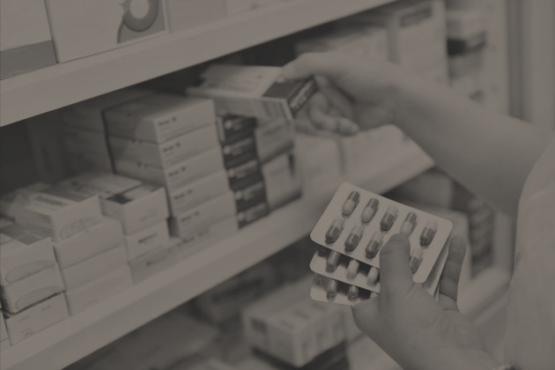
THE END
THE END

