Slide 1
PictoCaption

Slide 2
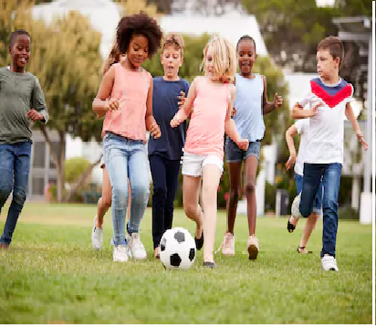
What do you see in this picture..?
Description 1: Children are playing football.
Description 2: Children are chasing the ball.
Description 3: Group of kids are playing on the green grass.
Predicted Description : Children are playing football on the green grass.

Slide 3
Objective of Image Captioning
Description of a Product
Caption Generator
Companion to the Blind
Add on to Self-driving cars

Slide 4
Object Detection
Image
Conv 1
Conv 2
MAX Pool
MAX Pool
Fully Connected
ReLU
Conv 3
ReLU
Conv 4
ReLU
Conv 5
ReLU
Conv 6
ReLU
ReLU
MAX Pool
Text and Blob
Texture
Object parts
Object Classes
VGG16

Slide 5
Modeling of Image
example
<start>
The
Person
<end>
softmax
softmax
softmax
softmax
GRU
G
R
U
GRU
GRU
Input Image
linear
CNN
Feature Vector
<start>
The
---
VGG16

Slide 6
The
Children
are
playing
football
on
green
grass

Slide 7
Generation of Caption
Object detection
⇒
Modeling image
RNN
⇒
Speech output
⇒
Object classes
Feature vector
Feature vector to Text
Text to Speech

Slide 8
Working of PictoCaption
Image input
Front - end
Image with .jpg extension
1
2
User
Back-end
3
4
Caption in speech form
Image and Caption in speech form

Slide 9
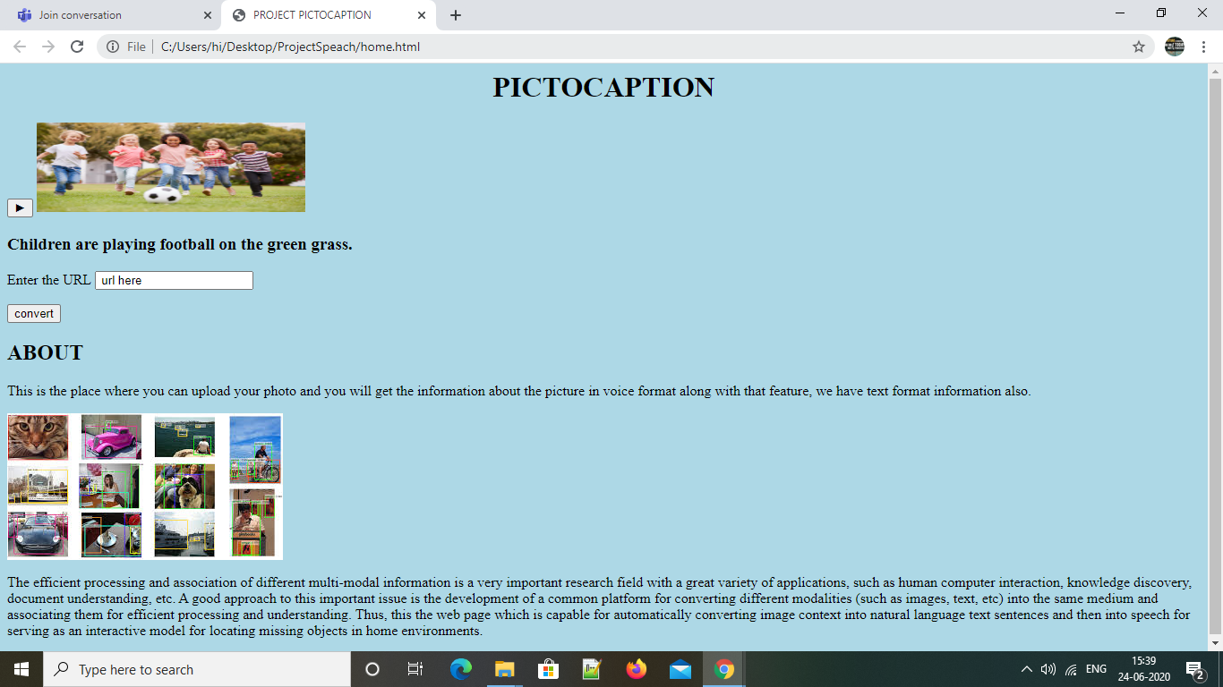
PictoCaption in API

Slide 10

PictoCaption in APK
Open Image caption Generator APK .
Chose a file with .jpg extension to generate caption
Click on submit.
Click on Play after navigation.
Voice description as output is generated.

