Slide 1
Chapter 11 Introduction to Cloud Computing
Modified from Mark Baker

Slide 2
Sources
Some slides based on slides by Mehmet H. Gunes
Above the Clouds: A Berkeley View of Cloud Computing, Michael Armbrust, Armando Fox, Rean Griffith, Anthony D. Joseph, Randy H. Katz, Andrew Konwinski, Gunho Lee, David A. Patterson, Ariel Rabkin, Ion Stoica, Matei Zaharia, 2009
An Introduction to Virtualization, Sean Campbell and Michael Jeronimo, Intel, 2006
Virtual Machine Monitors, Marc E. Fiuczynski, Princeton University, 2009

Slide 3
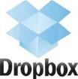















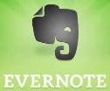





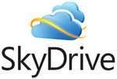
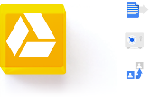

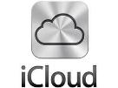

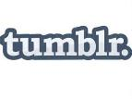







Do you use the Cloud?
Notes:
Let me start by asking a quick question: raise your hand is you used a least one of the services depicted here.
Well this is only a small segment of services that use the cloud

Slide 4
Cloud Computing: The Origins
Cloud Computing is a new term for the old dream of:
Utility Computing
“Computation may someday be organized as a public utility.”, John McCarthy, 1960s
The Challenge of the Computer Utility. Douglas Parkhill, 1966

Slide 5
Cloud Computing: The Origins
Amazon’s data centers were used at about 10% at any time
Amazon Web Service (AWS) launched on a utility computing basis in 2006.

Slide 6
What is Cloud Computing?

Slide 7
What is Cloud Computing?
Nearly 1/3 of the 1,000 American adults surveyed believed that cloud computing was a "thing of the future,"
Survey commissioned by Citrix in August 2012
Even though 97% of respondents, apparently unknowingly, used cloud computing to shop online, bank online, and to interact on social networks, such as Facebook, Instagram, Pinterest and Twitter.

Slide 8
What is Cloud Computing?
Cloud computing is a type of computing that delivers computing, storage, and even applications as a service across a network.
Operating Systems Concepts, Silberschatz et al.

Slide 9
What is Cloud Computing?
Cloud Computing is a general term used to describe a new class of network-based computing that takes place over the Internet,
A collection/group of integrated and networked hardware, software and Internet infrastructure (called a platform).
Using the Internet for communication and transport provides hardware, software and networking services to clients

Slide 10
What’s A Cloud?
The datacenter hardware and software is what we will call a Cloud.
Operating Systems Concepts, Silberschatz et al.

Slide 11
NIST Definition Of Cloud Computing
Cloud computing is a model for enabling ubiquitous, convenient, on-demand network access to a shared pool of configurable computing resources (e.g., networks, servers, storage, applications, and services) that can be rapidly provisioned and released with minimal management effort or service provider interaction.

Slide 12
5 Characteristics of CC (NIST)
On-demand self-service
Broad network access
Resource pooling
Rapid elasticity
Measured service

Slide 13
5 Characteristics of CC (NIST)
On-demand self-service
A consumer can unilaterally provision computing capabilities, such as server time and network storage, as needed automatically without requiring human interaction with each service provider.

Slide 14
5 Characteristics of CC (NIST)
Broad network access.
Capabilities are available over the network and accessed through standard mechanisms that promote use by heterogeneous thin or thick client platforms (e.g., mobile phones, tablets, laptops, and workstations).

Slide 15
5 Characteristics of CC (NIST)
Resource pooling
The provider’s computing resources are pooled to serve multiple consumers using a multi-tenant model
Dynamic reassignment of resources
Location independence
customer generally has no control or knowledge over the exact location of the provided resources

Slide 16
5 Characteristics of CC (NIST)
Rapid elasticity
Capabilities can be elastically provisioned and released, in some cases automatically, to scale rapidly outward and inward commensurate with demand. To the consumer, the capabilities available for provisioning often appear to be unlimited and can be appropriated in any quantity at any time

Slide 17
5 Characteristics of CC (NIST)
Measured service
Cloud systems automatically control and optimize resource use by leveraging a metering capability at some level of abstraction appropriate to the type of service (e.g., storage, processing, bandwidth, and active user accounts).
Resource usage can be monitored, controlled, and reported, providing transparency for both the provider and consumer of the utilized service.

Slide 18
Example
Elastic Compute Cloud (EC2) from Amazon Web Services (AWS) sells:
1.0-GHz x86 ISA “slices” for 10 cents per hour, and a new “slice”, or instance, can be added in 2 to 5 minutes.
Amazon’s Scalable Storage Service (S3) charges $0.12 to $0.15 per gigabyte-month,
with additional bandwidth charges of $0.10 to $0.15 per gigabyte to move data into and out of AWS over the Internet.
These rates may have changed!

Slide 19
More characteristics of Cloud Computing
Pay for use as needed
e.g., processors by the hour and storage by the day
No up-front commitment by cloud users
Companies can start small and increase hardware resources only when there is an increase in their needs

Slide 20
Service Models
Software as a Service (SaaS)
Platform as a Service (PaaS)
Infrastructure as a Service (IaaS)

Slide 21
Software as a Service (SaaS)
SaaS is a model of software deployment where an application is hosted as a service provided to customers across the Internet.
Consumer uses the provider’s applications running on a cloud infrastructure
Saas alleviates the burden of software maintenance/support
but users relinquish control over software versions and requirements.

Slide 22
Platform as a Service (PaaS)
Consumer deploys onto the cloud infrastructure consumer-created or acquired applications may be developed using programming languages, libraries, services, and tools supported by the provider.
Consumer has control over the deployed applications and possibly configuration settings for the application-hosting environment

Slide 23
Infrastructure as a Service (IaaS)
Consumer has access to processing, storage, networks, and other fundamental computing resources
Consumer is able to deploy and run arbitrary software, which can include operating systems and applications

Slide 24
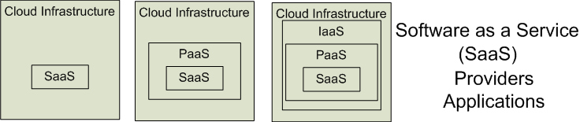

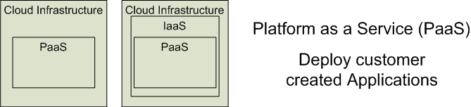

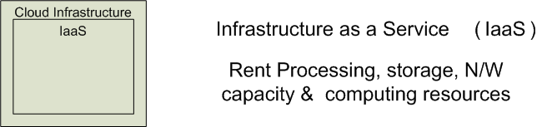


Service Models
Software as a Service (SaaS)
Platform as a Service (PaaS)
Infrastructure as a Service (IaaS)
SalesForce CRM
LotusLive
Google App Engine
Adopted from: Effectively and Securely Using the Cloud Computing Paradigm by peter Mell, Tim Grance
Notes:
IaaSdelivers computer infrastructure, typically a platform virtualization environment, as a service. Rather than purchasing servers, software, data center space or network equipment, clients instead buy those resources as a fully outsourced service.
PaaSdeliver a computing platform where the developers can develop their own applications.
SaaSis a model of software deployment where the software applications are provided to the customers as a service.

Slide 25
Different Cloud Computing Layers‏
Application Service
(SaaS)‏
MS Live/ExchangeLabs, IBM,
Google Apps; Salesforce.com
Quicken Online, Zoho, Cisco
Google App Engine, Mosso,
Force.com, Engine Yard,
Facebook, Heroku, AWS
Application Platform
Server Platform
3Tera, EC2, SliceHost,
GoGrid, RightScale, Linode
Storage Platform
Amazon S3, Dell, Apple, ...

Slide 26
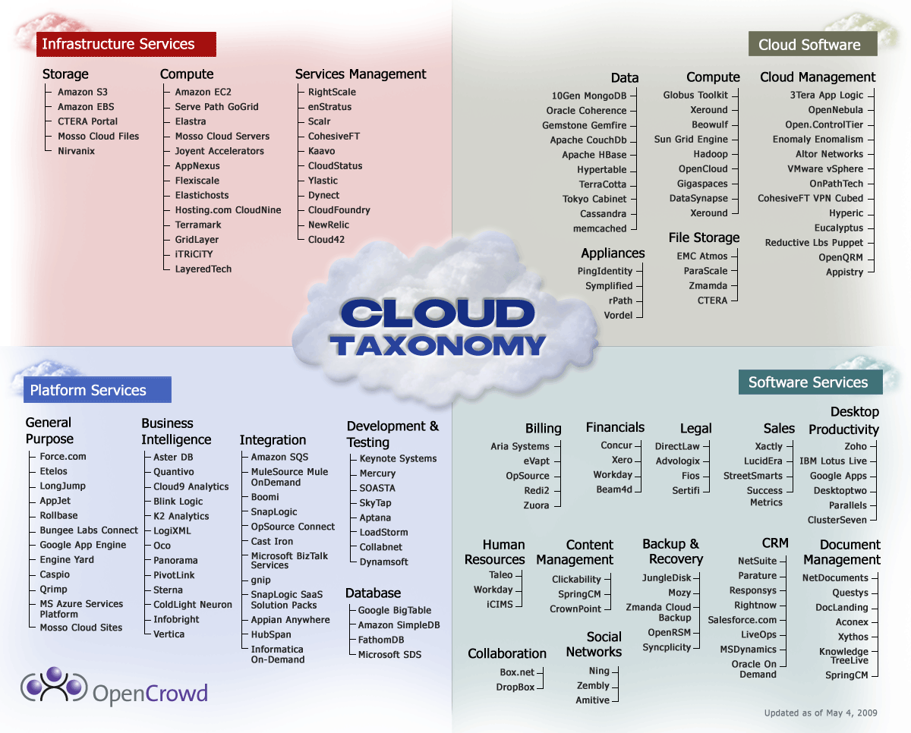
Cloud Taxonomy
Notes:
http://www.opencrowd.com/assets/images/views/views_cloud-tax-lrg.png

Slide 27
Deployment Models
Public
Private
Community
Hybrid

Slide 28
Public Clouds
Public cloud: a cloud available via the Internet to anyone willing to pay for the services
Service being sold is Utility Computing.
A public cloud is a computing service that charges you based only on the amount of computing resources you use (pay-as-you-go)

Slide 29
Public Clouds
Examples of public Utility Computing
Amazon Web Services,
Google AppEngine,
Microsoft Azure.

Slide 30
Private Clouds
Private Cloud:
An internal datacenters of a business or other organization that are not made available to the public.

Slide 31
Community Clouds
The cloud infrastructure is provisioned for exclusive use by a specific community of consumers from organizations that have shared concerns (e.g., mission, security requirements, policy, and compliance considerations)

Slide 32
Hybrid Clouds
A cloud that includes two or more distinct cloud infrastructures (private, community, or public) that remain unique entities, but are bound together by standardized or proprietary technology that enables data and application portability
e.g., cloud bursting for load balancing between clouds).

Slide 33
Opportunities and Challenges
The use of the cloud provides a number of opportunities:
It enables services to be used without any understanding of their infrastructure.
Cloud computing works using economies of scale:
It potentially lowers the outlay expense for start up companies, as they would no longer need to buy their own software or servers.
Cost would be by on-demand pricing.
Vendors and Service providers claim costs by establishing an ongoing revenue stream.
Data and services are stored remotely but accessible from “anywhere”.

Slide 34
Opportunities and Challenges
In parallel there has been backlash against cloud computing:
Use of cloud computing means dependence on others and that could possibly limit flexibility and innovation:
The others are likely the bigger Internet companies like Google and IBM, who may monopolise the market.
Security could prove to be a big issue
There are also issues relating to policy and access:
If your data is stored abroad whose policy do you adhere to?
What happens if the remote server goes down?
How will you then access files?
There have been cases of users being locked out of accounts and losing access to data.
Notes:
Freedom of Information == FOI

Slide 35
Cloud-Sourcing - Concerns
Performance, reliability, and SLAs,
Control of data, and service parameters,
Application features and choices,
Interaction between Cloud providers,
No standard API – mix of SOAP and REST!
Privacy, security, compliance, trust…
Do you trust the cloud provider?
Which laws apply?
Vendor lock-in

Slide 36
Cloud Storage
Several large Web companies are now exploiting the fact that they have data storage capacity that can be hired out to others.
allows data stored remotely to be temporarily cached on desktop computers, mobile phones or other Internet-linked devices.
Amazon’s Elastic Compute Cloud (EC2) and Simple Storage Solution (S3) are well known examples
Mechanical Turk

Slide 37
Utility Computing – EC2
Amazon Elastic Compute Cloud (EC2):
Elastic, marshal 1 to 100+ PCs via WS,
Machine Specs…,
Fairly cheap!
Powered by Xen – a Virtual Machine:
Different from Vmware and VPC as uses “para-virtualization” where the guest OS is modified to use special hyper-calls:
Hardware contributions by Intel (VT-x/Vanderpool) and AMD (AMD-V).
Supports “Live Migration” of a virtual machine between hosts.
Linux, Windows, OpenSolaris
Management Console/AP

Slide 38
Virtualization 1
Virtualization: An emulation of an environment
Virtualization: process of decoupling the hardware from the operating system on a physical machine.
Virtualization: a computer within a computer, implemented in software
Virtual Machine: An instance of an operating system running in a virtualized environment

Slide 39
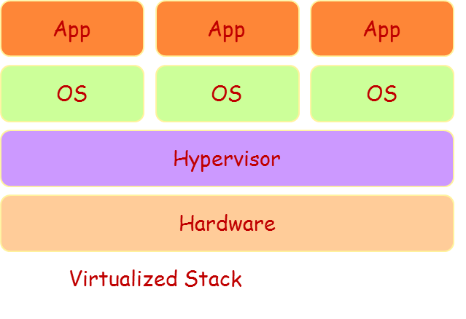
Virtualization 2
Virtualization technologies allow multiple virtual machines, with heterogeneous operating systems to run side by side and in isolation on the same physical machine.

Slide 40
Virtualization 3
Implement on Virtual Machines (VMs):
Abstraction of a physical host machine,
Hypervisor intercepts and emulates instructions from VMs, and allows management of VMs,
VMWare, Xen, etc.
Provide infrastructure API:
Plug-ins to hardware/support structures
App
App
App
OS
OS
OS
Hypervisor
Hardware
Virtualized Stack

Slide 41
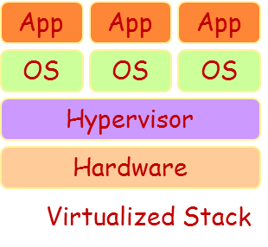
Virtualization Machine Monitor (Hypervisor?)
VMM virtualizes certain hardware resources, such as the CPU, memory, and physical disk, and creates emulated devices for virtual machines running on the host machine.
A VMM:
Resides as a layer below the operating system
Presents a hardware interface to an OS
Multiplexes resources between several virtual machines (VMs)
Performance Isolates VMs from each other

Slide 42
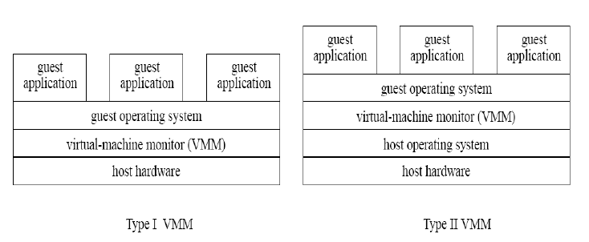
VMM Types
Native, or bare metal hypervisors
Hosted hypervisors
Oracle VM Server for x86,
Citrix XenServer,
VMware ESX/ESXi,
Microsoft Hyper-V hypervisor.
KVM, VMware Workstation
From: Virtual Machine Monitors, Marc E. Fiuczynski, Princeton University, 2009

Slide 43
Virtual Machines
VM technology allows multiple virtual machines to run on a single physical machine.
App
App
App
App
App
Xen
Guest OS
(Linux)
Guest OS
(NetBSD)
Guest OS
(Windows)
VMWare
VM
VM
VM
Virtual Machine Monitor (VMM) / Hypervisor
UML
Denali
Hardware
etc.
Performance: Para-virtualization (e.g. Xen) is very close to raw physical performance!

Slide 44
Advantages of virtual machines
Run operating systems where the physical hardware is unavailable,
Easier to create new machines, backup machines, etc.,
Software testing using “clean” installs of operating systems and software,
Emulate more machines than are physically available,
Timeshare lightly loaded systems on one host,
Debug problems (suspend and resume the problem machine),
Easy migration of virtual machines (shutdown needed or not).
Run legacy systems!

Slide 45
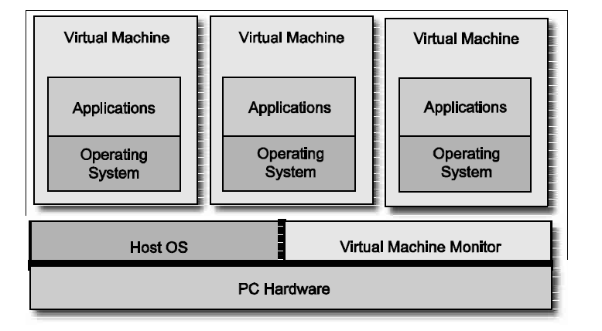
Virtual Machine Monitor -
A VMM is the software solution that implements virtualization to run in conjunction with the host operating system.
VMM virtualizes certain hardware resources, such as the CPU, memory, and physical disk, and creates emulated devices for virtual machines running on the host machine.
VMM determines how resources should be allocated, virtualized, and presented to the virtual machines running on the host computer.
From: An Introduction to Virtualization, Sean Campbell and Michael Jeronimo, Intel.

Slide 46
Hypervisors
A hypervisor runs directly on the physical hardware without any help from the host operating system to provide access to hardware resources.
The hypervisor is responsible for hosting and managing
virtual machines running on the host machine.
From: An Introduction to Virtualization, Sean Campbell and Michael Jeronimo, Intel.

Slide 47
(Some) Research Issues
Modified from Mark Baker

Slide 48
For Cloud Providers 1
Admission Control
VM deployment (Where to deploy a VM)
Resource Management
VM migration
Determine the best live migration strategy to minimize impact on performance
Exploiting Workload Dissimilarity

Slide 49
For Cloud Providers 2
CPU Consumption Estimation
Performance Management
Workload Consolidation
Energy Management
Energy Efficient Geographical Load Balancing
VM Consolidation

Slide 50
For Cloud Providers 3
Need for techniques to:
Define realistic SLAs
Optimal dimensioning of data centers,
Whether to accept new clients
Determine amount of resources to be reserved for high priority clients
VM Offerings
fixed price-based
auction-based VMs (Amazon EC2 spot instances)

Slide 51
For Cloud Users
Security
Privacy
Querying Encrypted Data on the Cloud
Economic Models
Spot instances: Optimal bidding strategy
Energy-as-a-Service for smartphones
Offloading heavy tasks to the cloud
Pay for more cloud resources or pay penalties for violated SLAs?

