Slide 1


VISVESVARAYA
TECHNOLOGICAL UNIVERSITY
JNANA SANGAMA, BELAGAVI - 590 018
Department of Mechanical and Robotics Engineering
Project Proposal Presentation on
“Advanced underwater detection”
By
Student Name | USN
Charan Raj B H | 4SF21RA009
Nithesh Shetty | 4SF21RA027
Shreenidhi D K | 4SF21CS152
Shreesha P Naik | 4SF21CS153
Under the Guidance of
Mr. Suhas P
Assistant Professor,
Department of Mechanical Engineering
2024-25
Notes:
ASDSJDBSD

Slide 2

Project Objectives
To build a device that can obtain the bathometric data from a river bed.
To create a sonar image of the river.
To develop an algorithm for detecting human traces in the river bed in real time.
To design a device modular to make it easy to go.

Slide 3
Background of the Project
Technical Field
Sector: Robotics for Disaster Management
The retrieval of the dead body is been done with the still old conventional method.
The conventional method that is been followed to solve a given problem is very time consuming.
The divers are getting into the high current flooded-river which is risky for them.
There are large amount of human resources and the money will be invested on every retrieval operations which is very inefficient.

Slide 4
Background of the Project (Contd..)
Background Research
Literature review(10) - Google Sheets

Slide 5
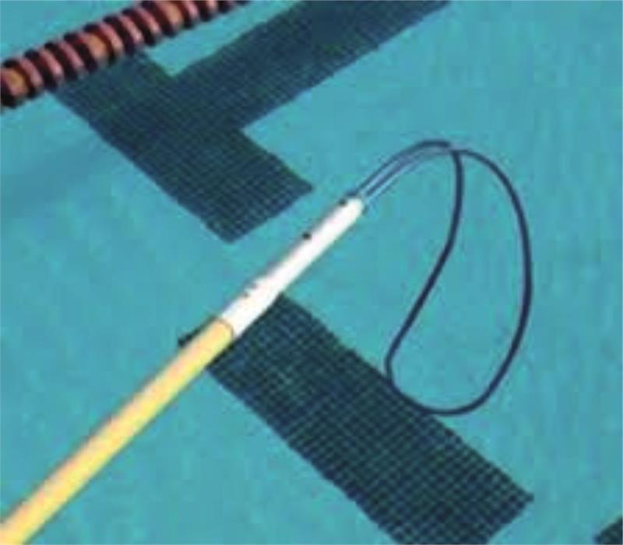
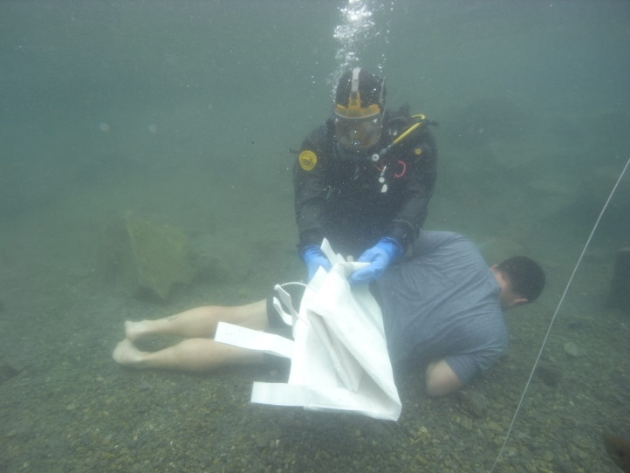
Background of the Project (Contd..)
State of the art solutions
The currently available solution for dead body retrieval involves the use of the grappler which is dragged along the river portions.
In some rare instances they employ divers who search for the dead body in the flooded high current river.
Both of these methods are employed in the downstream of the river till miles away..

Slide 6
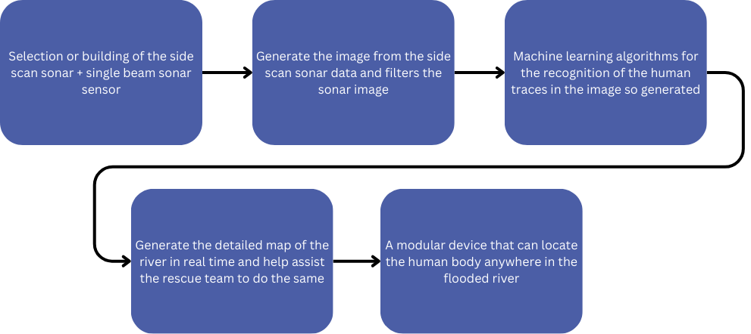
Background of the Project (Contd..)
Research and Development Methodology
The project had initially conducted stakeholder interview at different fire stations like Pandeshwara, Bantwal, Puttur, etc.
The team also visited the forensic doctors, etc.
The team conducted the literature survey as well and we are writing our review paper currently.

Slide 7
Background of the Project (Contd..)
References
[1] Z. Chen, Z. Zhang, F. Dai, Y. Bu, and H. Wang, “Monocular vision-based underwater object detection,” Sensors (Switzerland), vol. 17, no. 8, Aug. 2017, doi: 10.3390/s17081784.
[2] B. Kim and S.-C. Yu, “Imaging sonar based real-time underwater object detection utilizing AdaBoost method.”
[3] 2018 26th Signal Processing and Communications Applications Conference (SIU). IEEE, 2018.
[4] 2018 26th Signal Processing and Communications Applications Conference (SIU). IEEE, 2018.
[5] H. T. Nguyen, E. H. Lee, and S. Lee, “Study on the classification performance of underwater sonar image classification based on convolutional neural networks for detecting a submerged human body,” Sensors (Switzerland), vol. 20, no. 1, Jan. 2020, doi: 10.3390/s20010094.
[6] A. Unnikrishnan, A. T. Roshni, P. R. Anusha, A. M. Vinny, and C. K. Anuraj, “Identification of Drowning Victims in Freshwater Bodies using Drift Prediction and Image Processing based on Deep Learning,” in 10th International Conference on Advances in Computing and Communications, ICACC 2021, Institute of Electrical and Electronics Engineers Inc., 2021. doi: 10.1109/ICACC-202152719.2021.9708245.
[7] J. R. P. Gonzalez et al., “Hydroinformatic tools and their potential in the search for missing persons in rivers,” Forensic Sci Int, vol. 341, p. 111478, 2022, doi: https://doi.org/10.1016/j.forsciint.2022.111478.
[8] L. Dennison-Wilkins, L. Hackman, and M. Hayatdavoodi, “The Body Recovery From Water Study: The application of science to missing person search,” Policing (Oxford), vol. 17, 2023, doi: 10.1093/police/paad037.
[9] S. Chun, C. Kawamura, K. Ohkuma, and T. Maki, “3D Detection and Tracking of a Moving Object by an Autonomous Underwater Vehicle With a Multibeam Imaging Sonar: Toward Continuous Observation of Marine Life,” IEEE Robot Autom Lett, vol. 9, no. 4, pp. 3037–3044, Apr. 2024, doi: 10.1109/LRA.2024.3364470.
[10] Y. S1; K, “Autonomous Utility Vehicle (Auvs) Based Emergency Human Drowning Detection System Using Sonar and Thermal Detection Methods,” 2024.

Slide 8
Thank You

