Slide 1

A voice-first AI assistant that makes technology work for older adults, and keeps them in control
MHACKS 26
Notes:
EWOK is a voice-first assistant for older adults. It simplifies email, banking, health records and the computer itself, while keeping the older person in charge of every decision that matters.

Slide 2
Build for the hardest user, and you reach a billion
WHY OLDER ADULTS
AI for a billion users won't come from one more app. It comes from AI that works for someone who won't install one: slow speech, long pauses, low confidence, and the first target for scammers.
1B+
2.1B
$3.4B
people aged 60+ worldwide today (WHO)
people aged 60+ by 2050 (WHO)
lost to fraud by Americans 60+ in 2023 (FBI)
The curb-cut effect: what works for a grandparent on a landline works for anyone with an accent, a noisy line or no smartphone.

Slide 3



The people who could benefit most are served least
THE PROBLEM
Tech keeps getting harder
Scammers target older adults
Assistants assume a fast talker
Email, banking, appointments and patient portals each bring their own logins, menus and jargon.
Urgent calls, gift-card demands and fake bank emails are aimed squarely at this group.
Most expect quick speech, clean audio, an app install and confidence with technology.
Notes:
Technology is getting more complicated, older adults are the most heavily targeted group for scams, and mainstream assistants assume fast speech and tech confidence. The people who would benefit most from an assistant are the ones least served by today's assistants.

Slide 4




The older adult is the principal
OUR USERS
EWOK serves their goals, even when a family member sets it up. No infantilizing defaults; settings they can see and change.
Slow speech, long pauses, accents
Hearing aids and low vision
We design for
Every design choice that follows comes from these four realities.
Low technical confidence
Won't install an app
Notes:
Our users are older adults, and they are the principal. Even if a son or daughter sets EWOK up, the agent works for the older person. We design for slow speech, hearing and vision loss, low confidence with technology, and people who simply won't install an app.

Slide 5


Talk to EWOK like a person. It handles the rest.
THE SOLUTION
Phone call
Voice in the browser
Web chat
Dashboard
A Vapi number. No app, no install. Just dial.
ElevenLabs speech-to-text and text-to-speech, push to talk.
A large-text alternative to voice, first-class.
Everything EWOK knows, in one place the person can read.
Every channel reaches the same agent, the same memory and the same rules.
Notes:
You talk to EWOK like a person. Call it on a regular phone number, talk to it in the browser, or type in a large-text chat. Behind every channel is one agent with one memory and one set of rules.

Slide 6
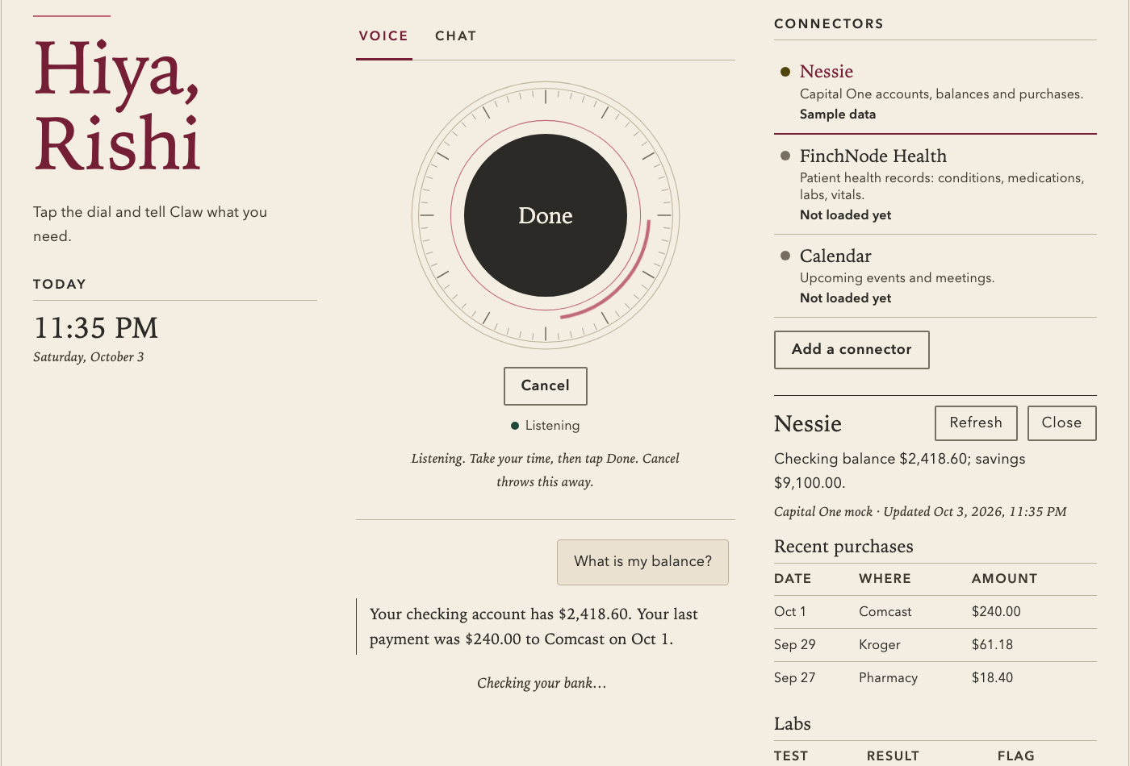
Built for the older adult, not a caregiver console
THE DASHBOARD
Greeting and clock
"Hiya, Rishi" with the time and date for orientation.
Voice dial
Tap, speak at your own pace, tap Done. Cancel throws it away.
Connectors
Bank, health and calendar panels open beside the conversation.
Labeled sample data
Mock data is marked as mock, never presented as real.
Notes:
This is the dashboard. It greets the person by name and shows the time and date. The voice dial lets them speak at their own pace. Connectors open next to the conversation, and sample data is clearly labeled. The design targets WCAG 2.2 AAA: 7 to 1 text contrast and enlarged targets, in light and dark mode.

Slide 7



Patient by design
ACCESSIBILITY
Speak, don't type
Large text and AAA contrast
Voice on every channel, including a plain phone call. Streaming speech in and out for quick replies.
Large-text chat is a first-class alternative. Design target: WCAG 2.2 AAA, 7:1 contrast.
Silence never feels like failure
Memory that restates context
Spoken fillers like "One moment." and turn-taking tuned for slow speech and long pauses.
"Last time we were scheduling your eye appointment..." Viewable, correctable, deletable.
One thing at a time
English-only speech recognition and synthesis keep accents from drifting into other languages.
One simple question when unsure, never five options. "Stop" and "undo" work instantly.
Notes:
Accessibility is the core of the product. Voice works on every channel. Spoken fillers mean silence never feels like the system broke. EWOK asks one simple question at a time, and stop and undo work instantly. Large text is a real alternative, and memory gently restates context rather than assuming the person remembers.

Slide 8
Friction where it matters, nowhere else
SAFETY IS ACCESSIBILITY
STATE THE CONSEQUENCE
“This pays $240 to Comcast from your checking account tomorrow.”
STRONG
Money, identity, personal info
LIGHT
Reversible, low-stakes actions
Caps, allowlists, cooling-off and a concrete confirmation.
FREE
Reading and reminders
A quick spoken "yes" first.
Not "Approve action?" Heavy prompts are saved for what matters, so confirmation fatigue doesn't set in.
Notes:
Safety is an accessibility feature: trust is what makes people willing to use it. Reading and reminders are free. Reversible actions get a light yes. Anything touching money, identity or personal information gets strong friction, and the confirmation says exactly what will happen, in plain language.

Slide 9
Rules the model can't talk its way around
THE POLICY LAYER
Policy lives in our backend, outside the model. Every tool call passes through it, and the tier is attached to the tool, not inferred by the model.
$500
$1,000
24 hrs
0
cap on any single payment
daily spending cap
cooling-off for a new payee
tools that can share a password or SSN
Plus a payee allowlist and single-use confirmation tokens. Passwords are safe by absence of capability.
Notes:
This is our main technical claim. The policy layer lives outside the model, so a clever conversation or a prompt-injected email cannot talk it out of its rules. Payments are capped at $500 each and $1,000 a day, new payees wait 24 hours, payees must be allowlisted, confirmation tokens are single-use, and there is simply no tool that can share a password or Social Security number.

Slide 10

A trusted second opinion
SCAM PROTECTION
All inbound email, text and web content is untrusted. Prompt injection is just a scam aimed at the agent.
“This looks like it could be a scam. Want me to read it, or flag it to your family?”
Urgency and pressure
Gift cards and wire transfers
"Don't tell your family"
Oversight without taking control
Credential requests
Rate-limited trusted-contact notifications
Full transcript and tool-call audit log
Autonomy settings the person can see and change
Impersonation
Notes:
Everything EWOK reads is treated as untrusted. A rules-based classifier flags the classic scam patterns, and EWOK says so plainly. Forwarding anything suspicious to EWOK becomes a habit. Family can be notified, but they don't take control away from the person.

Slide 11









EWOK drives the screen, with the brakes built in
COMPUTER USE
Every click, keystroke and page EWOK opens goes through a check that lives outside the model.
1 Propose
2 Check
3 Act aloud
4 Verify and log
The model asks to click, type or open a page.
Outside the model: is the site allowed, is the screen sensitive, does this click have consequences?
EWOK says what it's doing: "Opening your inbox now."
A fresh screenshot confirms the result. Every step lands in the audit log.
IN PLACE TODAY
One-switch off
Localhost only
OS permission
Bounded moves
CLAW_COMPUTER_USE=0
Gateway never faces the internet
macOS must grant screen + input access
Clicks clamped to the screen; waits and scrolls capped
Notes:
Computer use is the most powerful thing EWOK does, so it gets the most care. The model only proposes actions. A check outside the model decides whether each one runs, EWOK narrates what it's doing out loud, and a fresh screenshot verifies the result and goes in the audit log. Today the tool can be switched off with one setting, the gateway is localhost only, macOS has to grant permission, and every move is clamped to the screen. The check step is the design we're building toward.

Slide 12





Six rules for an agent at someone's computer
SAFEGUARDS WE'RE ADDING
Hands off at passwords
The screen is untrusted
On a password, card or SSN field, EWOK stops and says "You type this part, I'll wait." Those screenshots are never stored.
A pop-up saying "Call Microsoft now" is data, not an order. It gets scam-checked like any email.
Consequential clicks confirmed
Sites on a list
Send, Buy, Submit and Delete need a spoken yes: "This sends the email to Dr. Patel's office."
The browser opens the person's own sites. A new site needs a yes; known scam domains are blocked.
A step budget
"Stop" always wins
A cap on actions per task. After three failed tries, EWOK stops and asks one simple question.
Saying stop, or flinging the mouse to a corner, halts everything instantly.
Plus: a separate browser profile with no saved passwords, and the shell tool switched off in EWOK's everyday mode.
Notes:
These are the safeguards we're adding on top. EWOK never handles passwords or card numbers: it pauses and lets the person type. Anything on screen is treated like an untrusted email, so a fake tech-support pop-up gets flagged instead of obeyed. Clicks with consequences need a spoken confirmation that says exactly what will happen. The browser sticks to the person's own sites, every task has a step budget, and stop always wins. The mouse-to-corner abort already works today.

Slide 13




Ask by voice, and the right panel opens
CONNECTORS
Nessie
FinchNode Health
Calendar
Add a connector
Accounts, balances, recent purchases
Conditions, medications, labs, vitals, appointments
Upcoming events
More can be added. Suggest one.
Say "nessie"
Say "health"
Say "calendar"
Combined: "How much do my medications cost me?" pulls from health records and banking together.
Nessie (Capital One mock bank) and FinchNode (synthetic patient records) are sample data and are labeled that way in the UI.
Notes:
Connectors bring in the person's data. Nessie is a mock bank, FinchNode is synthetic health records, and there's a calendar. Ask by voice and the matching panel opens beside the conversation. EWOK can also combine them, for example to work out what medications cost.

Slide 14





What a day with EWOK looks like
USE CASES
Medications
Understanding money
Appointments
"What am I on, and when's my next refill?" Then a reminder, set by voice.
"Did I pay for Netflix this month?" Read back in plain English.
"What's on my calendar this week?" Read aloud, with reminders.
Scam second opinion
Email and the computer
Reminders and routines
Forward a suspicious email. EWOK explains the red flags.
"Open my email." EWOK drives the desktop and browser for them.
"Remind me to take my pills at 8." Automations run on their own.
Notes:
Six things EWOK does today: medications, money, appointments, a scam second opinion, operating email and the computer, and reminders that run on a schedule. Family can be notified for scam flags or after high-stakes actions.

Slide 15
Six layers, with policy outside the model
HOW IT WORKS
Interface
Vapi phone, ElevenLabs voice, web chat, dashboard
THE STACK
Python gateway (src/claw): Pydantic AI, FastAPI WebSockets, OpenClaw-style req/res/event frames
Node/TypeScript ElevenLabs agent with server-side tool webhooks
SpacetimeDB for atomic job claims across gateways
Host computer-use tool for screenshots, mouse and keyboard
Agent
Python WebSocket gateway on Pydantic AI, with sessions, memory and tools
Policy
Permission tiers, caps, allowlists, scam checks. Enforced server-side
Tools
Narrow, single-purpose, with scoped credentials the agent never holds
Memory
Routines, medications, people, preferences. Owned and editable by the person
118 automated tests across 16 suites
Oversight
Audit log and rate-limited trusted-contact notifications
Notes:
Architecturally there are six layers. The interface handles voice and screens. The agent is a Pydantic AI gateway. The policy layer sits between the agent and every tool, outside the model. Tools are narrow and hold their own scoped credentials. Memory is a store the person owns, and oversight covers the audit log and family notifications.

Slide 16




We built the harness from scratch
OUR BIGGEST CHALLENGE
No fork of OpenClaw. Pydantic AI runs the agent loop (typed deps, tools, streaming events) with Harness capabilities for the workspace and computer use. The control plane we re-derived by hand.
THE PROTOCOL
connect
req/res/event
agent → runId
agent.wait
Handshake opens the WebSocket session
Every message is one of three frame types
A turn is accepted at once and gets an id
Callers block until that run finishes
THE RUNTIME
Session lanes and queue modes
MEMORY.md bootstrap
Automations that fire
followup, collect, interrupt, steer
Persona and long-term memory, every turn
Cron jobs the gateway actually runs
Compatible feel, not a clone: no protocol v4, no messaging-platform identity. Every time we thought "OpenClaw already does this," we chose: copy the idea, or the implementation?
Notes:
Our biggest challenge was building the harness from scratch instead of forking OpenClaw. The agent loop is Pydantic AI, but we re-derived the control plane ourselves: the connect handshake, request, response and event frames, accepting a turn immediately with a run id, agent.wait, per-session lanes and queue modes, the MEMORY.md bootstrap, and automations the gateway actually fires. It feels compatible with OpenClaw, but it isn't a clone, and every time we had to decide whether to copy the idea or the implementation.

Slide 17


A smaller harness is a safer harness
WHY NOT FORK
Forking a hands-off harness
EWOK's own harness
The agent can write new skills for itself
A fixed set of tools we wrote and reviewed
Third-party skills from the internet, each one a possible hole
No skill marketplace. Every tool sits behind the policy layer
The interface grows and shifts as the agent does
The same interface every day, so routines hold
Fully hands-off autonomy
The person approves anything that matters
For someone who isn't technical, every new capability is one more thing to vet and one more thing to learn.
Notes:
We built our own harness mostly because of the safeguards needed when a non-technical person has an AI agent helping run their life. A fully hands-off harness lets the agent build new skills, which adds vulnerabilities, and an interface that keeps changing confuses people who rely on routine. Third-party skills mean vetting a potentially endless supply of code from the internet, which no older adult can be expected to judge. So EWOK has a fixed, reviewed set of tools, all behind the policy layer, and an interface that stays the same.

Slide 18


Honest about what's built
WHERE WE ARE
Built
Still to do
Voice, phone and web chat
Dashboard with connectors
Inspectable memory
Scam flagging
Policy layer: tiers, caps, allowlist, tokens
Scheduled automations and reminders
Real payment processing
SMS channel
A dedicated large-text companion view
Computer-use safety checks and site list
Testing with real users
Notes:
To be clear about where we are: the voice, chat, dashboard, connectors, memory, scam flagging and policy layer are built. Bank and health data are mock and synthetic. Real payments, SMS and a dedicated large-text view are still to come, and we haven't tested with real users yet, so we make no usage claims.

Slide 19
Technology should adapt to people, not the other way around
A PATIENT VOICE · A CLEAR SCREEN · GUARDRAILS THAT KEEP THEM IN CHARGE
Notes:
EWOK gives older adults a patient voice, a clear screen, and guardrails that keep them in charge. Thank you.

