Slide 1

ollUpJS NextGen Module Bundler

Slide 2
What is Rollup.js
A module bundler for JavaScript compiles small pieces of code into larger, more complex modules or packages.
Efficiently bundles your code for production, optimizing performance and reduce file size.

Slide 3
Key Features
Support different output format: ES modules, AMD, IIFE, CommonJS, UMD, SystemJS.
Tree-shaking: Removes dead code based on deep execution path analysis.
Code splitting: Splits code into chunks automatically, like dynamic loading or multiple entry points.
Plugins: Code injections and transformation with little code, also adopted by VITE and WMR
Bundler behind VITE: Preconfigure rollup with sensible defaults and plugins

Slide 4
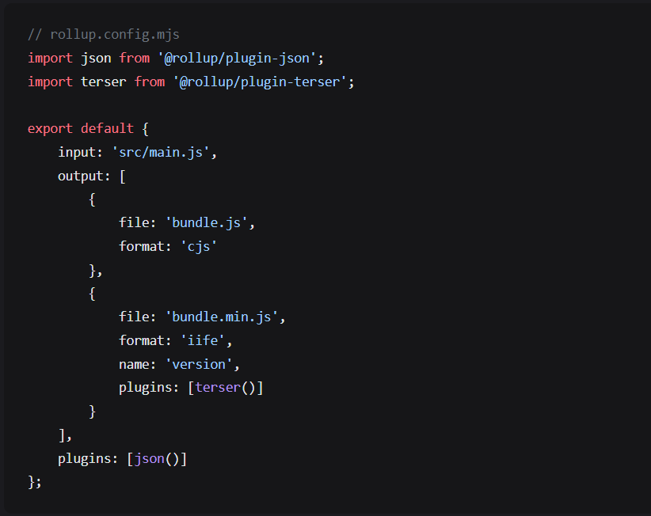

Get Started
https://github.com/rollup/rollup-starter-app

Slide 5
What’s next
Hands-on session we can develop together some cool library
Interested one can Join me or suggestions to execute in better way

