Slide 1

Machine Learning Hackathon Loan Default Analysis

Slide 2
Data Exploration
Visualize
missing Values
Correlation

Slide 3
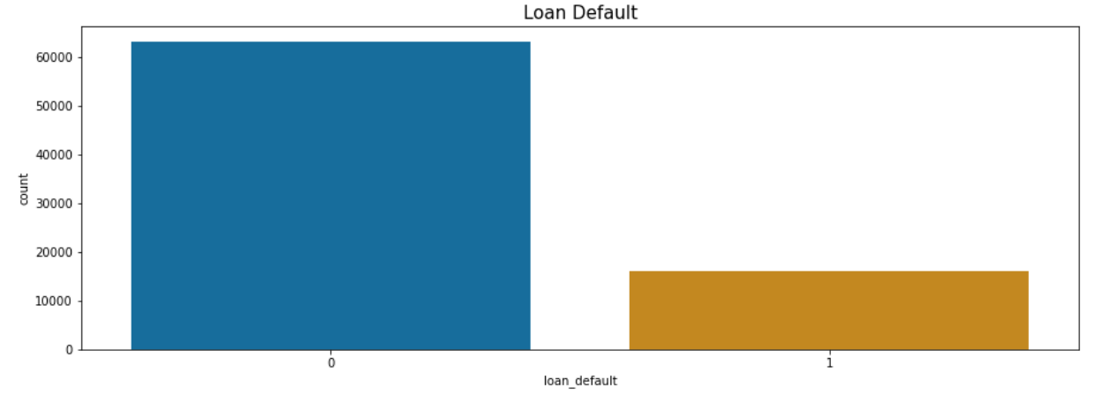
~ 20 % of Loans Default

Slide 4
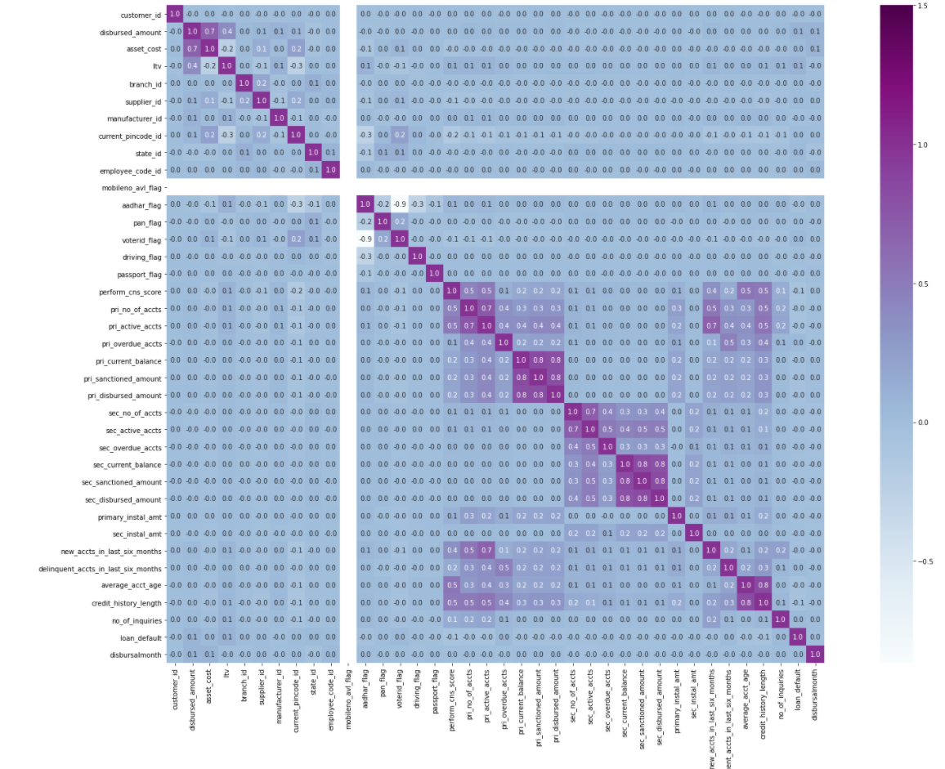
Correlation between all features

Slide 5
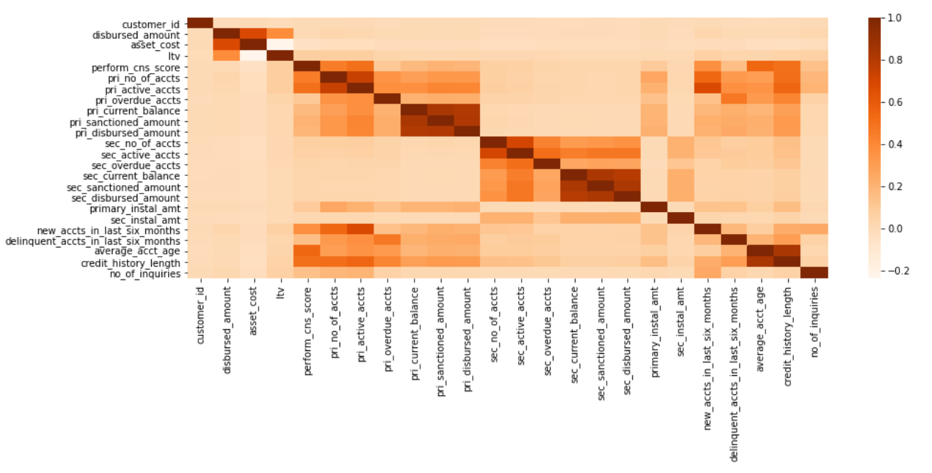
Correlation between Numerical Features

Slide 6
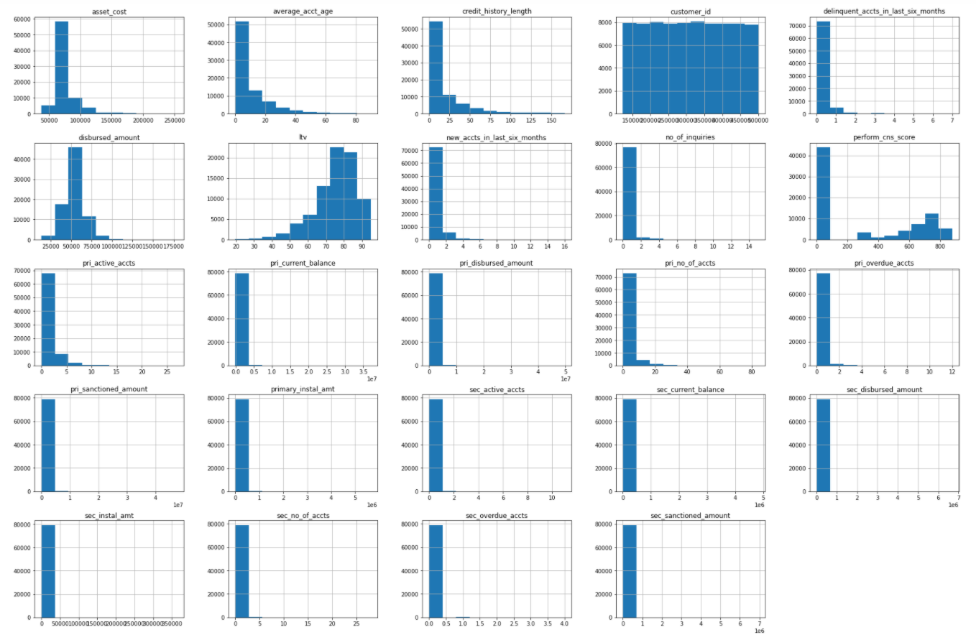
Numerical Feature Distribution

Slide 7
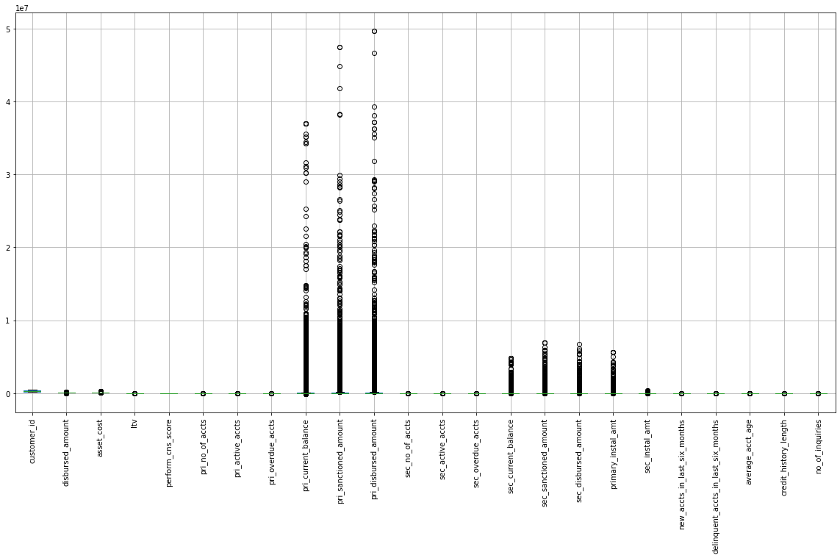
Outlier Analysis for numerical data

Slide 8
Unique data for categories
Categorical Feature | Unique Values
date_of_birth | 292
disbursaldate | 82
perform_cns_score_description | 19
branch_id | 158
supplier_id | 9129
manufacturer_id | 9
current_pincode_id | 6926
state_id | 22
employee_code_id | 3759
mobileno_avl_flag | 1
aadhar_flag | 2
pan_flag | 2
voterid_flag | 2
driving_flag | 2
passport_flag | 2

Slide 9
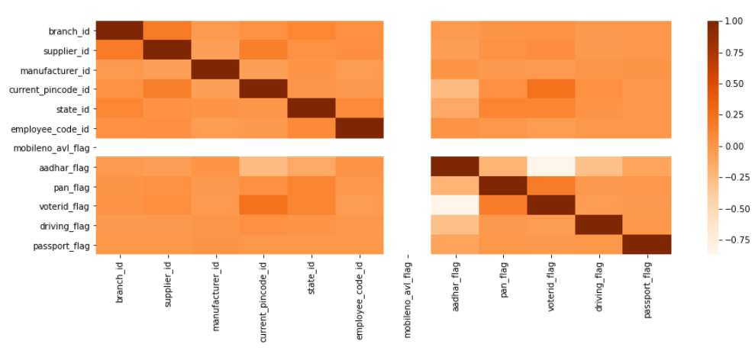
Correlation between Categorical Features

Slide 10
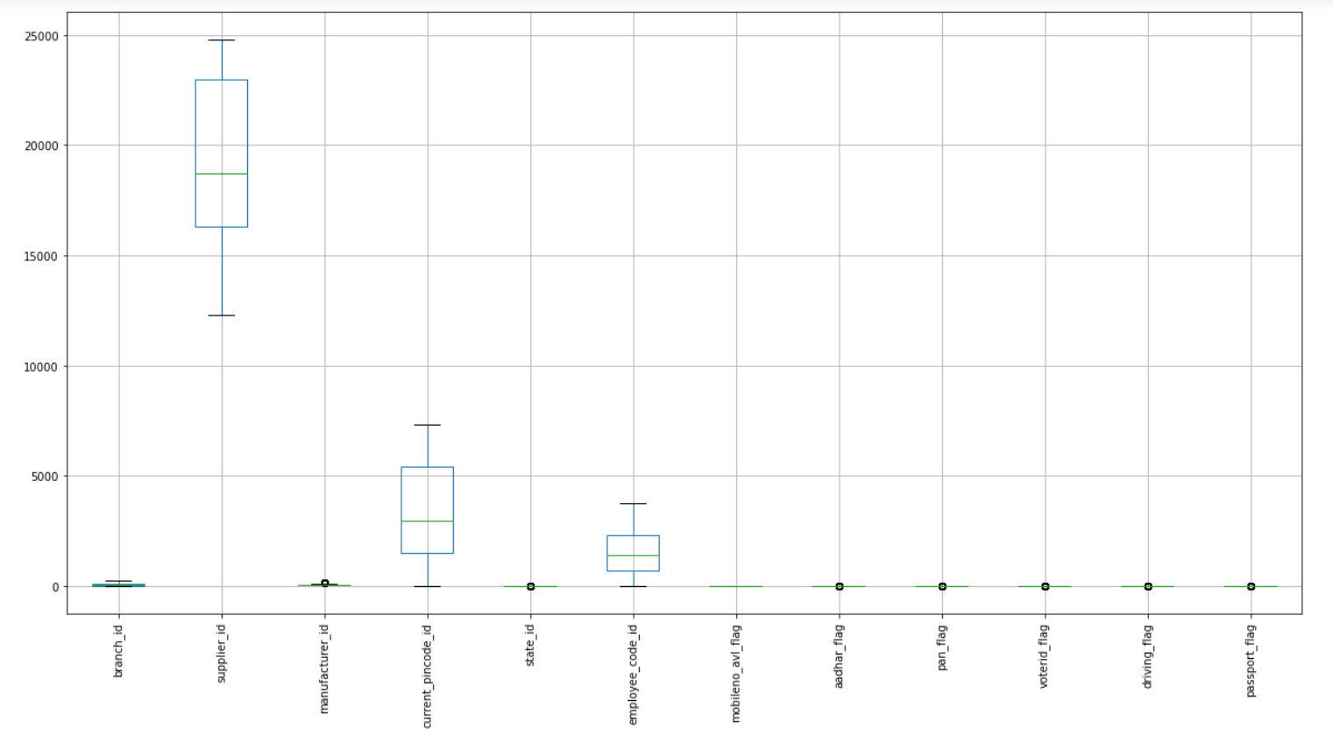
Outlier Analysis for categorical data

Slide 11
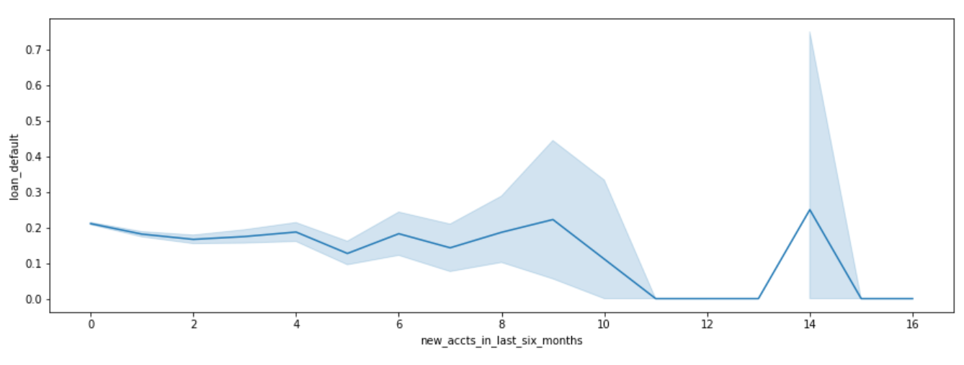
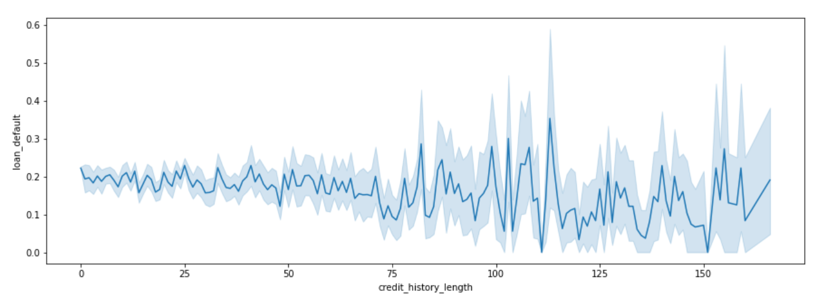
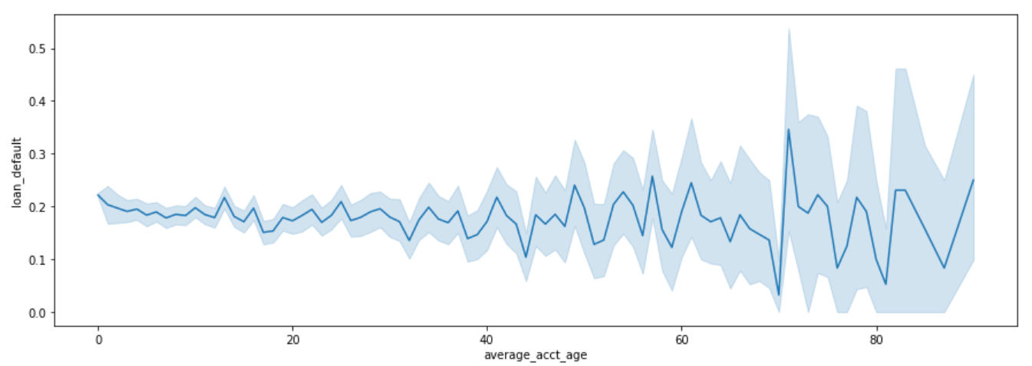
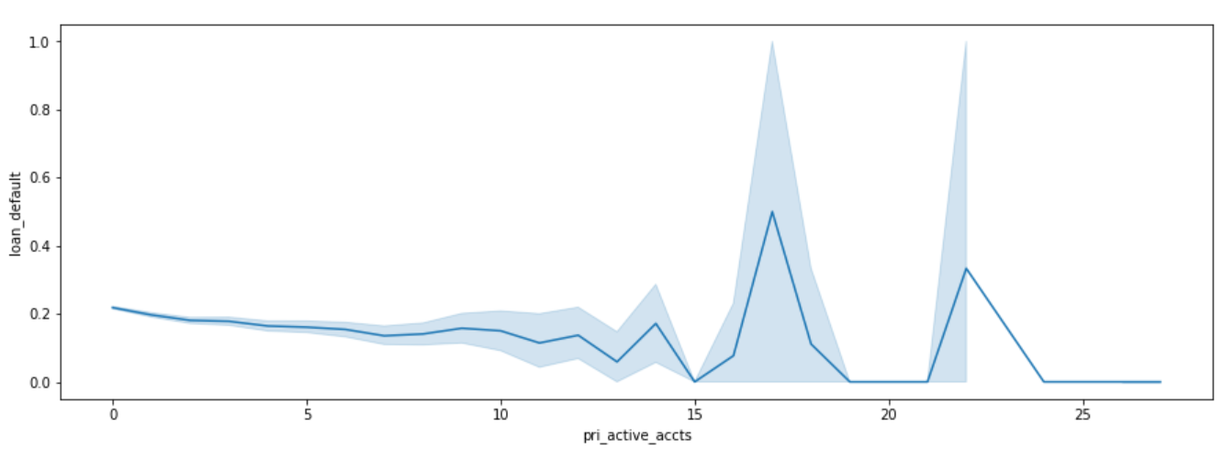
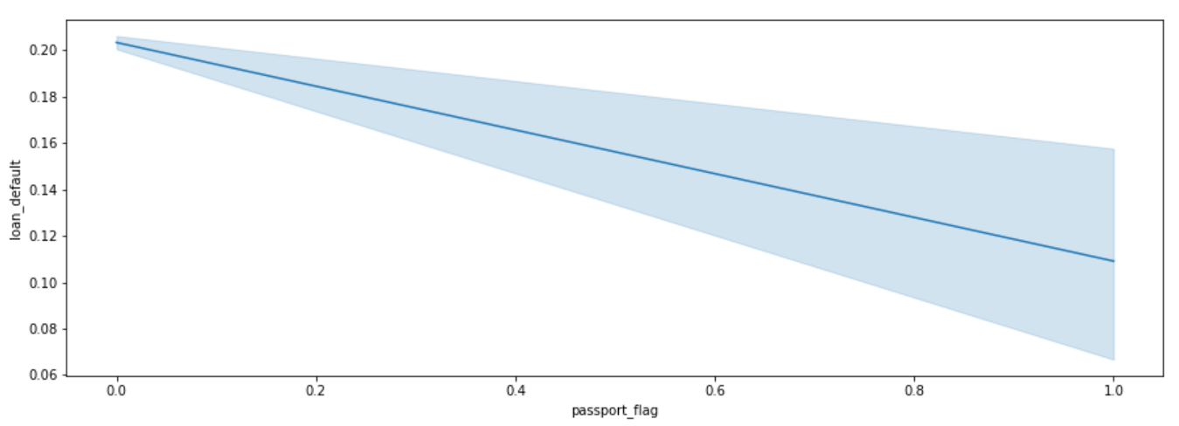
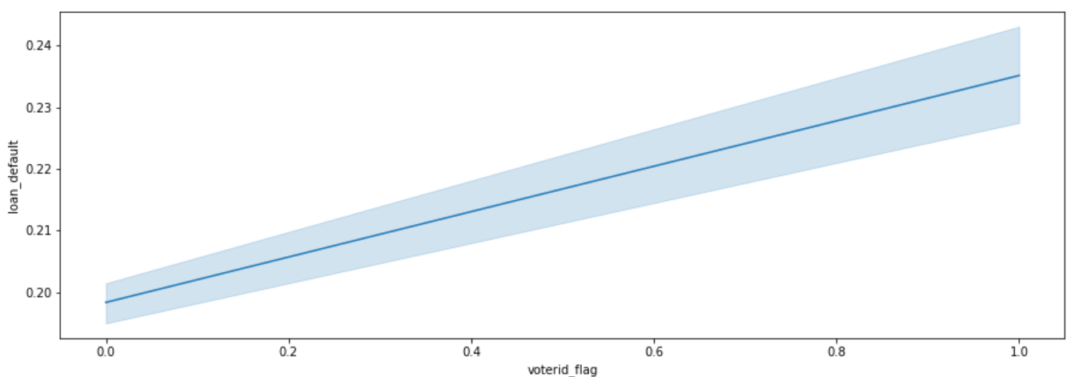
Metrics having strong relation with loan defaults

Slide 12
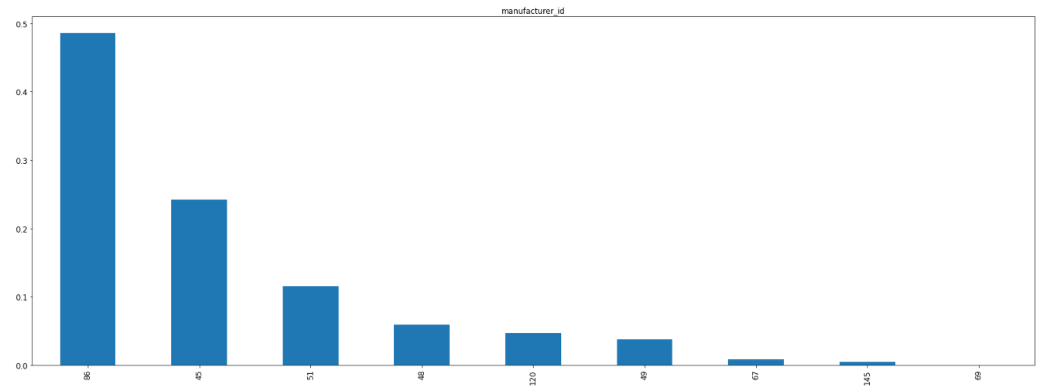
Manufacturer wise Loans % - 48% loans from one manufacturer

Slide 13
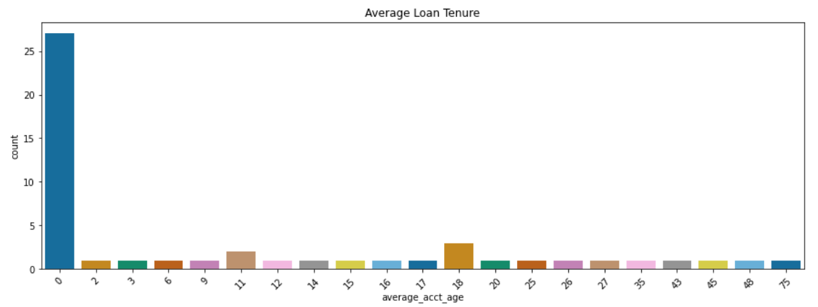
More than 25% of the loans are under 2 years

Slide 14
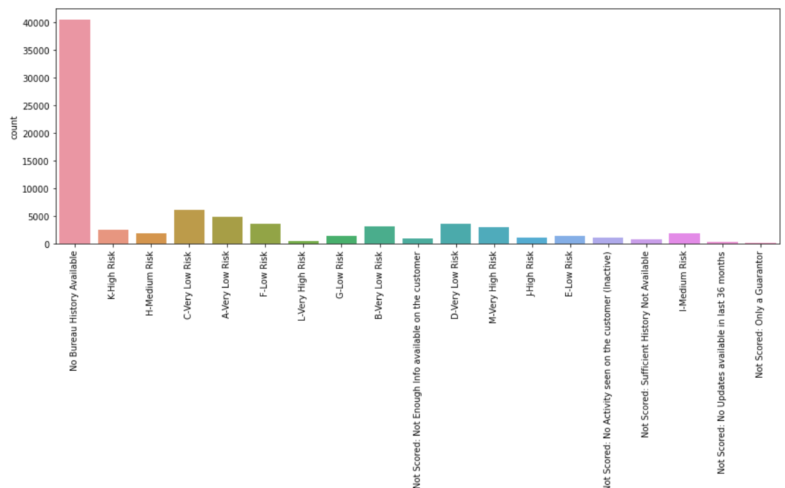
No Credit history available for majority of the loans

Slide 15
Data Cleaning and Processing
Missing Data in the following fields
Date of Birth (67.2%) – Too many missing data, the column was dropped
Employment Type (3.68%) – Created a new category called Not Available / Unemployed
Disbursal Date (0.03%) – Small set of data, imputed most frequent values
CNS Score Description (0.008%) – Small set of data, imputed most frequent values
Combined Data of categories for CNS Score Description to consolidate the categories
Not Scored
Very Low Risk
Low Risk
Medium Risk
High Risk
Very High Risk
Combined Primary and Secondary Account Details
Extracted features from Disbursal Date – Year, Month, Day of Month, Day of the week, Week

Slide 16
Model Building
One Hot Encoding for Employment Type
Label Encoding for CNS Score Description
Scaling the numerical variables using standard scalar
Identifying the significant variables using Stats model API
asset_cost, ltv, manufacturer_id, current_pincode_id, state_id, aadhar_flag, passport_flag, perform_cns_score, perform_cns_score_description, delinquent_accts_in_last_six_months, credit_history_length, no_of_inquiries, no_of_accounts, day_of_month, active_accts, overdue_accts, current_balance
Ran multiple algorithms with multiple parameter set to finalize the best model:
Model Name: Random Forrest Classifier
Max Depth = 15
Threshold = 0.19
Number of Estimators = 500

Slide 17
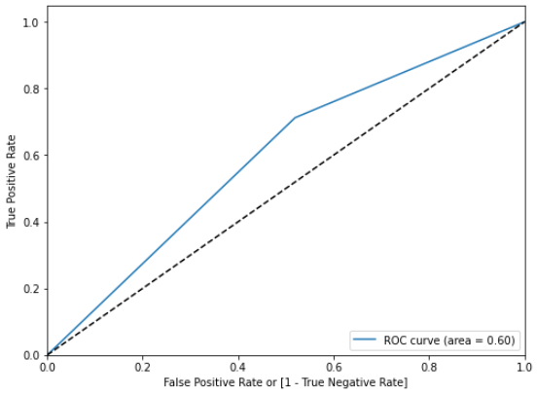
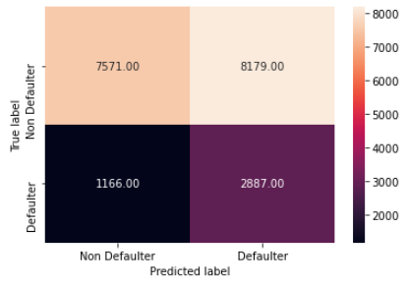
Results
Loan Default | Precision | Recall | f1-score | Support
0 | 0.87 | 0.48 | 0.62 | 15750
1 | 0.26 | 0.71 | 0.38 | 4053
Accuracy |  |  | 0.53 | 19803
Macro Avg | 0.56 | 0.6 | 0.5 | 19803
Weighted avg | 0.74 | 0.53 | 0.57 | 19803

