Slide 1
Finding the relationship between
functional brain connectivity
and behavior scores in ADHD

Slide 2
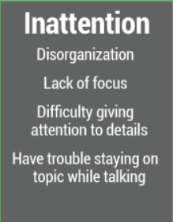

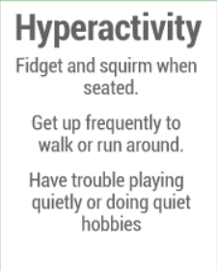
Previous studies & Motivation
Heterogeneous symptoms Diverse comorbid conditions
•Intellectual Disability
•Language Disorder
•Anxiety Disorders
(including specific phobia, social phobia, OCD)
•Major Depressive Disorder/Dysthymia
•Disruptive Behavior Disorder
•Oppositional Defiant Disorder
•Tic Disorder……
∴ Non-converging
brain-imaging study results
Notes:
ADHD는 부주의와 충동성으로 대표되는 질환이지만 이외에도 다른 comorbid가 보여지는 이질적인 증상을 보이는 mental disorder이다.

Slide 3
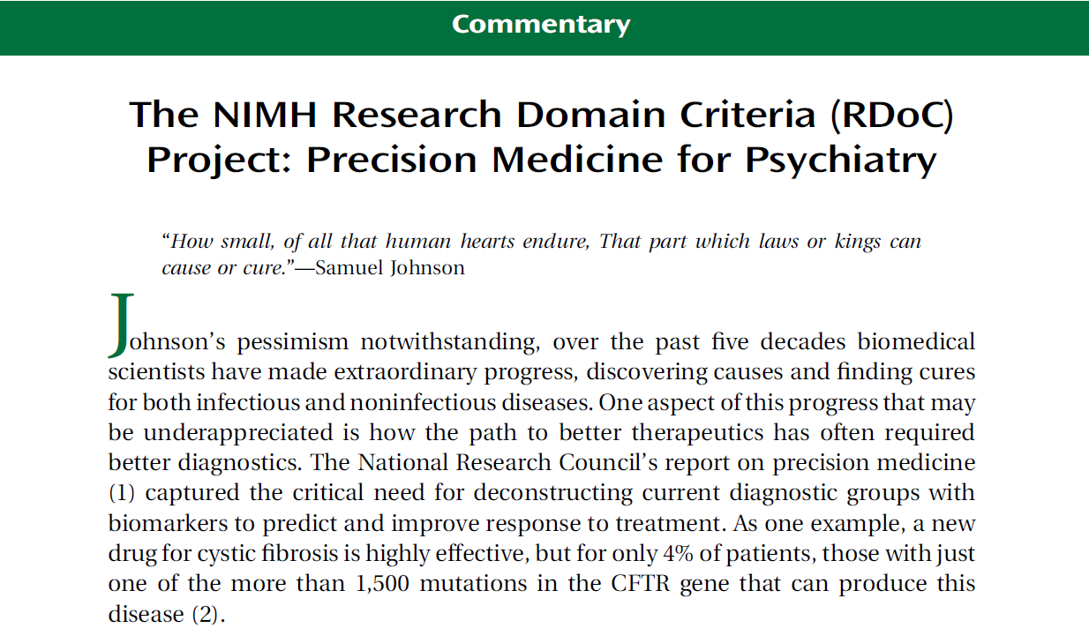

⇒ Dimensional perspective rather than categorical
Notes:
NIMH에서 이야기하는 RDoC에 따라 categorical 관점보다는 Dimensional한 관점으로 볼 수 있음

Slide 4
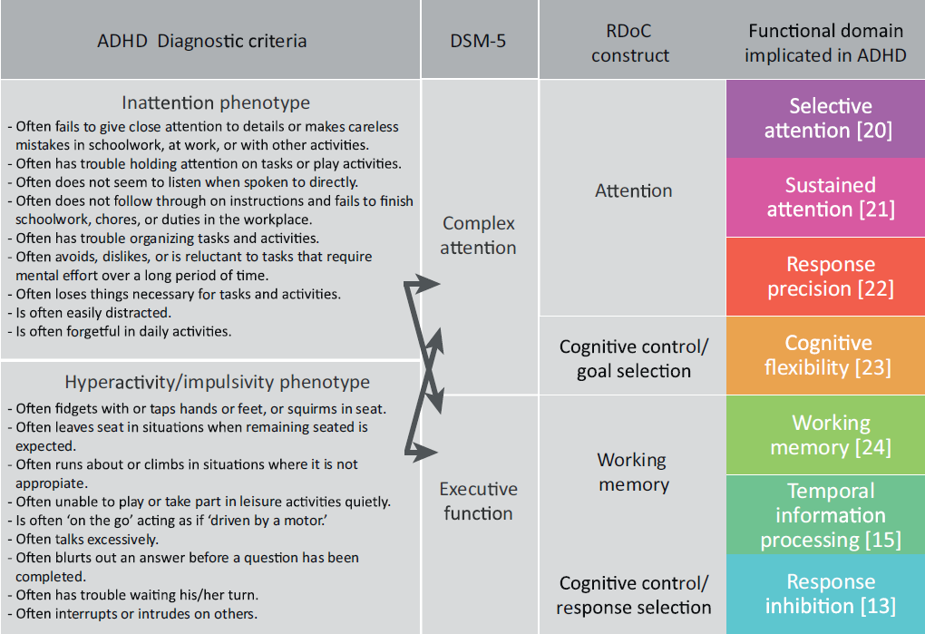
부주의
Cognitive tasks
- Go-no go
- CPT
- Stroop
- Trail making test
…..
충동성
Adrienne Mueller et al., Trends in Cognitive Sciences (2017)
Notes:
Dimensional 관점

Slide 5
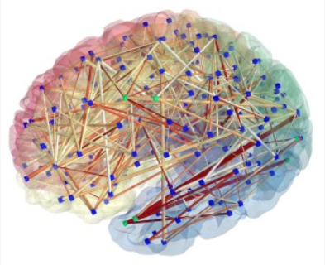
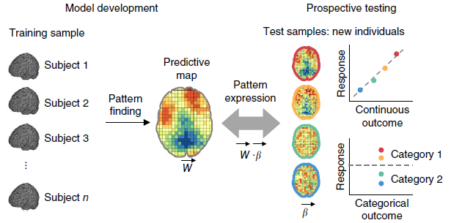
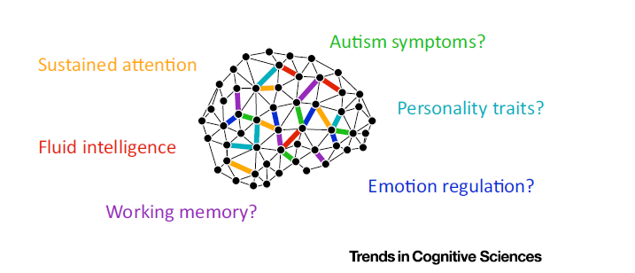
Modeling
Human Connectome
Biomarker?!
Notes:
Connectome과 관련된 여러 방법론을 사용하여 neuro-marker나 특정 인지기능과 관련된 기능적 연결성, 바이오마커를 찾을 수도 있음.
이와 관련된 방법론을 사용하여

Slide 6
>> Hypothesis Testing …
Predicting inattentive & hyperactive
symptoms in individuals.
2. Inattentive & Hyperactive model
generalization to other
neuropsychological tests.
(Identifying shared cognitive components)

Slide 7
★
Methods
Data Sets
⑴ resting-state fMRI brain scans of 299 children with and without ADHD
(all under the age of 17)
 |  | Mean±SD
 |  | ADHD (n=218) | TDC (n=81)
Age |  | 8.68 ± 2.28 | 10.51 ± 2.9
Gender(M:F) |  | 170:48 | 46:35
IQ |  | 106.14 ± 14.64 | 114 ± 11.48
Subtypes | combined | 101
 | inattentive | 78
 | hyperactive/impulsive | 12
 | Not Otherwise Specified | 27
ADHD: subjects with attention-deficit/hyperactivity disorder TDC: Typically developing controls.

Slide 8
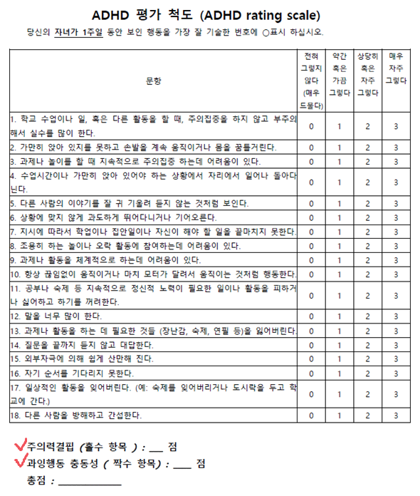

⑵ Clinical assessment data
-K-ARS for Modeling & 4 NP test for Generalization
K-ARS | 높을수록 증상 심각 | 부주의, 충동성 항목으로 Model 만듦
누락T (ATA 청각) | 높을수록 증상 심각 | 피검자가 표적자극에 반응하지 않음, inattention, 부주의
오경보T (ATA 청각) | 높을수록 증상 심각 | 피검자가 비표적자극에 반응, impulsivity, 충동성, 탈억제(disinhibition)
반응시간 표준편차T (ATA 청각) | 높을수록 증상 심각 | 주의집중의 일관성, 각성. Sustained attention(vigilance)/tonic alertness
누락T (ATA 시각) | 높을수록 증상 심각 | omission
오경보T(ATA 시각) | 높을수록 증상 심각 | commission
반응시간 표준편차T (ATA 시각) | 높을수록 증상 심각 | sd of reaction time
단어T(STR) | 높을수록 수행 좋음 | 제시된 단어읽기(속도)
색상T(STR) | 높을수록 수행 좋음 | X자로 표시된 색상 말하기(속도)
색상-단어T (STR) | 높을수록 수행 좋음 | 색상과 단어가 일치하지 않는 조건에서 단어 자극 무시하고 색상 말하기, 억제능력
간섭T (STR) | 높을수록 수행 좋음 | 순수 억제 능력 // (색상T가 빠른(높은) 경우 간섭T가 낮을 수 있음. 빨리 말하지만 억제능력은 낮을 수 있음)
CCTT1 | 높을수록 수행 좋음 | 숫자를 이어나가는 과제 - 정신운동속도와 순차적 처리 능력
CCTT2 | 높을수록 수행 좋음 | 숫자를 순서대로 연결하고 색깔도 번갈아 가면서 연결 - 주의 전환 능력
CCTT-P | 높을수록 수행 좋음 | CCTT1 대비 CCTT2 수행점수 // CCTT2의 기능에 더해 인지적 융통성 및 지속적 분할주의력

Slide 9
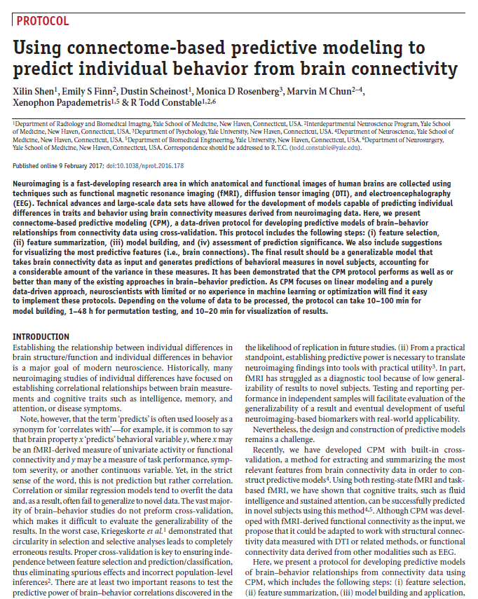
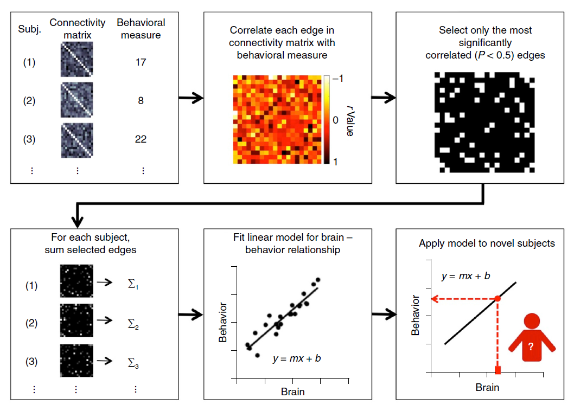
*CPM Algorithm
Xilin Shen et al., Nature Protocol (2017)

Slide 10
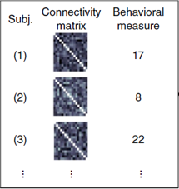
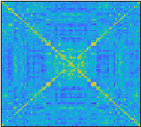
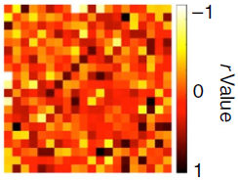
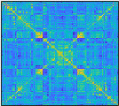
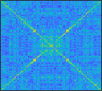
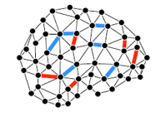


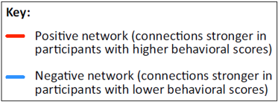
Select only the most significantly correlated
(P < ‘threshold’ )
Edges ⇒ ① r>0 Positive corr
② r<0 Negative corr
Correlate each edge
(total n(n-1)/2) in
connectivity matrix
with behavioral measure
behavioral measure
r value
Subjects’ edge strength
Summation of selected edges’ weight
Positive binary mask
Subject Summary value
Binary mask matrix
Connectivity matrix
∑
∑
(1)
(1)
1
1
∑
∑
(2)
(2)
Negative binary mask
2
2
∑
∑
(3)
(3)
3
3
….
….
….
….
….
Xilin Shen et al., Nature protocol (2017)

Slide 11
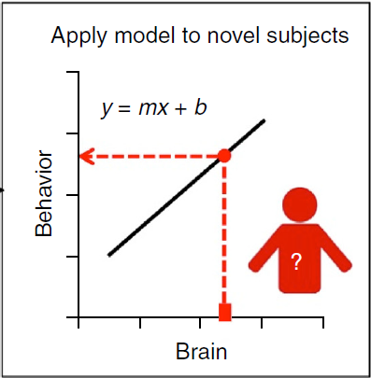
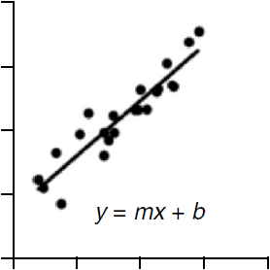
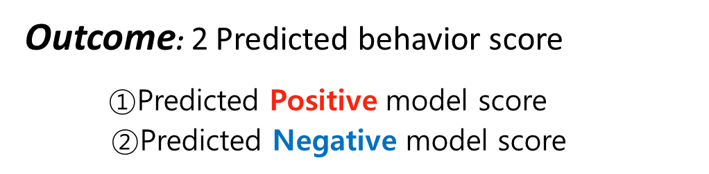
Fit a linear model
X axis – subject’s summary value
Y axis – subject’s behavior score
Subjects’ Behavior score
Subjects’ selected Edge weights’ Summation measure ⇒
∑
Outcome: 2 Predicted behavior score
$①$Predicted Positive model score
②Predicted Negative model score
Positive corr linear model ⇒ Y = mx + b
Negative corr linear model ⇒ Y=m’x + b’

Slide 12

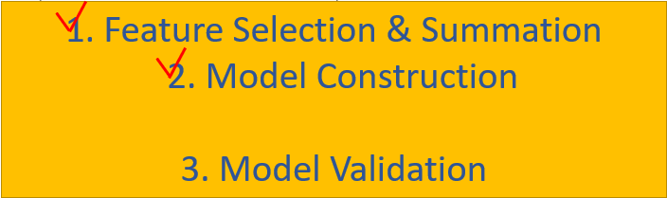
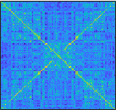
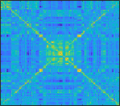
Connectivity
matrix
Behavioral
Measure
Summation of selected edge strengths in each individuals resulting in
“Single subject summary value”
Subject
Correlate each edge in connectivity matrix with behavioral measure
1
14
Make a binary mask
∑
∑
4
2
11
4
∑
∑
3
3
Training data
∑
∑
2
2
3
∑
∑
7
1
1
Fit a linear model
4
29
★
5
29
4
29
4
★
5
<Left-out subject>
Predict the behavior of left-out subject
14
1
14
1
Test data
5
26
11
2
11
2
7
3
7
3
∑
∑
∑
∑
∑
∑
∑
∑
∑
3
∑
5
4
2
3
1
4
5
2
1

Slide 13
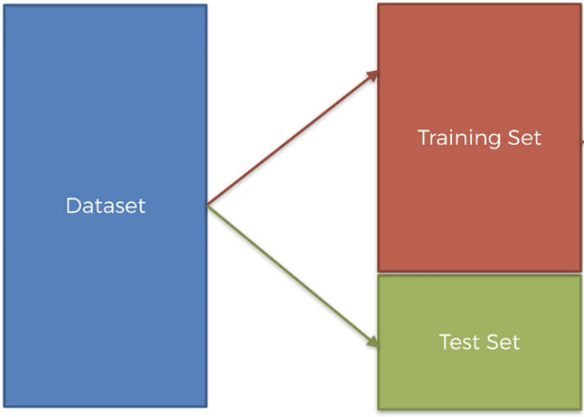
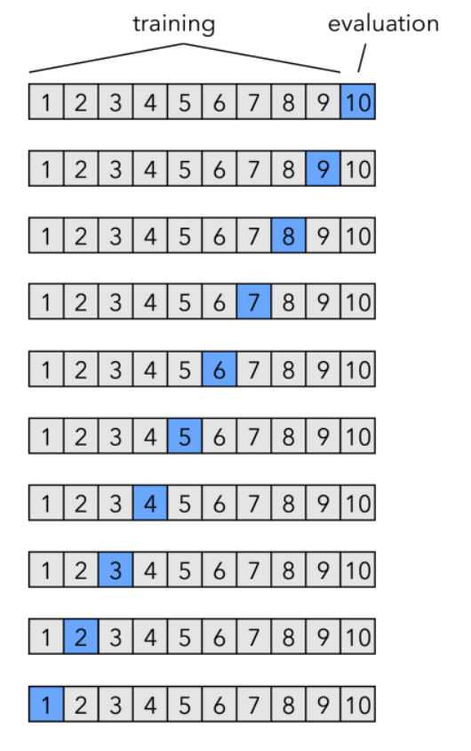
★Cross-Validation이란…
데이터를 train과 test로 나눠서 검증을 해보는 방법
결과에 대한 일반화가 가능하다.
LOO-CV: leave one out cross-validation.
하나의 data는 test이고 나머지 data는 training.
Training data의 결과를 test 데이터에 적용하여 나온 값을 실제
test 값과 비교.
Other CV methods..
K-fold cross-validation
Leave p out cross-validation
Repeated random sub-sampling validation

Slide 14
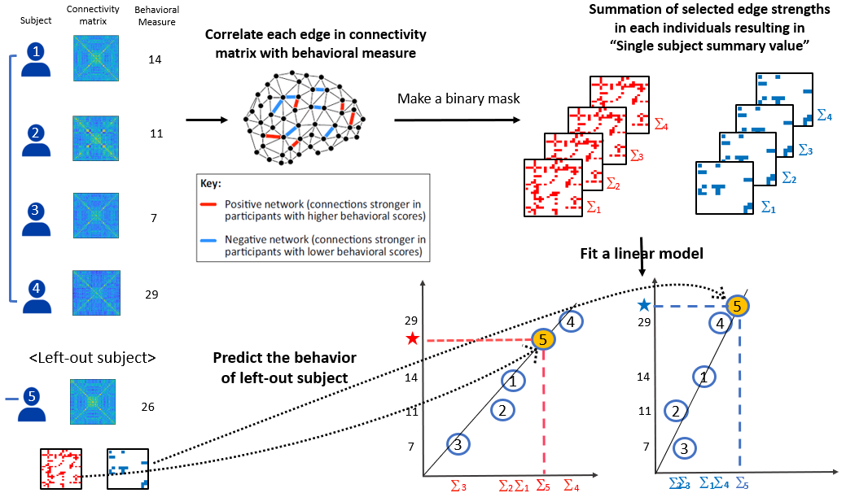
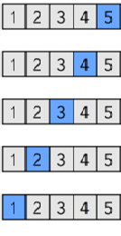
Training
Evaluation
Training data
Test data
1. Feature Selection & Summation
2. Model Construction
3. Model Validation
총 5개의 결과물(Predicted score)이 나옴
⇒ 피험자 수(299)만큼
결과물이 나옴

Slide 15
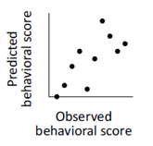
3. Model Validation
⇒ Compare “predicted” & “observed behavior score” to assess
“Predictive Power”
1) Correlation
2) Mean squared error
Positive
Negative

Slide 16
*Results
1. Model Validation – Internal validation (LOO-CV)
⑴ K-ARS 부주의 점수 ⇒ Inattentive Model
→ P-value <.05
유의미한 결과 (prediction O)
⑵ K-ARS 충동성 점수 ⇒ Hyperactive Model
→ P-value <.05
유의미한 결과 (prediction O)
Notes:
Compared to cross-correlation results, Inattentive model only predicted ATA-V & Stroop & CCTT1
Hyperactive model predicted ATA-V & Stroop

Slide 17
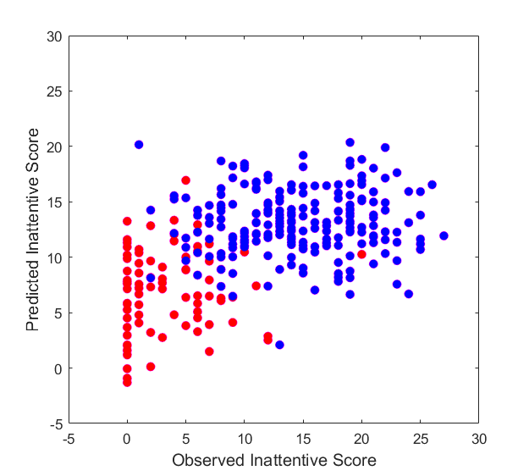
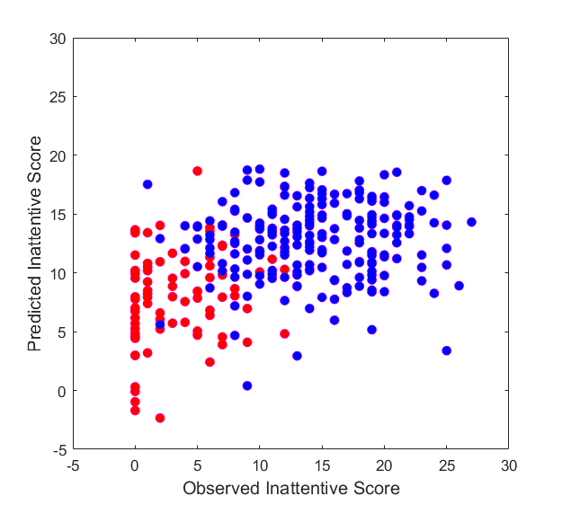

A. CPM results - Predictive power for K-ARS Inattentive models
(a)
Positive inattentive Predictive Power
(b)
Negative inattentive Predictive Power
N=299
N=299
P<2.0735e-18
r=0.48
P<3.4403e-15
r=0.43

Slide 18
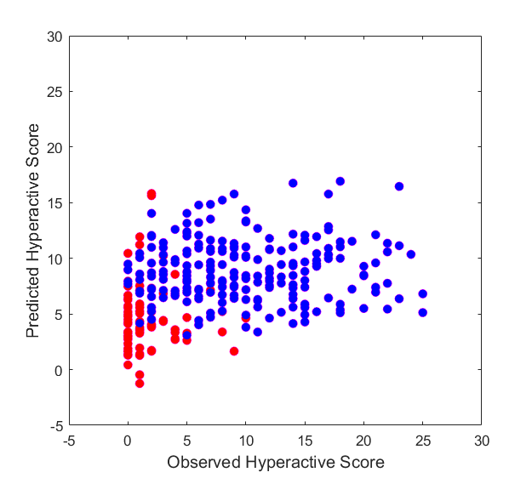
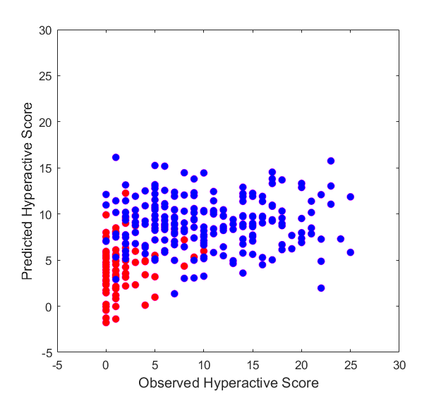
B. CPM results – Predictive power for K-ARS Hyperactive models
Positive hyperactive Predictive Power
Negative hyperactive Predictive Power
(c)
(d)
N=299
N=299
P<1.7606e-09
r=0.34
P<1.3205e-11
r=0.38

Slide 19
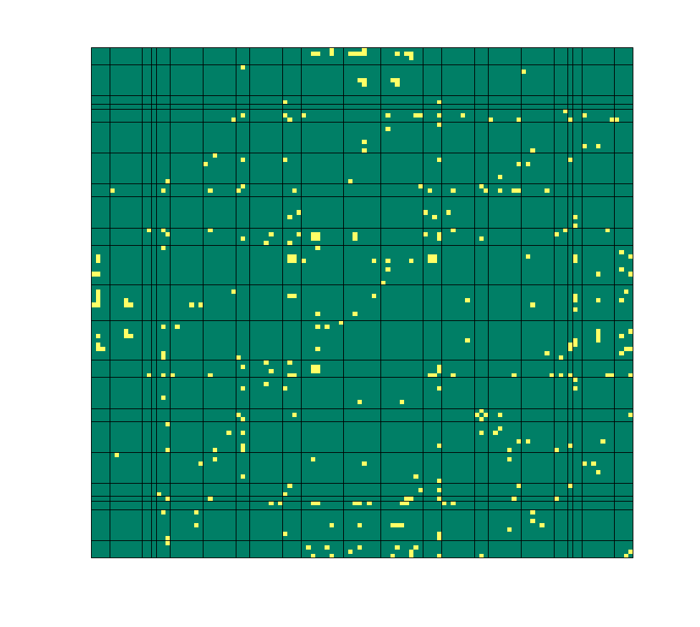
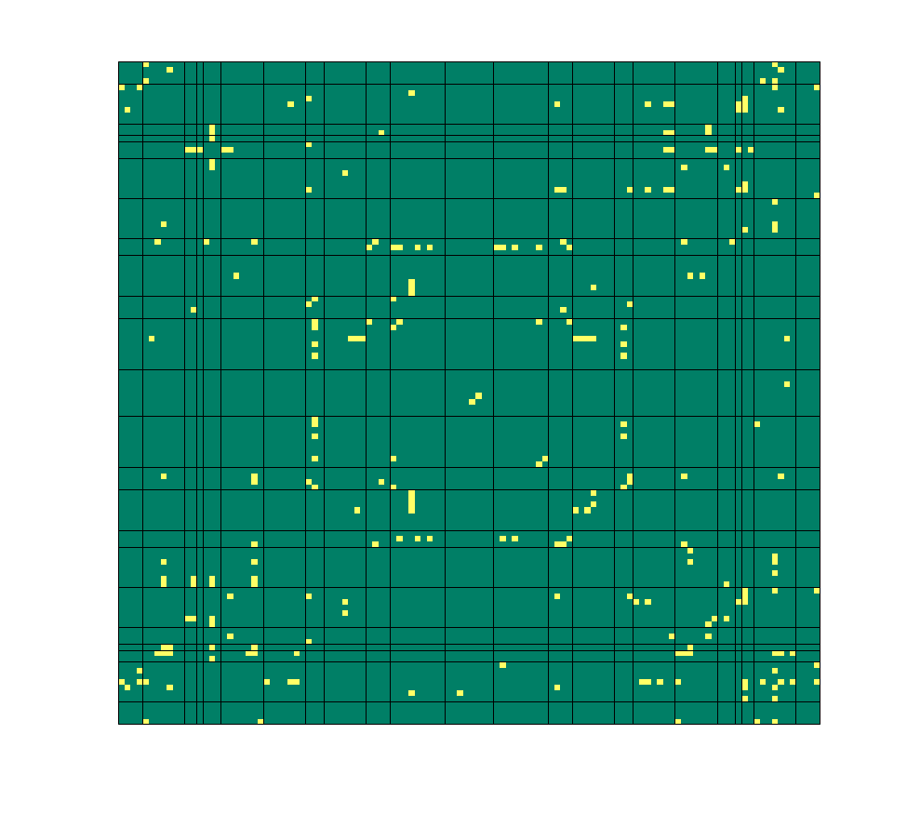
**Selected edges that appear in every round of LOO-CV Inattentive model
ROI ⇒ 116*116
Positive FC in inattentive model 158 edges
Total 285 edges
Negative FC in inattentive model 127 edges
Notes:
0.001 // r값을 고려 (0.3)

Slide 20
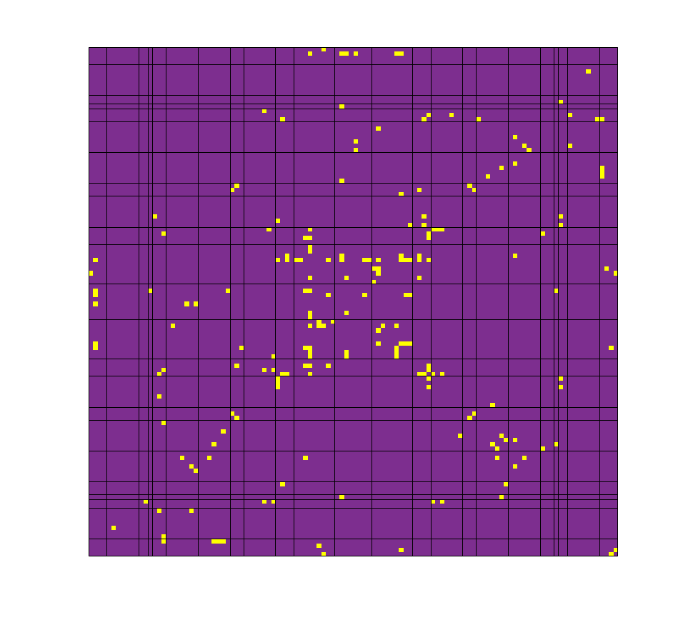
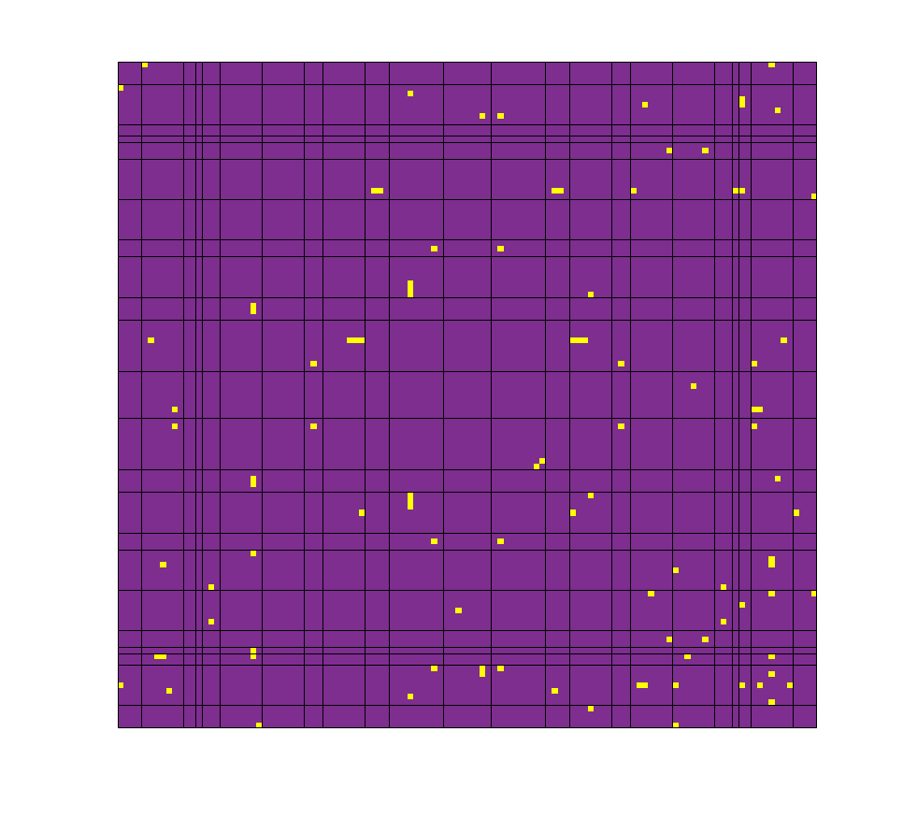
**Selected edges that appear in every round of LOO-CV Hyperactive model
ROI ⇒ 116*116
Positive FC in hyperactive model 102 edges
Negative FC in hyperactive model 51 edges
Total 153 edges

Slide 21
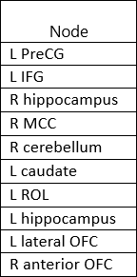
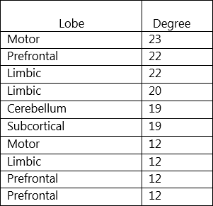
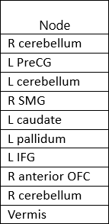
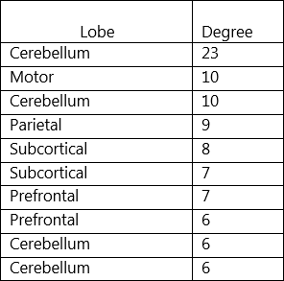
**Top 10 nodes with the most connections in inattentive
and hyperactive model
Ⅰ. Inattentive Model
Ⅱ. Hyperactive Model
⇒ Regarding previous studies…
Inattentive model – Prefrontal
Hyperactive model – Cerebellum

Slide 22
*Results
2. Model Validation – Generalization
⑴ Inattentive Model ⇒ ATA-V, Stroop, CCTT1
→ ATA-A, CCTT2 (X generalized)
⑵ Hyperactive Model ⇒ ATA-V, Stroop
→ ATA-A (X generalized)
Notes:
K-ARS(부주의, 충동성) 점수가 없는 피험자들의 brain connectivity matrix를 부주의, 충동성 모델에 넣어서 나온 predicted score값과 그들의 다른 신경심리검사와의 상관을 봄.

Slide 23
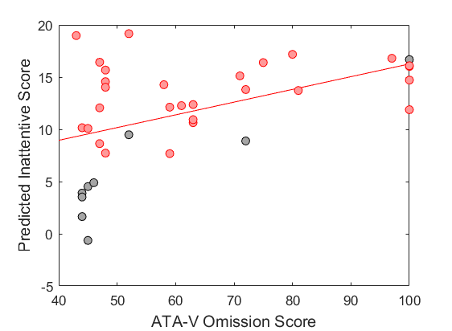
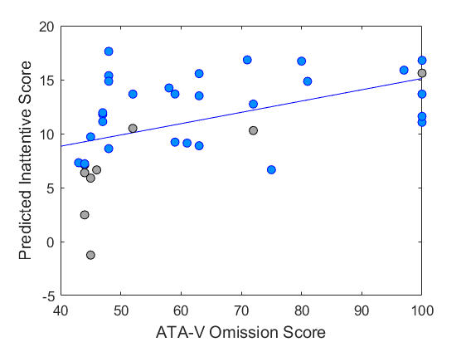
Inattentive model generalization
3 subscales of ATA-Vision, Stroop color-word, CCTT1
N=37
(Positive)
TDC
N=37
(Negative)
ADHD
TDC
ADHD
P<0.0022
r=0.49
P<0.0027
r=0.48
Notes:
N = 37 (+ve) (-ve)
P<0.0022 // P<0.0027
R=0.49 // R=0.48

Slide 24


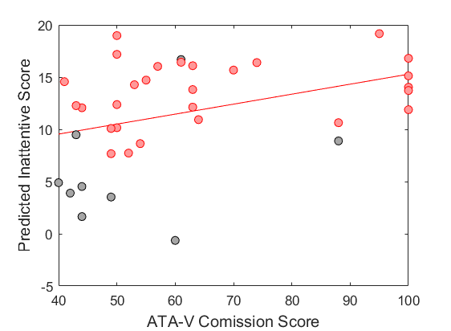
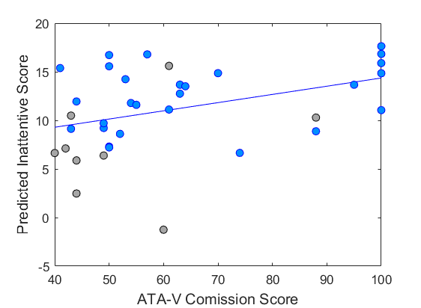
P<0.0184
r=0.39
P<0.0171
r=0.39
Notes:
N = 37 (+ve) (-ve)
P<0.0184 // P<0.0171
R=0.39 // R=0.39

Slide 25
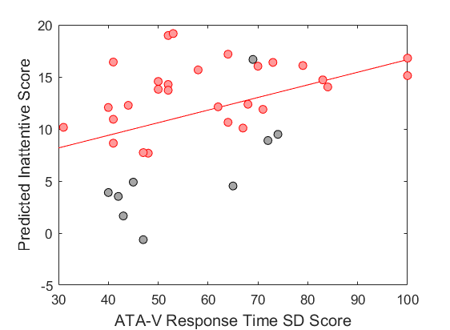
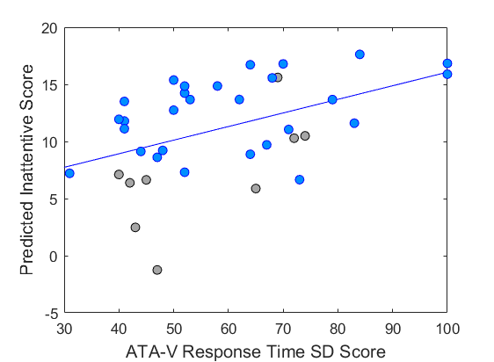
P<0.0104
r=0.42
P<0.0035
r=0.47
Notes:
N = 37 (+ve) (-ve)
R=0.42 // R=0.47
P<0.0104 // P<0.0035

Slide 26

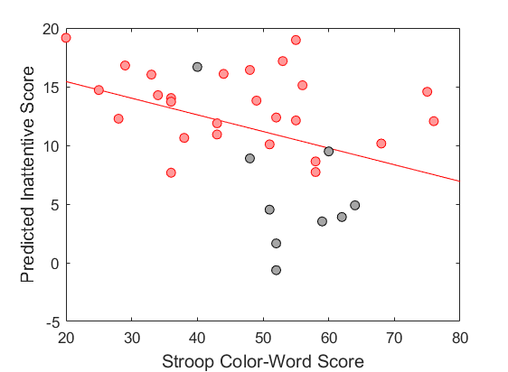
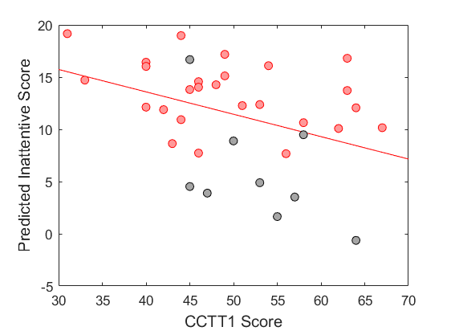
N=35
(Positive)
N=35
(Positive)
P<0.0217
r= -0.39
P<0.0223
r= -0.39
Notes:
N=35명 (+ve) // N=35명 (+ve)
R=-0.39 // R=-0.39
P<0.0217 // P<0.0223

Slide 27
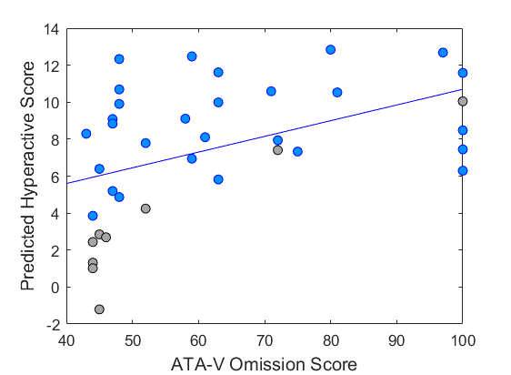
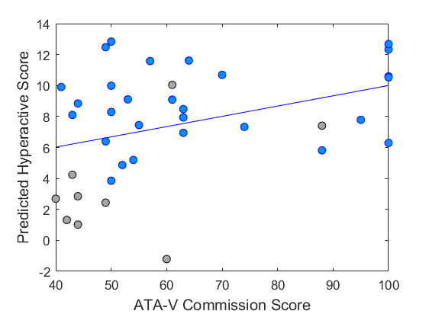
Hyperactive model generalization
3 subscales of ATA-Vision, Stroop color-word
P<0.0035
r=0.47
P<0.0247
r=0.37
Notes:
N=37명 (-ve) // N=37명 (-ve)
R=0.47 // R=0.37
P<0.0035 // P<0.0247

Slide 28



N=35
(Negative)
P<0.0138
r=0.4
P<0.0177
r=-0.4
Notes:
N=37명 (-ve) // N=35명 (-ve)
R=0.4 // R=-0.4
P<0.0138 // P<0.0177

Slide 29

**Neuropsychological Test
Cross-correlation Result
검사점수 간 상관에서는
부주의는 모든 검사와 유의미한 상관을 보임.
충동성 만 CCTT1, CCTT2 와
유의미하지 않은 결과를 보임.
p value < .05
Notes:
결과 그림 & 논문 요약
Motivation --- Generalization 의 목적
Motivation && Contribution --- Generalization

Slide 30
Model
Behavior score
 | Inattentive Model | Hyperactive Model | Inattentive Score | Hyperactive Score
 | p-value | p-value | p-value | p-value
ATA-V 누락 | 0.0022 | 0.121 | 6.81E-07 | 3.29E-06
 | 0.0027 | 0.0035
ATA-V 오경보 | 0.0184 | 0.1801 | 0.000253245 | 6.11538E-05
 | 0.0171 | 0.0247
ATA-V RT SD | 0.0104 | 0.1936 | 5.20E-07 | 4.77036E-05
 | 0.0035 | 0.0138
ATA-A 누락 | 0.8222 | 0.2189 | 1.63631E-05 | 0.029346903
 | 0.445 | 0.9249
ATA-A 오경보 | 0.3745 | 0.8333 | 0.03163271 | 0.11850682
 | 0.2496 | 0.1197
ATA-A RT SD | 0.802 | 0.3836 | 0.001172602 | 0.017404445
 | 0.917 | 0.6466
STR 색상-단어 | 0.0217 | 0.0798 | 0.000585961 | 0.002648077
 | 0.1001 | 0.0177
CCTT1 | 0.0223 | 0.7897 | 0.002442776 | 0.215697373
 | 0.0649 | 0.2653
CCTT2 | 0.114 | 0.9878 | 0.022254624 | 0.201227587
 | 0.2452 | 0.2124

Slide 31
*Discussion
▷ FC contain information about two primary
symptoms of ADHD.
▷ CPM considers both neural system and
behavioral(cognitive) measure. Thus
components represent cognitive measurements
including these 2 factors.
▷ Individuality is considered an important factor
when diagnosing one’s disorder.
Neuroimaging aligns with this idea introducing
models that show continuous measures.
Predicting 2 primary symptoms
of ADHD is possible from
RS-fMRI.
Trans-diagnostic
measurements are required.
⇒ CPM enables dimensional
perspective by looking
at relationships with other
Neuropsychological
measurements.

Slide 32


Positive inattentive Predictive Power
Negative inattentive Predictive Power
N=299
N=299
P<2.0735e-18
r=0.48
P<3.4403e-15
r=0.43
Notes:
X -> o

Slide 33


Positive hyperactive Predictive Power
Negative hyperactive Predictive Power
N=299
N=299
P<1.7606e-09
r=0.34
P<1.3205e-11
r=0.38

Slide 34
★
5
(h)
29
4
★
5
29
4
(f)
(h)
∑
14
1
14
1
5
(b)
5
26
11
2
11
2
(g)
7
3
7
3
∑
5
∑
∑
∑
∑
∑
∑
∑
∑
∑
∑
5
2
3
1
4
5
3
2
1
4

Slide 35



Slide 36




** Mean r-value of selected edges in every round of LOO-CV (299 round)
Positive FC in inattentive model
Negative FC in inattentive model

Slide 37




** Mean r-value of selected edges in every round of LOO-CV (299 round)
Positive FC in hyperactive model
Negative FC in hyperactive model

