Slide 1
Three dimensional data
Dimension: 91 x 109 x 91
Number of voxels >> 200,000
(From http://pds21.egloos.com/pds/201108/19/90/c0134890_4e4dfab480d6b.jpg)
Notes:
The brain imaging data is three dimensional data.
The dimension is ninetyone-by one hundred nine by ninty one.
That is to say, the number of voxels is more than two hundred thousand.
Then, the number of connections is two hundred thousand times two hundred thousand.
It is impossible to compute.

Slide 2
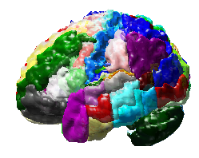
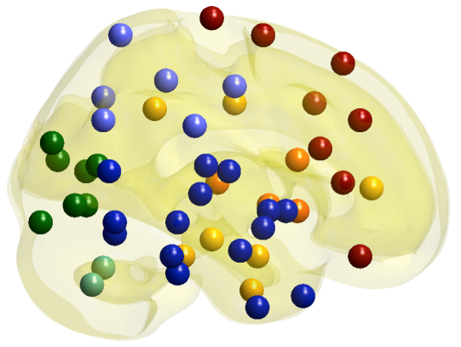
Node set
Predefined anatomical atlas
Region of interest (ROI),
90~130 ROIs
Location of a node: center of ROI
Measurement of a node: average of voxel intensities in a ROI
Notes:
So, we divide a brain into about one hundred regions according to the predefined anatomical atlas.
In this study, we used automated anatomical labeling.
Each region is called a region of interest, shortly ROI.
Then, the location of node is the center of ROI
And the measurement of a node is the average of voxel intensities in a ROI.

Slide 3
Persistent homology
Notes:
Persistent homology is also one of topological data analysis methods.

Slide 4

Algebraic topology
Shape descriptors
Connected components
Holes
Voids
Betti number
Number of CCs, β0
Number of holes, β1
Notes:
The persistent homology is a branch of algebraic topology.
The algebraic topology deals with the shape of topological space including a network.
It also defines topological invariants that quantify the shape of topological space.
The first invariant is connected components and the second invariant is holes, and the third invariant is voids.
The number of each invariant is also importantly considered in the algebraic topology.
The number of connected components is called the zeroth Betti number.
And the number of holes is called the first Betti number.
---------------------------------------------------------------
We will extract the information of the network base on the persistent homology, a new branch of the algebraic topology.
Given the topological space, brain network is also the topological space, the algebraic topology defines the topological invariants in the algebraic form.
For example, the connected components and holes or cycles.
Especially, it counts the number of connected components and holes and called them as the zeroth and first betti numbers.
If we have the binary network or thresholded network with the given epsilon like this, we have two connected components and there is no hole in this example.
In this way, the existing algebraic topology finds the connected components and holes at the fixed scale or threshold.

Slide 5
from wikipedia
 | Coffee mug | Doughnut
Number of CCs, β0 | 1 | 1
Number of holes, β1 | 1 | 1
Notes:
There are two topological spaces here.
One is a coffee mug. The other is a doughnut.
The coffee mug has one connected component and one hole.
The doughnut also has one connected component and one hole.
So, they have the same shape in the view of topologist.

Slide 6
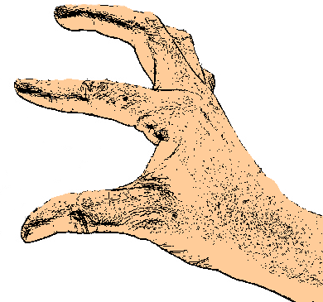
Binary network
Two nodes are connected, if the distance between the nodes is less than the given threshold, ε.
1.2
1.3
1.8
2.0
1.4
1.0
1.2
Threshold at 1.2
Threshold at 1.8

Slide 7
Thresholding
1.2
1.3
1.8
2.0
1.4
1.0
1.2
Threshold at 1.2
Threshold at 1.8
# connected components β0
# holes β1
30
11
Notes:
But, when the topological space is a binary network, the Betti number depends on the threshold.
For example, given the weighted network, if the threshold is 1.2, the binary network is constructed by connecting this, this and this edges.
Then, the zeroth Betti number is 3 and the first Betti number is zero.
If the threshold is 1.8, the binary network is constructed like this.
Then, the zeroth and first Betti numbers are one.
In this way, the Betti number is changed depending on the threshold.
So, the persistent homology proposed a method to solve this problem.
--------------------------------------------------
We will extract the information of the network base on the persistent homology, a new branch of the algebraic topology.
Given the topological space, brain network is also the topological space, the algebraic topology defines the topological invariants in the algebraic form.
For example, the connected components and holes or cycles.
Especially, it counts the number of connected components and holes and called them as the zeroth and first betti numbers.
If we have the binary network or thresholded network with the given epsilon like this, we have two connected components and there is no hole in this example.
In this way, the existing algebraic topology finds the connected components and holes at the fixed scale or threshold.
We will extract the information of the network base on the persistent homology, a new branch of the algebraic topology.
Given the topological space, brain network is also the topological space, the algebraic topology defines the topological invariants in the algebraic form.
For example, the connected components and holes or cycles.
Especially, it counts the number of connected components and holes and called them as the zeroth and first betti numbers.
If we have the binary network or thresholded network with the given epsilon like this, we have two connected components and there is no hole in this example.
In this way, the existing algebraic topology finds the connected components and holes at the fixed scale or threshold.

Slide 8
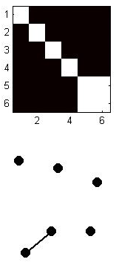
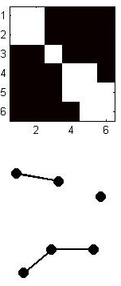
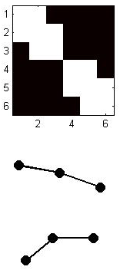
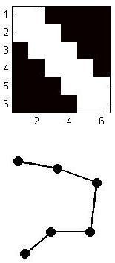
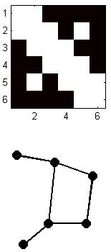
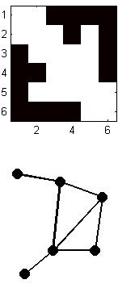
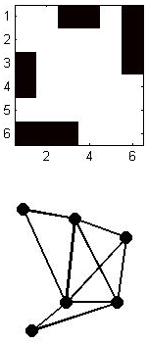
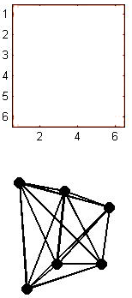
Persistent Homology
ε =1.0
ε =1.2
ε =1.3
ε =1.4
ε =1.8
ε =2.0
ε =2.5
ε =3.0
β₀ = 5
β₀ = 3
β₀ = 2
β₀ = 1
β₀ = 1
β₀ = 1
β₀ = 1
ε
β₀ = 1
β₁ = 0
β₁ = 0
β₁ = 0
β₁ = 0
β₁ = 1
β₁ = 2
β₁ = 5
β₀ = 10
Filtration
Notes:
By observing the sequence of binary networks at all possible thresholds.
And we observe the change of the Betti numbers by varying the threshold.
This procedure is called a filtration.
-----------------------------------------
But the persistent homology look at the changes of such topological invariants when the threshold or scale is varied.
This procedure is called as the filtration.
During the filtration, the number of connected components and holes are counted and it is visualized by barcode.

Slide 9
Barcode
ε =1.0
ε =1.2
ε =1.3
ε =1.4
ε =1.8
ε =2.0
ε =2.5
ε =3.0
# Connected Components
β₀ = 6
β₀ = 5
β₀ = 3
β₀ = 2
β₀ = 1
6
5
β0-curve
4
3
2
1
0
1.0
1.25
1.5
1.75
2.0
ε
Notes:
The persistent homology also provides a tool for visualizing the change of Betti numbers, called barcode.
The horizontal axis of barcode is the threshold.
And the vertical axis of barcode is the index of a connected component.
Each connected component is represented by bar.
When the threshold is zero, there is no edge to be connected.
So, the number of connected components is equal to the number of nodes.
In this example, it is six.
So, six bars are plotted like this.
When the threshold is one, these two nodes are connected.
Then, the number of connected components is 5.
So, one bar is ended and only five bars are remained.
When the threshold is one point two, two edges are connected.
And the number of connected components is three.
So, two bars are ended and only three bars are remained.
Finally, all nodes are connected in one connected component and only one bar is remained.
This is a barcode.
The barcode represents the connected component as a bar.
When epsilon is equal to zero, the number of connected components is equal to one of nodes.
Whenever the edges are added by increasing the threshold, the number of connected components decreases.
The holes are generated at 1.8 and 2.0 and they never disappear during the filtration in the network.

Slide 10
Connected Components
1
2
3
5
4
6
ε =1.0
ε =1.2
ε =1.3
ε =1.4
ε =1.8
ε =2.0
ε =2.5
ε =3.0
# Connected Components
6
5
4
3
2
1
0
1.0
1.25
1.5
1.75
2.0
6
5
4
3
2
1
0
1.0
1.25
1.5
1.75
2.0
ε
Notes:
In the barcode, we can find the whole changes of the connected structure during the filtration.
In the topology, the index of node is not important. This is because the topology thinks that bending, crumpling, rotating, or stretching affects shape.
But in the brain network, the location of nodes is very important.
So, we rearrange the bars according to the location of nodes.
Then, we obtained this Dendrogram.

Slide 11
Single Linkage Dendrogram
1
2
3
5
4
ε =1.0
ε =1.2
6
ε =1.3
ε =1.4
ε =1.8
ε =2.0
ε =2.5
ε =3.0
Single Linkage Distance
Single Linkage Dendrogram
6
5
4
3
2
1
0
1.0
1.25
1.5
1.75
2.0
ε
Notes:
In this dendrogram, two connected components are connected at the minimum distance between two connected components.
For example, the connected component consisting of nodes 1, 2, and 3 and the connected component consisting of nodes 4, 5, and 6 are connected at the threshold 1.4.
This is the minimum distance between two connected components.
This distance is single linkage distance. So, this dendrogram is called a single linkage dendrogram.

Slide 12
Shape of Network (minimum spanning tree)
Shape of network
Graph filtration
ε
x₁
1.2
x₂
1.3
x₃
2.6
1.8
1.4
1
1.2
x₅
x₄
Graph(X, 0)
Graph(X, 1.0)
Graph(X, 1.2)
Graph(X, 1.3)
Graph(X, 1.4)
Graph(X, 1.8)
x₆
x₁
x₂
x₃
x₄
x₅
x₆
x₁
x₂
x₃
x₄
x₅
x₆
x₁
x₂
x₃
x₄
x₅
x₆
x₂
x₃
x₄
x₅
x₆
ε₁= 1 2
1 ε₂= 1.2
1 1.2 ε₃= 1.3
1 1.2 ε₄= 1.4
If two nodes have been already connected directly or indirectly, no redundant edges are allowed.
Notes:
Now, I will show the shape of network.
In the shape of network, if two nodes have been already connected directly or indirectly, no more edges are allowed.
For example, these two connected components are connected by this edge.
No more edge can not be connected between them.
We call this the shape of network. It is also the minimum spanning tree of the original network.

Slide 13
Network distance
Beta0-curve of CC
KS-test like distance
Gromov-Hausdorff distance
Bottleneck distance
Kernel distance
Simplicial complex
Hole
Persistence
Persistence diagram
Notes:
There are several network distances based on persistent homology.
Except for the Gromov-Hausdorff distance, KS-test like distance, Bottleneck distance and kernel distance are the network distances based on persistent homology.
KS-test like distance was developed by Prof. Moo Chung.
This is the distance defined on the beta0-curve of connected components.
It works very well when the beta0-curves are different.
The biggest advantage of KS-test like distance is that it has the statistical model and we can estimate the significance of distance directly.
The other distances don’t have the statistical model. So, if we want to know the significance of the result, we should do permutation or bootstrap.
It takes a very long time.
The KS-test like distance would be much better to learn directly from Prof. Moo Chung.
Here, I will talk about bottleneck distance and kernel distance.
To understand these two distances, we need to know simplicial complex, hole, persistence and persistence diagram.
So, I will explain them first.

Slide 14
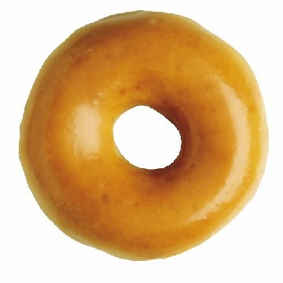
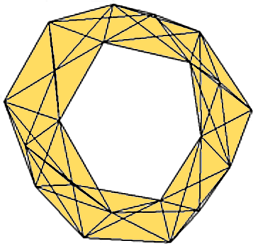
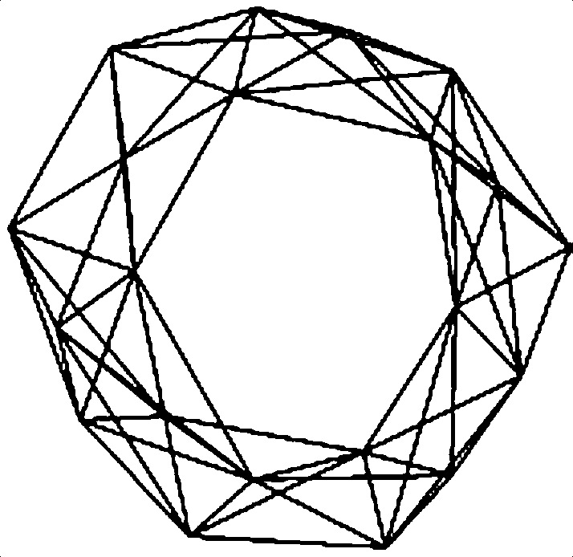
Simplicial complex
node
edge
filled-in
triangle
network
complex
Notes:
As you know, the nodes and edges are a building block of a network.
The algebraic topology introduce a new building block, filled-in triangle.
If we add this filled-in triangles to this network, then, you can see the hole of doughnut more clearly.
This is called simplicial complex, especially clique complex.
But for convenience, I just call it a network.

Slide 15
Persistence diagram
0
1.0
1.2
1.3
1.4
6
5
3
2
1
(0, 1.0)
(0, 1.2)
6
5
(0, 1.2)
4
(0, 1.3)
3
(0, 1.4)
2
1
0
1.0
1.2
1.3
1.4
Notes:
Then, let’s move on to the next topic, persistence diagram.
This is the barcode of this example that shows the change of connected components over the threshold.
In the barcode, each bar represents a connected component
The bar starts when the connected component appear
And the bar ends when the connected component disappear.
Now, we represent each bar by a point like this, the threshold when the bar starts comma the threshold when the bar ends.

Slide 16
0.4
0.8
1.2
1.6
2
Persistence diagram
of connected component
0
0.4
0.8
1.2
1.6
2
(0, 1.0)
(0, 1.2)
6
5
(0, 1.2)
4
(0, 1.3)
3
(0, 1.4)
2
1
0
1.0
1.2
1.3
1.4
Notes:
Then, these points can be plotted in two dimensional space like this.
This is called the persistence diagram of connected components.
In the network, all connected components are started at the threshold zero.
So, all points are on the vertical axis.
The persistence diagram is the set of points.

Slide 17
Holes
0
0
1.0
1.2
1.3
1.4
1.8
2.0
1.0
1.2
1.3
1.4
1.8
2.0
1.2
(1.8,
2.0)
1.3
1.8
2.0
0.4
0.8
1.2
1.6
Persistence diagram
of hole
1.4
2
1.0
1.2
0
0.4
0.8
1.2
1.6
2
Notes:
We can draw the persistence diagram of hole.
In this example, the hole appears at the threshold one point eight. And disappears at the threshold two by connecting this edge.
And its barcode is drawn like this and its persistence diagram is drawn like this.
The point is at 1.8 comma two.

Slide 18
1.2
0.4
0.8
1.2
1.6
2
1.3
Connected components
(CCs)
1.8
2.0
1.4
0
0.4
0.8
1.2
1.6
2
1.0
1.2
0.4
0.8
1.2
1.6
2
Holes
0
0.4
0.8
1.2
1.6
2
Notes:
In this way, a network can have two persistence diagrams. One is for connected components and the other is for holes.
They show the change of connected structure or hole structure during the filtration of a network.

Slide 19
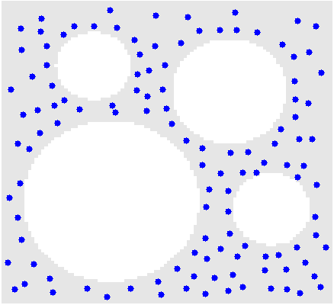
Persistence
Distance between nodes
: Euclidean distance
How many holes does
this topological space have?
Notes:
So far, we have talked about simplicial complex, hole, and persistence diagrams.
Let's take a look at why persistent homology is persistent homology.
Suppose that we have a topological space like this.
The distance between nodes are defined by Euclidean distance between them.
Now, how many holes does this topological space have?
Maybe you can count.
It is four.

Slide 20
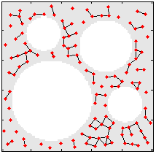
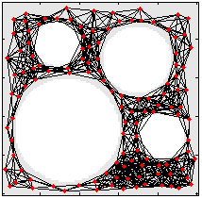
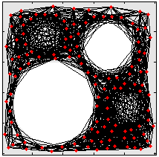
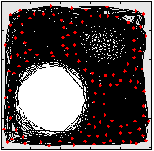
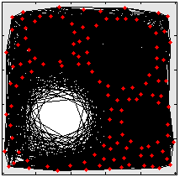
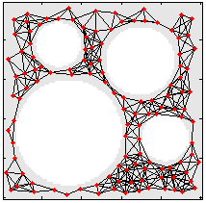
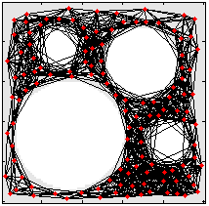
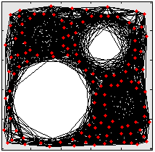
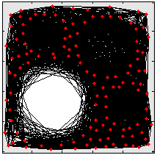
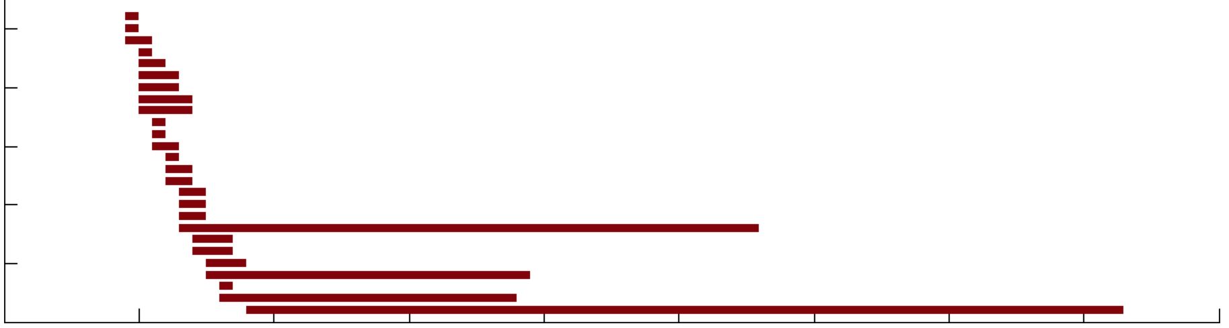
20
Index of holes
10
Barcode of holes
0
0.1
0.2
0.3
0.4
0.5
0.6
0.7
0.8
0.9
threshold
Notes:
Let’s check the number of holes by the filtration and the barcode of holes.
At the threshold 0.1, there are three small holes here and three bars are here.
But they disappear soon.
At the threshold 0.2, there are four holes that we might find.
There are four bars in the barcode. They last for a long duration of threshold.
The persistent homology considers such persistent holes as a signal that represents the underlying topological structure of a network.
And the other holes with short duration are considered as noise.
In the barcode, the persistence is represented by the length of bar.

Slide 21
Birth=Death
Death
persistence
Persistence diagram
of holes
Birth
20
Barcode of holes
Index of holes
10
0
0.1
0.2
0.3
0.4
0.5
0.6
0.7
0.8
0.9
threshold
Notes:
In the barcode, the persistence is the length of a bar.
In the persistence diagram, the persistence is the L-infinite distance to the diagonal line like this.
So, the farther from the diagonal line, the more persistent the hole is.

Slide 22
Birth=Death
Death
persistence
Persistence diagram
of holes
Birth
Persistent homology
Long duration of threshold
A connected component or a hole
Notes:
In the word persistent homology, the homology can represent a connected component or a hole.
The persistent means a long duration of threshold.

