Slide 1

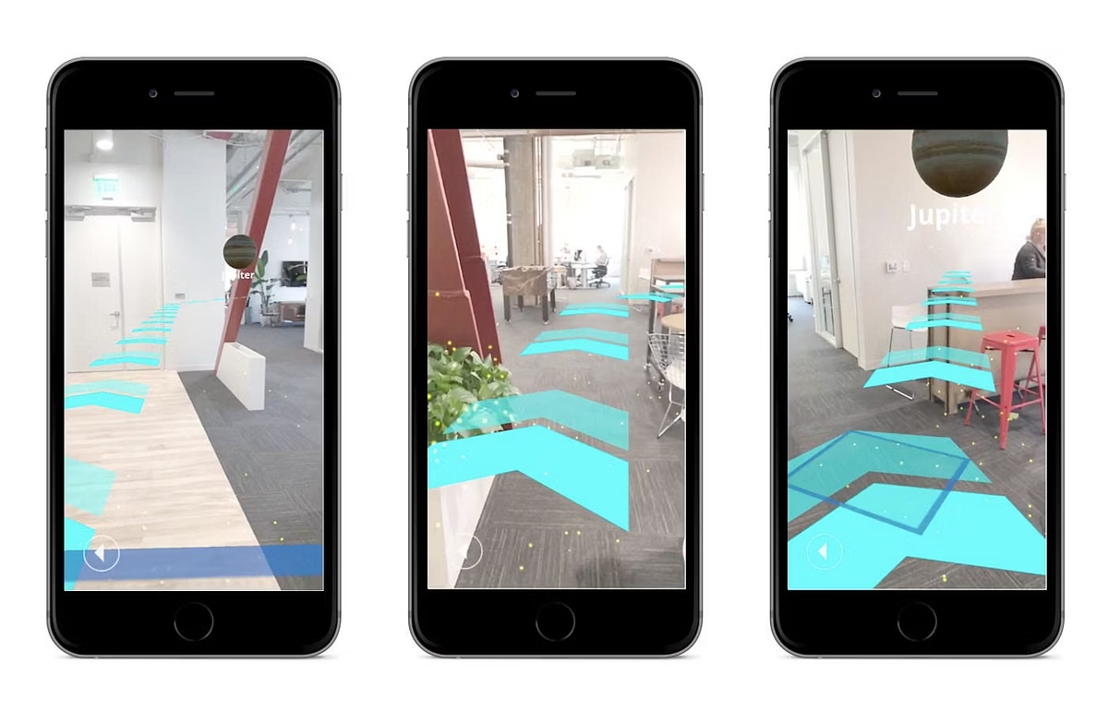
Griffith Go: Enhancing Campus Navigation with AR
Jeeyoung Park (s5378253)
Josh Yu (s5401891)
Yeongjoo Kim (s5413681)

Slide 2



Griffith Go: AR Campus Navigation Solution
The Problem
Our Solution
Campus navigation is confusing and time-consuming. Static maps lack real-time interactivity.
Griffith Go provides AR-based navigation with dynamic visual cues for offering a more efficient way to find campus.
New students and visitors struggle to orient themselves quickly and confidently.
Features include real-time AR arrows, destination badges, and gamified elements for exploration.
Seamless Experience
Responsive Design
Immersive AR
Intuitive interface bridges digital information with physical environments.
Consistent experience across all device screen sizes.
Natural, intuitive interactions that make navigation enjoyable.

Slide 3



Meet Our Project Team & Contributions
Yeongjoo
Jeeyoung
Josh
UI Designer / Video Editor
Project Manager / 3D Engineer
UI & System Integrator
Designed Start/End screens
Designed AR scenes and UI/UX
Designed Menu & 2D UI components
Set up UI flow
Developed wayfinding and animal collecting scripts
Provided video editing support
Integrated prefabs
Integrated code and conducted testing
Conducted system testing

Slide 4



Design Rationale: UI/UX & AR Integration
UX Design Goals
Easy & intuitive navigation across both physical and digital spaces
User-centered layout prioritizing essential information
Visual consistency between UI elements and AR objects for intuitive navigation
UI Components & Responsiveness
Used curated icons & buttons from Canva and Freepik libraries
Made fully responsive interface using Unity’s Canvas Scaler with Anchor presets
Consistent color scheme and typography across platforms
AR Interaction Design
Contextual directional arrows that adapt to user movement
Achievement-based destination badges to track exploration progress
Interactive animal spawning mechanics to gamify the navigation experience
Our design philosophy centers on creating an engaging experience that seamlessly blends UI clarity with AR immersion. By implementing intuitive navigation cues and gamified elements, we've developed a system that feels natural while encouraging exploration. The responsive framework ensures consistent performance across different device types and screen sizes.

Slide 5
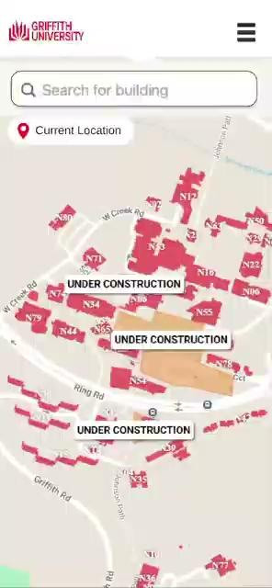
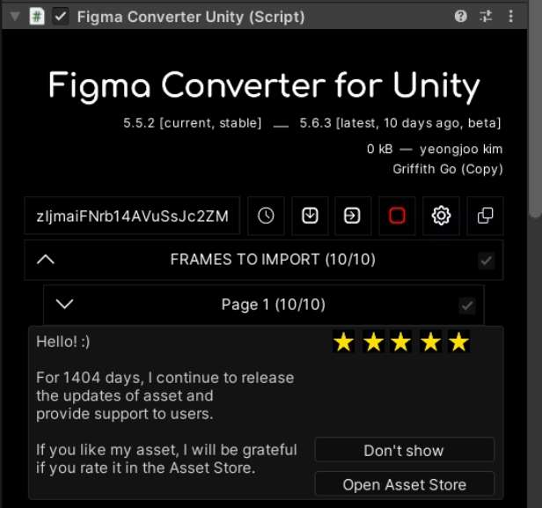
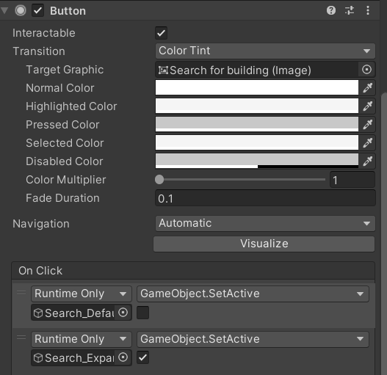
2D Pages Design
(Navigation selection)
Design UI in Figma Converter to Implement it into Unity.
After importing, Button Setup interaction by connecting OnClick events to activate specific gameObject

Slide 6

2D Pages – Design
Canva
Logo (Image)
Header
Icon
Button
Text
Page switching logic
Background
Notes:
Next, before I talk about the page switching logic, I’ll first go over how I built the UI pages.
I first identified all the essential UI elements.
I needed the Canvas to hold everything: background, logo, header, icons, buttons, and text.
And of course, the most important part: the page switching logic.
So, that’s all I need.

Slide 7
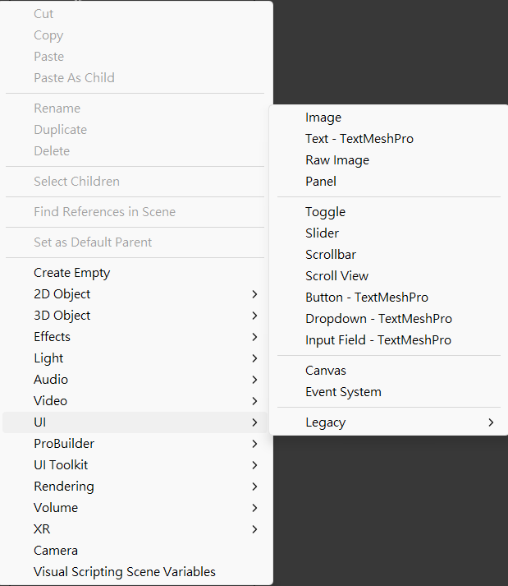

2D Pages – Canva UI Components
Built-in components
Free Icon Recourse
Notes:
After that, I built the interface using Unity’s built-in UI components.
They’re easy to test and maintain, especially across different screen sizes.
For icons, I used free resources from Asset Store and Flaticon to make things more user-friendly.

Slide 8
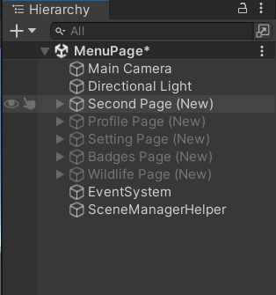
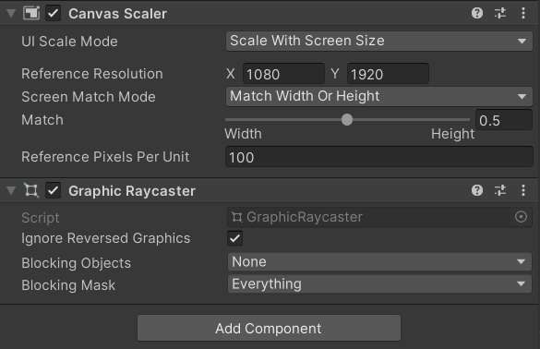
2D Pages – Screen Size
Single scene setup
with multiple UI page
Canvas Scaler
Scale with screen size
Screen Ratio:1080x1920
Match: 0.5
Notes:
Next, we put all the UI pages in one scene, to avoid layout problems and keep everything easier to control.
So, we used a single scene with multiple UI pages.
You can see the light grey text here, that means it's currently hidden or not active in the scene.
For screen scaling, I set the reference resolution to 1080 by 1920 ( ten eighty by nineteen twenty)
and match value to 0.5 to balance width and height.

Slide 9
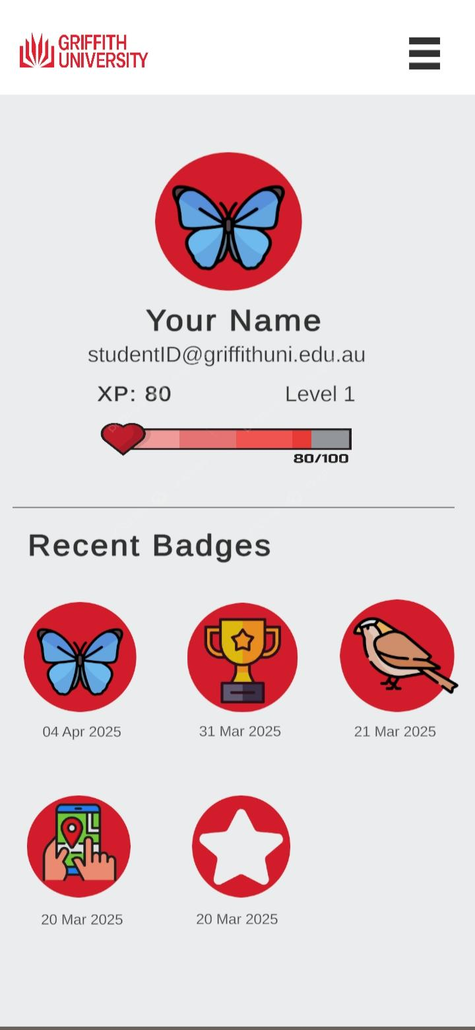
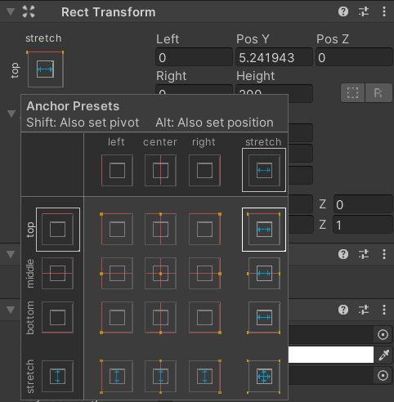
2D Pages – Screen Size
Keeps UI elements
in the correct position
on different screen sizes
Anchor Presets
Notes:
I also used Anchor Presets to make sure buttons and badges stay in the right place,
like centered or bottom-aligned, no matter the screen size.

Slide 10
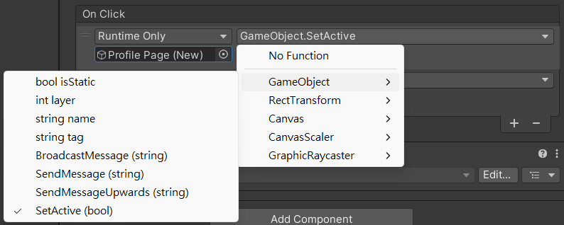
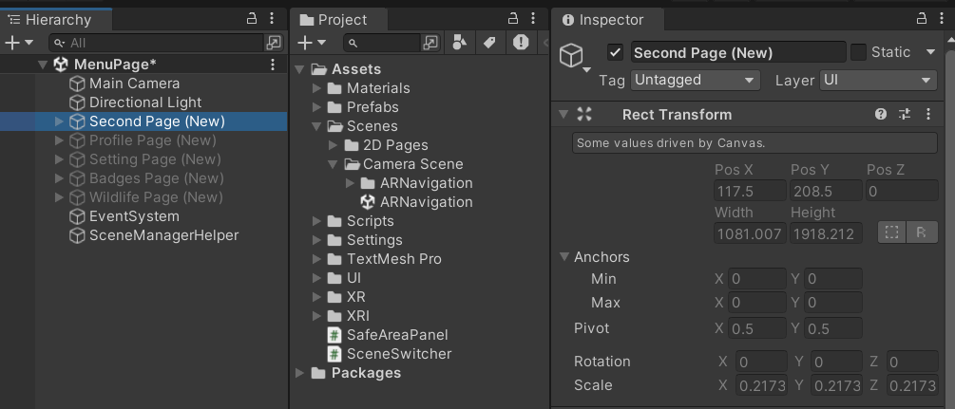

2D Pages – Page Switching Logic
Toggle between UI pages using SetActive(true/false) for smooth screen switching
True (Open Page)
False (Hide Page)
Notes:
For page switching, as Yeongjoo mentioned, we placed all pages in a single scene, and used OnClick event to show or hide them with SetActive.
This screenshot shows how it works, clicking a button will activate one panel and hide the others.
All the pages are in one scene, so there‘s no scene loading. Page switching can stays smooth.

Slide 11
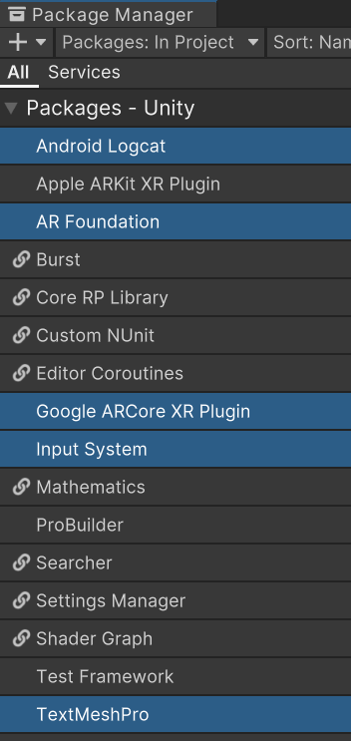
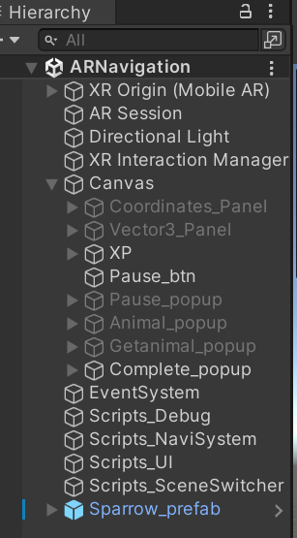
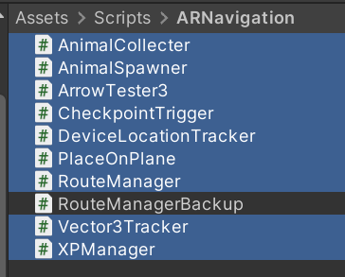
AR Scene Development – Scene Overview
Package Dependencies
+
Unity AR Template
Scene Objects
C# Scripts Involved
Debugging
AR dev
AR dev
Detect user touch & Raycasting

Slide 12
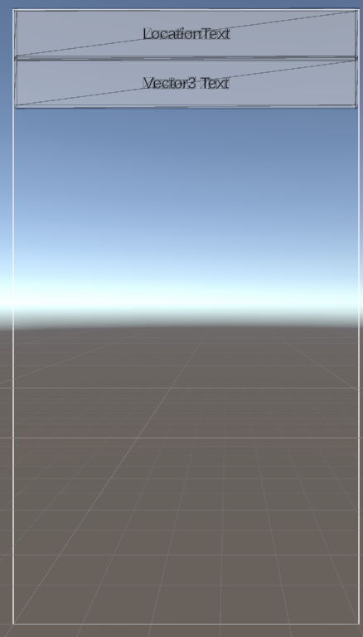
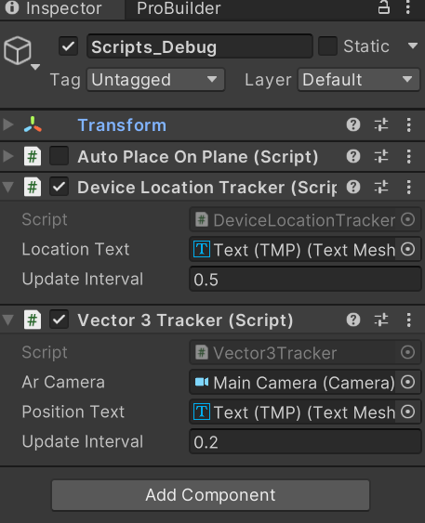
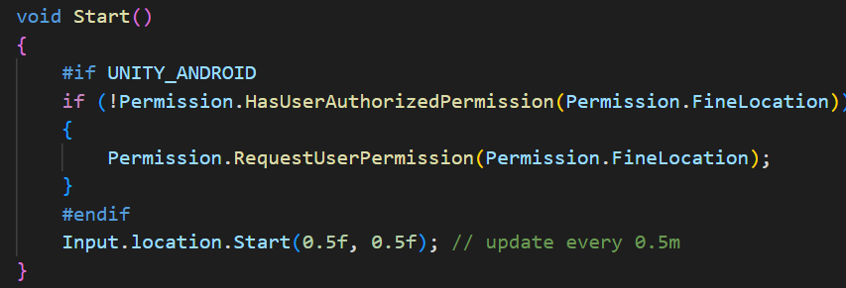
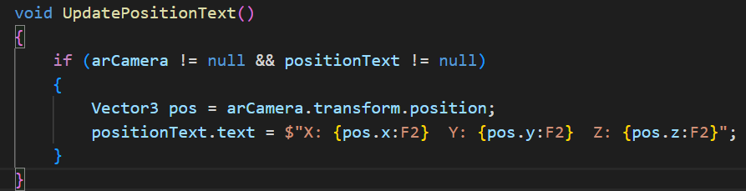
AR Scene Development – How to spawn Direction Arrows?
1st Approach: Check Accuracy of Device GPS Coordinates
Debug: Print absolute/relative Coordinates on screen
DeviceLocationTracker.cs
Get Android permission to get absolute position
Vector3Tracker.cs
Get AR camera position (relative)
Test Result: Using GPS location only is not accurate enough for short-distance route!
Compromise Plan: Calculate distance/directions with Coordinates > convert into Vector3

Slide 13
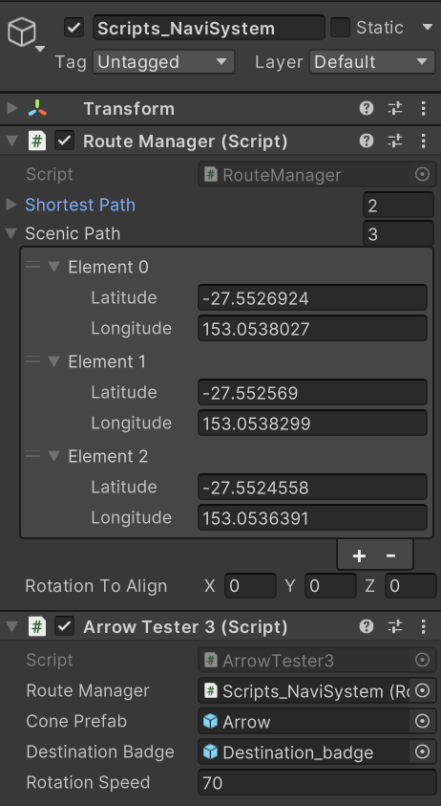
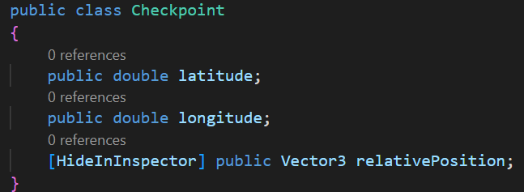
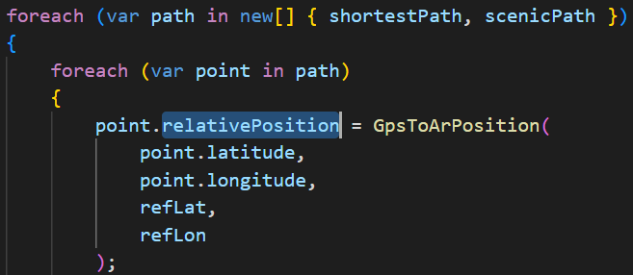
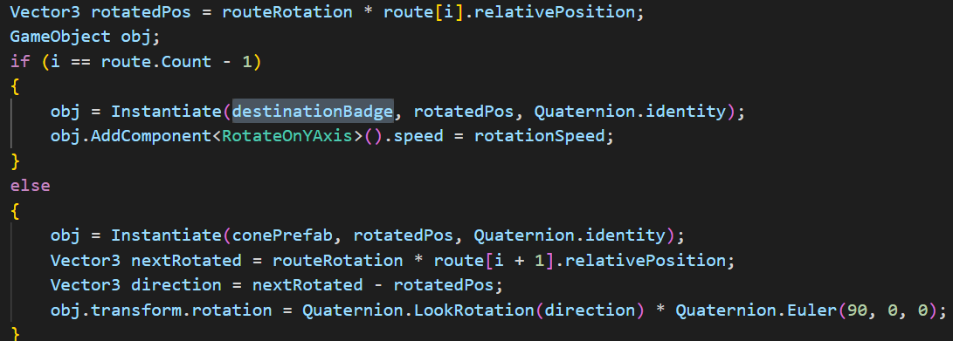
AR Scene Development – How to spawn Direction Arrows?
2nd Approach: Adopt both Absolute+Relative Position
Checkpoint Config on Editor
RouteManager.cs
Convert (lat, lon) into Vector3 Position
ArrowTester3.cs
Last position(Destination) -> spawn Destination Badge
Else -> spawn Arrow Object
-> Works well with same starting point

Slide 14
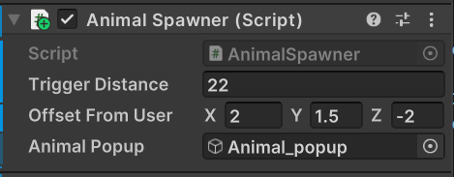
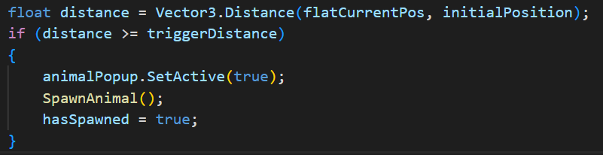
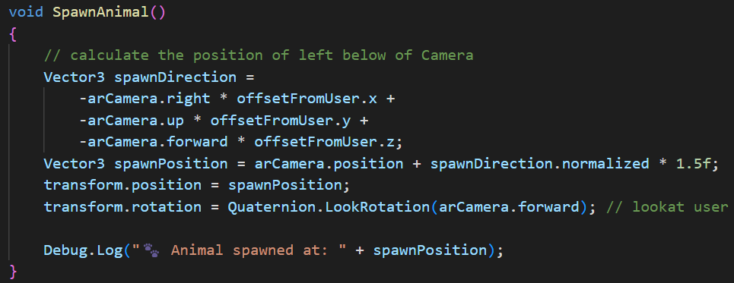
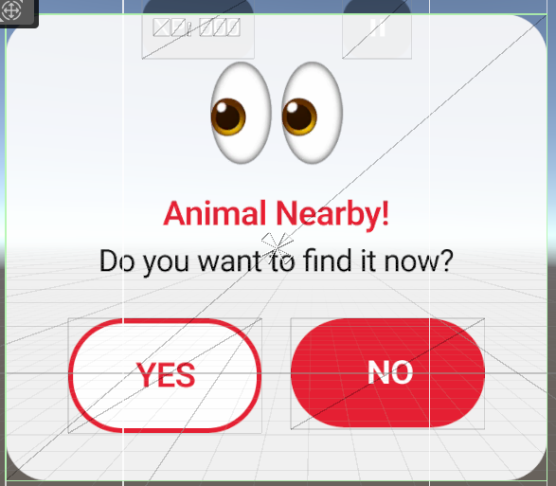
AR Scene Development – How to spawn Wildlife Animal?
Spawn Animal when user moved predefined distance
Script attached to Animal Obj
AnimalSpawner.cs > Update()
This case, If user moved more than 22m, shows Animal_popup and spawns animal
Animal_popup

Slide 15
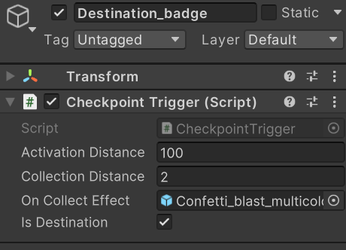
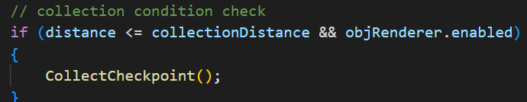
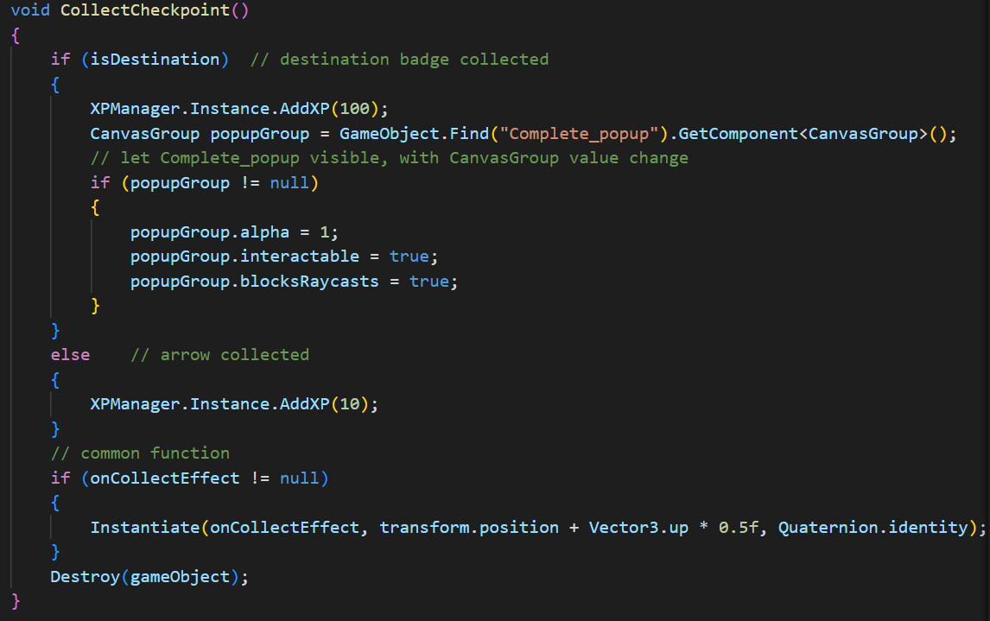
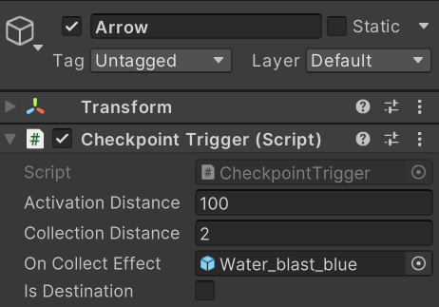
AR Scene Development – How to Collect AR Objects?
Navigation Objects: Distance based Collection
Destination Badge Config
CheckpointTrigger.cs
Destination: XP + 100 show completion popup
Arrow Config
Arrow: XP + 10
Common: Instantiate VFS Destroy current obj

Slide 16
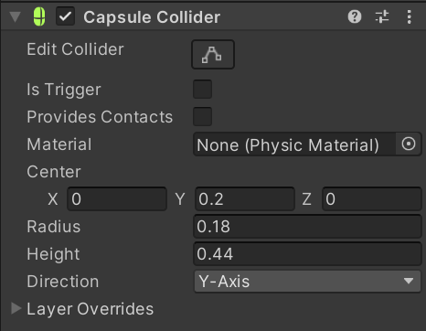
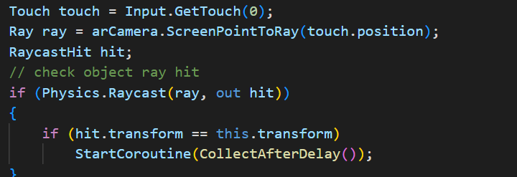
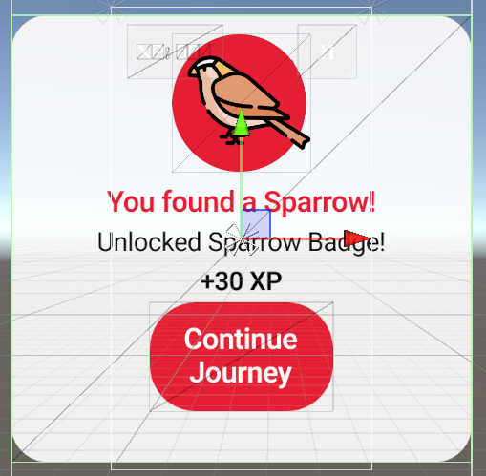
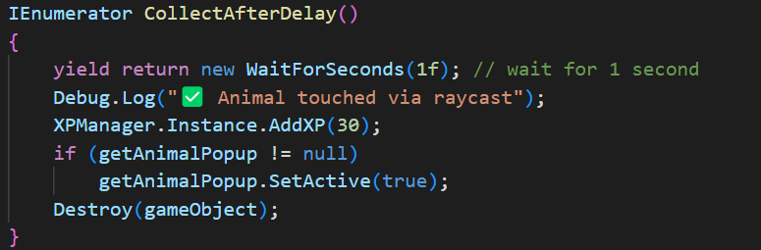
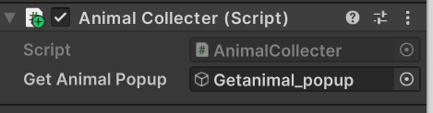
AR Scene Development – How to Collect AR Objects?
Animal Objects: Collision based Collection
Sparrow Prefab Config
AnimalCollecter.cs
Detect raycasting
Detect user raycasting
Wait for 1 sec XP + 30 show Getanimal popup destroy current obj
Wayfinding with AR obj + Animal Collecting Completed!🎉

Slide 17
Challenge of this project
Challenge | Solution
No free 3D koala model | Used a sparrow model instead of koala to keep the interaction fun
The interface looks different on different devices | Used a single scene with multiple UI pages. (Canvas Scaler+Anchor Presets)
Voice notification not implemented | Used basic arrival sound
Inaccurate absolute GPS coordinates | Calculated distance of each checkpoint and converted them into relative coordinates (Vector3)
Limitation of plane detection application | Spawned animal based on user device location (left below of AR Camerea, look towards camera)
Notes:
So here are some of the challenges we faced during development.
I won’t go through every single one, but I’ll highlight a few ones.
First — the koala.
We couldn’t find any free 3D models that looked good... most of them were either too expensive or... let’s just say, not good enough
So we replaced it with a sparrow to keep it fun.
Second — UI layout looked different on different phones.
We fixed that using Canvas Scaler and Anchor Presets.
Other features like GPS and voice notification were simplified to keep the demo stable.

Slide 18
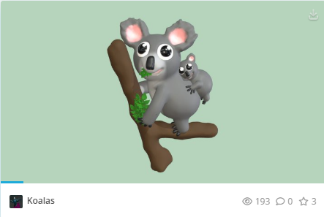
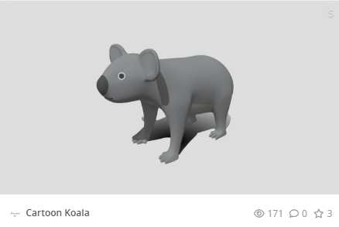
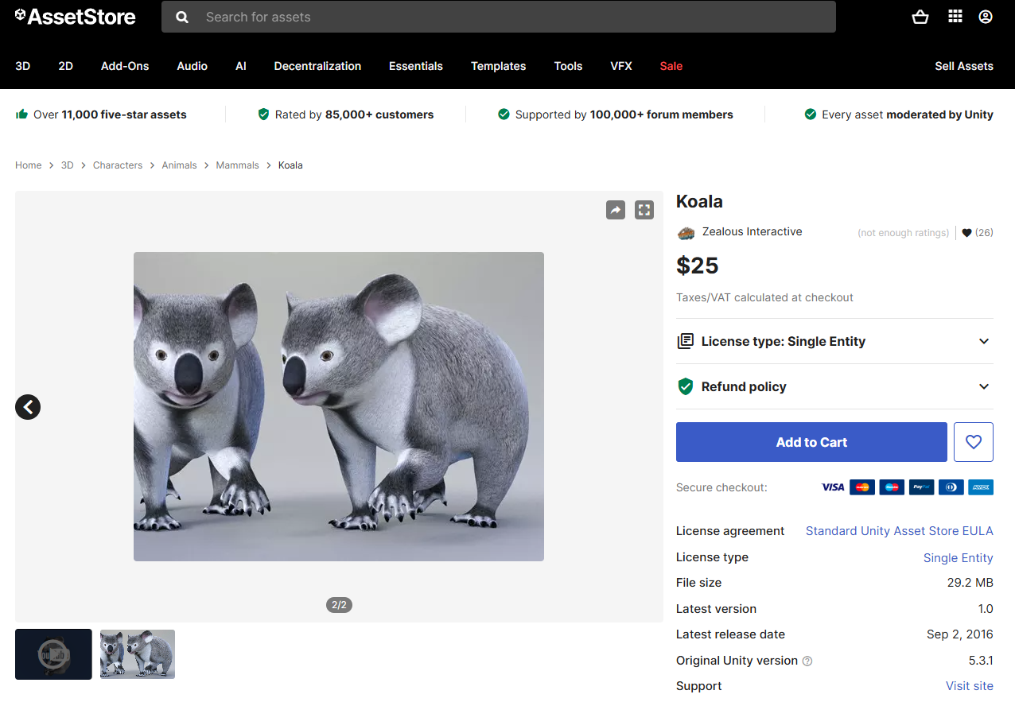
Resource: https://sketchfab.com/search?q=koala&type=models
Notes:
The ones at the top… not great.
You might think the ones at the bottom? look good, right? Well… but they cost 25 dollars.

Slide 19
THANK YOU
(Q&A Time)
Notes:
So that’s a quick overview of how we designed and built the pages,
and some of the challenges we faced during development.
Thanks for listening!
If you have any questions, feel free to ask.

