Slide 1
Neighborhood scouting
Opening a French Restaurant in New York

Slide 2
Project goal
Identify candidate neighborhoods in which to seek a location for a new French restaurant
Use Foursquare data to group data by venue types
Avoid being too close to open competitors
Produce ordered list of top recommended neighborhoods to investor considering whether to fund opening

Slide 3
DATA
Foursquare venue data, with location coordinates (from Foursquare API)
New York neighborhood list with location coordinates (provided by Coursera)

Slide 4
Methodology – data analysis
302 neighborhoods
40 contain a French restaurant within 500m of neighborhood center
262 have no French restaurant
433 categories of venue
One-hot encoding to create neighborhood feature vectors
Neighborhood feature vectors
Weight venue category by portion of venues in that neighborhood/category

Slide 5
Methodology - clustering
k-means clustering of neighborhoods with French restaurants
Discarded two clusters with only one neighborhood each
k-means clustering of candidate neighborhoods
Only one cluster with more than five neighborhoods
Identified 235 candidate neighborhoods and three clusters with target means

Slide 6
Methodology - evaluation
Minimum Euclidean distance between candidate neighborhood’s feature vector and nearest target cluster center
Confirm reasonableness with distribution of distance metrics

Slide 7
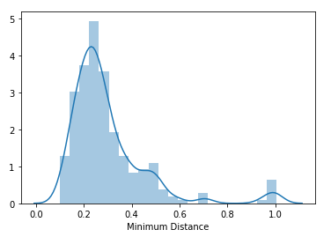
Feature vector distance distribution
Lack of concentration near 0 indicates neighborhoods are reasonably distinguished by distance to target cluster center

Slide 8
Conclusion – recommended neighborhoods
South Side
Brooklyn Heights
East Village
Flatiron
Gowanus
Gramercy
Washington Heights
Hunters Point
Prospect Heights
Astoria

Slide 9
Recommendations for refinement
Identify possible locations of available real estate
Use proximity to favored venues (positive) and competing restaurants (negative) to prioritize
Rank venues that indicate a French restaurant cluster by cost

