Slide 1
EV Infrastructure Sim
Discrete Event Simulation of Point-to-Point EV Travel
Jeff Parks, July 2024 CUNY DATA 604 – Simulation & Modeling Techniques https://github.com/jefedigital/sim-ev-chargers

Slide 2
Electric car sales keep rising and could reach around 17 million in 2024, accounting for more than one in five cars sold worldwide.
Global EV Outlook 2024, International Energy Agency (IEA)

Slide 3
(We are) setting the vision for a national charging network that is convenient, affordable, reliable, and equitable to enable a future where everyone can ride and drive electric .. capable of supporting 30–42 million PEVs on the road by 2030.
The 2030 National Charging Network, National Renewable Energy Laboratory (NREL)

Slide 4
Research Question
The primary question this simulation aims to address is:
What is the optimal distribution and capacity of public EV charging stations needed to support long-distance travel, reducing consumer 'range anxiety' while minimizing wait times and overall trip time?
As more consumers switch to EVs, the demand for reliable and efficient charging infrastructure, especially for long-distance travel, has become critical. Ample public EV charging stations are essential for several reasons:
Range Anxiety Reduction: Adequate charging infrastructure alleviates concerns about running out of power during long trips.
EV Adoption Acceleration: Robust charging networks encourage more consumers to switch to electric vehicles.
Economic Impact: Supporting long-distance EV travel can boost tourism and interstate commerce.
Environmental Benefits: Facilitating EV use for long trips reduces overall carbon emissions from the transportation sector.

Slide 5
Methodology
This model employs a discrete event simulation approach using Python and the SimPy library. Key components include:
Stochastic Driver Generation: Creates a population of EV drivers with varying trip start times and destinations.
Charging Network Model: Simulates a network of charging stations with different capacities and charging speeds.
Battery Consumption Model: Calculates energy consumption based on distance traveled and vehicle efficiency.
Charging Process Simulation: Models queuing, charging times, and battery replenishment at stations.

Slide 6
Data Sources
Where possible, publicly-available datasets were used to create rough estimates of traffic density, vehicle models, battery capacity and public charging station capacities, including:
The Federal Highway Administration's TMAS Datasat¹, featuring state-level hourly traffic density by day of week. For this project California's 2020 Monday-Friday data were used and fitted to a Gaussian Mixture Distribution to represent their bimodal nature.
The Open Charge Map², with extensive crowd-sourced information on public charging locations and capacities along specific U.S. routes.
The Electric Vehicle Database³, with details on specific EV models, ranges and battery capacities.
EVadoption⁴ for consumer reports on EV market share by brand, model and year.

Slide 7
Key Metrics + Variables
The simulation tracks and analyzes several important metrics and variables:
Dead Battery Events: A running count of dead batteries, used for a simple optimization function.
Charger Queue and Charging Times: Average and maximum time drivers spend queuing at charging stations.
Charging Station Utilization: Percentage of time chargers are in use, and noting where bottlenecks or underutilized chargers exist along the point-to-point route.
Trip Completion Times: Including a "Station Time Limit" variable representing consumer elasticity around charger availability, which can be used for route optimization.

Slide 8
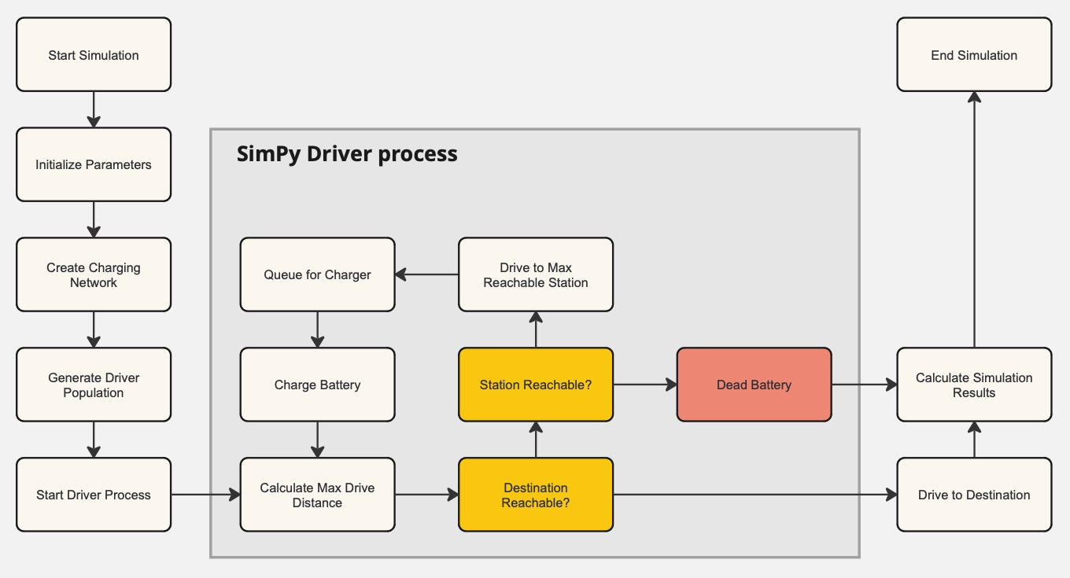
Simulation Model
Please see https://github.com/jefedigital/sim-ev-chargers for Jupyter notebooks and data.

Slide 9
Analysis
For the following exercises, we will consider scenarios of one-way weekday trips between San Francisco and Los Angeles, CA.
The estimated highway driving distance of this route is approximately 616km, and could theoretically be travelled in about 5.8 hours (or 350 minutes) at an average speed of 104.6 kph (65mph).
Additional assumptions:
For simplicity, the model does not vary the average speed. In future iterations this could be modeled as dependent upon the hourly traffic density data.
For simplicity, this model uniformly distributes station locations along the 616km route. In future iterations these could be simulated to match demand patterns.
Driver start times are staggered throughout the day, sampling from a bimodal Gaussian Mixture Distribution fitted to actual California weekday traffic data.
Other variables such as Chargers per Station, Charging Speeds and Vehicle models (with unique battery capacity and range profiles) are fitted to Beta distributions with adjustable parameters.

Slide 10
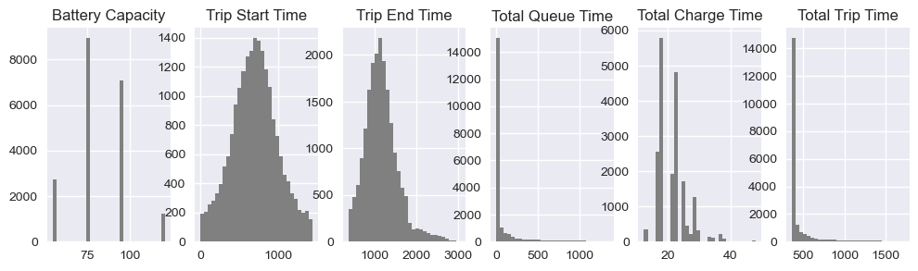
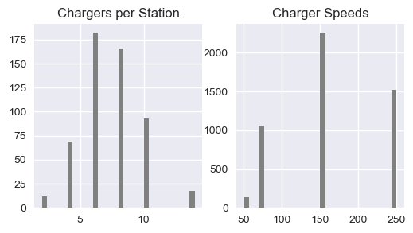
Scenario 1 Long Queue Times
For the first scenario, we'll simulate 1000 drivers on the road with access to 25 charging stations uniformly distributed, with trip start times staggered to match our GMM of actual traffic density from the National Highway Administration. (Confidence Intervals are 95%)
s1 = run_scenario(num_drivers=1000, num_stations=25, num_epochs=20)
Avg Trip Time | 461.9
CI Trip TIme | 459.0, 464.9
Max Trip Time | 1810.1
Avg Queue Time | 87.3
CI Queue Time | 84.3, 90.3
Max Queue Time | 1440.2
Avg Charge Time | 21.3
CI Charge TIme | 21.2, 21.3
Max Charge Time | 48.0
Avg Station Time | 108.5
CI Station TIme | 105.6, 111.5
Max Station Time | 1456.7
Avg Dead Batteries | 0.0

Slide 11
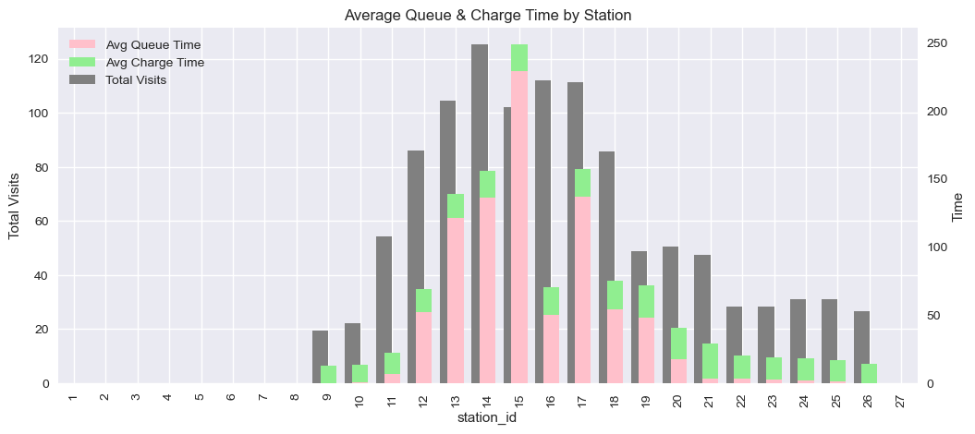
Scenario 1 Long Queue Times
At first glance this seems like a decent solution - no dead batteries! But if we look closely at the average trip time and especially the red bars representing queue time on the station plot, we may have a lot of drivers waiting in line for chargers. Not a great customer experience, especially at those midpoint stations where riders can be waiting 2+ hours for a 20-minute charge.
Avg Trip Time | 461.9
CI Trip TIme | 459.0, 464.9
Max Trip Time | 1810.1
Avg Queue Time | 87.3
CI Queue Time | 84.3, 90.3
Max Queue Time | 1440.2
Avg Charge Time | 21.3
CI Charge TIme | 21.2, 21.3
Max Charge Time | 48.0
Avg Station Time | 108.5
CI Station TIme | 105.6, 111.5
Max Station Time | 1456.7
Avg Dead Batteries | 0.0

Slide 12
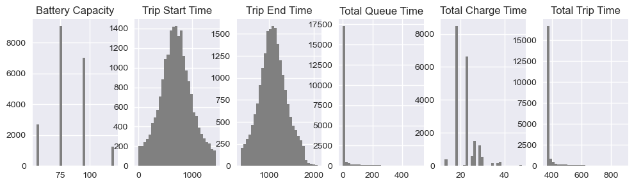
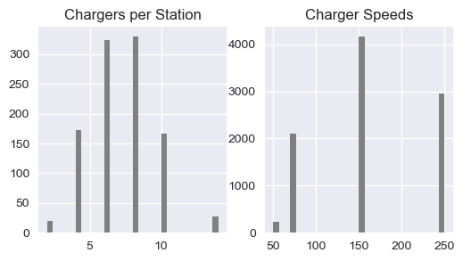
Scenario 2 More Stations, Less Waiting?
Let’s see if we can improve queue times by doubling the number of stations along this route.
s2 = run_scenario(num_drivers=1000, num_stations=50, num_epochs=20)
Avg Trip Time | 393.0
CI Trip TIme | 392.1, 393.9
Max Trip Time | 1249.9
Avg Queue Time | 858.5
CI Queue Time | 17.2, 19.0
Max Queue Time | 858.5
Avg Charge Time | 21.5
CI Charge TIme | 21.5, 21.6
Max Charge Time | 48.0
Avg Station Time | 39.6
CI Station TIme | 38.7, 40.5
Max Station Time | 896.5
Avg Dead Batteries | 0.0

Slide 13
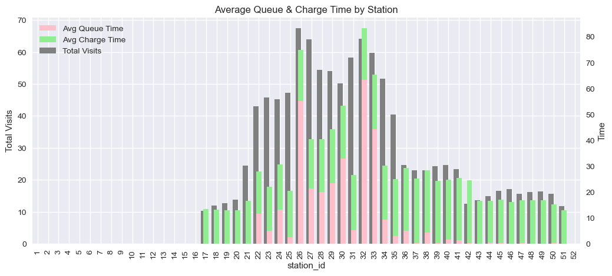
Scenario 2 More Stations, Less Waiting?
This second scenario is looking much better with average queue time greatly reduced! However there are still some long wait times around those midpoint stations - perhaps this might suggest more geographically-targeted infrastructure build along heavily-trafficked routes. Since this simulation spreads the stations out uniformly we won't be able to tackle that question right away.
Avg Trip Time | 393.0
CI Trip TIme | 392.1, 393.9
Max Trip Time | 1249.9
Avg Queue Time | 858.5
CI Queue Time | 17.2, 19.0
Max Queue Time | 858.5
Avg Charge Time | 21.5
CI Charge TIme | 21.5, 21.6
Max Charge Time | 48.0
Avg Station Time | 39.6
CI Station TIme | 38.7, 40.5
Max Station Time | 896.5
Avg Dead Batteries | 0.0

Slide 14
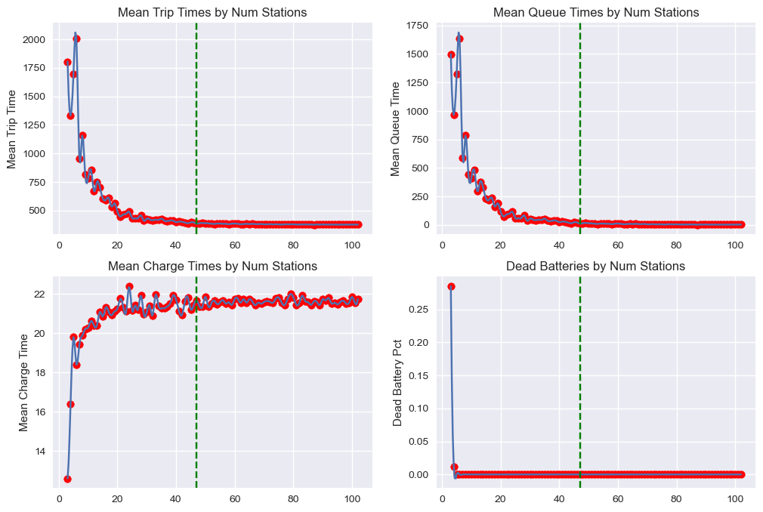
Scenario 3 Optimize Total Trip Time
We may be able to identify an ideal station frequency for the current simulation model, based on consumer preferences for total trip time. Assuming the average consumer doesn't want to spend more than 30-35 minutes charging on a nearly 6-hour trip, we can perform a simple sensitivity analysis and sweep a range of viable station counts, selecting the minimum number of stations that produce no 'dead battery' events and get us to our destination in less than 390 minutes (on average.)
s3 = run_sweep(sweep_variable = 'num_stations', num_drivers=1000, station_time_limit=35, num_epochs=10)
s3['min_num_stations’] 47

Slide 15
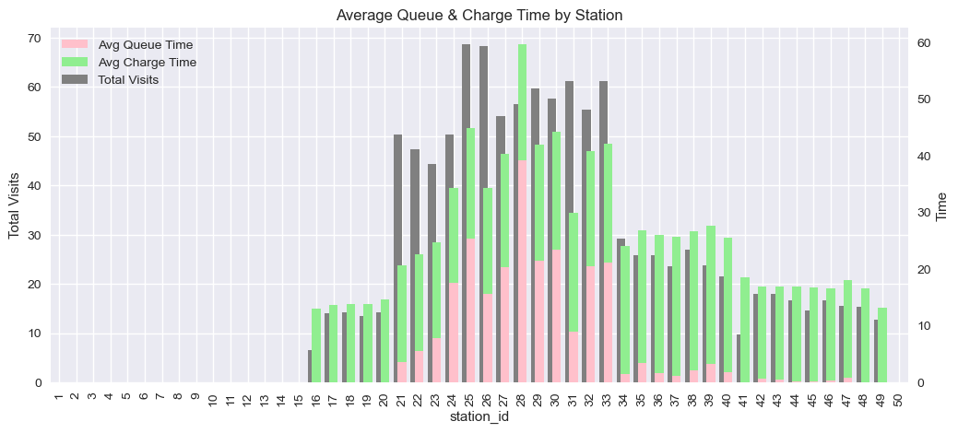
Scenario 3 Optimize Total Trip Time
With approximately 48 stations as an optimum, let’s run this scenario to obtain our metrics. Since we’re not sweeping all possible station frequencies, we can increase the number of epochs to get more robust results. Average queue time has come down significantly, though stations in the 21-33km range are still producing long queues.
s3b = run_scenario(num_drivers=1000, num_stations=48, num_epochs=35)
Avg Trip Time | 388.0
CI Trip TIme | 388.3, 389.3
Max Trip Time | 927.9
Avg Queue Time | 13.8
CI Queue Time | 13.3, 14.4
Max Queue Time | 556.5
Avg Charge Time | 21.6
CI Charge TIme | 21.5, 21.6
Max Charge Time | 48.0
Avg Station Time | 35.4
CI Station TIme | 34.9, 35.9
Max Station Time | 575.5
Avg Dead Batteries | 0.0

Slide 16
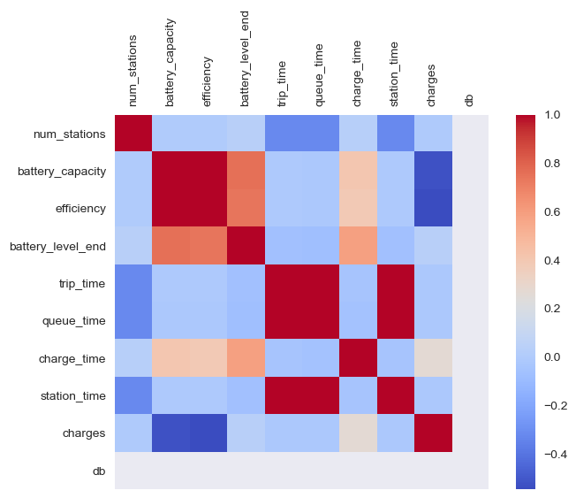
Scenario 4 Monte Carlo
Finally, we can begin to explore some of the relationships between our simulation variables by performing a Monte Carlo simulation, randomly varying our parameters for vehicle model mix, number of stations, chargers and charging speeds.
s4 = run_montecarlo(num_runs=50, num_epochs=5)
While a heatmap is simply a first pass at a Monte Carlo analysis, we can confirm some of the observed characteristics of our simulation, and perhaps uncover some new ones.
For example, the relationship between trip time <> queue time is stronger than trip time <> charge time, reinforcing our finding that queue times are a serious bottleneck for our simulation!

Slide 17
Conclusions
Of course this is only half the story for our simple model of point-to-point travel between two major cities -- there is also traffic moving in the opposite direction, perhaps experiencing similar charger queue woes in the reverse order.
However we can make a few observations based on this initial simulation:
Assuming stations are roughly equally spaced along this 600km route, approximately 1 station for every 20 drivers is a starting benchmark for station density supporting long-distance travel, statistically reducing or eliminating 'dead battery' events due to charger scarcity.
This station density can be further optimized by analyzing locations experiencing long charging queues, and simulating increased station frequency and/or capacity in these regions.
Consumer preferences around total trip times, queue and charging times can be simulated and optimized against for higher levels of driver satisfaction.

Slide 18
Resources
TMAS Data Program, Federal Highway Administration
Open Charge Map
Electric Vehicle Database
EVadoption.com
Global EV Outlook 2024, International Energy Agency (IEA)
The 2030 National Charging Network, National Renewable Energy Laboratory (NREL)

