Slide 1



Slide 2
Context
Problem statement
Warehouses gave governed analytics, but usually inside proprietary storage/compute.
Data lakes made storage cheaper and open.
Open table formats added transactional table semantics
Parquet became a common physical file format for analytical data.
Different teams and engines adopted different formats
Converting formats created duplication, cost, and synchronization work
The problem is not storing the data. The problem is making the same table readable across ecosystems without copying it."
Notes:
XTable's core idea is simple: keep one copy of the data, but generate the metadata needed by other table formats.
So if the source table is Hudi, XTable can generate Iceberg metadata and Delta log metadata that point to the same physical files. Consumers can then read through the format their engine supports best.
This does not mean every feature is interchangeable. It also does not mean all formats should write independently to the same files.

Slide 3
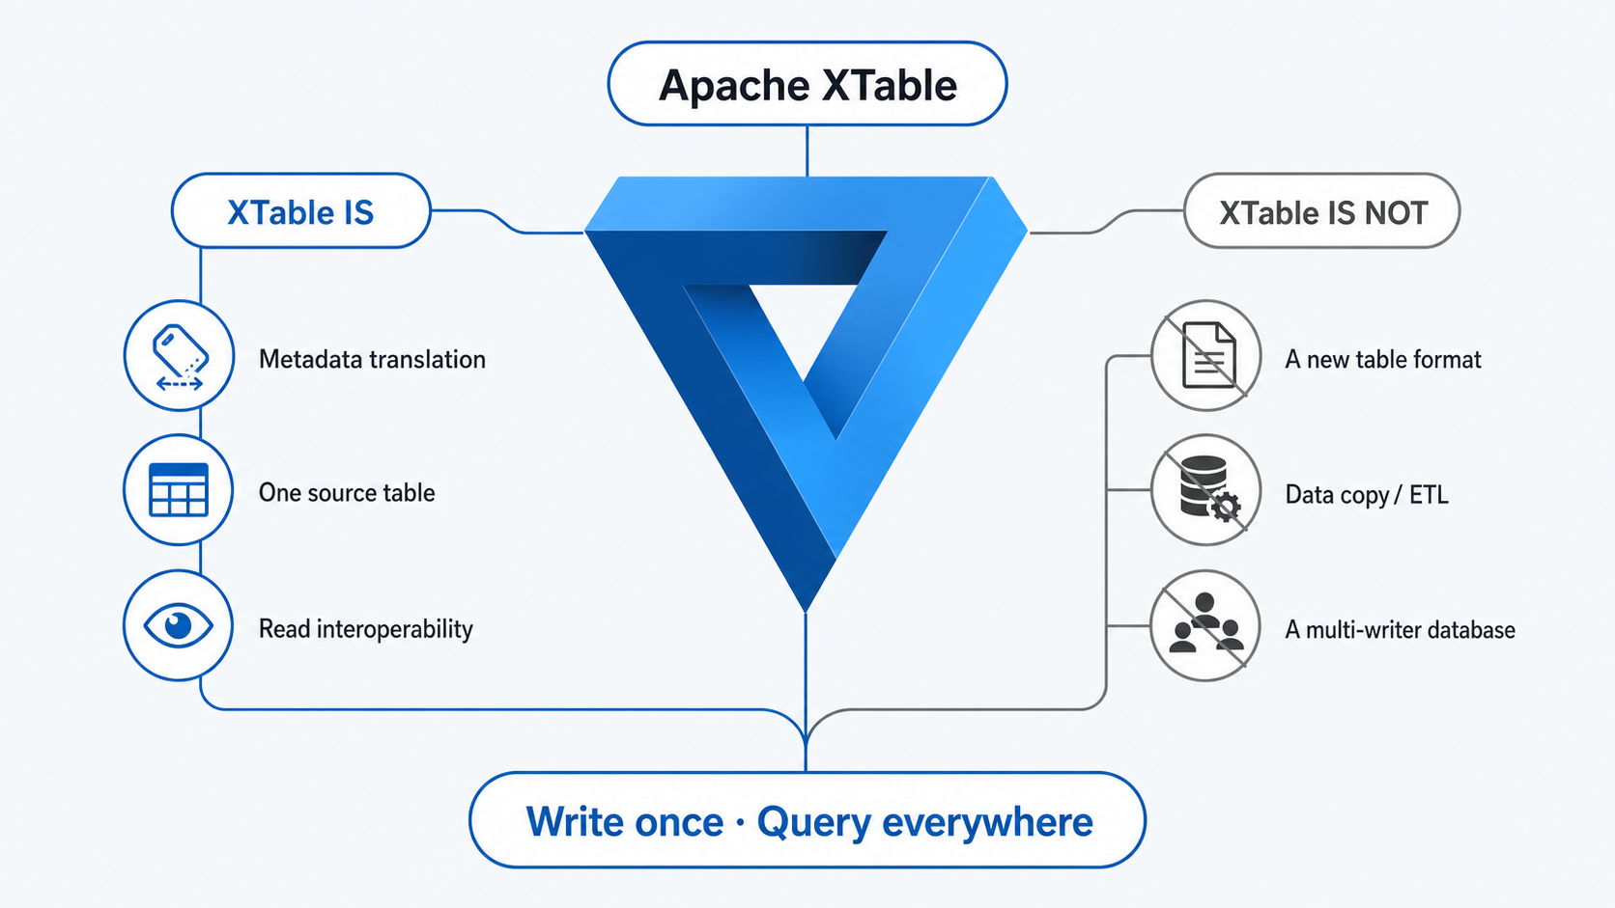
Apache XTable
Introduction
- Apache XTable provides omni-directional interoperability across lakehouse table formats.
- It is NOT a new table format.
- It provides abstractions and tools for translating lakehouse table format metadata.
- It was formerly known as OneTable.
- Supported core table formats today: Hudi, Iceberg, Delta Lake.
Notes:
XTable is best understood as a metadata interoperability layer with one authoritative source table.
It is not an ETL engine. It is not a storage format. It is not a distributed scheduler. It is not a complete bidirectional multi-writer database.
This distinction matters because it explains both the benefit and the limitations.

Slide 4
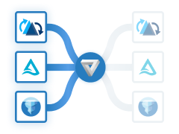
Apache XTable
How it solves the problem
- Hudi, Iceberg, and Delta all combine data files + table metadata.
- XTable reads the source table metadata.
- It creates equivalent target metadata using the target format APIs.
- Target metadata is written under the table base path:
- `_delta_log/` for Delta
- `metadata/` for Iceberg
- `.hoodie/` for Hudi
- Query engines then read the same physical files through their preferred format.
Notes:
At a fundamental level, the formats share a similar shape: Parquet data files plus a metadata layer. XTable uses those commonalities.
The most important architectural point: it normally does not convert or rewrite the records. It translates metadata so the same files can be interpreted as another table format.
Good sentence to say:
"The conversion is not data-to-data. It is metadata-to-metadata."

Slide 5
Apache XTable
Architecture
Notes:
The important design choice is the neutral internal model. Without it, every format would need direct converters to every other format.
```textWithout neutral model: N * (N - 1) convertersWith neutral model: N sources + N targets```
The controller coordinates extraction, sync mode, target creation, and optional catalog sync. Source and target logic are isolated behind adapters.

Slide 6
Apache XTable
Competitors

Slide 7
Apache XTable
Pros and Cons

Slide 8
Apache XTable
Trade-offs

Slide 9
Apache XTable
Demo

Slide 10
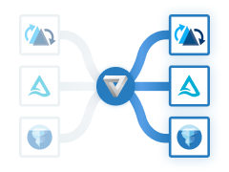

Context
Solving the problem
- The need is not another table format.
- The need is to make one physical dataset readable through multiple table-format ecosystems.
- Apache XTable translates metadata from one source format into one or more target formats.
- The physical data files stay in place.
- One format remains authoritative; the other formats are synchronized views.

