Slide 1

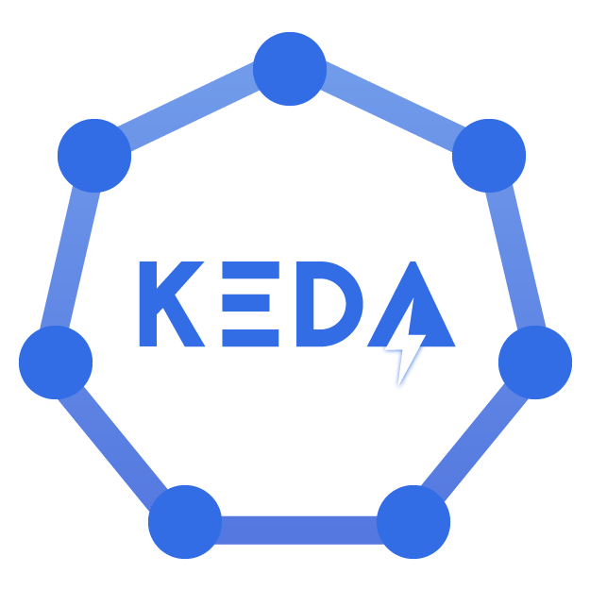
|
INTRODUCTION
the problem
CPU is not the workload
A queue can be full while a worker looks “healthy” to a traditional HPA. It won’t scale.
Therefore, higher pressure on each pod and queue growth.
QUEUE BACKLOG
•
•
•
•
•
•
•
CPU 18%
Memory 31%
40 orders waiting
The signal that matters is backlog / lag.
Nothing to scale.

Slide 2
|
INTRODUCTION
a solution
KEDA extends Kubernetes autoscaling
It connects event sources to Kubernetes while keeping the HPA model.
Kubernetes HPA
KEDA
Workload
CPU / memory
resource signals
Queue depth • lag
cloud metrics • cron
custom / external scalers
Deployment
StatefulSet
Custom Resource
NATIVE
EVENTS
SCALE 0 → N
<number>

Slide 3
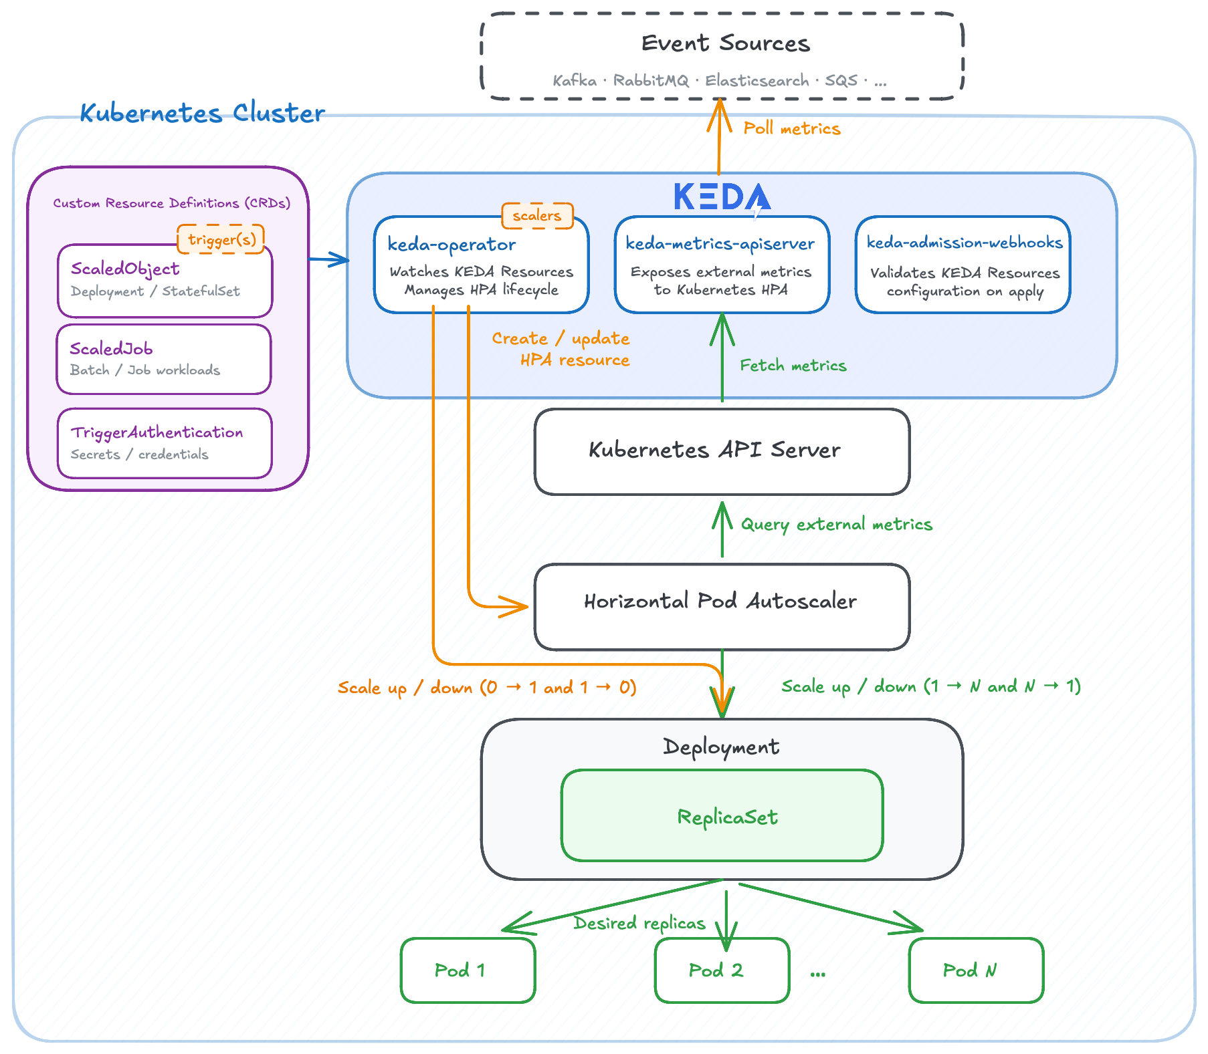
|
WHAT IT IS
architecture
<number>

Slide 4
|
WHAT IT IS
how it works
keda-operator
watches ScaledObjects
0 ↔ 1 activation
HPA
Kubernetes
API server
1 ↔ N replicas
External
event source
CRDs • HPA • etcd
queue • DB • API
keda-metrics-
apiserver
serves external metrics
Deployment /
ReplicaSet / Pods
actual workload

Slide 5
|
COMPARISON
similar tools
 | Keda | Knative Serving | HPA + Prometheus Adapter
Resources utilization | Lightweight | More components required | Lightweight adapter; needs Prometheus
Integration | Kafka, SQS, RabbitMQ, Prometheus, 75+ buil-in scalers | HTTP requests, RPS, concurrency | Any suitable Prometheus metric
Configuration | Simple trigger-based YAML | More platform configuration | HPA + metric mapping rules

Slide 6
|
DEMO
VIDEO

