Slide 1
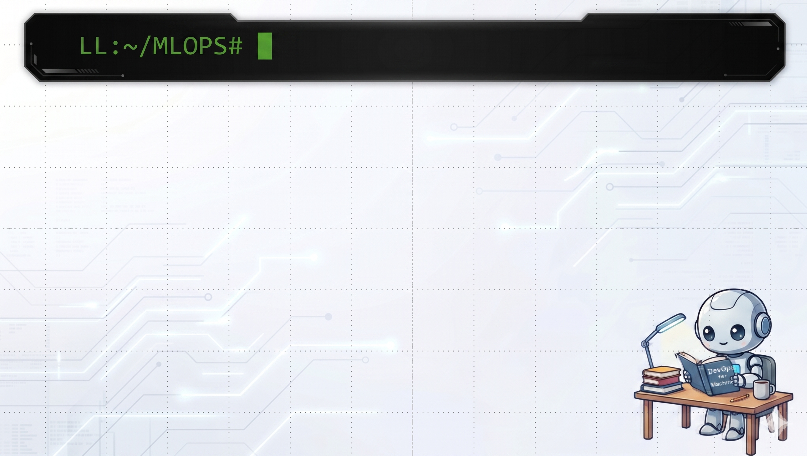

What is Machine Learning?
Machine learning is a type of artificial intelligence that performs data analysis tasks without explicit instructions
is a branch of artificial intelligence (AI) and computer science that leverages data and algorithms to enable AI systems to learn and improve in a manner similar to humans, progressively enhancing their accuracy over time
Deterministic,Predict things
Notes:
Here are the notes for the presenter

Slide 2
Why ?
when the rules are too complex, too dynamic, or too perceptual for hand-written logic, such as speech recognition, image classification, stock prediction, churn prediction, and recommendation
Notes:
Here are the notes for the presenter

Slide 3
Use cases
Here we may use the fraud detection example or a
recommendations, classification, sentiment analysis, and content generation.
Notes:
Here are the notes for the presenter

Slide 4
So what is wrong?
What it is, why it’s necessary and that it needs to be updated
Based on previous example, we demonstrate the problem: data decay overtime and needs re-train and re-deployment quickly to production
Notes:
Here are the notes for the presenter

Slide 5

How can we solve?
MLOPS
Machine Learning Operations
Notes:
Here are the notes for the presenter

Slide 6
What is MLOPS ?
It’s the practice of
the extension of DevOps practices to ML and data science assets. The goal is to treat data, models, training code, pipelines, and serving services as first-class production assets.
Its main focus of the _“ML Operations”_ phase is to deliver the previously developed ML model in production by using established DevOps practices such as testing, versioning, continuous delivery, and monitoring.
Notes:
Here are the notes for the presenter

Slide 7
What is MLOPS ?
1. Principles
2. Components
3. Experimets Tracking
4. Tests
5. Monitoring
Notes:
Here are the notes for the presenter

Slide 8
Slide name
1. Topics
Notes:
Here are the notes for the presenter

Slide 9
Slide name
1. Topics
Notes:
Here are the notes for the presenter

Slide 10
Slide name
1. Topics
Notes:
Here are the notes for the presenter

Slide 11
Demonstration
Notes:
Here are the notes for the presenter

