Slide 1

SWE 4743:
Object-Oriented Design
Jeff Adkisson
Monday, Wednesday at 6:30 PM
Architecture, 175

Slide 2
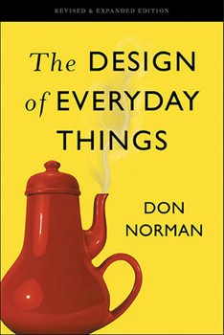
“Good design is actually a lot harder to notice than poor design, in part because good designs fit our needs so well that the design is invisible.
Don Norman
The Design of Everyday Things

Slide 3
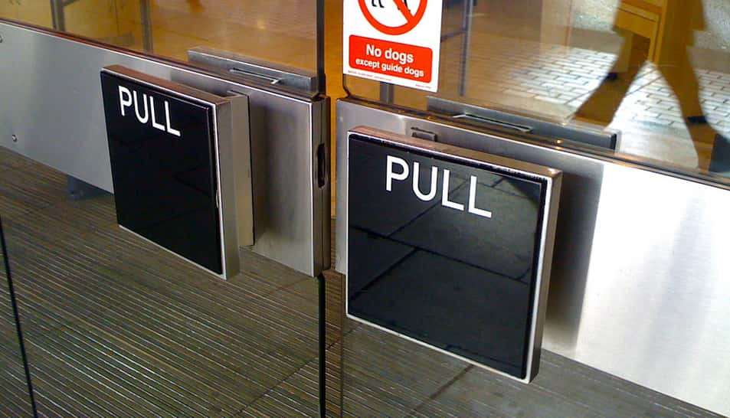

Slide 4
Code makes things work.
Design makes things last.
Two identical features implemented:
Version A: shipped fast, hard to change
Version B: shipped thoughtfully, adapts for years
Most software cost is not writing code—it’s changing it.
Design choices compound over time, for better or worse.
Good design lets average developers produce excellent systems.

Slide 5
Why do so many successful systems still get rewritten?
Month 1 - Works! We shipped so fast! Vibe coding ROCKS!
Month 6 - Still okay, slightly difficult to maintain…
Year 2 - Pain, every ”enhancement” breaks something, so buggy…
Year 5 ─── Rewrite discussion, so brittle nothing can be added, ugh…
Design debt doesn’t hurt immediately—that’s why it’s dangerous.
Early success often masks structural problems.
OO design exists to manage long-lived complexity, not toy programs.

Slide 6
Design Is About Change, Not Features
Initial requirements don’t kill systems - changing requirements do.
Object oriented design techniques exist to localize change.
Single responsibility, open-closed principle, dependency inversion all answer the same question:
“Where should this change go?”

Slide 7
Your most important reader is future developers, not the compiler.
Code is read far more than it is written.
Good design communicates intent, boundaries, and invariants.
Classes and interfaces are sentences, not just containers.
Design is how you talk to people you’ll never meet.
--- or if you stick around long enough ---
Design is how future you
can avoid hating past you.

Slide 8
Good design limits what you can do… on purpose!
Encapsulation is about preventing misuse.
Constraints reduce cognitive load.
Well-designed systems make wrong code hard to write.

Slide 9
The Tragedy of “Just One More If”
Most design failures start small and seem reasonable.
Today:
  if (type == A) { ... }
  else if (type == B) { ... }
  else if (type == C) { ... }
Soon:
  18 more conditions, cases,
  tweaks, requirements, etc.
Design erosion happens incrementally.
OO design provides escape hatches before conditionals explode.
Patterns often emerge after pain—this course helps you see them earlier.

Slide 10
Design distinguishes programmers from software engineers.
Industry rewards people who can manage complexity.
Design skill is what scales your impact.
Languages and frameworks change—design principles do not.
Compare:
“Can you implement this?”
“Can you evolve this safely?”
Job title progression
Junior →
Senior →
Architect

Slide 11
Abstraction Is Choosing
What Not to Care About
Without Abstraction
Every detail is visible everywhere
↓
More things to think about
↓
Harder to change safely
With Abstraction
Important ideas are visible and
unimportant details are hidden
↓
Fewer things to think about
↓
Changes stay localized

Slide 12
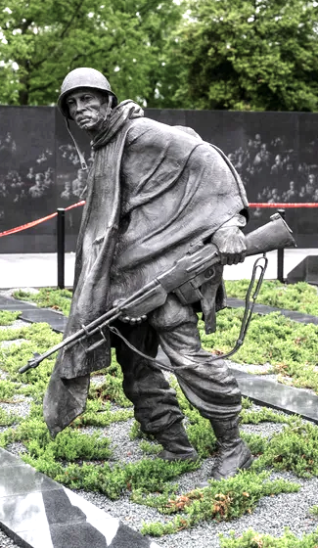
ABSTRACTION
Korean War Veterans Memorial, 1995
Frank Gaylord
Washington, DC

Slide 13
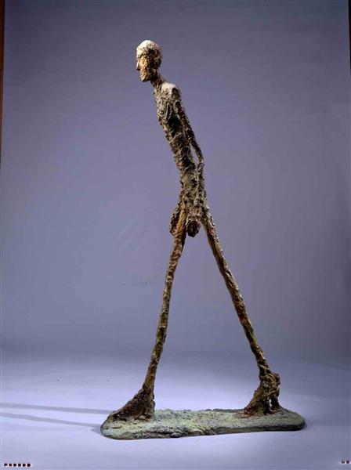
ABSTRACTION
The Walking Man, 1960
Alberto Giacometti
Museum of Modern Art (MoMA), New York

Slide 14
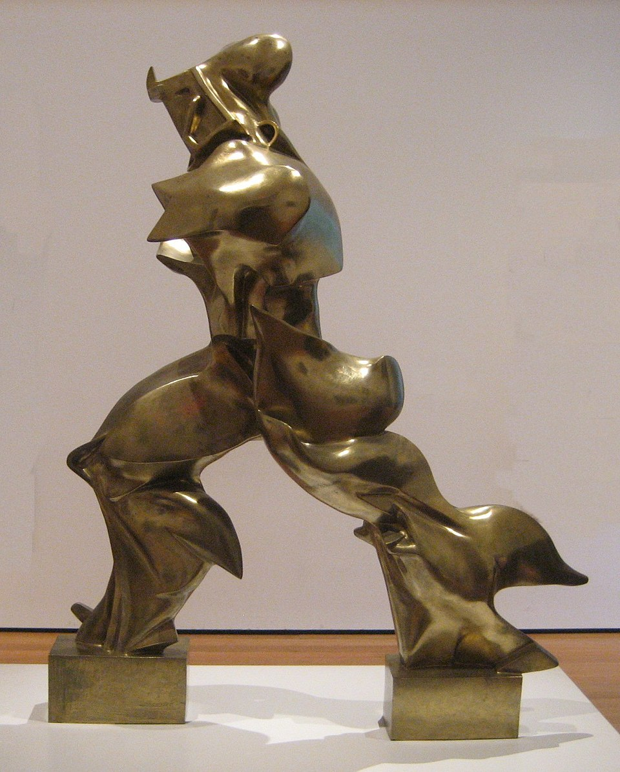
ABSTRACTION
Unique Forms of Continuity in Space (1913)
Umberto Boccioni
Museum of Modern Art (MoMA), New York

Slide 15
Abstraction Is Choosing
What Not to Care About
Without Abstraction
Every detail is visible everywhere
↓
More things to think about
↓
Harder to change safely
With Abstraction
Important ideas are visible
Unimportant details are hidden
↓
Fewer things to think about
↓
Changes stay localized

Slide 16
What you do not see is the point
Every abstraction hides or eliminates irrelevant information.
In other words, good design discards the right details.
Bad design discards the wrong ones—or none at all.
Abstraction is selective blindness.

Slide 17
Abstraction Comparison: The Linux File System API
The Actual Linux API…
int fd = open("data.txt", O_RDONLY);
read(fd, buffer, 4096);
write(fd, buffer, 4096);
close(fd);
Hypothetical Bad Abstraction
int disk = openDisk(0);
int block = allocateBlock(disk);
writeBlock(disk, block, buffer);
flushCache(disk);
What it abstracts
Persistent storage
Sequential & random access
Durability
Naming (paths)
What it hides
Disk blocks
SSD vs HDD
Caching
Journaling
RAID
Network storage
Failure recovery
What it exposes
Block sizes
Disk layout
Caching policy
Storage hardware
Write ordering
What it forces
Every program to manage storage details
Widespread changes when hardware changes
High cognitive load
Fragile code

Slide 18
Abstraction Comparison: The Linux File System API
The Actual Linux API…
int fd = open("data.txt", O_RDONLY);
read(fd, buffer, 4096);
write(fd, buffer, 4096);
close(fd);
Good abstractions let you reason about what you want to accomplish…
not how it is achieved.
What it abstracts
Persistent storage
Sequential & random access
Durability
Naming (paths)
What it hides
Disk blocks
SSD vs HDD
Caching
Journaling
RAID
Network storage
Failure recovery

Slide 19
“Any fool can write code that a computer can understand. Good programmers write code that humans can understand.”
Martin Fowler

