Slide 1
OO Foundations Review
SWE 4743:
Object-Oriented Design
Jeff Adkisson
Notes:
Explain that this is a fast refresher to establish shared vocabulary before design topics.

Slide 2
Why Review OO Concepts?
Students arrive with uneven OO backgrounds
We need shared terminology
Design discussions assume these concepts
The following lecture demonstrates how to diagram OO relationships using Mermaid.js
Notes:
Reassure students this is a reset, not a test.

Slide 3
Agenda
Polymorphism, encapsulation, inheritance, interfaces
Access modifiers and visibility boundaries
Classes, fields, methods, properties
Primitive, abstract, and concrete types
Namespaces, modules, and basic organizational structure
Notes:
Reassure students this is a reset, not a test.

Slide 4
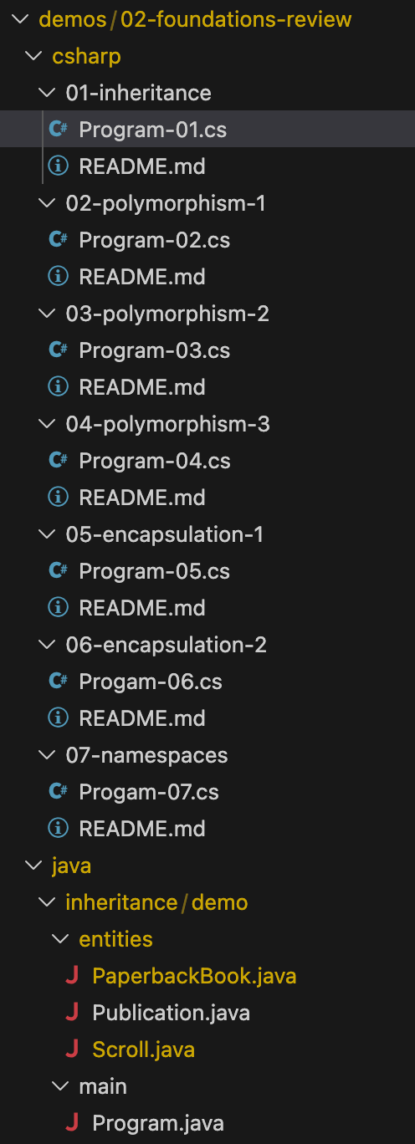
Demo Code
Demo code is located in the course repository under demos/02-foundations-review
Most demo code is in C#.
There is one version of Progam-01.cs in Java to demonstrate the difference in how Java handles namespaces (must be in separate folders and files).
Notes:
Reassure students this is a reset, not a test.

Slide 5
Inheritance
Allows one class to reuse another class’s behavior
Represents an "is-a" relationship
Creates a relationship between types
Notes:
Keep neutral: what it is and why it exists.

Slide 6
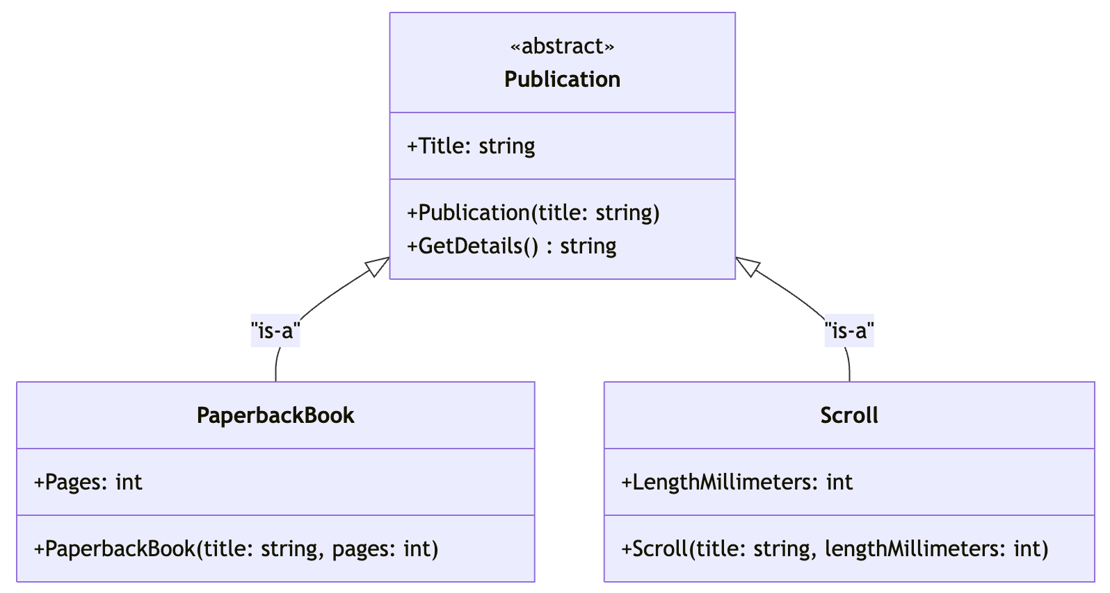
Inheritance
Program-01.cs

Slide 7
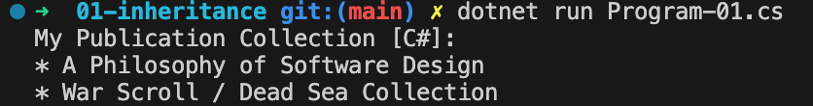
Inheritance
Program-01.cs
Architecture
Defines an abstract base class (Publication) that represents a general domain concept.
Concrete subclasses (PaperbackBook, Scroll) inherit shared state from the base class.
The base class provides non-abstract shared behavior (GetDetails) that subclasses may override.
Client code operates on a collection of the base type.
OO Concepts Illustrated
Abstract classes
Inheritance
Code reuse through shared base implementation

Slide 8
Polymorphism
Code works with many related types
Uses a base type reference
Enables flexible behavior
There are various polymorphic techniques
  Abstract classes
  Interfaces
  Abstract methods (children must implement)
  Virtual methods (descendants can override parent implementation)
Notes:
Stress usage, not implementation.

Slide 9
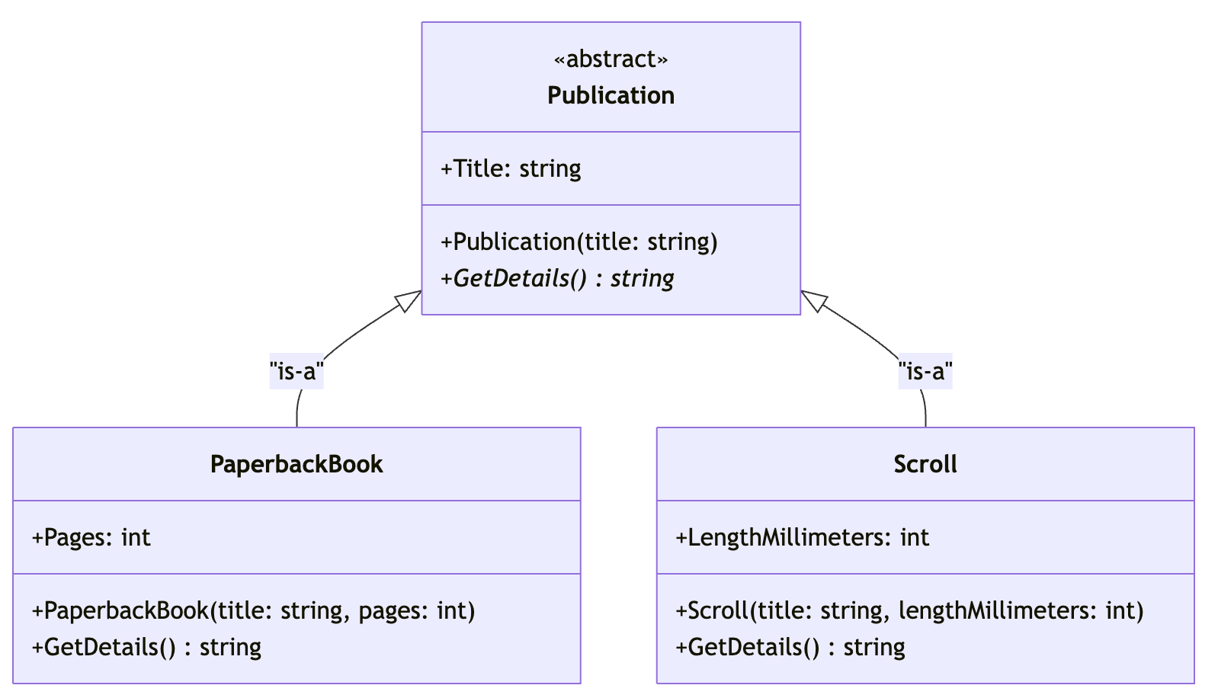
Polymorphism 1
Program-02.cs

Slide 10
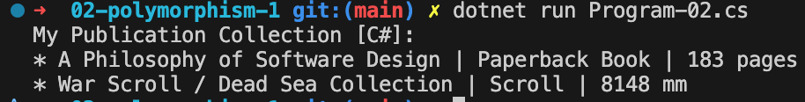
Polymorphism 1
Program-02.cs
Architecture
Evolves the base class by introducing an abstract method.
Subclasses are now required to implement behavior specific to their type.
Polymorphism is exercised by calling the abstract method through a base-class reference.
Shared data remains in the base class; behavior diverges in subclasses.
OO Concepts Illustrated
Polymorphism
Abstract methods
Method overriding
Dynamic dispatch

Slide 11
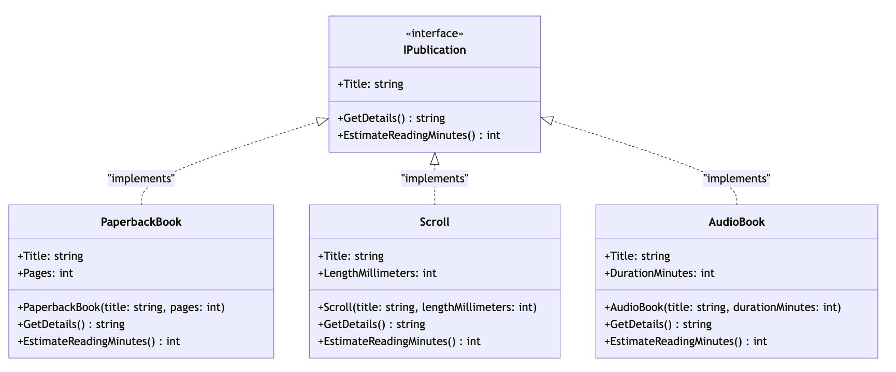
Polymorphism 2
Program-03.cs

Slide 12
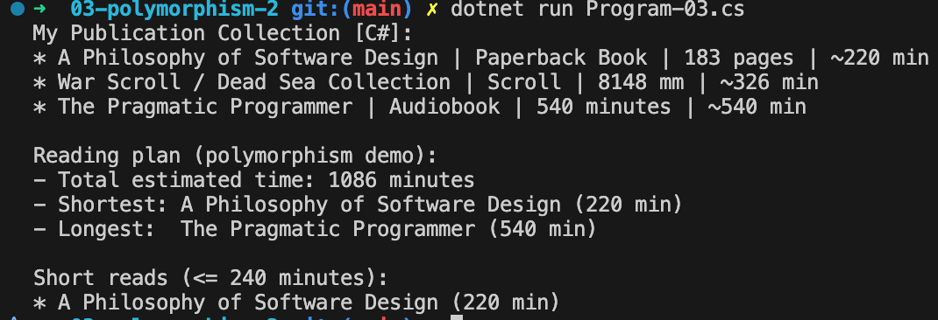
Polymorphism 2
Program-03.cs
Architecture
Introduces an interface (IPublication) to define behavioral contracts.
Abstract base class is no longer responsible for polymorphic behavior.
Concrete classes implement the interface directly.
Base class (if present) is now focused on shared state only.
OO Concepts Illustrated
Interfaces
Interface-based polymorphism
Separation of concerns

Slide 13
Interfaces
Define what a class can do
Do not contain implementation details
Allow multiple implementations
Notes:
No design tradeoffs yet.

Slide 14
Kinds of Types
Primitive types: built-in values
Concrete types: instantiable classes
Abstract types: interfaces and abstract classes
Notes:
Students often confuse these categories.

Slide 15
Type Examples
int count; // primitive
class User { } // concrete
interface IRepository { } // abstract
abstract class UserBase { } // abstract with implementation
Notes:
Highlight intent vs implementation.

Slide 16
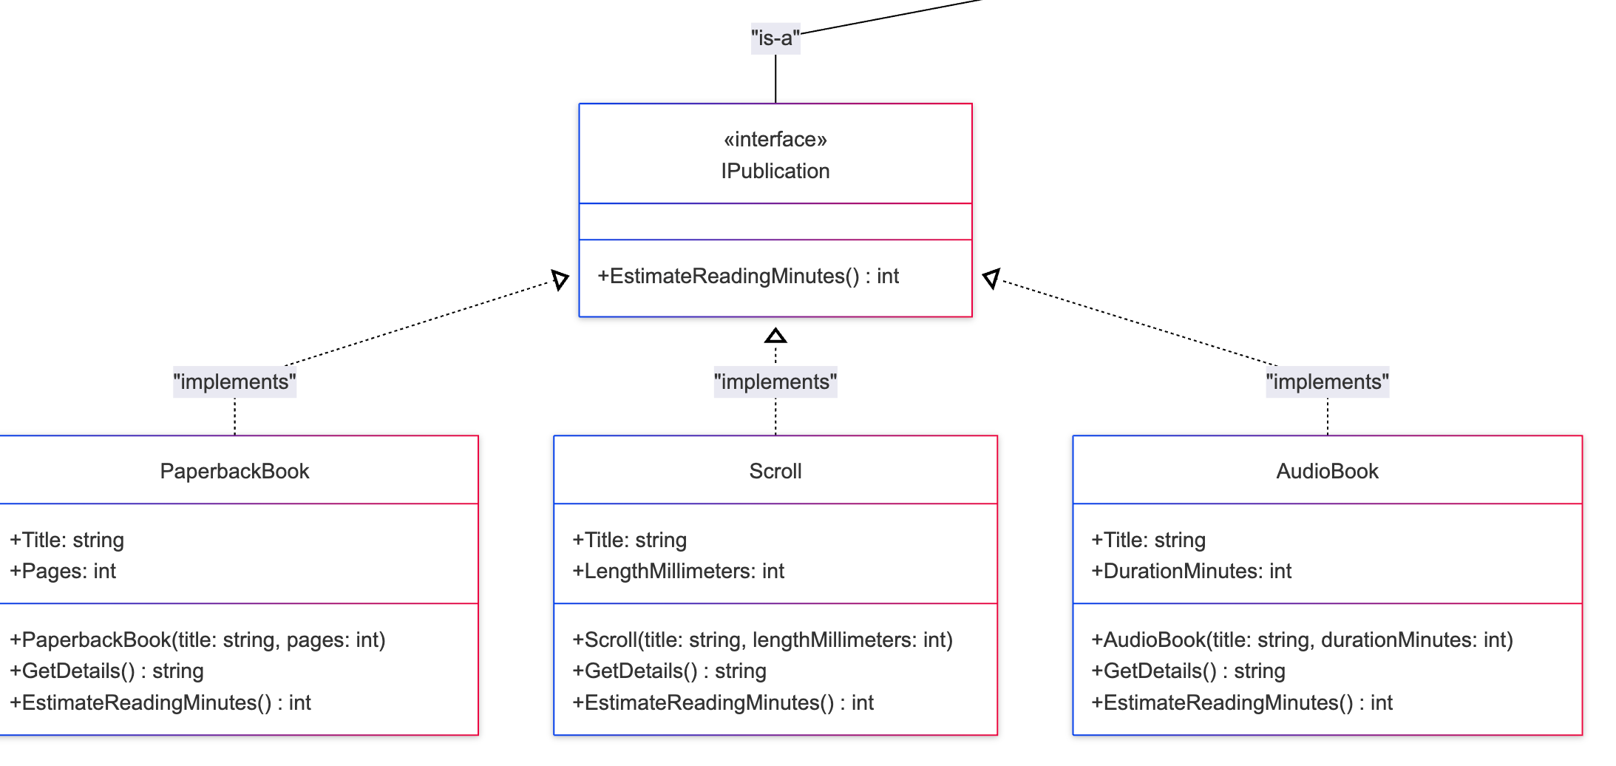
Polymorphism 3
Program-04.cs

Slide 17
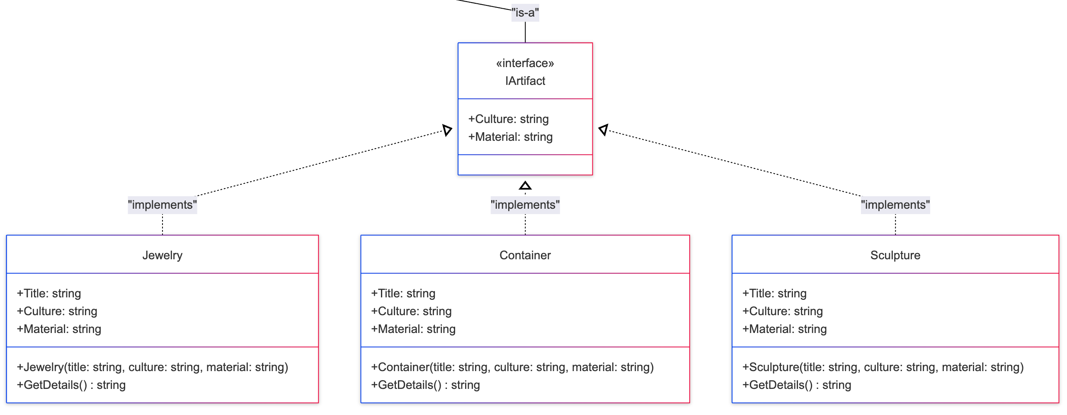
Polymorphism 3
Program-04.cs

Slide 18
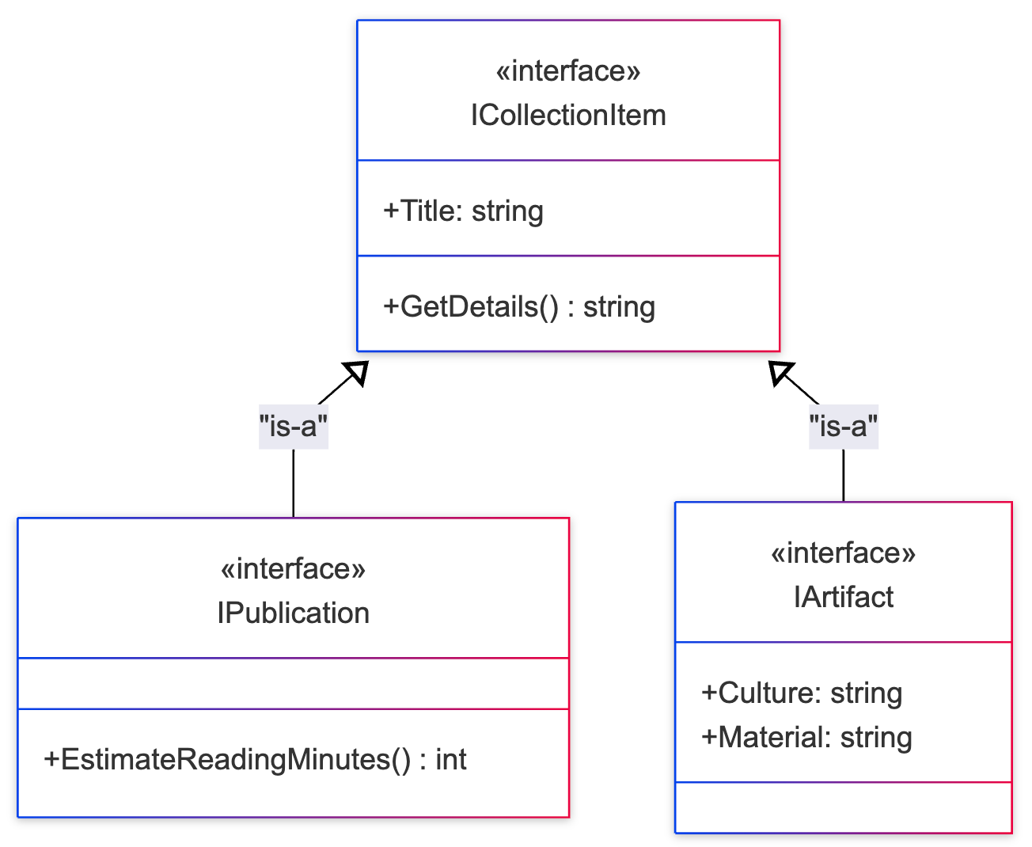
Polymorphism 3
Program-04.cs

Slide 19
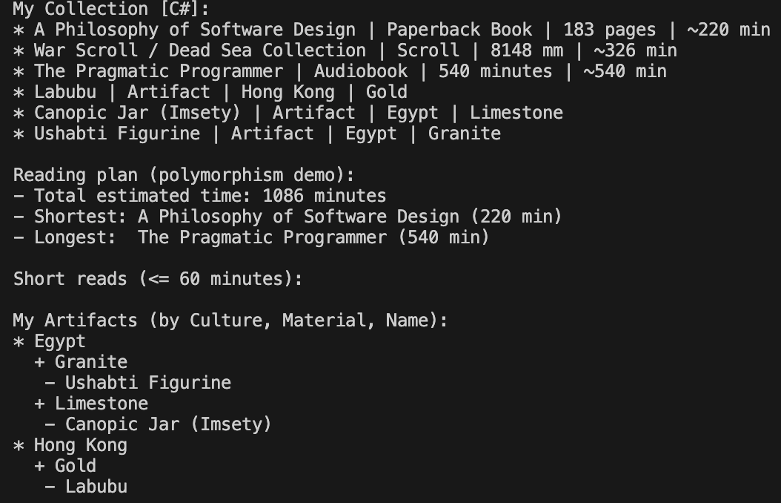
Polymorphism 3
Program-04.cs
Architecture
Introduces a top-level interface (ICollectionItem) representing a broad capability.
Specialized interfaces (IPublication) extend the top-level interface.
Concrete classes implement the most specific interface appropriate to them.
Client code works against multiple abstraction levels.
OO Concepts Illustrated
Interface inheritance
Liskov Substitution Principle (LSP)
Deep polymorphism

Slide 20
Encapsulation
A class controls its own data
State is accessed through methods
Protects internal consistency
Notes:
Many students struggle here—slow down slightly.

Slide 21
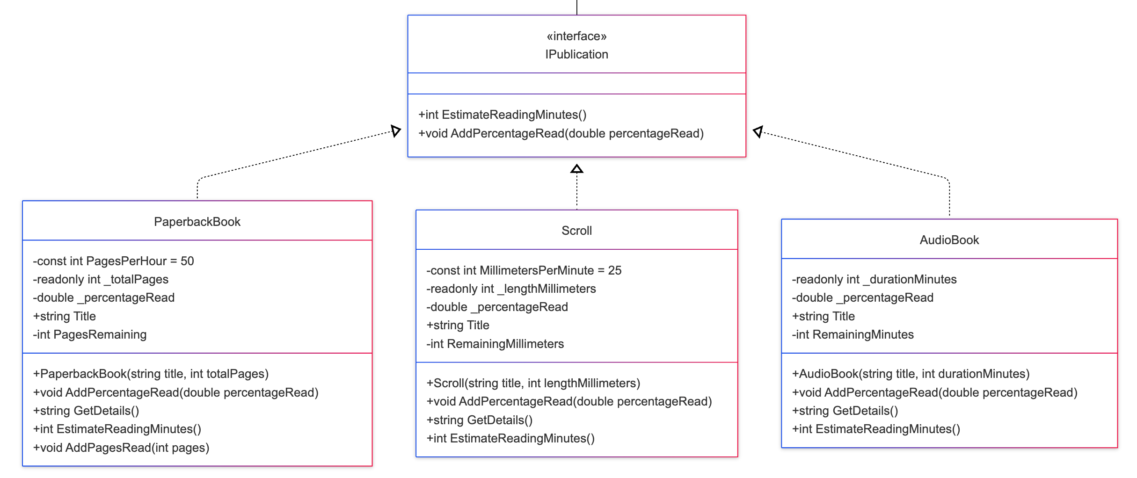
Encapsulation 1
Program-05.cs
Notes:
Many students struggle here—slow down slightly.

Slide 22
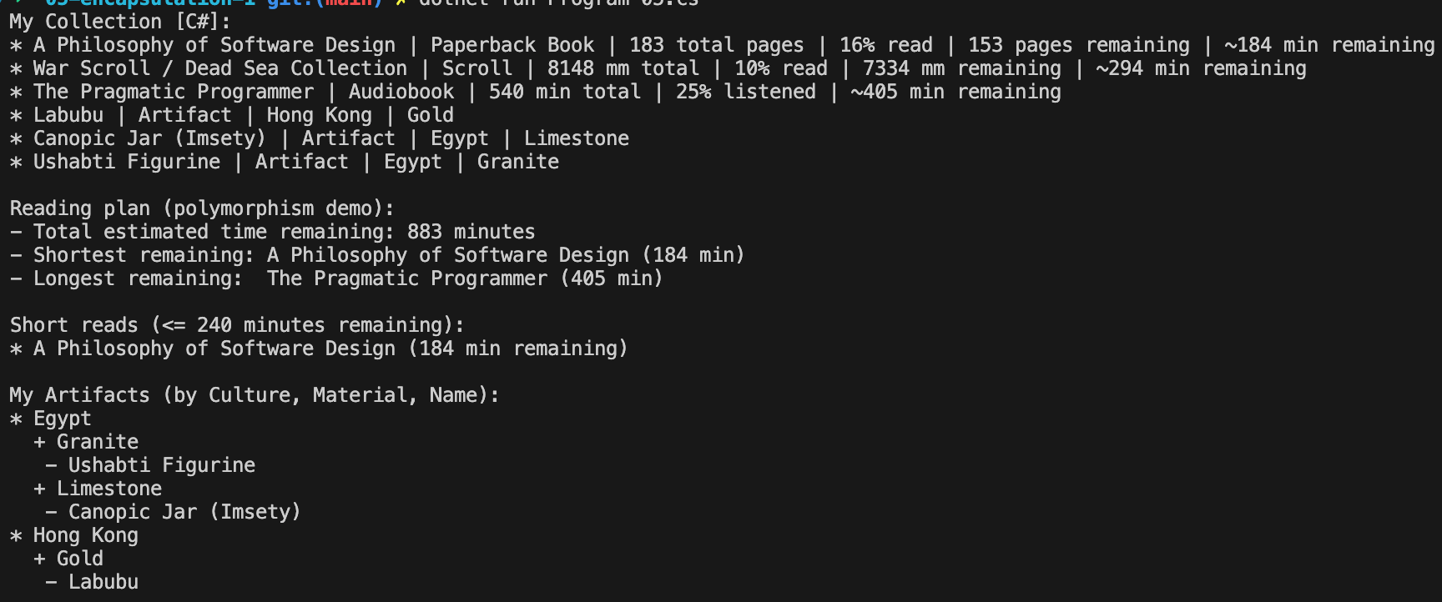
Encapsulation 1
Program-05.cs
Architecture
Introduces private fields to encapsulate internal state.
State changes are controlled via methods and properties.
Demonstrates casting between interfaces and concrete types where appropriate.
Maintains polymorphism while protecting object invariants.
OO Concepts Illustrated
Encapsulation
Information hiding
Controlled access to state
Safe downcasting

Slide 23
Access Modifiers
private: accessible only inside the class
public: accessible everywhere
protected: accessible to subclasses
Notes:
Tie modifiers to encapsulation.

Slide 24
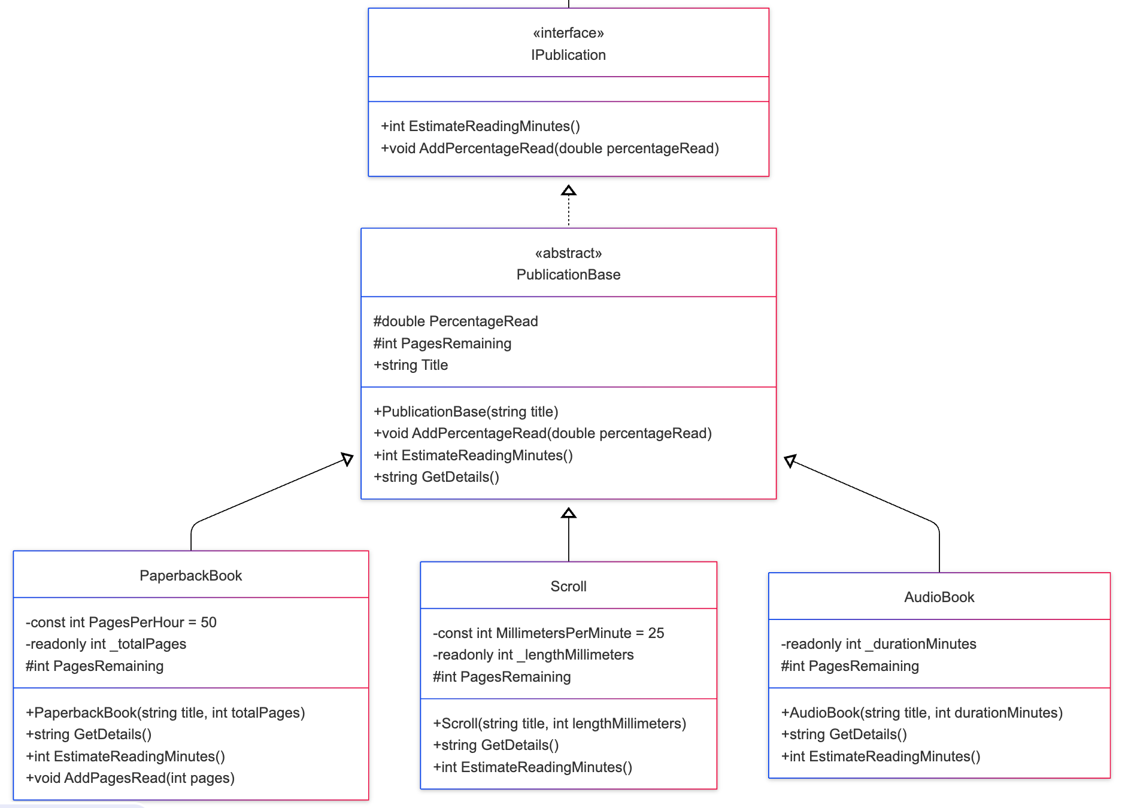
Encapsulation 2
Program-06.cs
Notes:
Many students struggle here—slow down slightly.

Slide 25
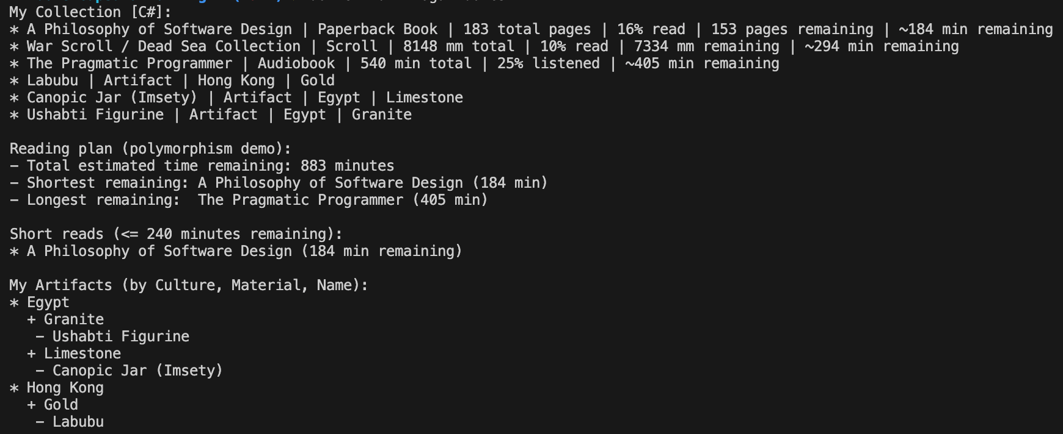
Encapsulation 2
Program-06.cs
Architecture
Keeps the interface-first design:
  ICollectionItem remains the base interface for anything in the collection.
  IPublication : ICollectionItem still defines “publication” capabilities (e.g., estimated time remaining + progress updates).
  IArtifact : ICollectionItem continues to represent non-reading/listening collection items.
Introduces a new abstract class beneath the interface:
  PublicationBase : IPublication acts as a shared implementation layer.
  Holds common state for publication progress using protected fields (teaching-focused encapsulation).
Centralizes shared progress behavior:
  A single implementation of progress mutation logic (e.g., “add % read/listened”) now lives in the abstract base.
  Concrete publication types override only what varies (e.g., how “remaining” is computed and how details are presented).

Slide 26
Encapsulation 2
Program-06.cs
OO Concepts Illustrated
Encapsulation via protected (and what it exposes vs private)
Interfaces + abstract classes together (“contract + partial implementation”)
Reuse without duplicating state/logic
Template-style variation: base handles common mechanics, subclasses specialize specifics

Slide 27
Namespaces and Organization
Group related classes
Prevent naming conflicts
Improve readability
Notes:
Explain this is for humans, not compilers.

Slide 28
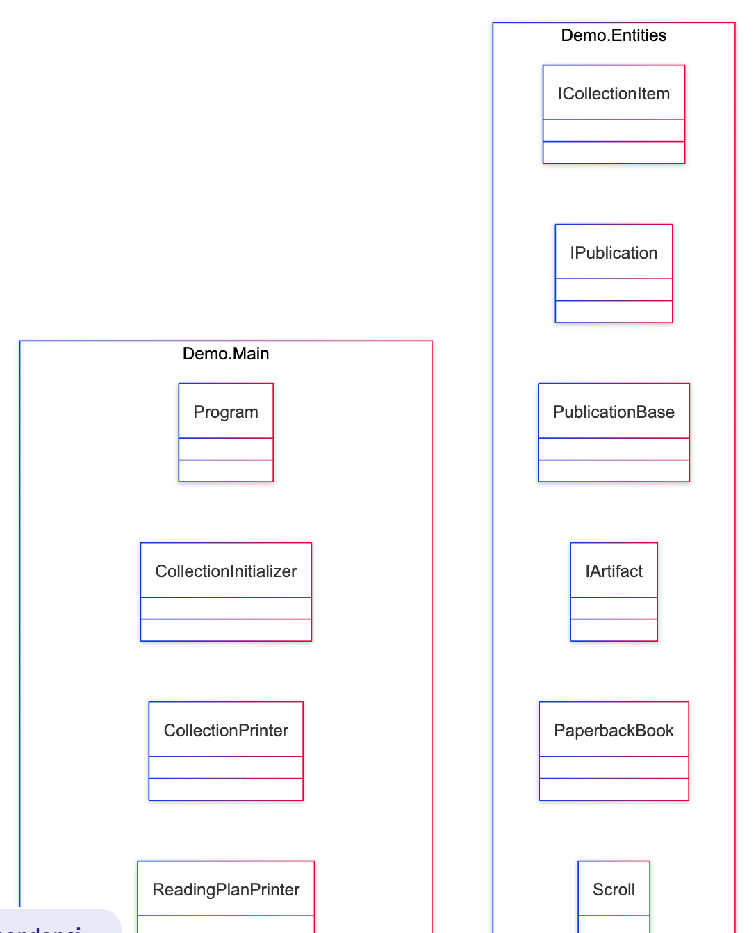
Namespaces
Program-07.cs
Notes:
Encourage logical grouping.

Slide 29
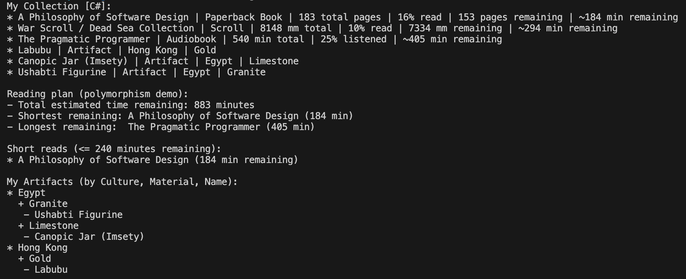
Namespaces
Program-07.cs
Architecture
Refactors the “main program” responsibilities into focused helper classes:
  CollectionInitializer (builds the collection)
  CollectionPrinter (prints all items)
  ReadingPlanPrinter (prints reading plan view)
  ShortReadsPrinter (filters and prints short reads)
  ArtifactsByCultureMaterialNamePrinter (grouping/sorting/reporting)
Program.Main() becomes a small coordinator:
  Instantiates helpers
  Orchestrates the workflow
  No longer contains all the logic itself

Slide 30
Namespaces
Program-07.cs
OO Concepts Illustrated
Avoiding a God class
Single Responsibility Principle (SRP)
Basic “composition of services” (Main composes small collaborators)
“Namespace/storytelling” benefits:
  Code layout communicates intent (main entry + helpers + entities)

Slide 31
What You Should Take Away
OO concepts give us shared language
Each concept solves a specific problem
The following lecture goes into diagramming with Mermaid.
Following the diagramming lecture, we go on to how to make good OO design decisions.
Notes:
Bridge to design and diagramming lectures.

Slide 32
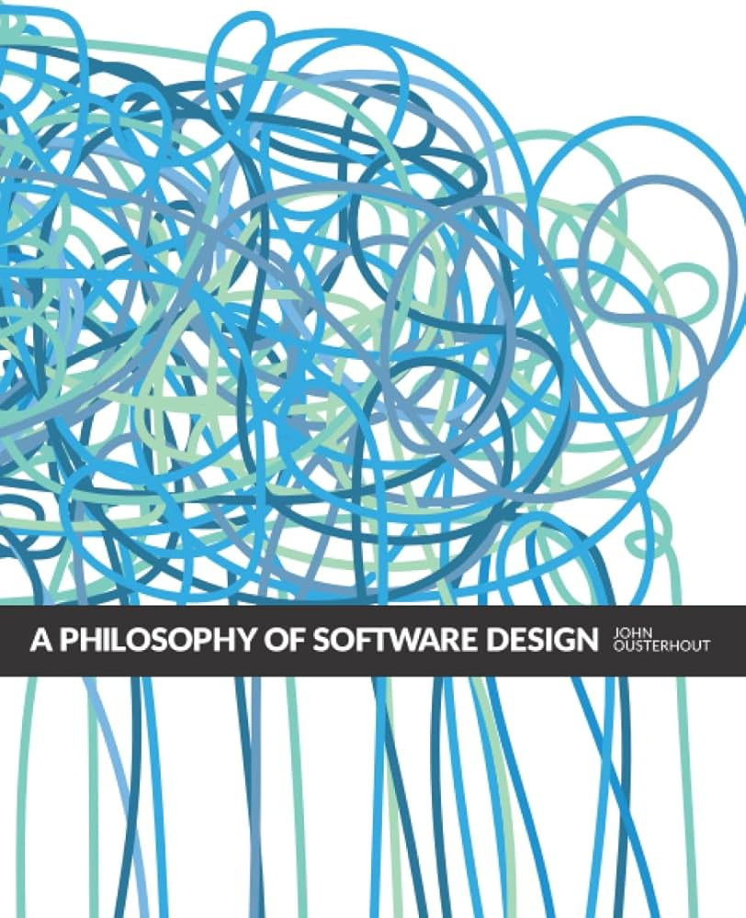
Assigned Readings
A Philosophy of Software Design - Ousterhout
  Preface
  Chapter 1: Introduction
  Chapter 2: The Nature of Complexity

Slide 33
Lecture Recording
Jan 14 2026
https://www.loom.com/share/b54e52c10e0a4d11909f2adbefee5c14

