Slide 1

User Centered Design Process
Jeff Adkisson, Chief Technology Officer
Jeff@HighMatch.com
KSU MSCS, Class of 2017
KSU Adjunct Professor, SWE

Slide 2
Lecture Format
  Questions are encouraged.
  I am available for questions after the lecture.
  If we start to run long, we’ll move questions to the end, or you can email me. I am happy to connect on LinkedIn as well.
  Please call me Jeff.

Slide 3
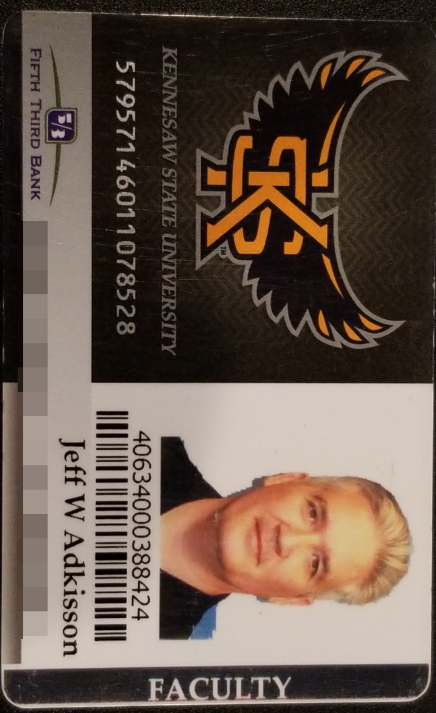
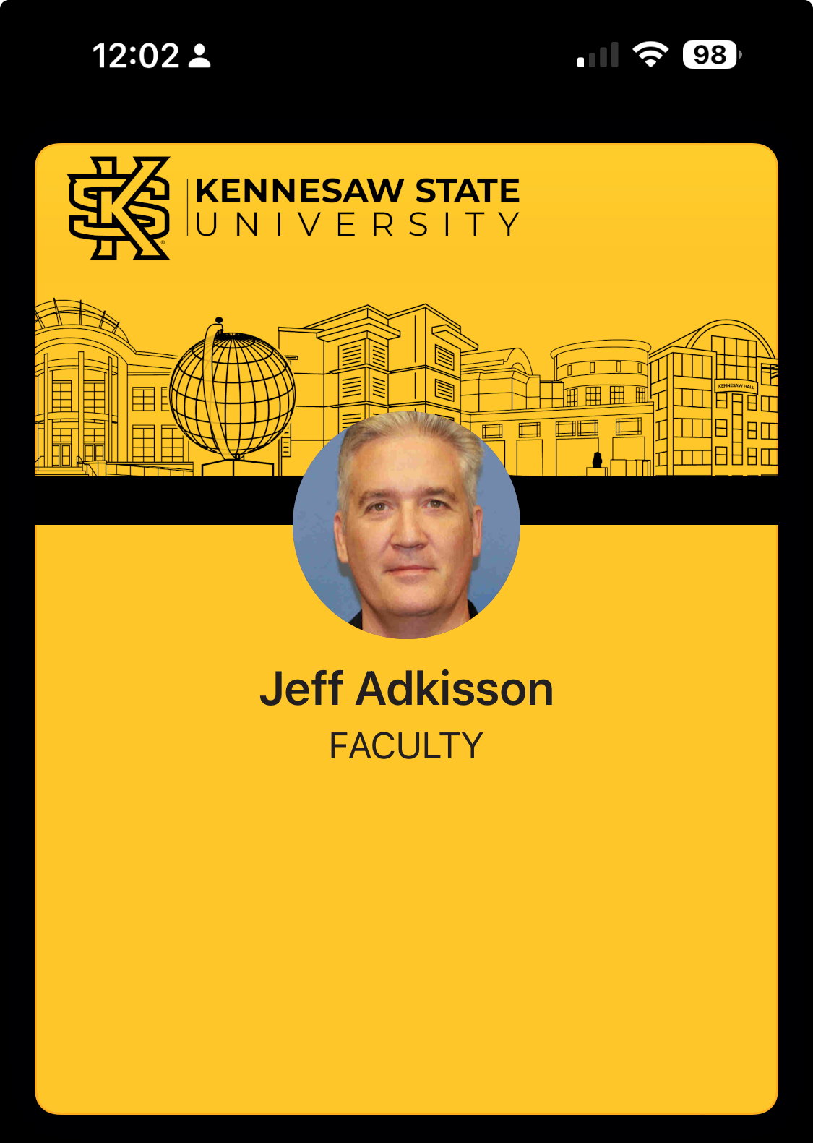
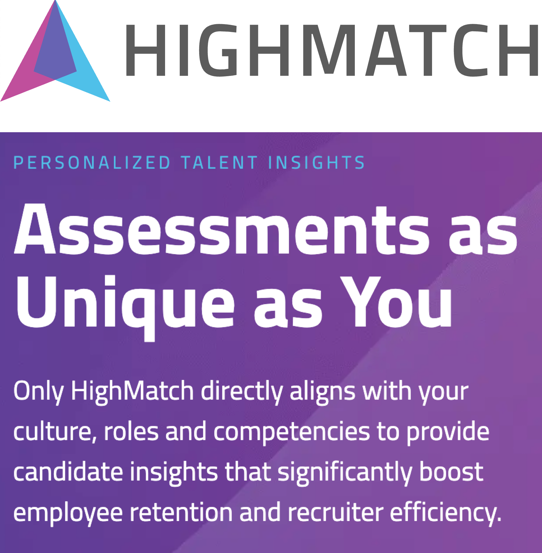
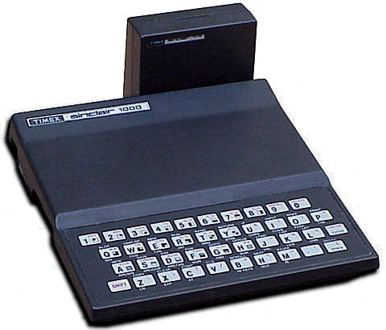
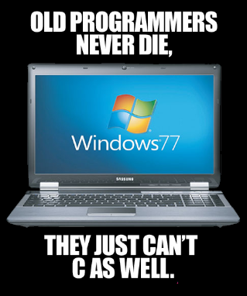
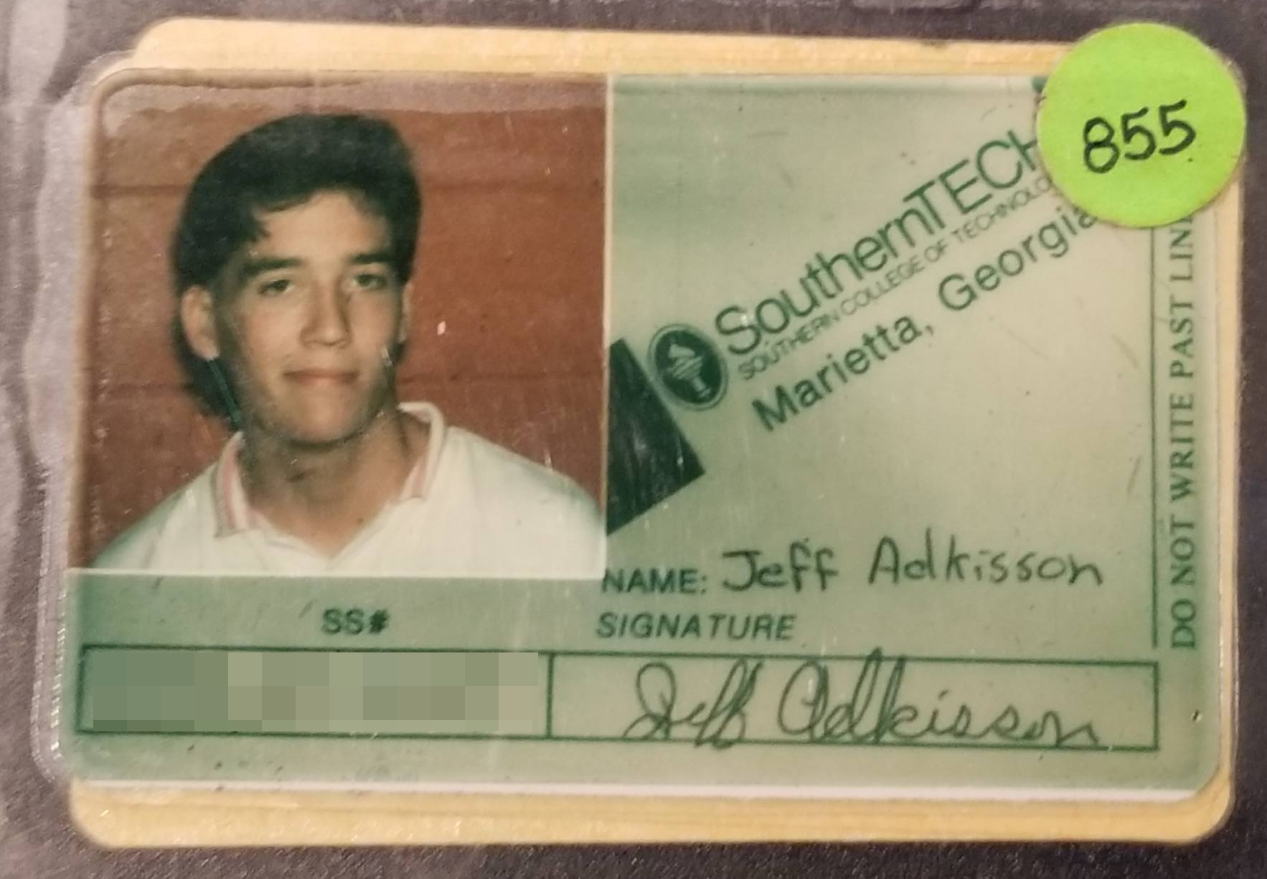
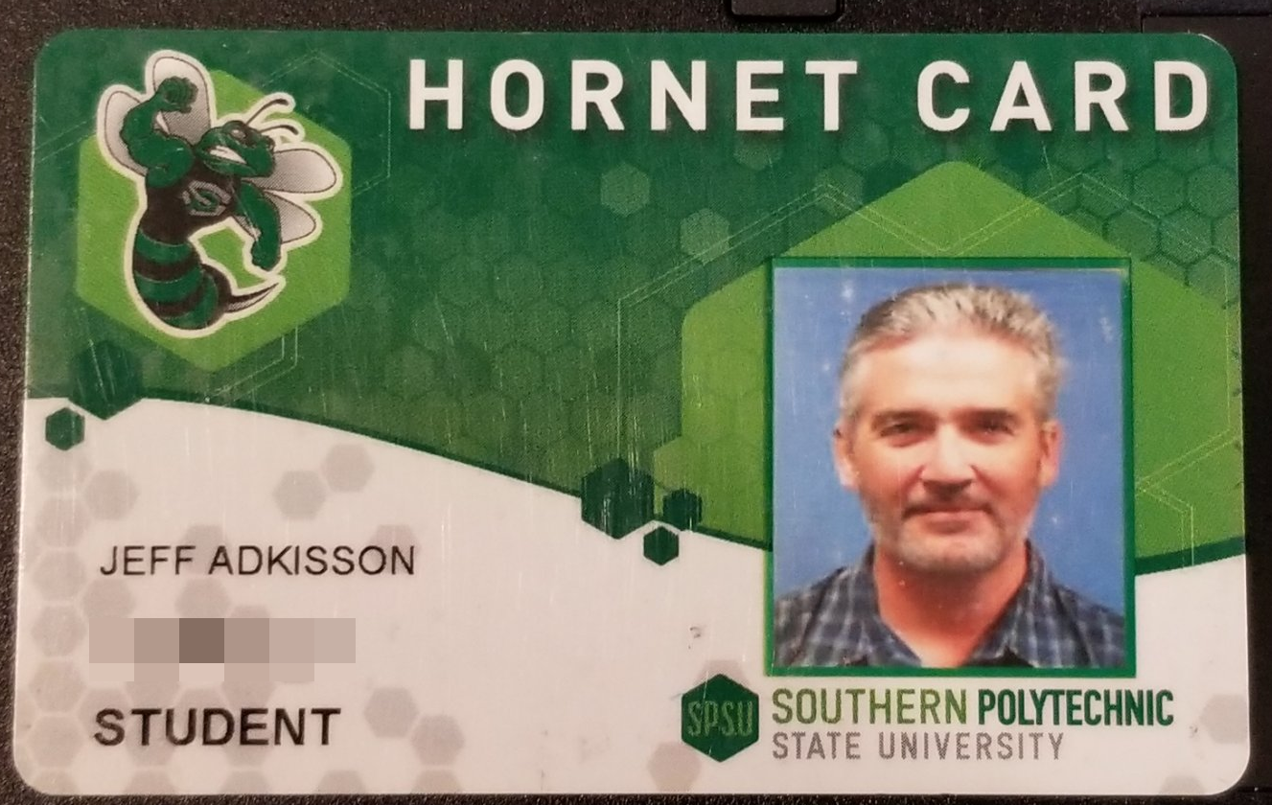
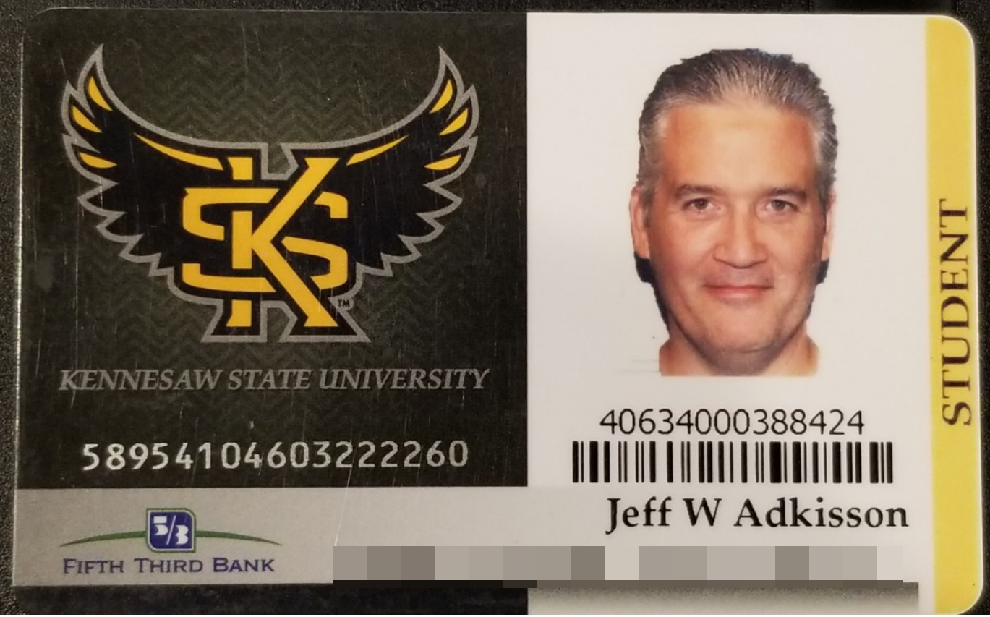
About Me
  Started programming at young age
  First computer Timex Sinclair 1000, 16k of RAM, Z80 processor
  Started ACS program 1988
  when this school was named Southern Tech
  Worked in software field since 1994
  Started CS Master’s in 2013 when SPSU
  Graduated 2017 from KSU
  Part-time KSU instructor in SWE department
  CTO at HighMatch since 2010.

Slide 4
Lecture Topics
  How does HighMatch design, build, and test our products?
  Agentic Design Demo & Discussion
    Use Claude Code to generate a high-fidelity UI prototype of a new HighMatch feature.
    – Use existing look/feel/palette/control set
  – Generate documentation to be used to review, implement, and test the final implementation
Note!
Claude will interrupt us as it works… we will move between the live design generation and this presentation.

Slide 5
Claude Agentic Design Demo
What We Are Doing Today
Interviewers must be able to annotate a candidate's assessment report in one or two gestures while staying focused on the candidate.
Any block can take a thumb, star rating, marker, or note from a hover rail, and any selected text can be highlighted, with notes anchored to a heading plus quoted text so they survive report changes.
Notes show as margin chips, inline callouts, or hidden, alongside an overall rating card, a panel in report order, and a print preview with or without notes.
Notes are private by default, shareable only by their owner, never editable by others, and speech-to-text is excluded for PII and SOC 2 reasons.
https://report.highmatch.com/LbOAeFTuzcRo3ZZeyJpSZTbIpMp5il

Slide 6
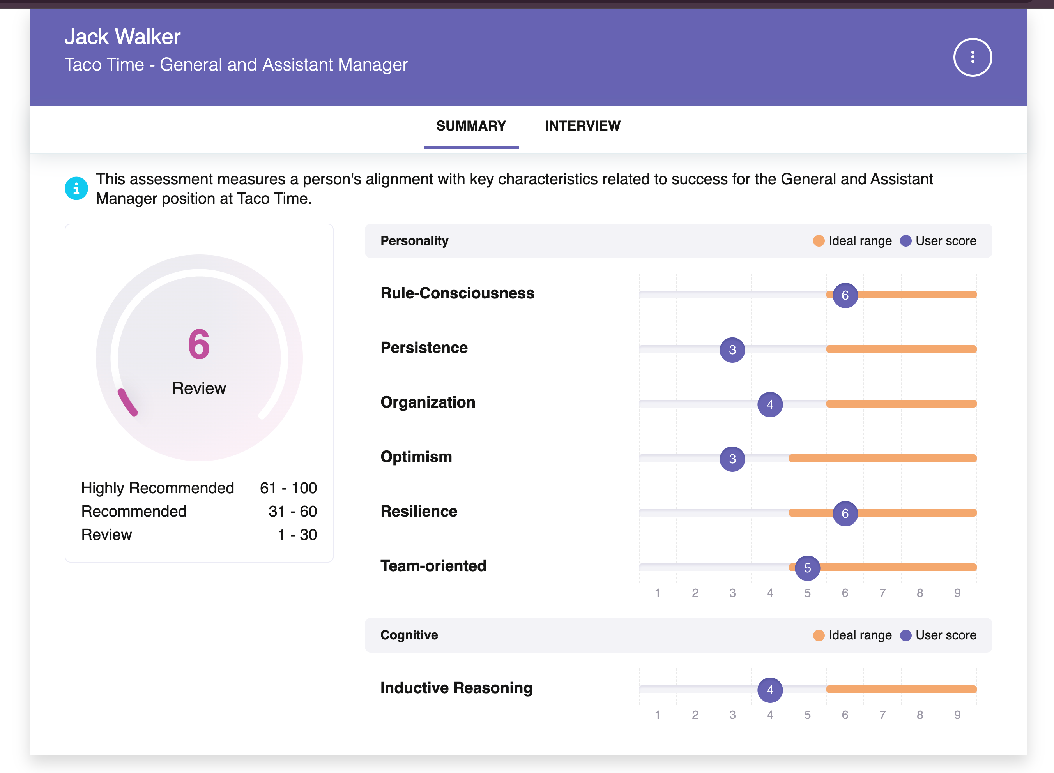
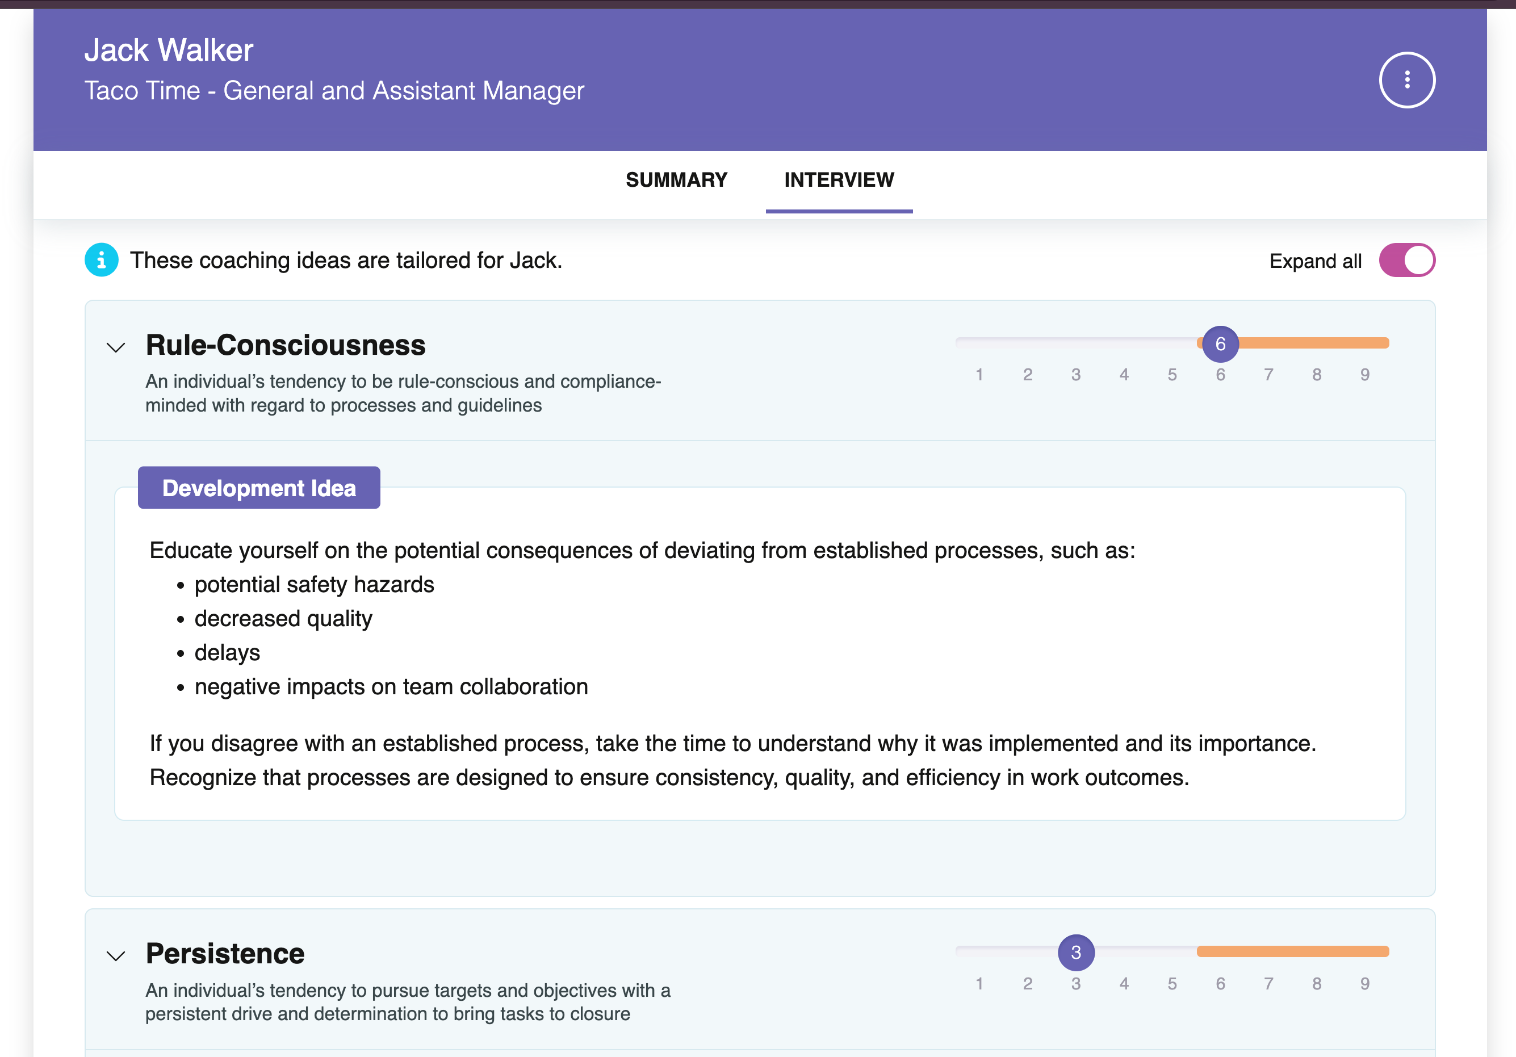
Claude’s Initial Input
A Working HighMatch report
https://report.highmatch.com/LbOAeFTuzcRo3ZZeyJpSZTbIpMp5il

Slide 7
To Save Time…
Agentic design is not fast yet, though it is far faster than a few months ago and improving constantly. For today I added a "lecture time limits" trailer to every prompt:
Desktop only, one window size, panel open. No mobile testing.
Verify by sampling, not exhaustively: one block of each kind. This can let bugs through, so be warned.
At most 60 seconds per browser check and 3 minutes of checking per prompt. This rule is new, so I may have to stop it myself.
No screenshots, short replies.
I captured the live report as a static page (prompt 0) and cut it from four pages to two (removing Details and Develop).

Slide 8
The Six Prompts
Foundation. One-file clickable prototype on the sample report. Notes anchor to heading plus quoted text, not page structure. Logged-in users, no speech-to-text, one or two gestures per action. Deliver only an app bar, a notes panel on N, and seeded notes.
Inline annotations. A hover rail on any block offers thumbs, stars, markers, and note. Click sets a value; same value removes, new value replaces, one per family per block per user. Notes become margin chips and panel rows grouped by page and heading. Unmatched notes go to Unplaced.
Highlighting. Selecting text shows a bar with four colors and "highlight and note". Clicking a highlight opens a card to recolor, annotate, or remove. Anchor by the quote plus nearby text. Double-clicking an accordion heading word must not toggle the section.
Note classes and display. An overall card with per-person ratings and notes. One Hidden, Margin, or Inline control, cycled with H. Print with or without notes through an in-page preview. Stamps and highlights can carry text.
Sharing. Notes start private; only the owner can share or edit, enforced in the update and delete functions. A "Viewing as" switch with three seeded interviewers. Keep the fields a later AI summary needs, but build no summary.
Review, fix, publish. Check a three-block sample: gestures, nothing covers text, all selections raise the bar, "Viewing as" hides and locks. Fix only failures, finish in five minutes, then publish as a Claude artifact and return the link.
https://jeff-adkisson.github.io/ui-design-lecture/prompts/

Slide 9
Let’s Get Claude Working
Technical Stack
Supacode - Jeff’s preferred terminal environment (great for worktree development)
Claude Code CLI - Agentic AI
Playwright MCP – Browser testing tool Claude can control
Git / GitHub – Source control
Clone from: https://github.com/jeff-adkisson/ui-design-lecture
Pages at: https://jeff-adkisson.github.io/ui-design-lecture
Prompts used today are in the ~/prompts folder

Slide 10
Claude Will Interrupt Us
Every time a prompt is complete, the AI will call out.
Also note that Claude will be opening browser windows using Playwright MCP, so expect the presentation to be interrupted from time to time.
We will drop out of the presentation as each prompt completes, then return when Claude starts on the next effort.

Slide 11
When Claude Is Done
We will review the work Claude performed, plus compare it to work performed in prior passes I performed to refine this lecture (mainly to keep Claude’s work to a reasonable amount of time).
Generative AI is not deterministic, so you will see that each pass looks different. The more specific your prompts, the more specific the output. Therefore, anywhere you see differences, that is a place the AI decided for you. This is very important because you want to be in control – not handing control blinding to the AI.
Pass 1
https://jeff-adkisson.github.io/ui-design-lecture/finished-design/pass-1/report-notes.html
Pass 2
https://jeff-adkisson.github.io/ui-design-lecture/finished-design/pass-2/index.html
Pass 3
https://jeff-adkisson.github.io/ui-design-lecture/finished-design/pass-3/prototype.html
SWE Design Docs (from pass 3): https://github.com/jeff-adkisson/ui-design-lecture/tree/main/finished-design/pass-3/final-design-docs

Slide 12
Software Engineering with an AI Agent;
NOT Vibe Coding / AI Slop
Pass 3 includes a full set of requirements, technical designs, etc. that a software engineer would develop to produce this feature.
To get the best results, you still need to produce great documentation, outstanding plans, and highly detailed instructions.
Skipping this step leads to Vibe Coding / AI Slop.
Remember – you are in control - unless you hand off control to the AI. The AI may be doing the coding, but the design, the requirements, etc. are yours to define and see transformed into a great, maintainable, extensible solution.
Think of the AI as a gifted, incredibly fast developer. Do not delegate control and responsibility to the AI. Use your training, education, and wits at all times.

Slide 13
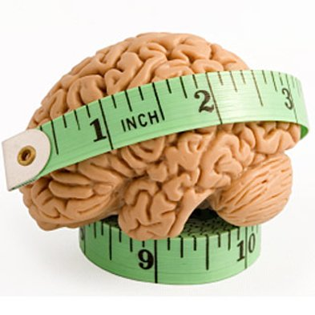
What HighMatch Does
HighMatch measures personality traits, cognitive abilities, attitudes, and skills.
We are not allowed to directly examine brains, unfortunately.
Instead, we ask a bunch of odd questions that have been proven by 50+ years of academic research to measure things employers are seeking, such as high sociability and strong problem-solving skills.
Industrial/Organizational (IO) psychologists create assessments. The science of assessment is called psychometrics.

Slide 14
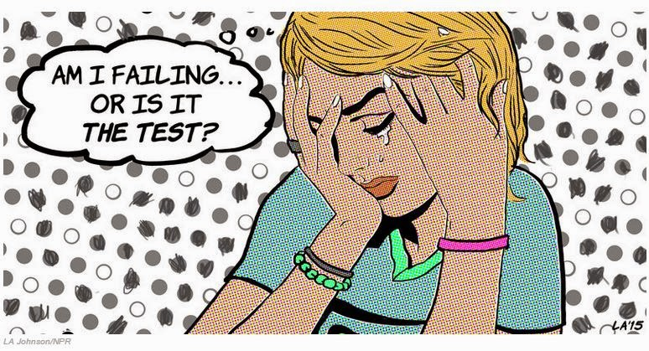



Good Design is Critical

Slide 15

Is This A Bad Design?

Slide 16
What HighMatch Considers “Design”
The process we follow to
communicate sophisticated ideas
and enable complex actions
while requiring the smallest effort
and least expertise from the user.

Slide 17
What HighMatch Considers “Design”
communicate sophisticated ideas
enable complex actions
require the smallest effort
require the least expertise

Slide 18
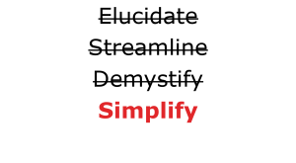
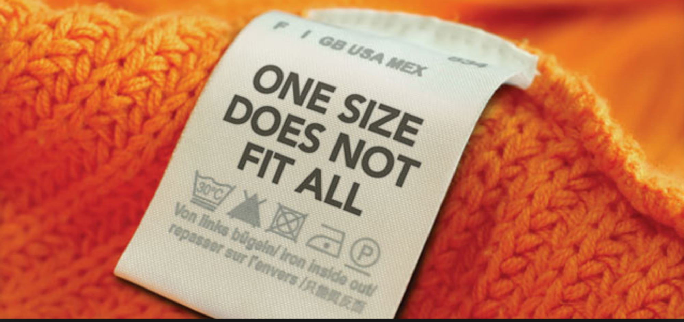
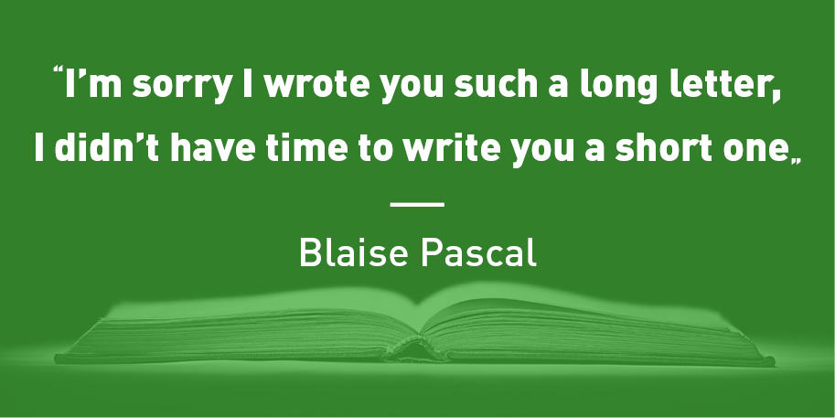
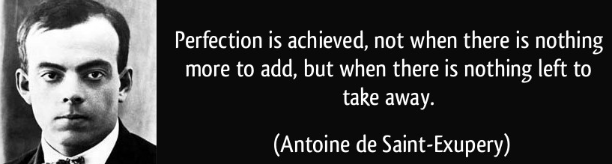
Communicating Sophisticated Ideas
  Everything we communicate has a clear goal;
  anything else is a distraction
  Know our audience
  Avoid jargon
  Avoid large blocks of text

Slide 19
What HighMatch Considers “Design”
communicate sophisticated ideas
enable complex actions
require the smallest effort
require the least expertise

Slide 20
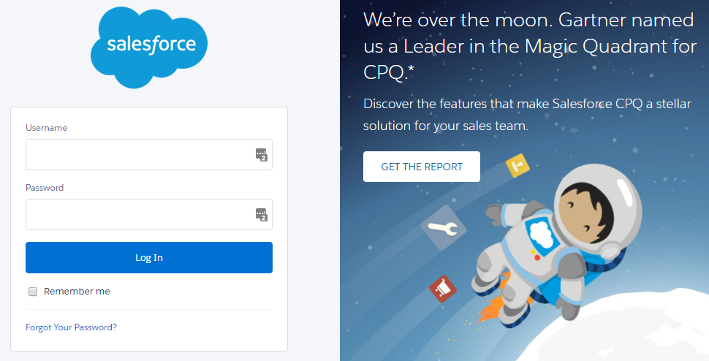
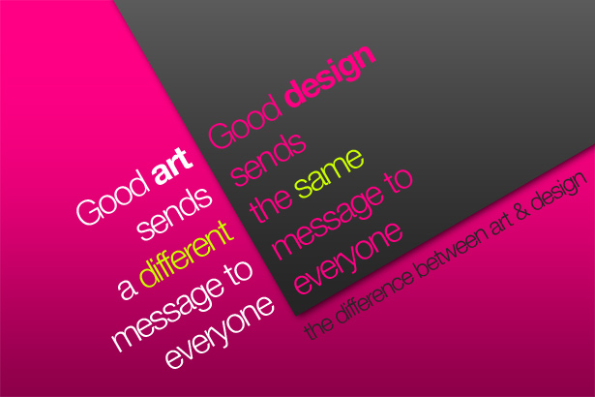
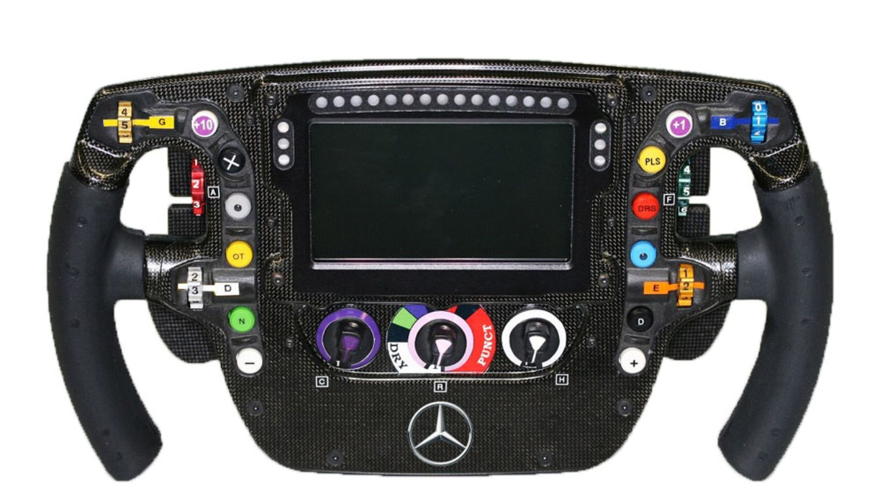
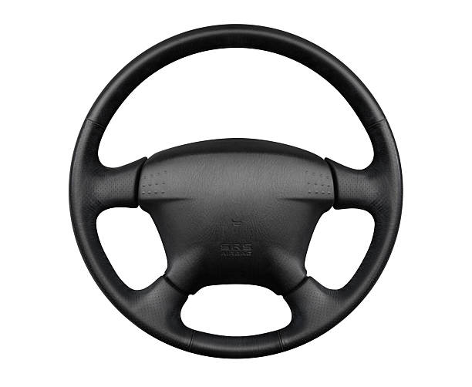
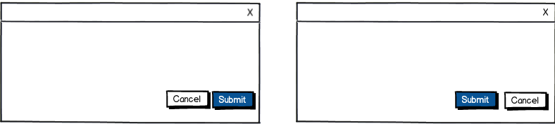
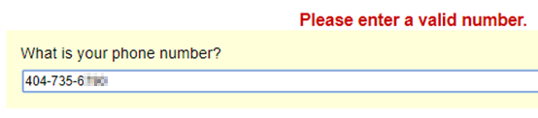
Enabling Complex Actions
  Every user interface element has a clear goal;
  anything else is a distraction
  Know our audience
  Be as consistent as possible
  Don’t irritate our audience
  Our work is not art;
  aesthetics matter,
  but not as much as outcomes

Slide 21
What HighMatch Considers “Design”
communicate sophisticated ideas
enable complex actions
require the smallest effort
require the least expertise

Slide 22
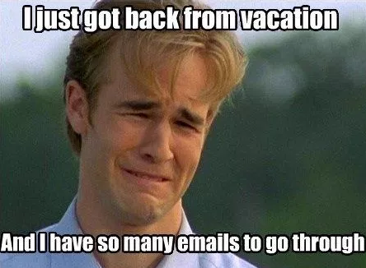
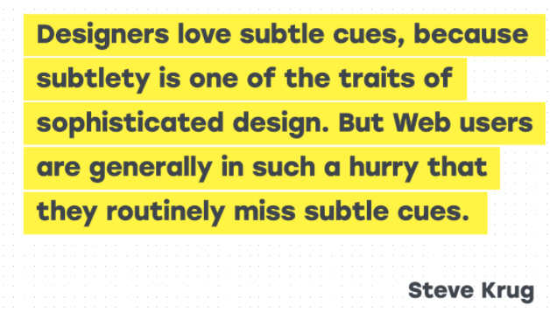
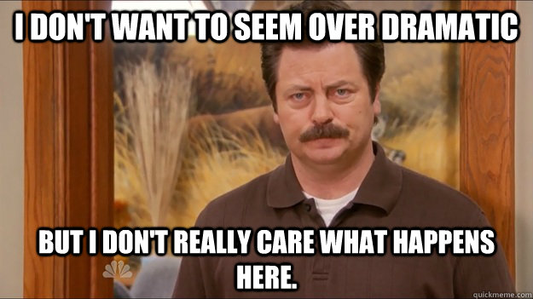
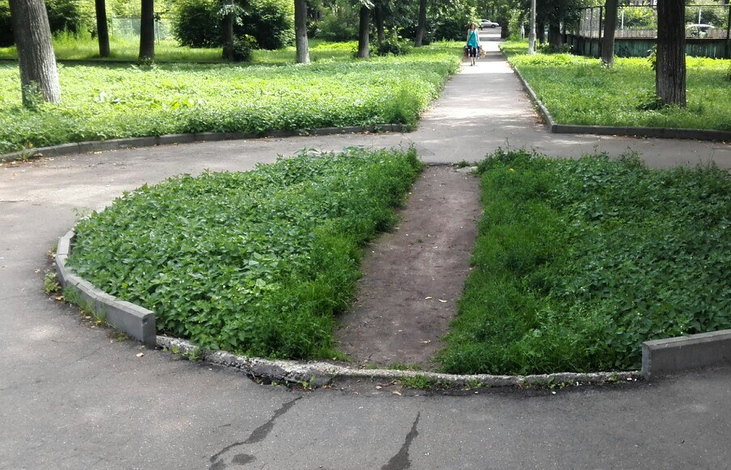
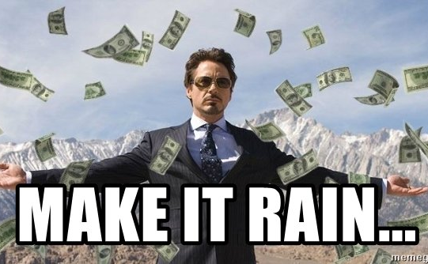
Require the Smallest Effort
  Users are busy;
  don’t waste their time or energy.
  Some users don’t want to be here;
  make it as painless as possible.
  Users seek the most direct path;
  give it to them.
  Businesses will pay for tools that
  make employees more efficient.

Slide 23
What HighMatch Considers “Design”
communicate sophisticated ideas
enable complex actions
require the smallest effort
require the least expertise

Slide 24
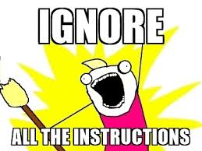
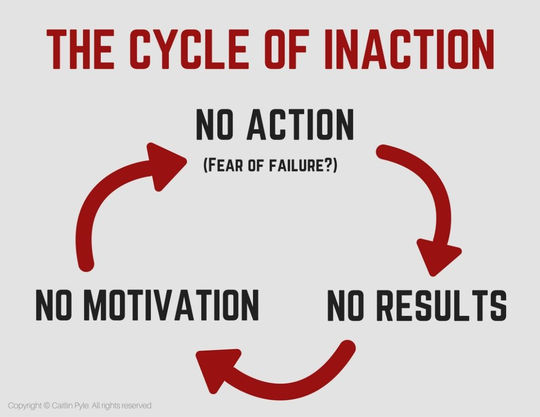
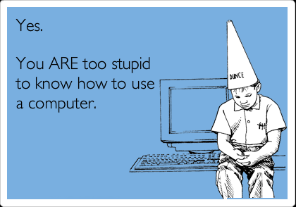
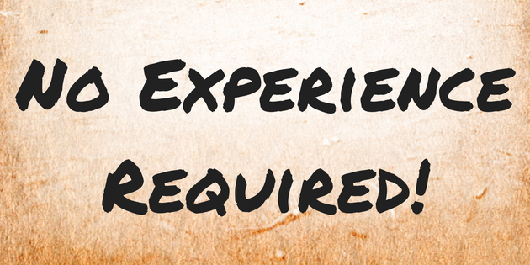
Require the Least Expertise
  Minimize training to save time,
  money, and effort.
  Users get the results
  they want, sooner.
  Learning requires motivation
  users may not have.
  Making users feel stupid
  loses customers. If your system
  makes people feel stupid,
  that’s a design failure.
To avoid this, focus on giving your users Internal Locus of Control

Slide 25
HighMatch Design Process
  Decide what to make
  Design the product
  Develop the product
  Test the product
  Release the product
  Monitor how well it works
  Repeat, as needed
Decide
Design
Develop
Test
Release
Monitor
Repeat?

Slide 26
Decide What to Make
Some ideas come from customers.
Some ideas are ours.
Sometimes the customer knows best.
Other times, we do.
We cannot make everything we want to make.
There is never enough time or money or people to do the work, ever, in any company, so
prioritizing what we make is critical to success.

Slide 27
Decide What to Make
  Is what we want to make possible?
  Many concepts our customers request cannot be assessed reliably, over the web, or economically. Also, we may not know how to make it, requiring expensive new hires.
  We have lots of meetings
  A lot of whiteboards get covered with drawings, requirements, and notes.
  We ask a lot of people for an opinion
  Is it feasible, how our competitors are doing it, whether this is more important than that other critical thing the Chief Revenue Office wants.
  We define exactly who the audience is…
  Technical? Mobile-only? High-volume?
  We decide what it means to the rest of our products…
  Will they need an update as well? Will this break something important? Will this require technology that doesn’t play nice with our current stuff?
  We ask “can we sell this?”

Slide 28
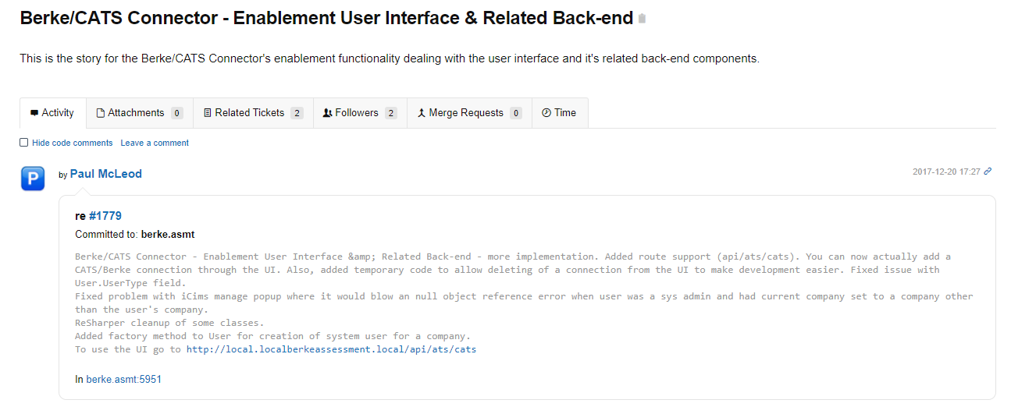
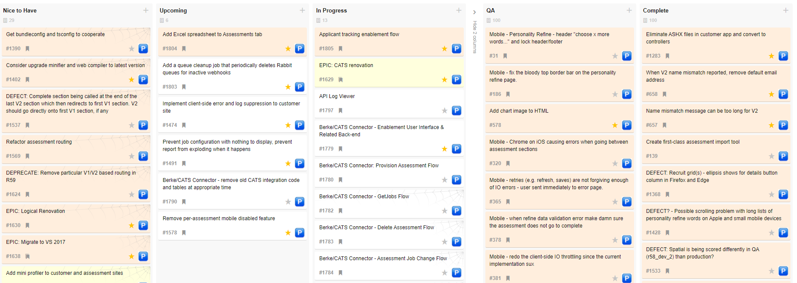
Designing the Product: Requirements

Slide 29
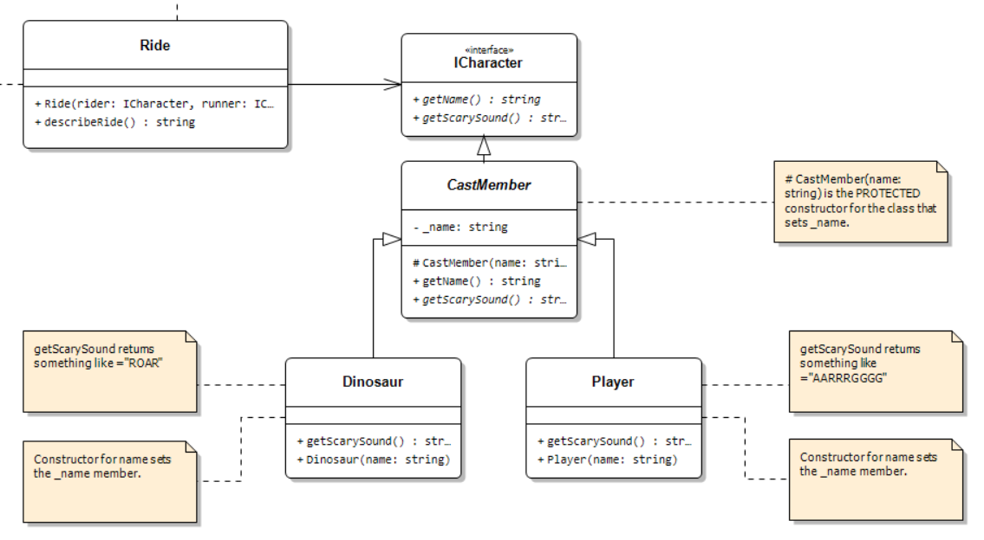
Designing the Product: Architecture
UML Class Design
Take SWE 4743 to learn advanced OO design topics like UML, design patterns, SOLID, DRY, etc. ☺

Slide 30
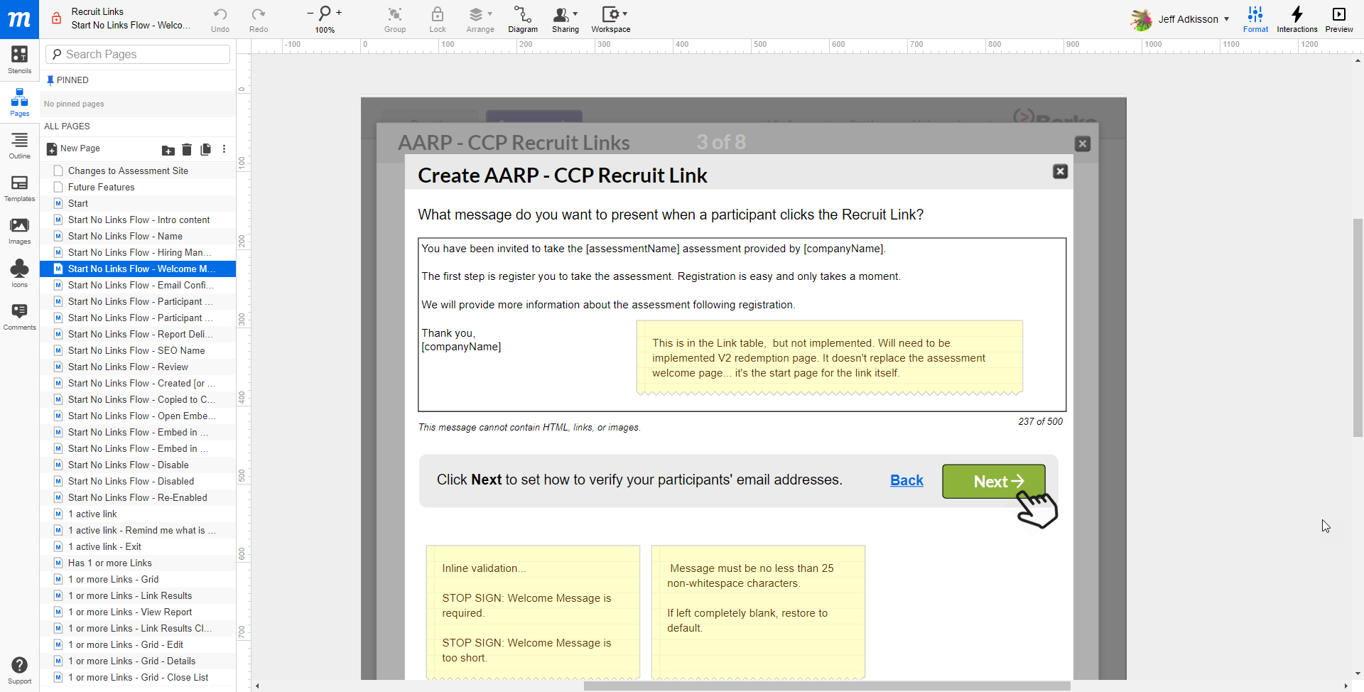
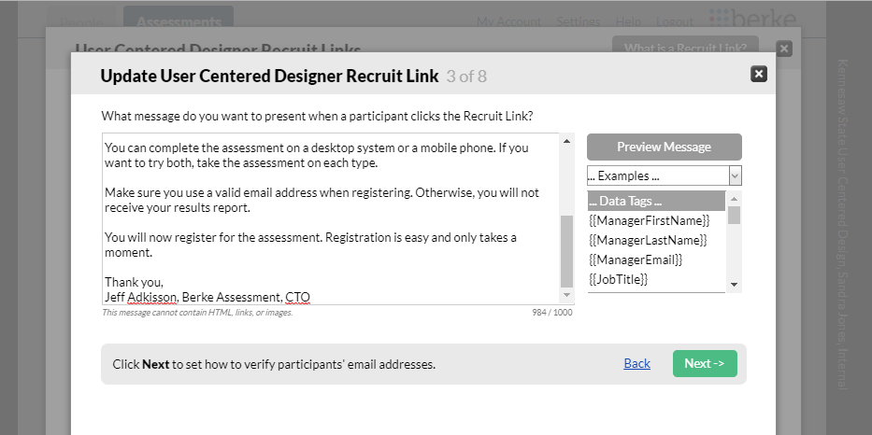
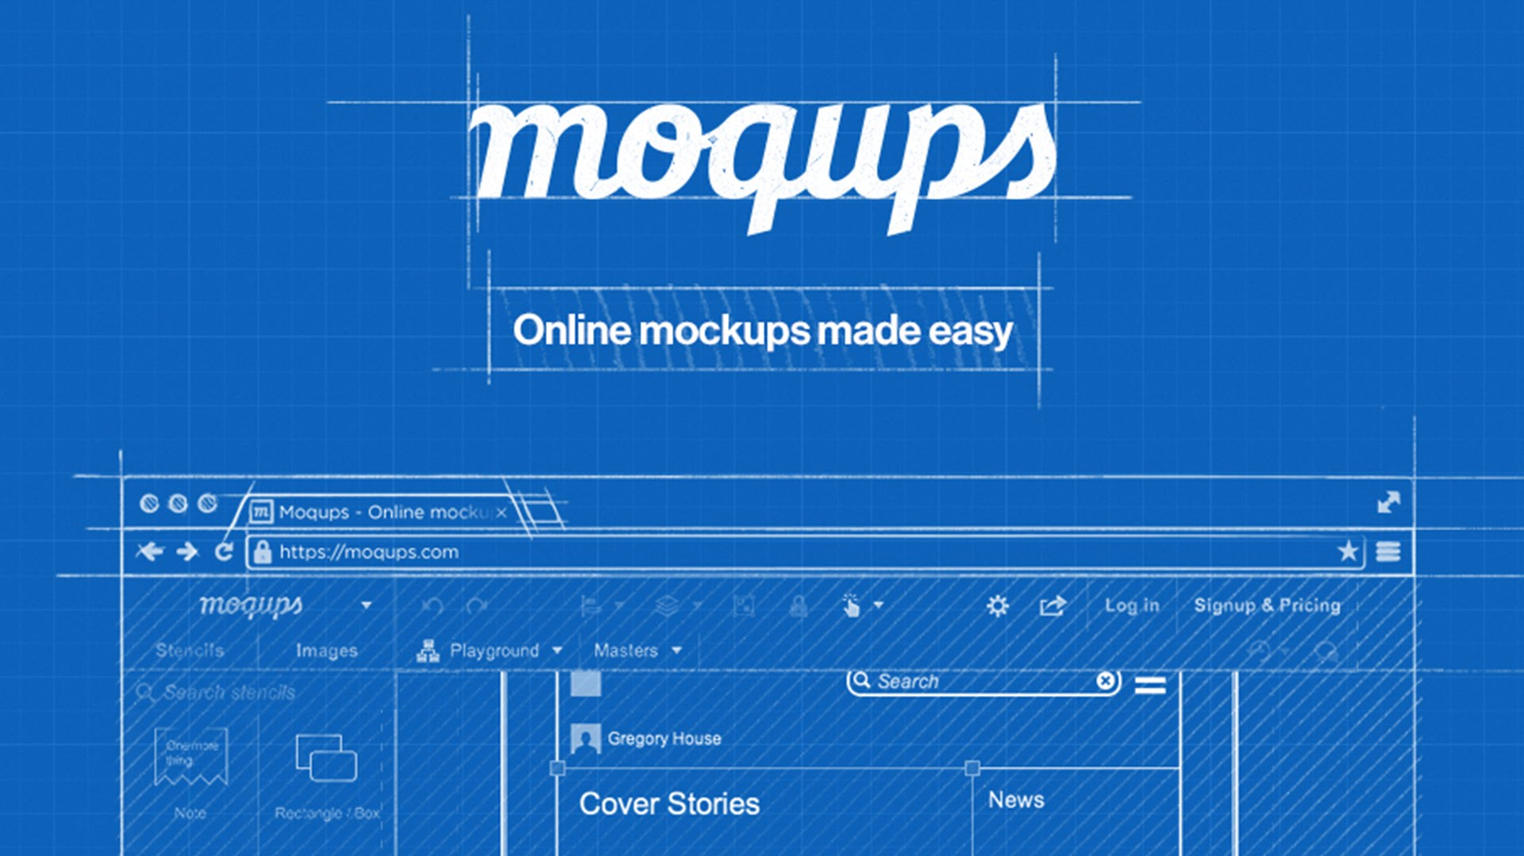
Designing the Product: Mockups
Open
MOCKUP
ACTUAL

Slide 31
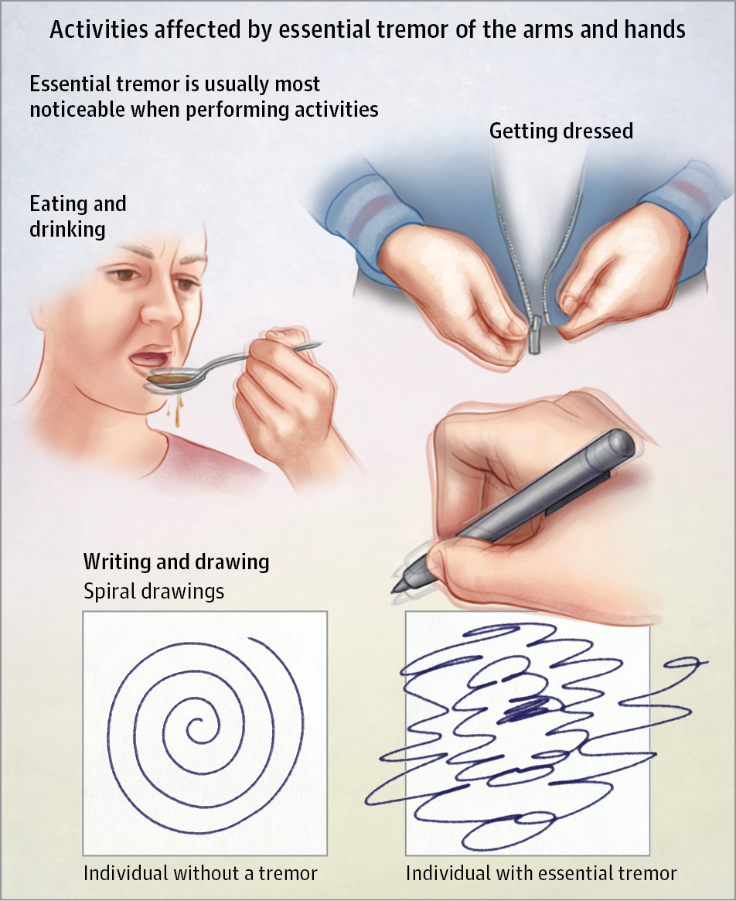
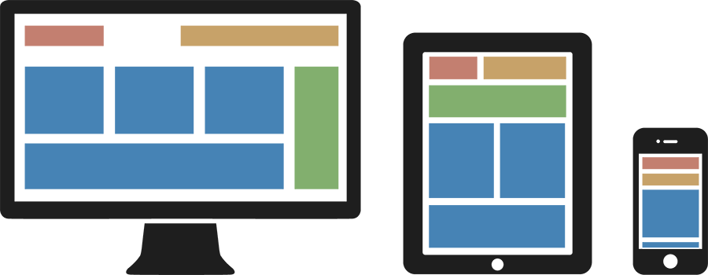
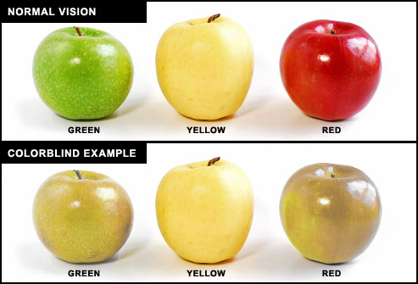
Designing the Product: Who is the Audience
  Technical estimation
  Motivation level
  Hardware and screen size
  Bandwidth available
  Education, language proficiency
  Colorblindness,
  essential tremors,
  visually impaired, etc.

Slide 32
Developing the Product
  Get working model to QA environment as soon as possible
  This gets staff and customers into the new product for early reviews.
  Eliminate risks early.
  Automate testing as much as reasonable
  Unit testing is like flossing – no one does enough.
  Keep milestones short – don’t let the dev team disappear for months
  Try to manage the project in a way where there are early wins.
  Be prepared for estimates to be wrong.
  Estimates rarely survive first contact with actual code.
SWE 3313 covers these topics when teaching you Agile fundamentals.

Slide 33
Testing the Product
  Test the new product in all browsers, email clients, operating systems, and platforms necessary to meet the requirements.
  This can be automated to a degree with tools like EmailOnAcid and CrossBrowserTesting.
  Get as many people as possible to test the product.
  Give them a script to ensure the most important bits get reliable coverage, plus tell them after covering their script to “go off-road” and use it in ways important to who they represent. By the way, thanks for helping us test our product in exchange for this informative lecture, swag, and donuts. ☺
  Find the person at your company who breaks everything and have them test your products (or ask my Mom).
  Some people have a knack for breaking things. As frustrating as they can be, they will find paths through your application you didn’t expect.
  Give people plenty of time to test.
  Unless someone is a dedicated QA engineer, it’s unlikely testing your buggy product is their top priority. Give them plenty of time. Incentives help too – gift cards, beer, threats, etc.

Slide 34
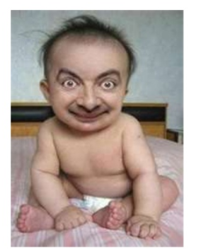
Testing the Product
Don’t get defensive.
Getting feedback from testers can hurt your feelings. They might call your baby ugly.
Take what’s constructive and use it to make it better.
If you develop a reputation for defensiveness, no one will give you honest feedback.
I still struggle with this. Some people's feedback, regardless of how good it is, just irritates me. Admit they are right, thank them, and make the changes.

Slide 35
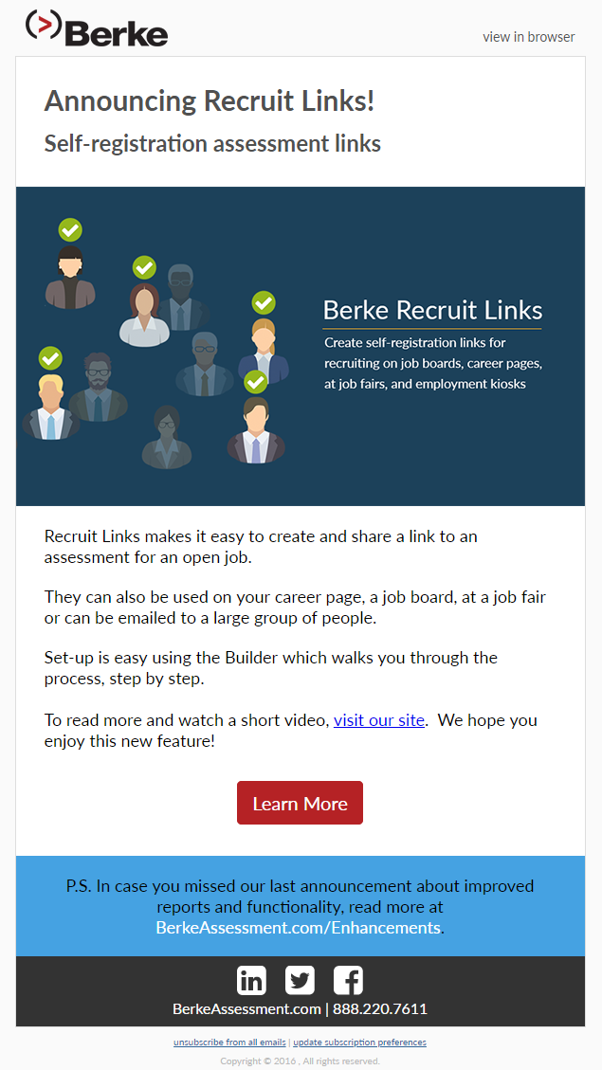

Release the Product

Slide 36
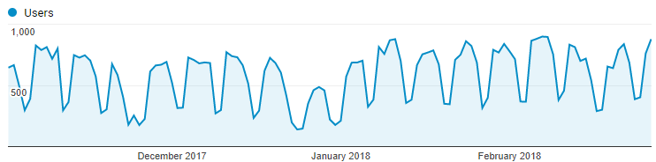
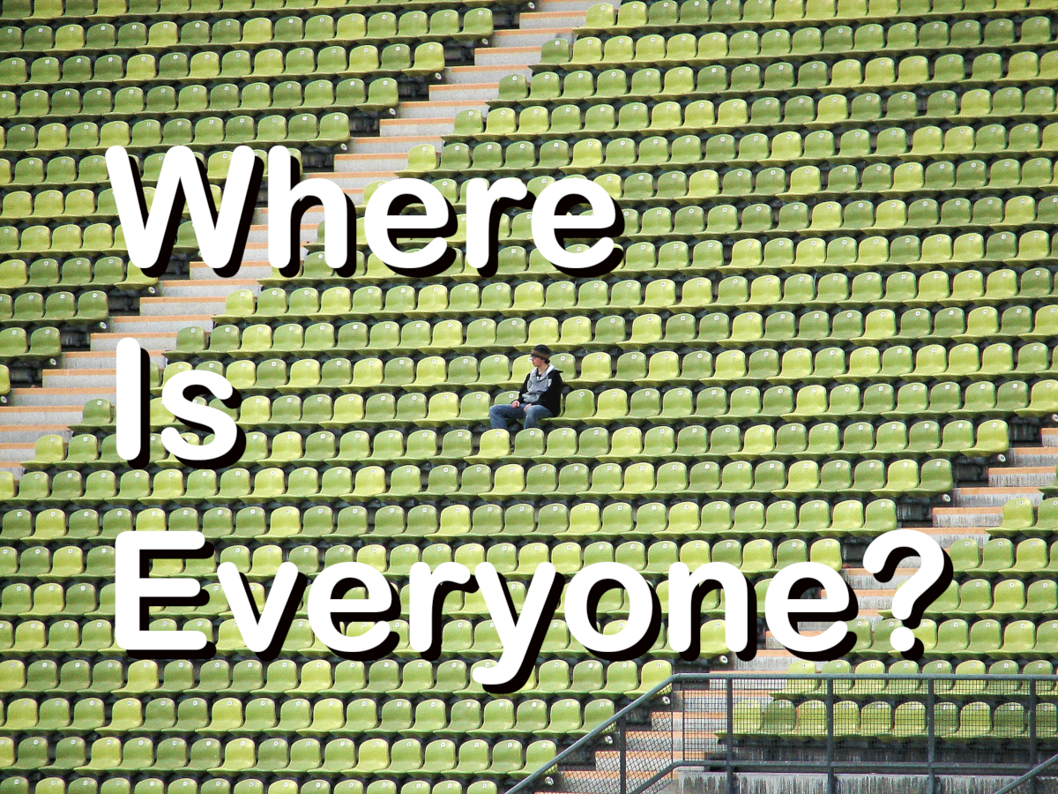
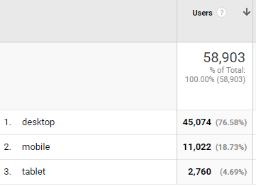
Monitor How Well It Works: Usage

Slide 37
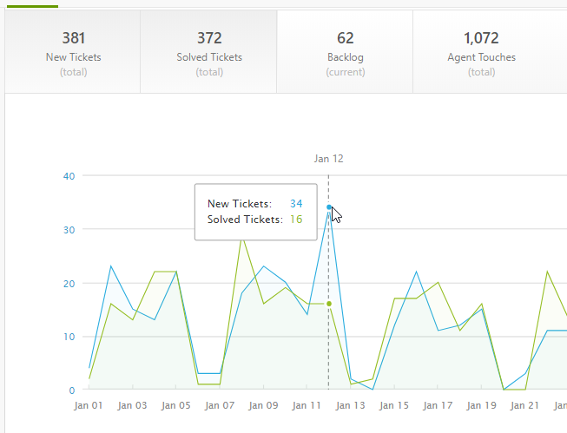
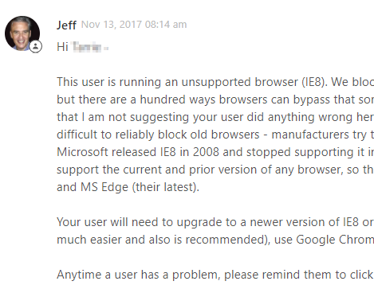
Monitor How Well It Works: Tech Support

Slide 38
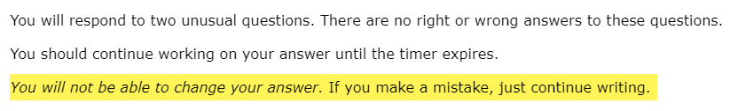
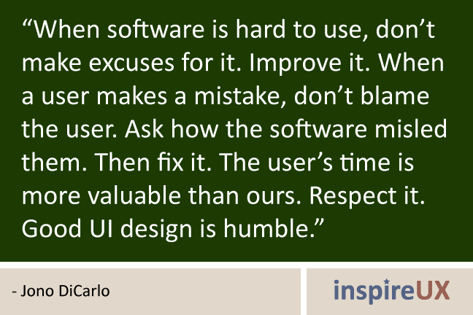
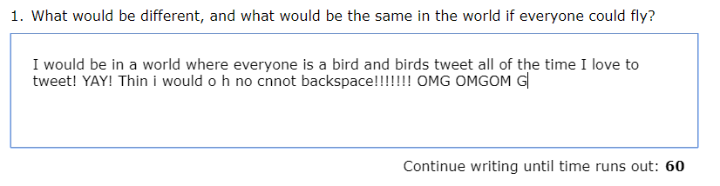

Assume Tech Support Problems
Begin With Your Design
Your baby is ugly.
Admit it and fix it.

Slide 39

Monitor How Well It Works: Logging

Slide 40


Monitor How Well It Works: Errors

Slide 41

Monitor How Well It Works: Uptime

Slide 42

Monitor How Well It Works: Performance

Slide 43


Monitor How Well It Works: Analysis

Slide 44
Avoid Cognitive Bias When Measuring Results
That weird thing that Customer Support just reported…
"It must be an anomaly. I think we can ignore it."
NO!
If the weird thing happened to one person who bothered to report it,
it probably happened to 99 people who did not report it.

Slide 45
Avoid Cognitive Bias When Measuring Results
Confirmation Bias
The tendency to search for, interpret, focus on and remember information in a way that confirms one's preconceptions.
Experimenters Bias
The tendency for experimenters to believe, certify, and publish data that agree with their expectations for the outcome of an experiment, and to disbelieve, discard, or downgrade the corresponding weightings for data that appear to conflict with those expectations.
Focusing Effect Bias
The tendency to place too much importance on one aspect of an event.
Illusion of Validity Bias
Belief that our judgments are accurate, especially when available information is consistent or inter-correlated.
Status Quo Bias
The tendency to like things to stay relatively the same.
https://en.wikipedia.org/wiki/List_of_cognitive_biases

Slide 46

Listen and Be Humble
Your users
will surprise you.
EVERY DAY.
Be humble and learn from it.

Slide 47

Repeat, as needed, forever
Great designs should be timeless, but most of the time, you will look back and think “OMG, that seemed like such a good idea at the time. Kill that with fire.”

Slide 48
How Can You Make Great Software?
Software Engineering
Process & Discipline
Computer Science & Engineering
User Experience & Interaction Design
Graphic Design
Great software is found at the intersection of these disciplines
Learn how to:
Work in teams
Listen to your users
Integrate multiple disciplines
Learn from failure
Embrace change
Recognize cognitive bias

Slide 49
Thank you!
Jeff@HighMatch.com
linkedin.com/in/jeffadkisson
If we want users to like our software,
we should design it
to behave like a likeable person.
Alan Cooper

