Slide 1
Temporal Databases
Jeff Davis, DBA, Laika, Inc.
Selena Deckelmann, IS Manager, Chris King Precision Components

Slide 2
Introduction
Target Audience: Developers, DBAs
Types of time, definitions
Types of queries
Example
Constraints & Performance

Slide 3
Developers & DBAs
Present different methodologies for dealing with different types of temporal data
Avoid pitfalls and confusing aspects of temporal databases
Not all of these methodologies apply to all applications

Slide 4
Definitions
Time point: Timestamp, TIMESTAMPTZ
Time quantity: a definite quantity of time, e.g. “42.3” seconds.
Time Interval: not a SQL interval, but the mathematical definition of an interval: a set of contiguous points between two indicated value.

Slide 5
Time Intervals
[
)
[
)
FEB
MAR
JUL
AUG
closed-open notation, inclusive of first component and exclusive of the second.
SQL has no real interval support, so many applications resort to two TIMESTAMPTZ attributes. This leads to awkward queries
e.g.: ... WHERE start <= x AND x < finish
Overlaps, Intersection are much more difficult

Slide 6
Definitions Cont.
Date parts: unanchored pieces of “real world” time that don't have definite meaning out of context, e.g. “1 month”, “3 years”.
'2007-02-14' + '0.5 months' + '1 month'
'2007-02-14' + '1 month' + '0.5 months'
Not Equal! Commutativity of addition is broken!

Slide 7
t_interval
introduce t_interval, our own interval type.
Interval in the mathematical sense
closed-open notation, e.g.
'[2007-01-01, 2007-03-01)'

Slide 8
operations on t_interval
Boolean: equals, overlaps, adjacent, contains (“@>”), is_empty, before
t_point: prior, first, last, next
t_interval: minus, intersection, union
All empty intervals are equal and indistinguishable:
'[2007-11-11,2007-11-11)' =
'[2008-11-11,2008-11-11)' =
'<empty>'

Slide 9
Valid Time
The time we believe something is, was, or will be true.
Can be in the future
Can be updated by the application
You can treat it somewhat like a spatial attribute
“The contract is effective from Mar 1st, 2007 to Mar 1st, 2008.”

Slide 10
“Since” tables
add attribute “since” of type t_point
means “true from this point until further notice”
can be in the future
Key
Att0
Att1
Since

Slide 11
“During” tables
add attribute “during” of type t_interval
means “true during this interval of time”
can be in future
Key
Att0
Att1
During

Slide 12
Transaction Time (Log)
The log is a record of transactions in the database
should be maintained by the system, not the application.
Useful for auditing (could include the user that performed the update)
“jsmith updated the status of the equipment to 'disposed' on Mar 1st, 2007”

Slide 13
Log Tables
add attribute “log_since” of type t_point to table
create new table mytable_log with attribute log_during of type t_interval
never in future
maintain mytable_log with triggers

Slide 14
Log Tables Cont.
mytable_since
Key
Att0
Att1
Since
mytable_since
Key
log_since
Key
Att0
Att1
Att1
log_since
Att0
Att1
Since
mytable_since_log
Key
Att0
Att1
Since
log_during

Slide 15
Example
Asset Tracking Database
  not realtime data entry
  must be auditable by Accounting Dept.
  Data entry in batches by asset owners

Slide 16
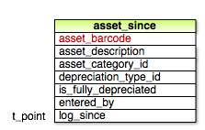
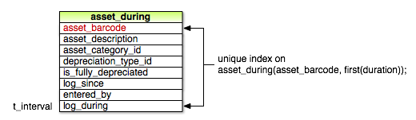

Slide 17
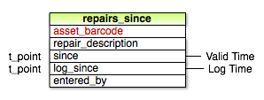
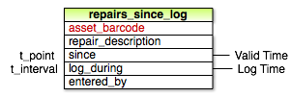

Slide 18
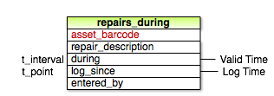


Slide 19
Now
“The moving point now”
Sometimes represented as NULL or 'infinity'
Not needed with “since” and “during” tables

Slide 20
Natural Partitioning
Temporal data partitions very naturally
“since” tables are likely to be smaller and accessed more frequently
“during” and log tables are bigger and accessed less frequently

Slide 21
6th Normal Form (6NF)
Store only one non-key attribute per table
Creates more column-oriented design
Eliminates redundancy: don't re-state things that are still true.
Used for “diff” queries
Key
Att0
Att1
Since
Key
Att0
Since
Key
Att1
Since

Slide 22
6NF Cont.
No need for NULLs with 6NF design
Be careful, the number of relations can explode when using 6NF
A table in 5NF with 2 key attributes and 5 non-key attributes turns into 5 three-attribute tables!

Slide 23
Query: Time Travel
What did we believe at time T1 was true at time T1?:
SELECT att1, att2 FROM r_since_log
WHERE log_during @> T1
UNION
SELECT att1, att2 FROM r_since
WHERE t_interval(log_since,now()) @> T1;

Slide 24
Query: “diff”
What updates were made to attribute A of relation R over the interval I?
SELECT k, A, t_interval(log_since, now())
AS log_during FROM R_A
WHERE overlaps(I,log_during)
UNION
SELECT k, A, log_during FROM R_A
WHERE overlaps(I,log_during);

Slide 25
Constraints
Key constraints on “since” tables are simple
Key constraints on “during” tables are not well supported.
We want to be able to say in a constraint that “during” intervals shouldn't overlap
Indexes only support UNIQUE as a constraint, not “non-overlapping”.

Slide 26
Performance
More data
Mitigated by the natural partitioning of time-based data
Constraints can perform poorly
6NF can be costly in some situations

Slide 27
Conclusion
Many strategies available for different needs
Choose what's right for your application
  do you need auditing?
  valid time?
  “diff” queries?
  what volume of data can you support?

