Slide 1
Visualization
Jeff Goldsmith, PhD
Department of Biostatistics

Slide 2
A picture is worth 1000 words
Looking at data is critical
True for you as an analyst
True for you as a communicator
You should make dozens of graphics for each dataset
Most of these are for your eyes only
A (small) subset are for others

Slide 3
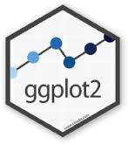
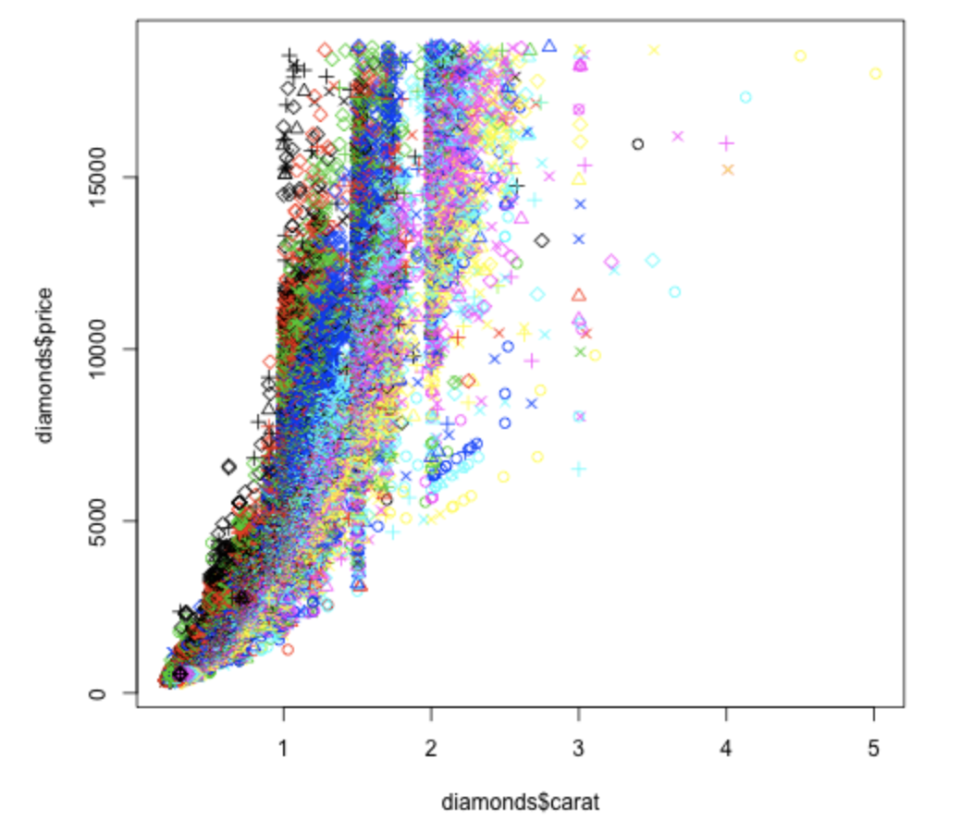
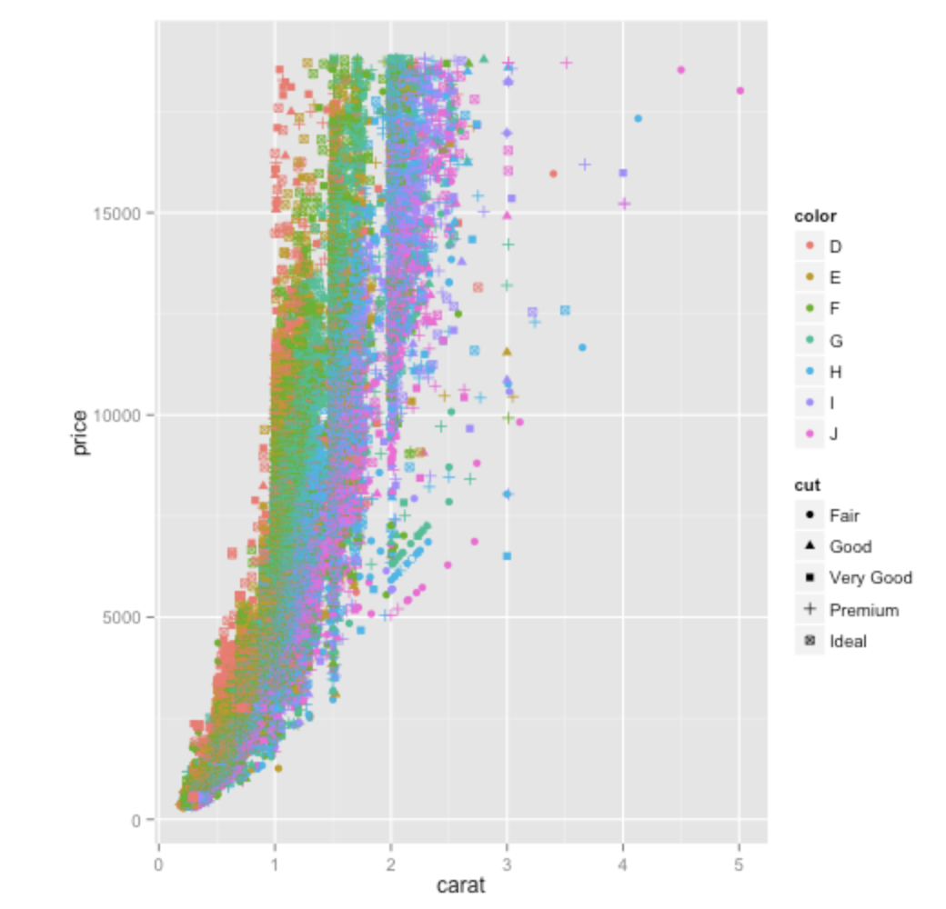
Why ggplot?
Makes good graphics with relative ease
“Relative” here is compared to base R graphics
vs
“Don’t teach built-in plotting to beginners (teach ggplot2)” – blog post by David Robinson

Slide 4
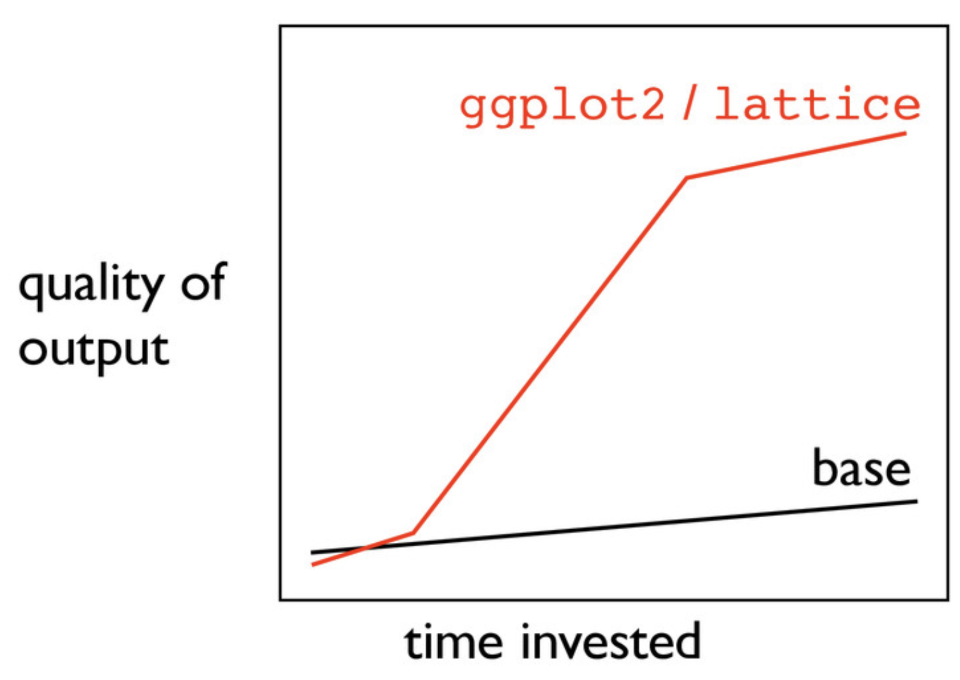
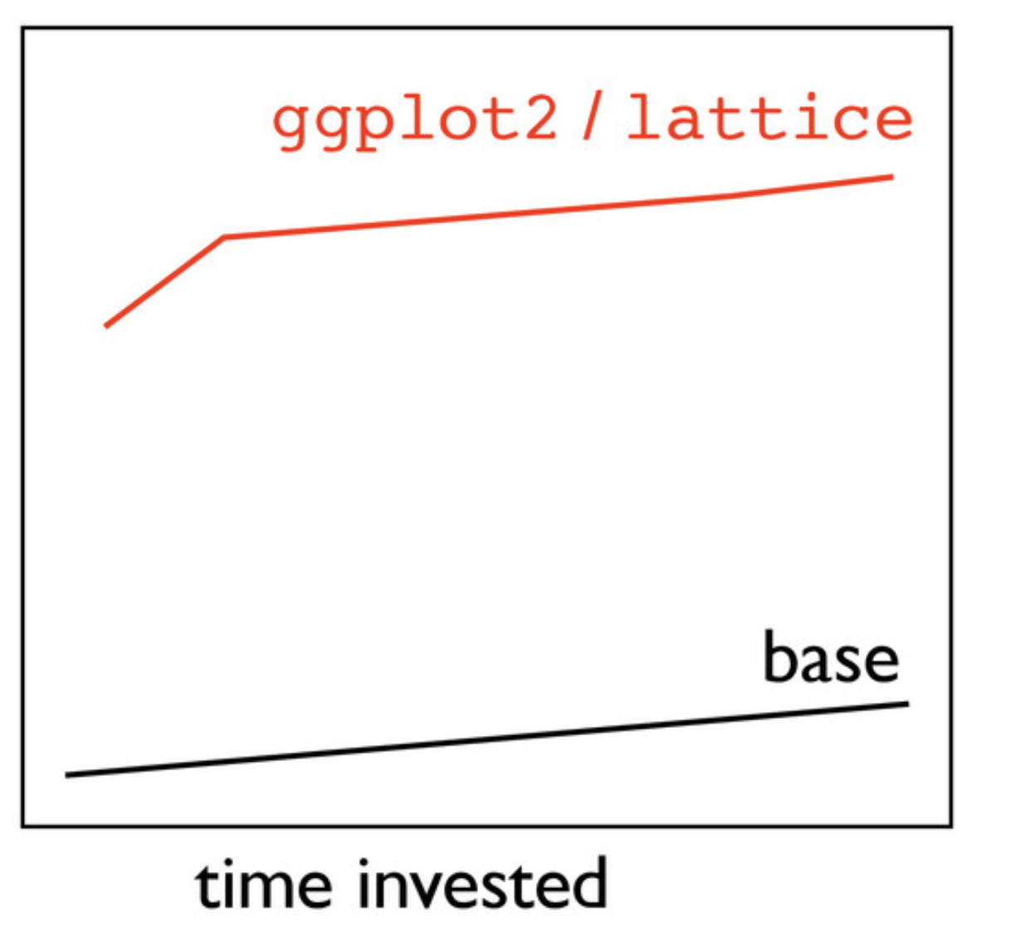
Why ggplot?
Cohesiveness shortens the learning curve
Same principles underlie all graphic types
“hello ggplot2!” – talk by Jenny Bryan

Slide 5
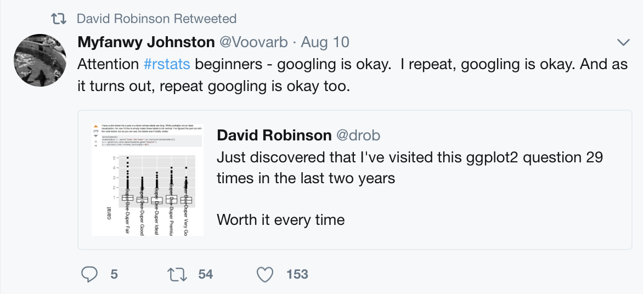
Learning ggplot
Lots of materials online
google is your friend
Start searches with “ggplot”
StackOverflow has lots of questions and useful answers
Don’t worry about googling stuff you “should know”

Slide 6
Using ggplot
Basic graph components
data
aesthetic mappings
geoms
Advanced graph components
facets
scales
statistics
A graph is built by combining these components
Components are consistent across graph types
Scatterplots, bar graphs, density plots, ridge plots …

Slide 7
Time to code!!

