Slide 1
Getting Started
Jeff Goldsmith, PhD
Department of Biostatistics

Slide 2
Overall goals
The short course is intended to introduce some common tools
This lecture will get us started by focusing on:
RStudio
Some coding best practices
R Markdown
Project organization

Slide 3
Why are we using RStudio?
Makes life much easier for useRs (not a typo – people who use R are sometimes referred to as useRs…)
The RStudio folks are also leading the development of a new analytic framework within R, and that work is integrated into RStudio

Slide 4
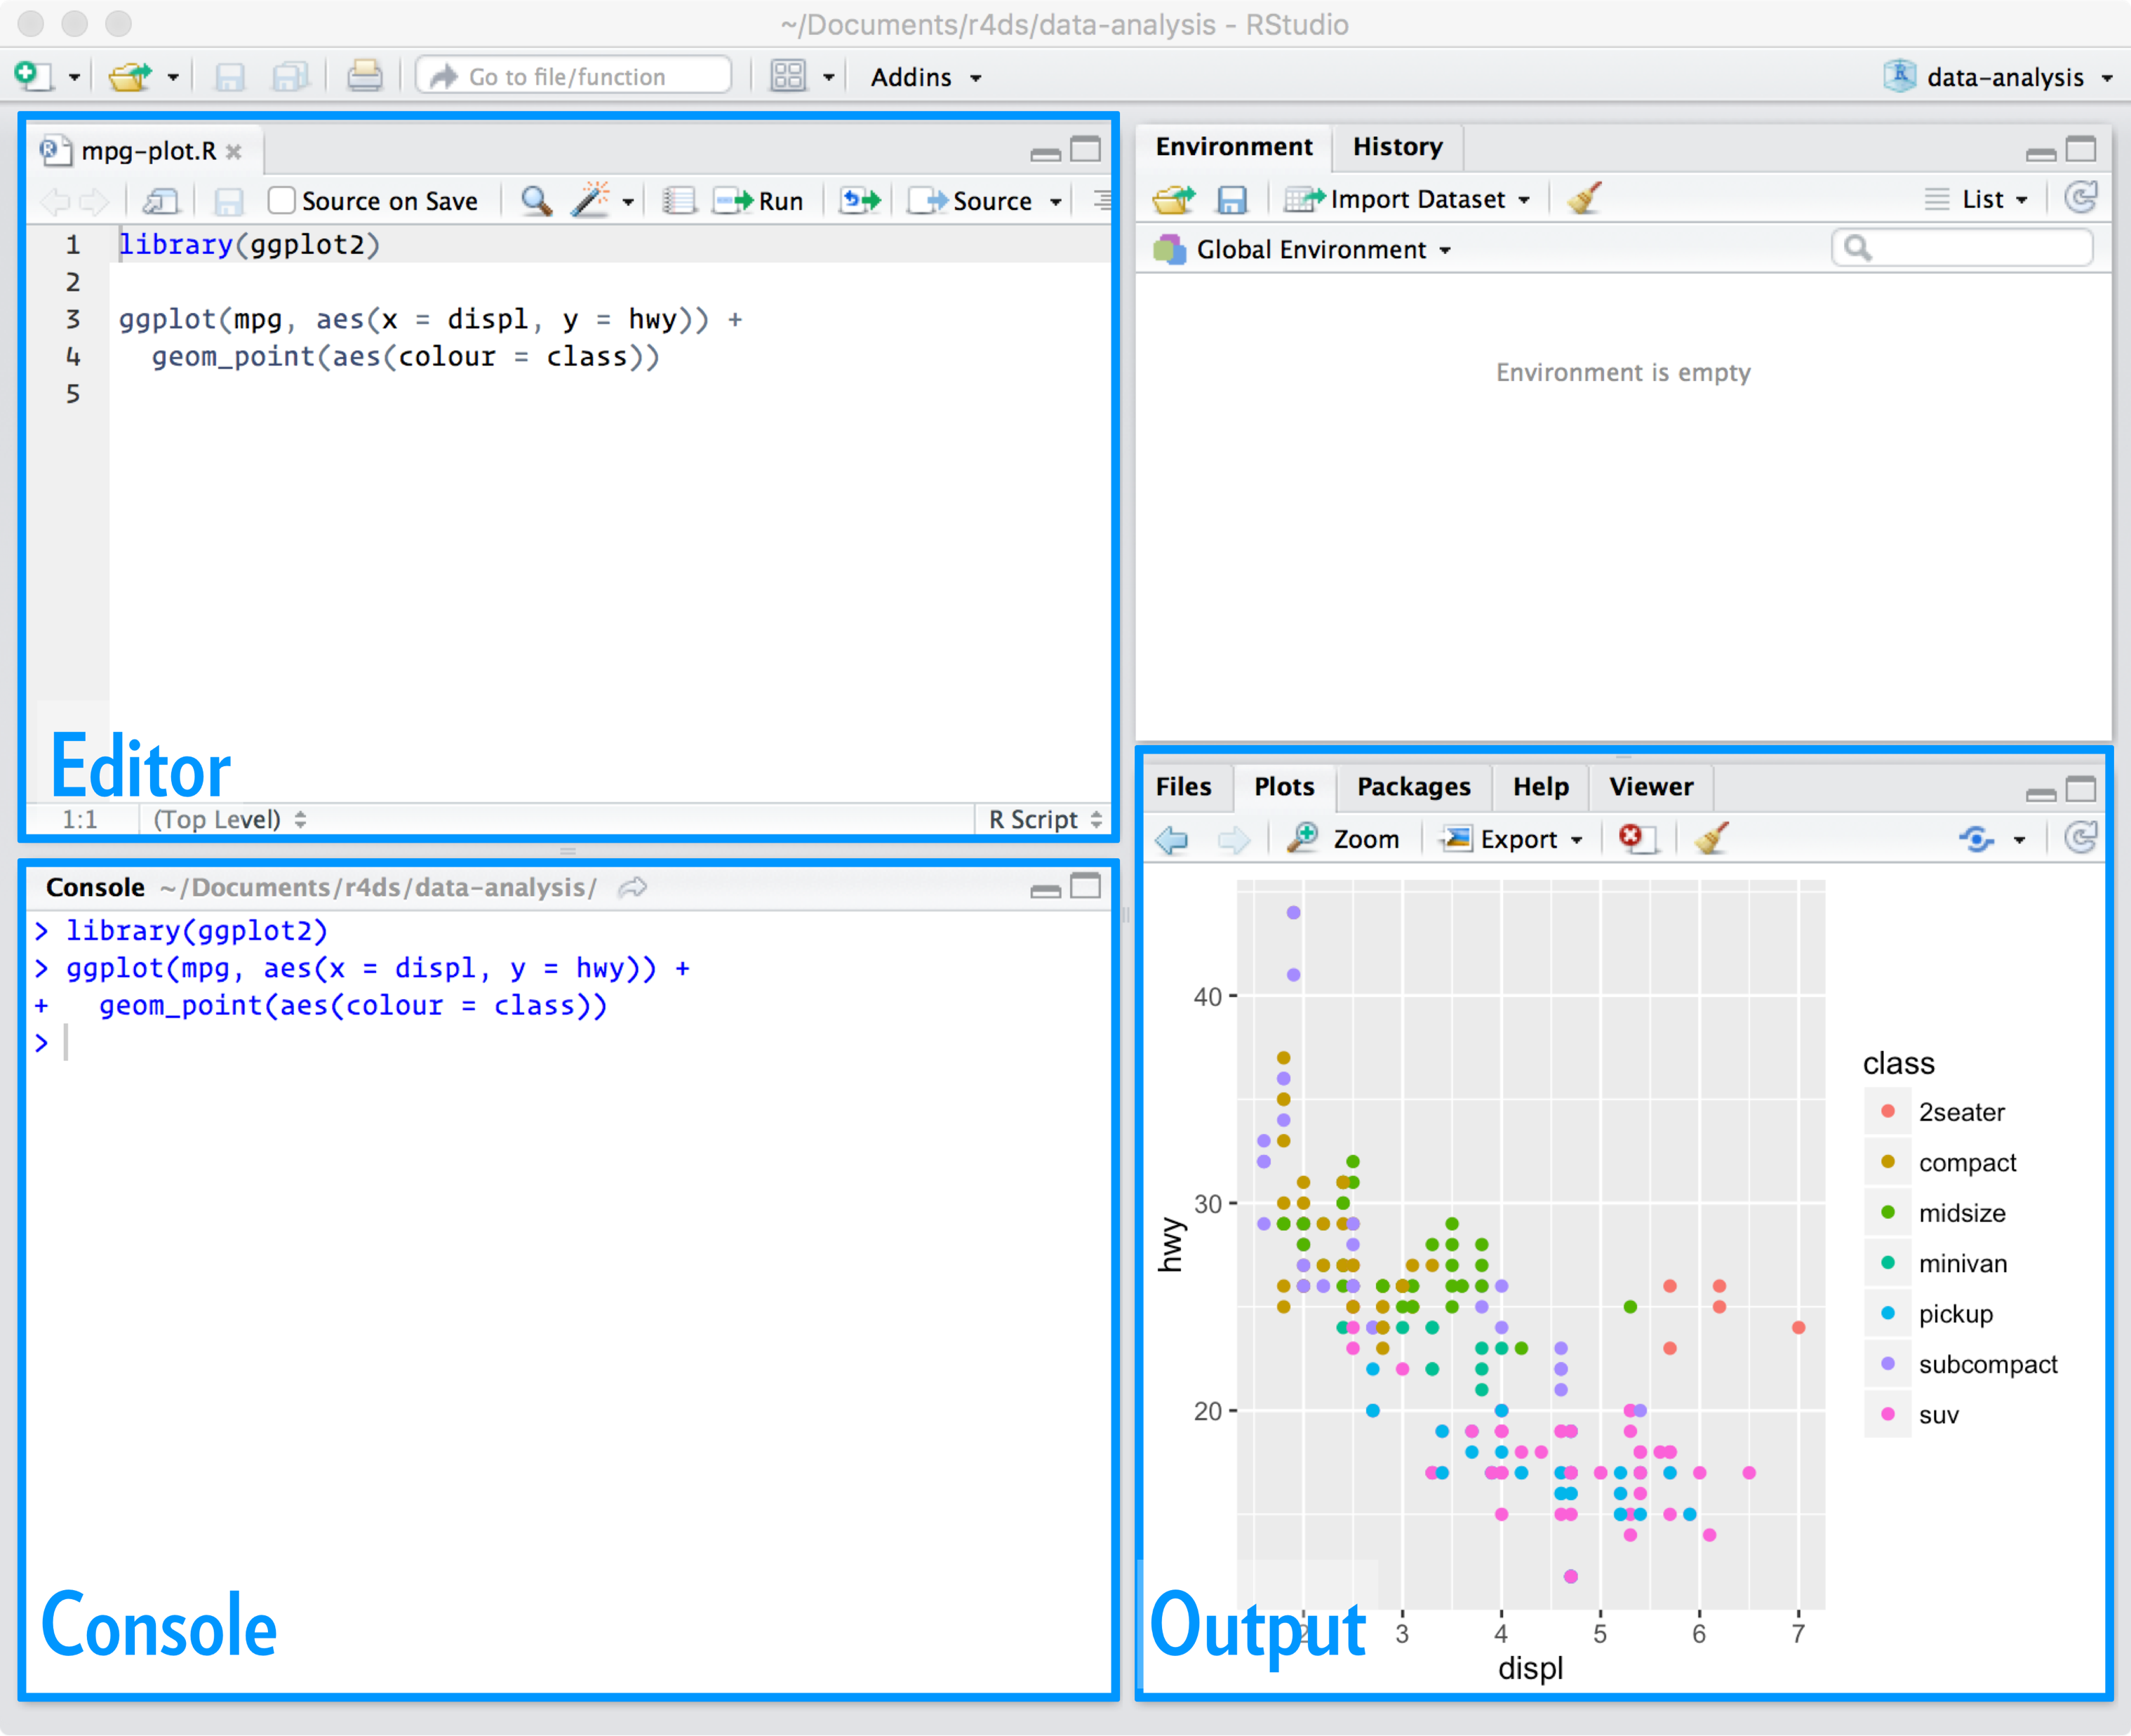
Working in RStudio
Rstudio is an Integrated Development Environment (IDE)
It’s got everything you need to do data science in R
This IDE is one of the better reasons to use R …
R for Data Science

Slide 5
Code
Code is case sensitive
There is no autocorrect
Establish a variable naming convention
this_is_snake_case
this.is.period.case
thisIsLowerCamelCase
ThisIsUpperCamelCase
Your names should match your regex skills
Extensive documentation will save you headache
Notes:
https://twitter.com/drob/status/882988972888215552
https://twitter.com/rabaath/status/882995183255793664

Slide 6
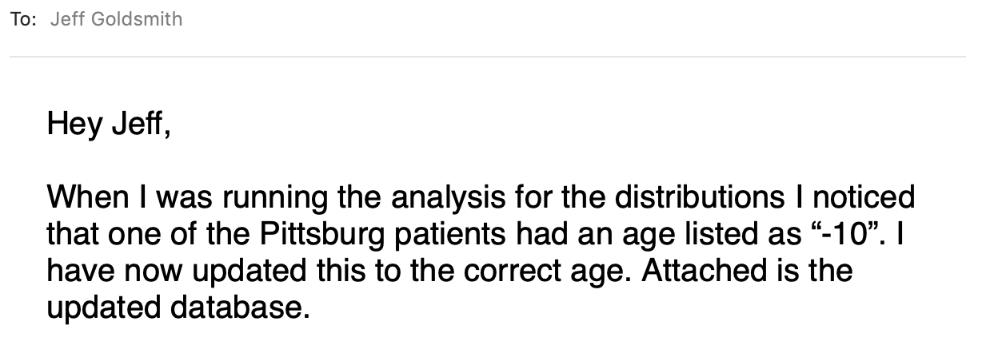
Some perspective on code
Treat your inputs (e.g. raw data) and code as “real”
Your results and created by input and code, and you can always reproduce your results from these if you need to
Your code matters
It’s one of the most central ways you will communicate.
Plan for mistakes
Write code that makes it easy to fix mistakes without breaking the rest of your analysis

Slide 7
Text and code are important
You spend a lot of your time communicating in writing
With collaborators, a general public, future you
About data cleaning, analyses, results
In formal reports, brief summaries, replies to questions

Slide 8
Tools
Code is necessary but not sufficient for clear communication
Use tools that combine your code and text
Greatly facilitates reproducibility, which is a big concept
In short, someone you don’t know or work with should be able to reproduce each step of your analysis
As a part of this, they should understand why you did what you did
(Again, this someone is often future you)
We’ll use R Markdown to write reproducible reports

Slide 9


R Markdown
A “Markdown” language is a lightweight syntax that can be easily converted to another format (HTML, PDF, Word)
R Markdown lets you combine formatted text with code chunks and the results of those chunks
Having text and code in the same place, and having the combined output be user-friendly, is huge for your workflow
R for Data Science

Slide 10
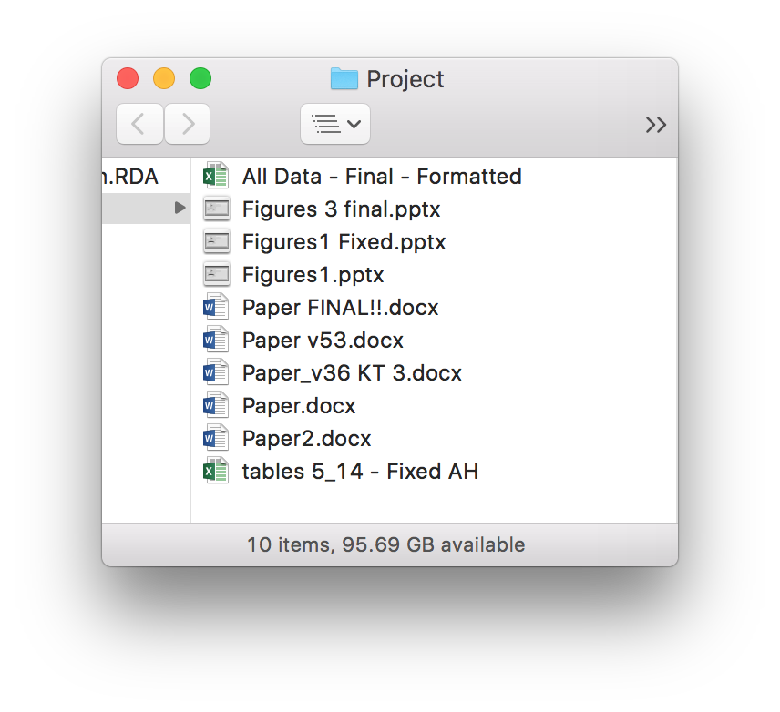
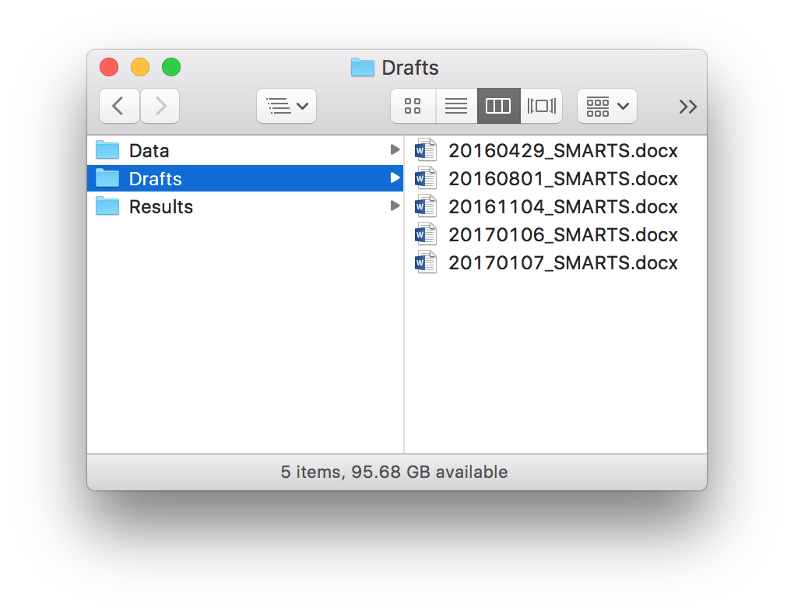
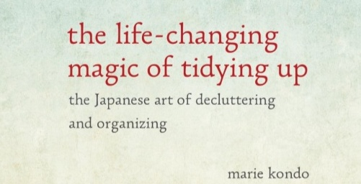
Organizing files
😡
😄

Slide 11
Why organization matters
Being organized will frequently make your life easier
“Your most frequent collaborator is you from six months ago, but you don’t reply to emails”¹
Eventually, someone other than you (or even future you) will need to reproduce your results
Be ready for that.
1. This version of the quote comes from Karl Broman, who traced it to a tweet: http://bit.ly/motivate_git

Slide 12
Time to code!!

