Slide 1
Data Import and Manipulation
Jeff Goldsmith, PhD
Department of Biostatistics

Slide 2
Data wrangling
Data don’t magically appear in your R session
They’re rarely even in the form you need
The process of taking data in whatever form they exist and transforming them to the form you need is “wrangling”

Slide 3
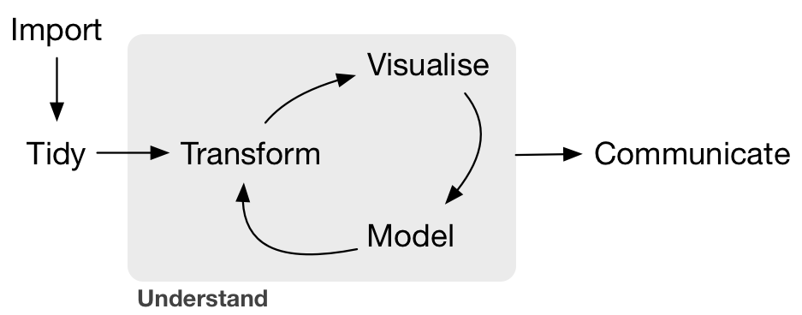
Import
“Import” is the first step to “wrangle”
R for Data Science

Slide 4
Data tables
Data often come in tables
Row = subject
Column = variable
The variables may be of different types
In R, data.frames are designed to hold this kind of dataset
Looks like a matrix
Actually a very specific list

Slide 5
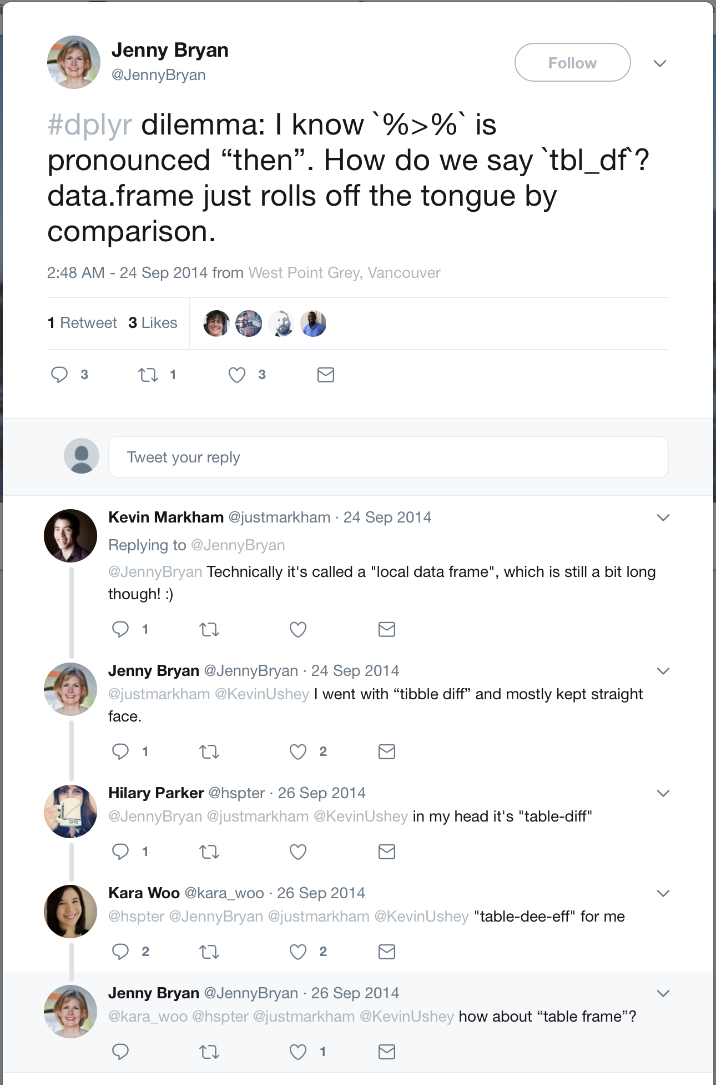
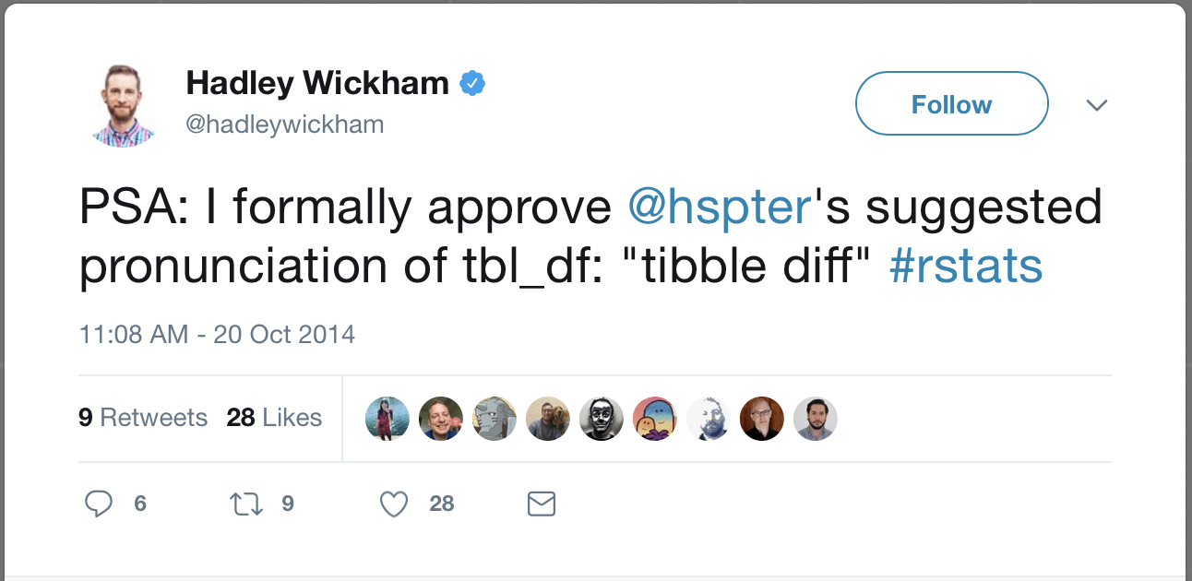
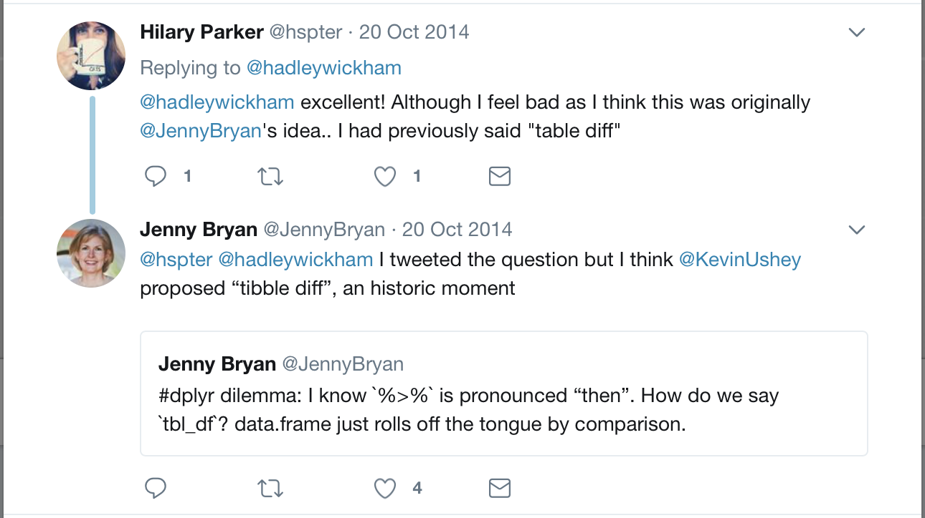
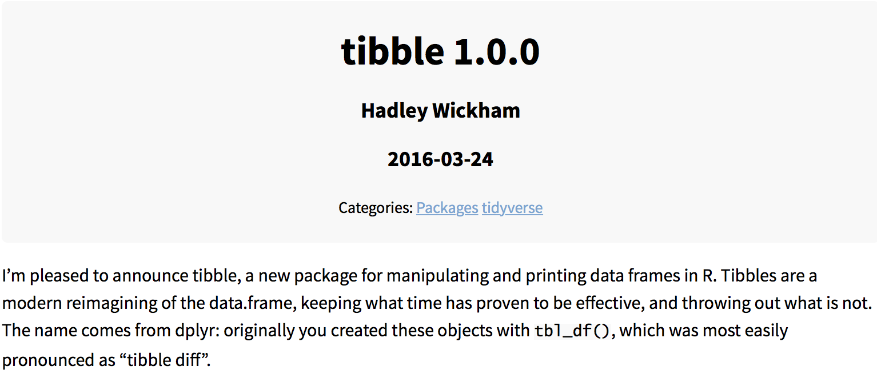
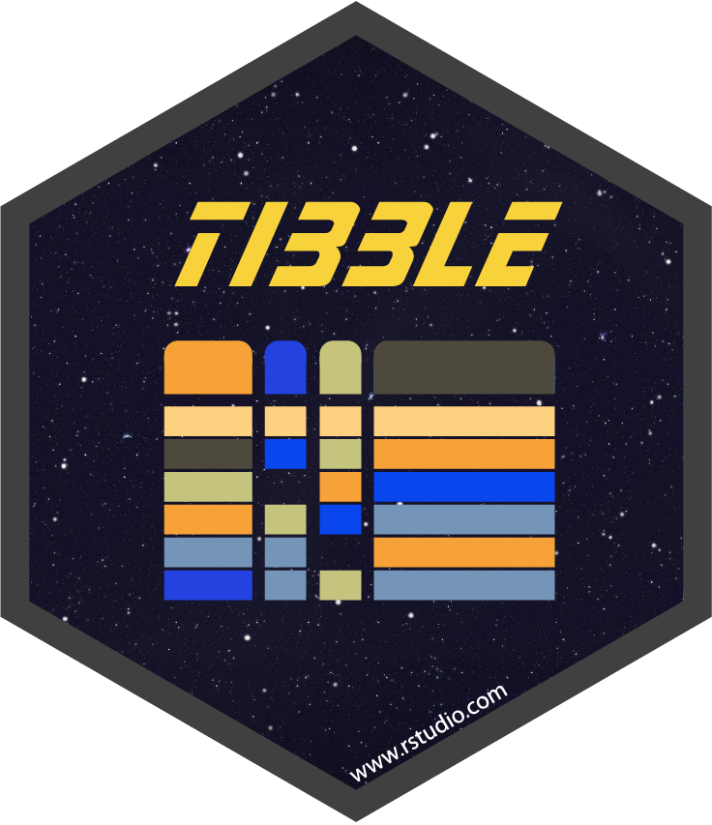
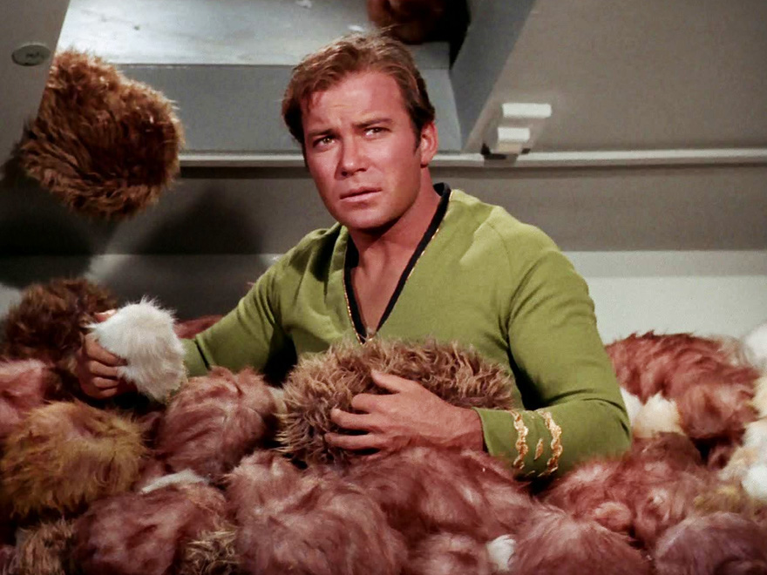
Tibbles
… formerly tbl_df …

Slide 6
Why tibbles?
data.frames have been around since R was introduced
Some things change; base R is not one of those things
Tibbles are data frames, just slightly different
They keep you from printing everything by accident
They make you type complete variable names

Slide 7



Tools for data import
The tools I use most for data import are readr, haven, readxl
Useful functions for importing from several sources
Produce tibbles
Fairly consistent interfaces

Slide 8
Data manipulation
Manipulate (aka transform, manage, clean) is the third step in wrangling
R for Data Science

Slide 9
Major steps
There are a few things you’re going to do a lot of when you manipulate data:
Select relevant variables
Filter out unnecessary observations
Create new variables, or change existing ones
Arrange in an easy-to-digest format

Slide 10
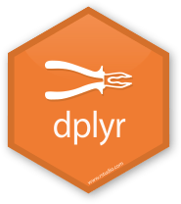
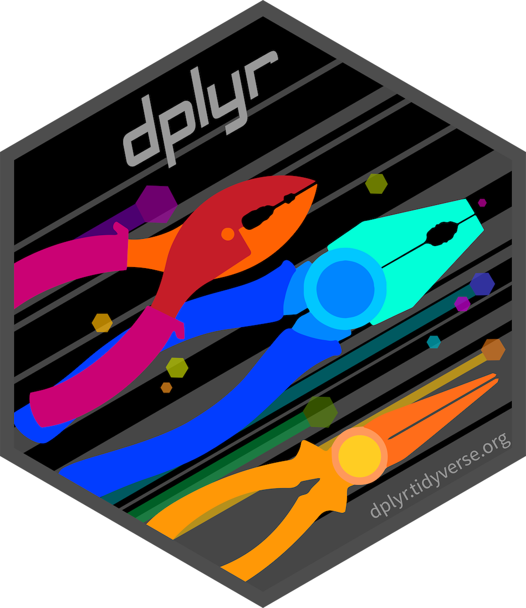
dplyr
The dplyr package has specific functions that map to each of these major steps
select relevant variables
filter out unnecessary observations
mutate (sorry) new variables, or change existing ones
arrange in an easy-to-digest format

Slide 11
dplyr
The modularity is intentional
Each function is designed to do one thing, and do it well
This is true of other functions as well (and there are several others)
These functions share a structure: the first argument is always a data frame, and the returned objects is always a data frame
tibble comes in, tibble goes out, you can’t explain that …

Slide 12
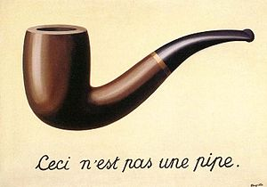
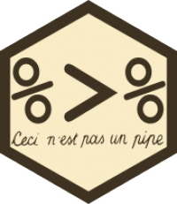
Pipes
Piping allows you to tie together a sequence actions
“New” to R (2014)
Comes from the magrittr package; loaded by everything in the tidyverse

Slide 13
Pipes
Sequence of actions to start my days
Wake up
Brush teeth
Do data science
In “R”, I can nest these actions:
happy_jeff = do_ds(brush_teeth(wake_up(asleep_jeff)))
Alternatively, I could name a bunch of intermediate objects
awake_jeff = wake_up(asleep_jeff)
clean_teeth_jeff = brush_teeth(awake_jeff)
happy_jeff = do_ds(clean_teeth_jeff)

Slide 14
Pipes
Using pipes is easier to read and understand, and avoids clutter
happy_jeff =
wake_up(asleep_jeff) %>%
brush_teeth() %>%
do_ds()
Read “%>%” as “and then”
The result of one function gets passed as the first argument to the next one by default, although you can be more specific
Works very well with “tibble goes in, tibble comes out” philosophy
You will probably never fully appreciate how great piping is
You should be glad that that’s true

Slide 15
Time to code!!

