Slide 1
Notation for FDA
Jeff Goldsmith, PhD
Department of Biostatistics

Slide 2
What are “Functional Data”?
Tentative definition:
Observations on subjects that you can imagine as X_{i}(t_{i}), where t_{i} is continuous
Functional notation is conceptual; observations are made on a finite discrete grid.

Slide 3
Characteristics of FD
High dimensional
Temporal and/or spatial structure
Interpretability across subject domains

Slide 4
Discretization
Conceptually, we regard functional data as being defined on a continuum, e.g. Xi(t), 0 < t <1
In practice, functional data are observed at a finite number of points
Observation grid is often regular and dense – many observations for each subject, all over a common collection of time points
Minute of the day
At each observation point t, Xi(t) has a distribution

Slide 5
Summaries of FD
Suppose we have functional data
Mean:
The mean is itself functional
Typically, we assume that the mean is smooth.
“Raw'' estimator is sample mean:
A typical estimator of would be a smoothed version of this

Slide 6
Summaries of FD
Suppose we have functional data
Variance:
This is a (two-dimensional) surface
“Raw'' estimator is sample covariance:
Would need to smooth this as well.

Slide 7
Data displays
Spaghetti plots
Rainbow plots
Lasagna plots

Slide 8
Switch to code

Slide 9
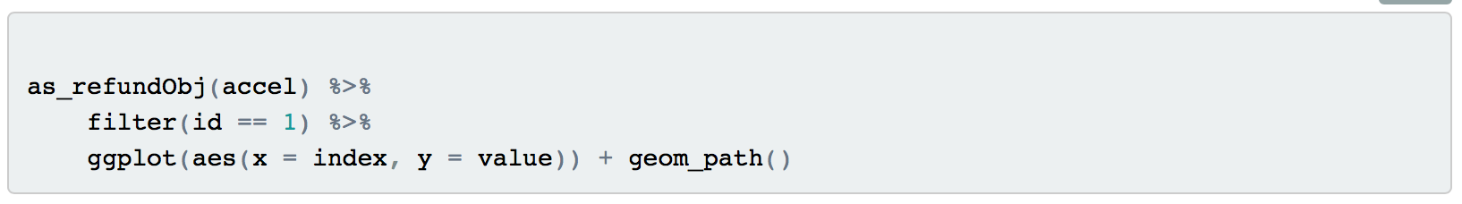
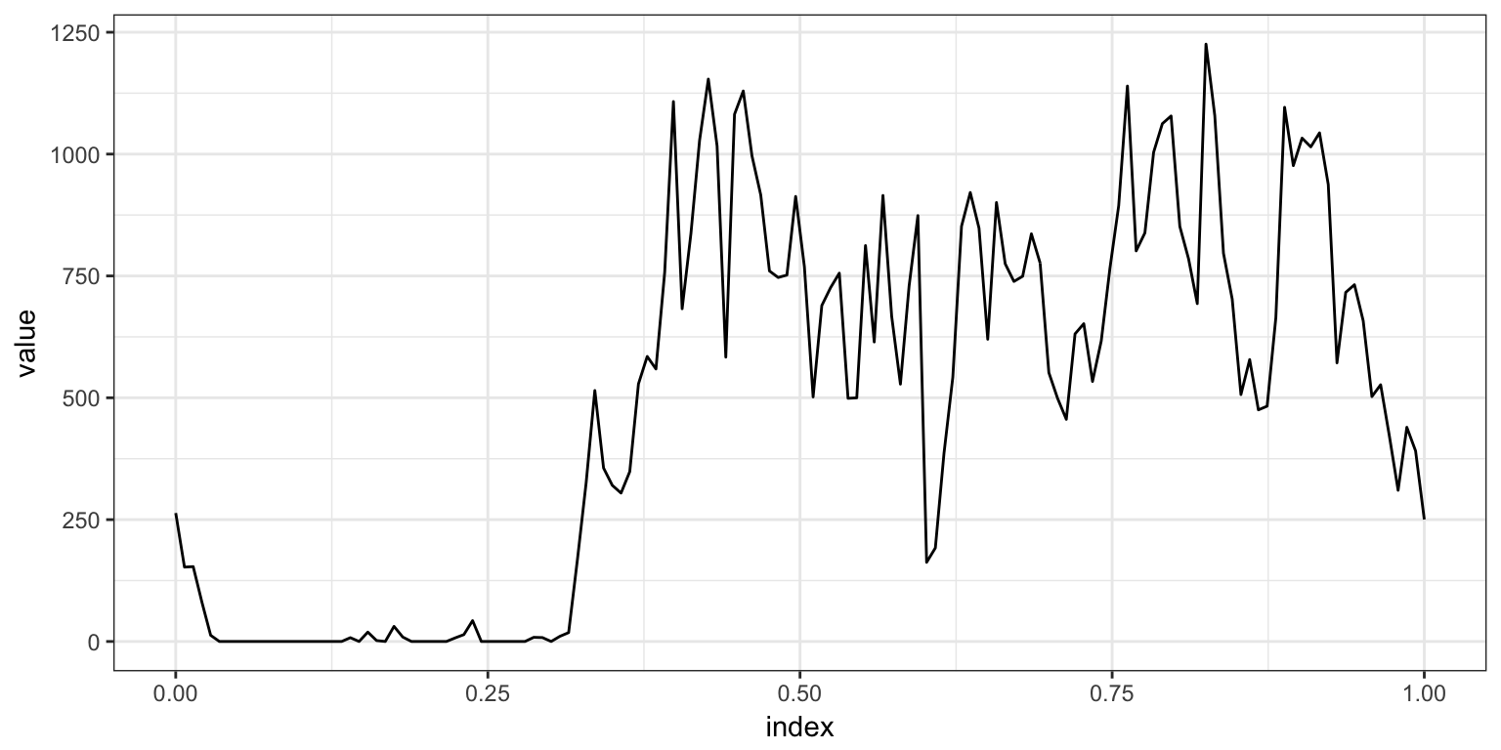
Code

Slide 10
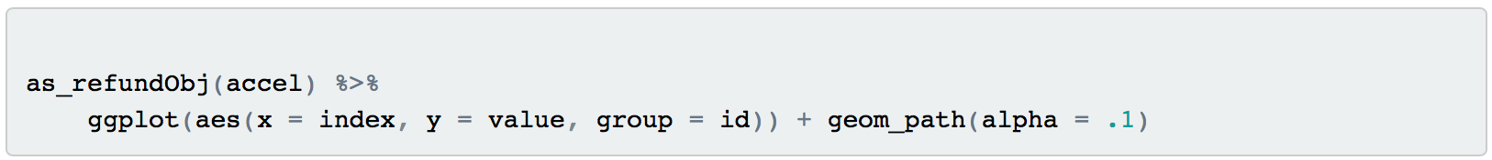
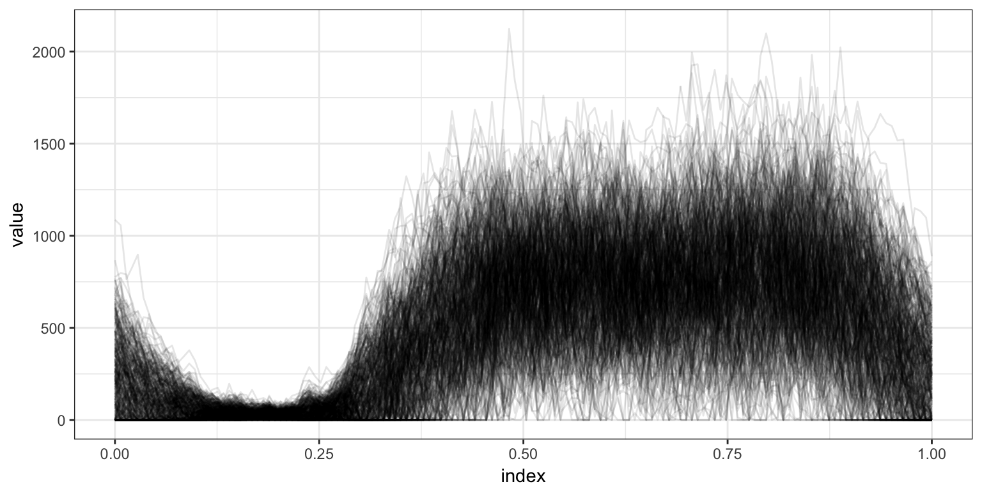
Code

Slide 11
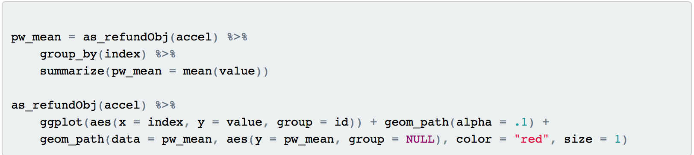
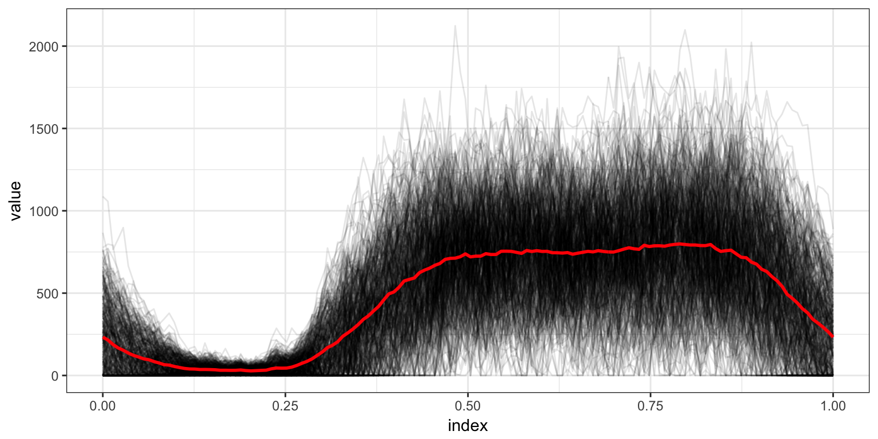
Code

Slide 12
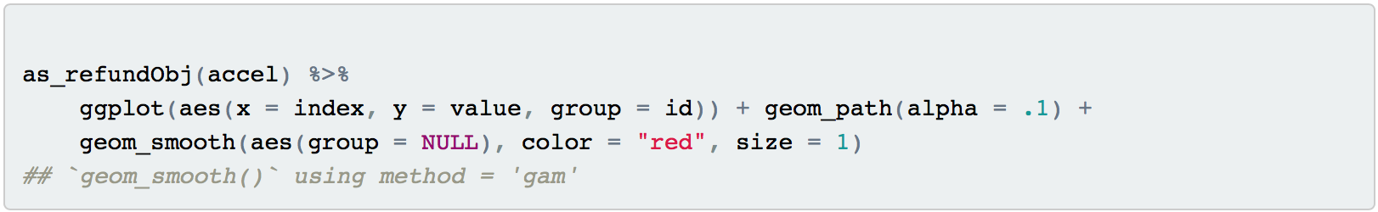

Code

Slide 13
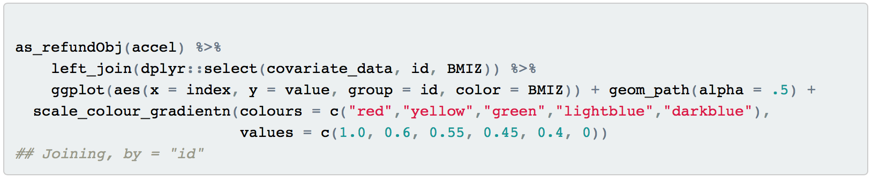
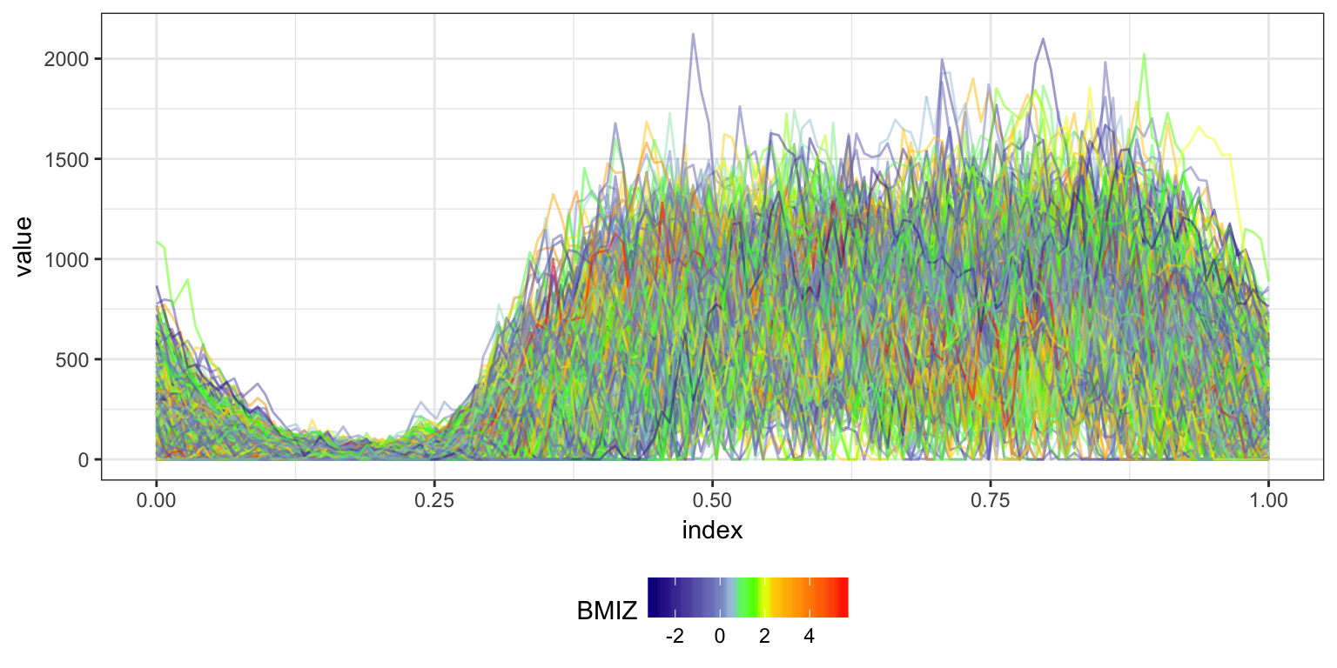
Code

