Slide 1
Function-on-Scalar models
Jeff Goldsmith, PhD
Department of Biostatistics

Slide 2
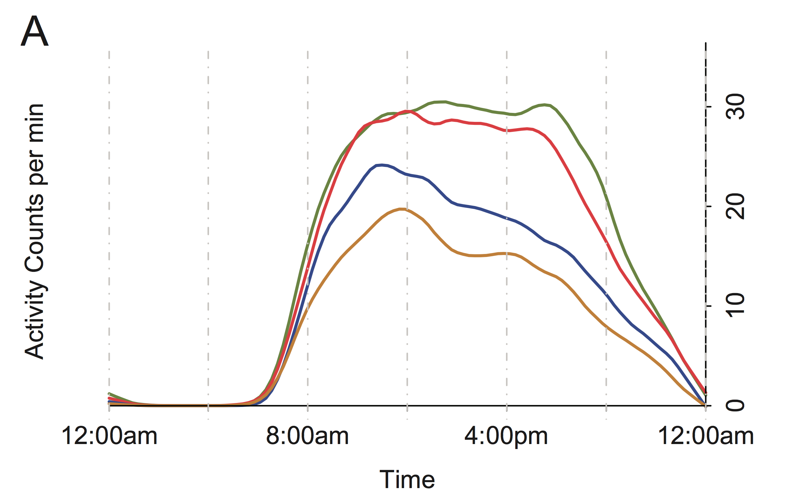
Motivation
J. A. Schrack, V. Zipunnikov, J. Goldsmith, J. Bai, E. M. Simonsick, C. M. Crainiceanu, L. Ferrucci (2014). Assessing the “Physical Cliff”: Detailed Quantification of Aging and Physical Activity. Journal of Gerontology: Medical Sciences, 69 973-979.

Slide 3
Questions to address
Association?
Confounding?
Significance?

Slide 4
Functions as outcomes
Activity may depend on covariates
Associations may be different at different times of day
Shift from functions as predictors to functions as outcomes
“Function-on-scalar” regression

Slide 5
Simple linear regression
The function-on-scalar model that is analogous to simple linear regression is
Functional response y_{i}
Scalar predictor x_{i}
Functional covariate is of interest
Linear model
Most common approach

Slide 6
Linear FoSR
The MLR equivalent is
Functional response y_{i}
Scalar predictor x_{i}
Functional covariates are of interest
Linear model
Most common approach

Slide 7
Basis expansion
The functional coefficients are usually expanded in terms of a basis:
Several basis options are possible
FPC
Splines (my preference)
Wavelets
Fourier

Slide 8
Basis expansion
For response data on a common finite grid, the model can be expressed
Y is the matrix of row-stacked responses
X is the usual design matrix
is the matrix of basis functions evaluated over the common grid
B is the matrix of basis coefficients
E is the matrix of row-stacked errors

Slide 9
Recast model
By vectorizing the response and the linear predictor, we obtain the equivalent model formulation
vec() concatenates the columns of the matrix argument
is the kronecker product
This reformulates function-on-scalar regression as a usual least-squares problem
Goal is to estimate the columns of B or, equivalently, the elements of vec(B)

Slide 10
Correlated errors
Errors are correlated within a subject, but variable selection methods assume independent errors
Three approaches:
Ignore this issue
Use GLS in place of OLS by “pre-whitening” the left and right side of the matrix formulation of the model:
I.e. define where is the error covariance matrix, and similarly modify the RHS
Jointly model the coefficient vector and the residual covariance
Easiest in a Bayesian setting

Slide 11
Smoothness constraints
The preceding does not include smoothness constraints on estimated coefficients
Such constraints often take the form of a penalty
Can be expressed in terms of a penalty on the basis coefficients
Alternatively, one can be careful about the dimension of the spline basis

Slide 12
Testing
“Global” test: under the null, there is no association between the predictor and outcome at any time
“Local” test: under the null, there is no association between the predictor and outcome at time t
Both can be implemented by focusing on basis coefficients
The former avoids some multiple comparisons issues
Analogous to F and t tests in MLR

Slide 13
Connection to MLR
Integrating over t for each subject gives the average activity for a subject
Can similarly average over coefficients in FoSR to approximate estimates in MLR
Will differ slightly from an MLR fit to average activity counts
Illustrates the connection (and difference) between approaches

Slide 14
Switch to code

Slide 15
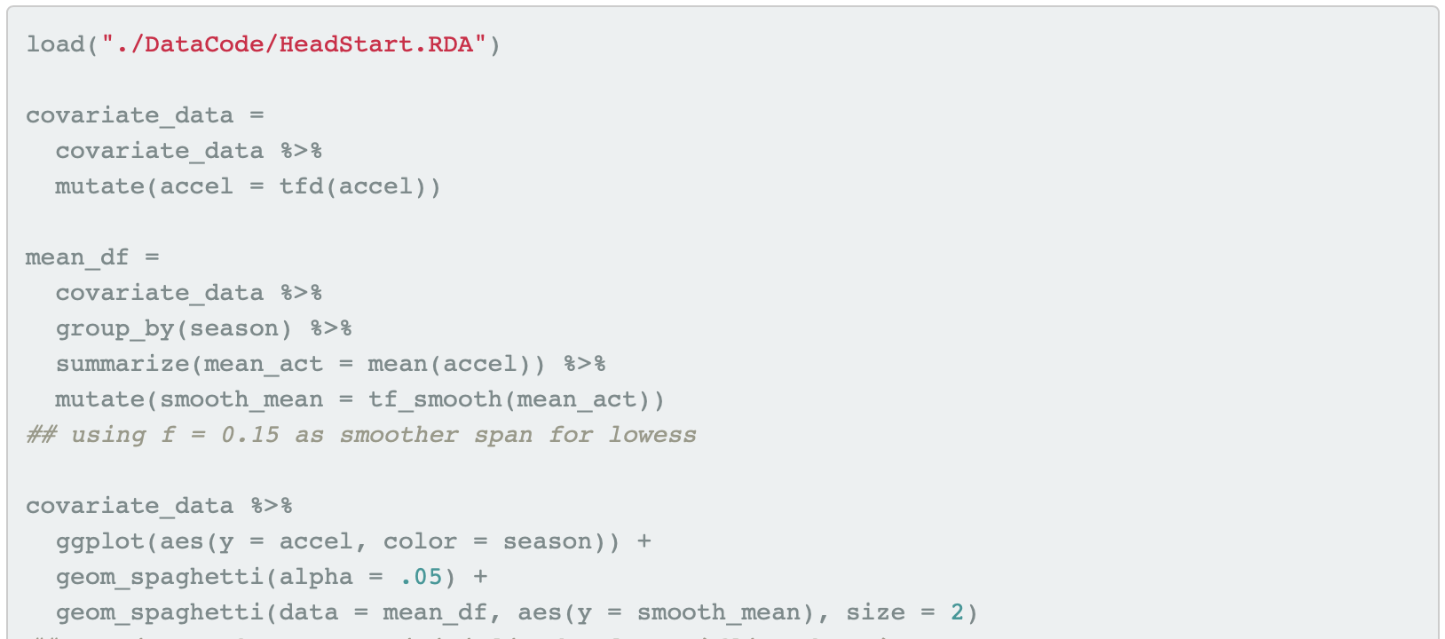
Code

Slide 16
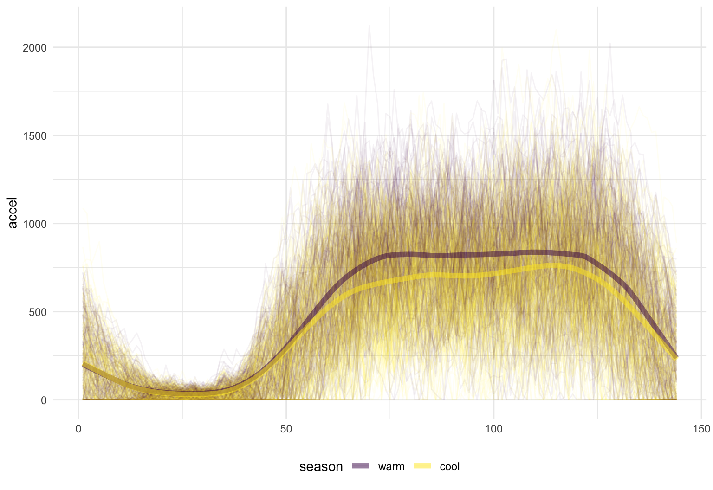
Code

Slide 17
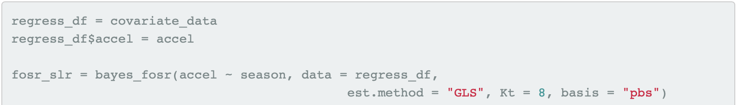
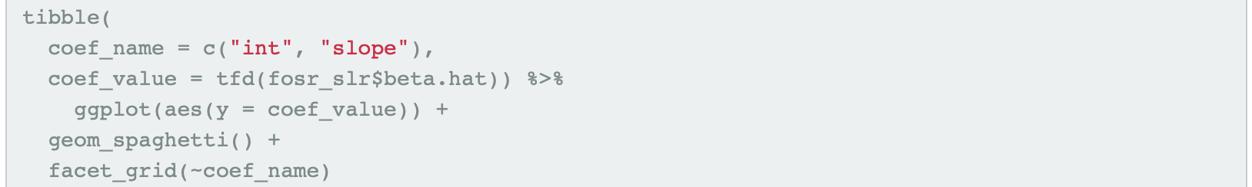
Code

Slide 18
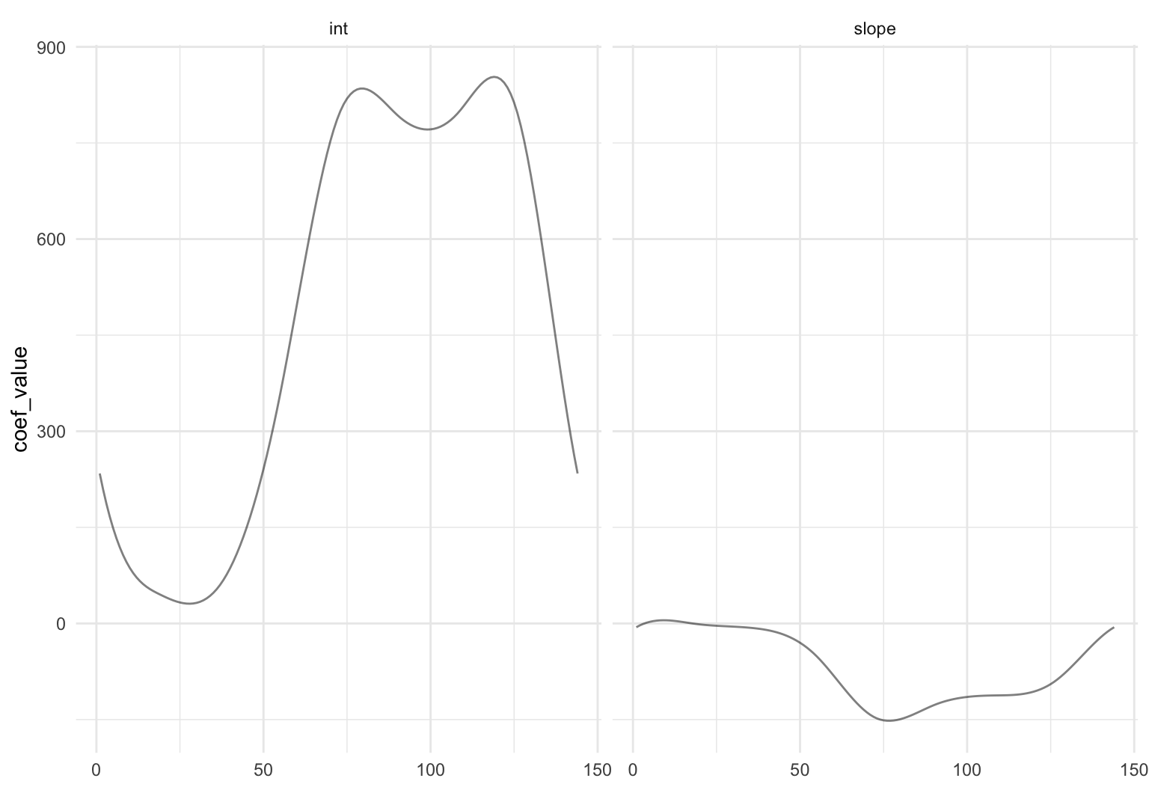
Code

Slide 19
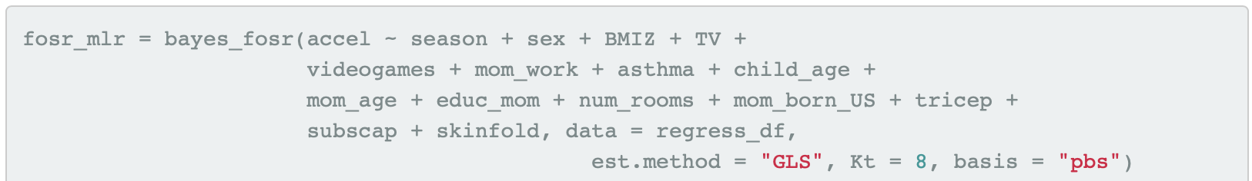
Code

Slide 20
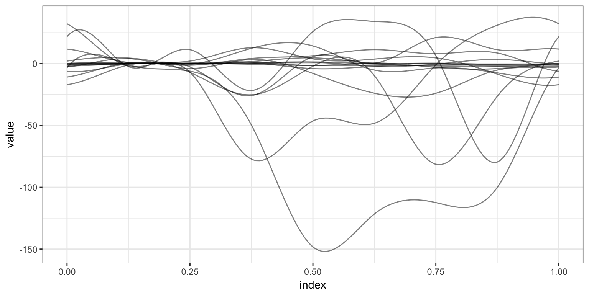
Code

Slide 21
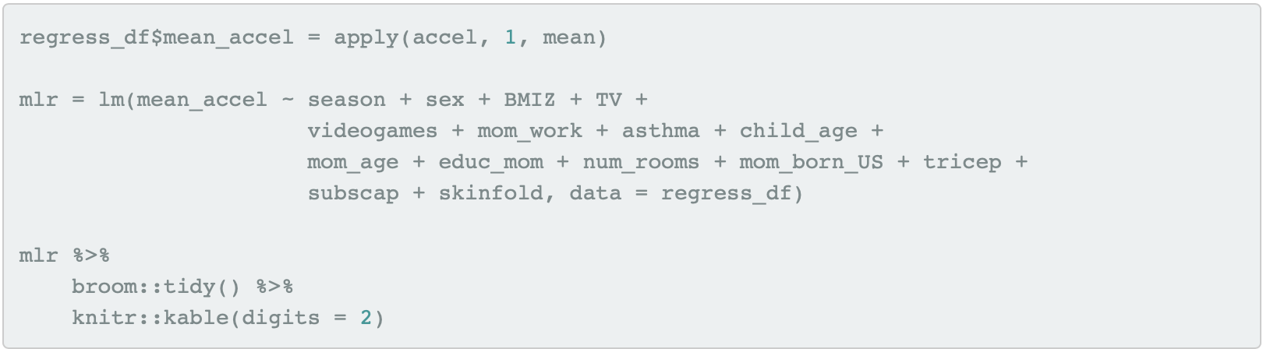
Code

Slide 22
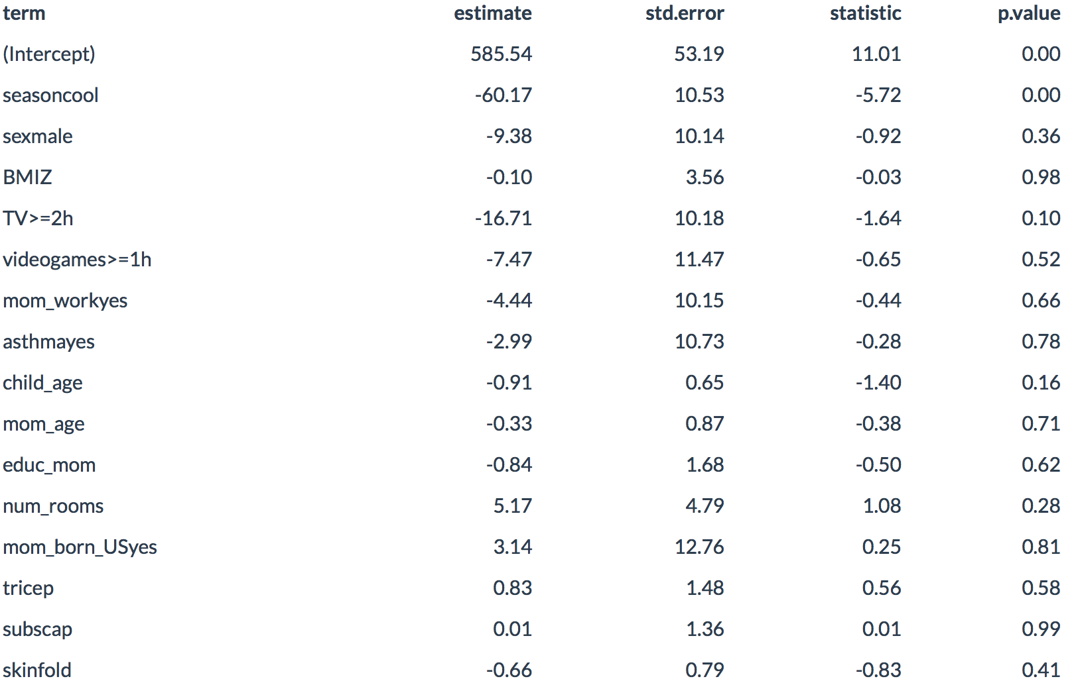
Code

Slide 23
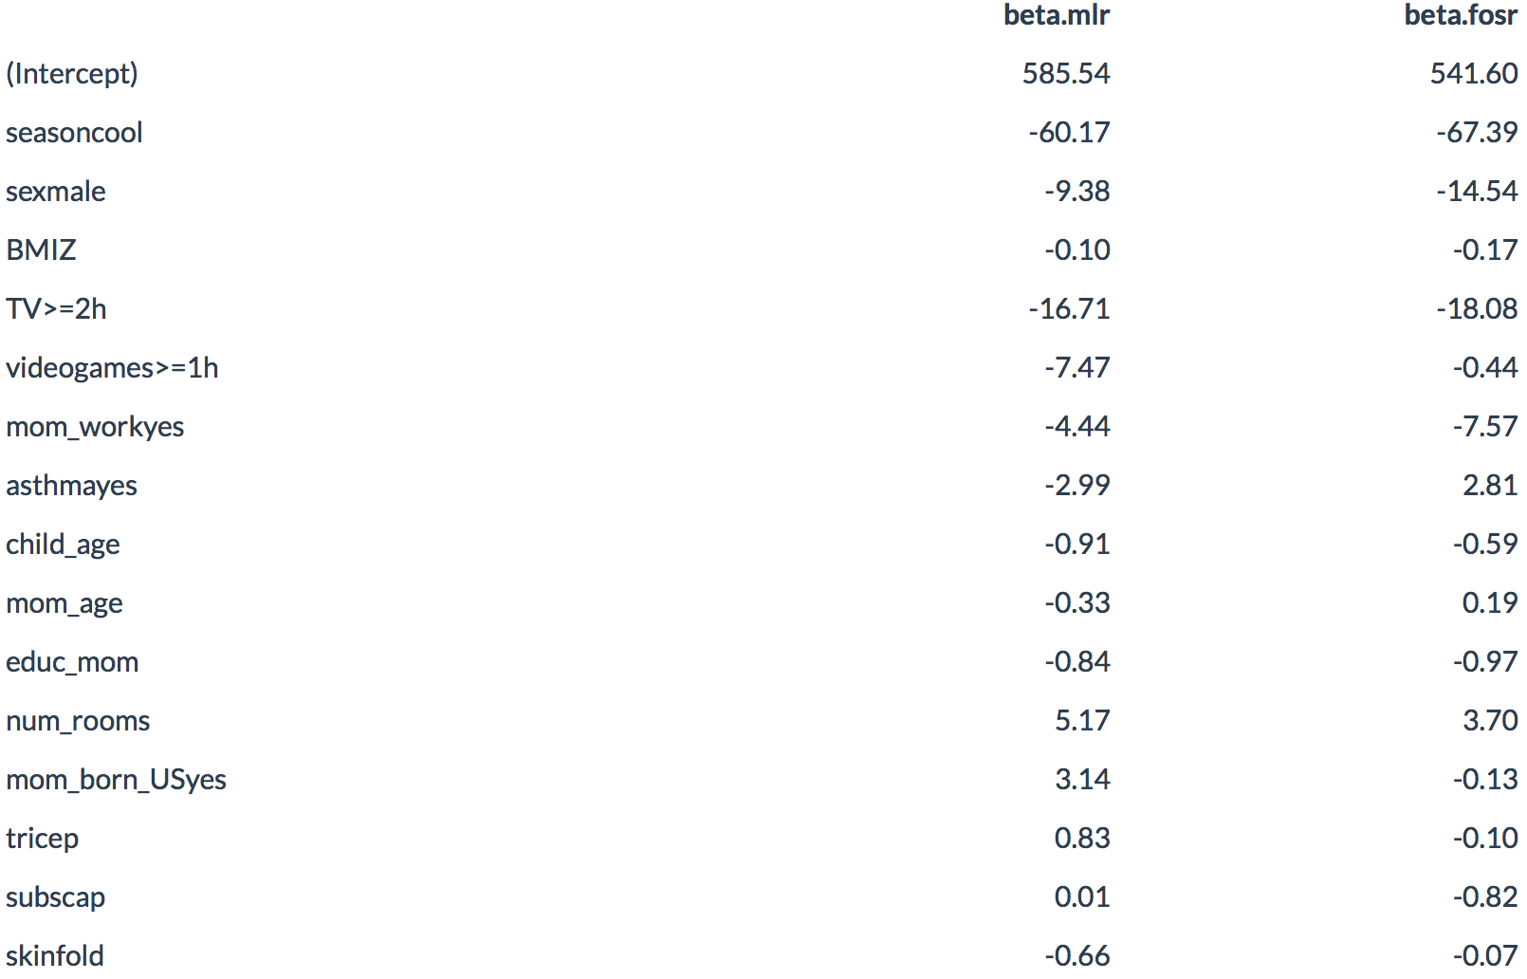
Code

