Slide 1


Slide 2

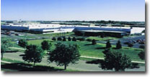
Background
Problem
Statement
Achievements & Progress
Questions
Team
Goals
Dispensing
Mixed Model
OMRON is a global supplier of automotive electronics.
Produces 100,000s of pieces of automotive electronic equipment per month.

Slide 3
Background
Problem
Statement
Achievements & Progress
Questions
Team
Goals
Dispensing
Mixed Model
OMRON faces obstacles regarding their production means which effect their ability to efficiently manufacture certain products
IPRO 326 seeks to enhance the manufacturing capabilities of the sponsor by expediting some of their product assembly lines

Slide 4
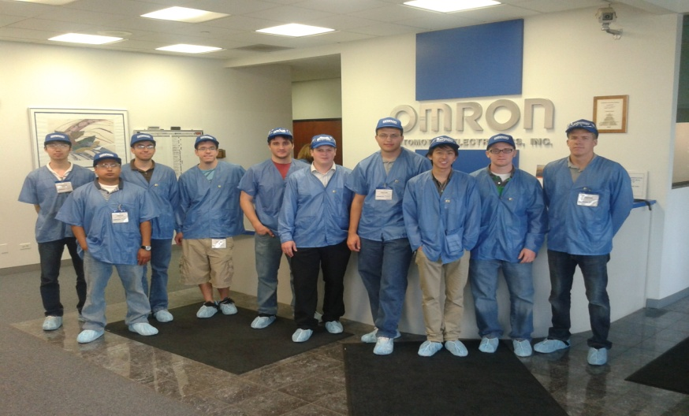
Background
Problem
Statement
Achievements & Progress
Questions
Team
Goals
Dispensing
Mixed Model
IPRO 326
Dispensing
Mixed Model Lines

Slide 5
Background
Problem
Statement
Achievements & Progress
Questions
Team
Goals
Dispensing
Mixed Model
Overall Goal
Improve OMRON's product line efficiency
Dispensing Team
Modify the dispensing station to reduce inconsistency in Loctite dispense process
Find a solution to avoid the breakage of needles
Mixed Model Line Team
Consolidate the production area of OMRON’s variety of low volume automotive electronics

Slide 6
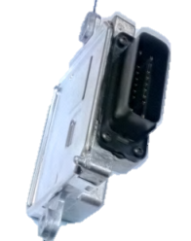
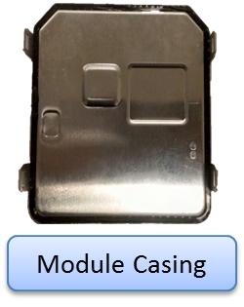
Background
Problem
Statement
Achievements & Progress
Questions
Team
Goals
Dispensing
Mixed Model
Fuel Pump Controller
New Product
Dispensing Needle Breaking Issues
Loctite Dispensing Issues

Slide 7
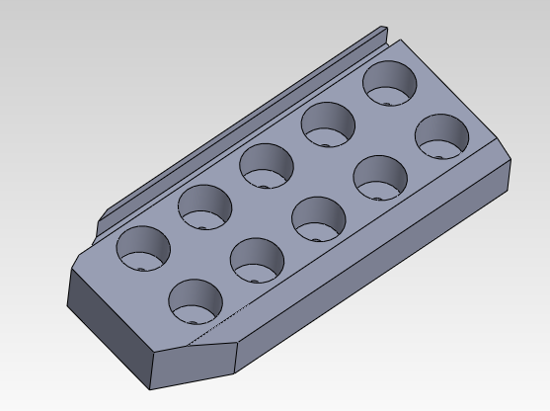
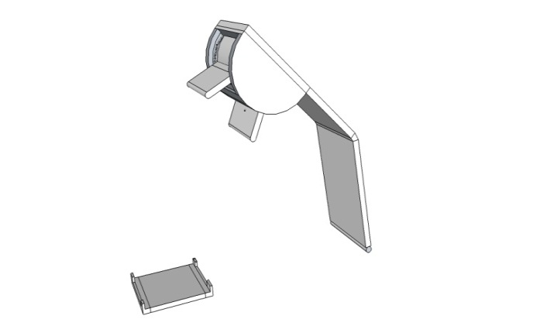
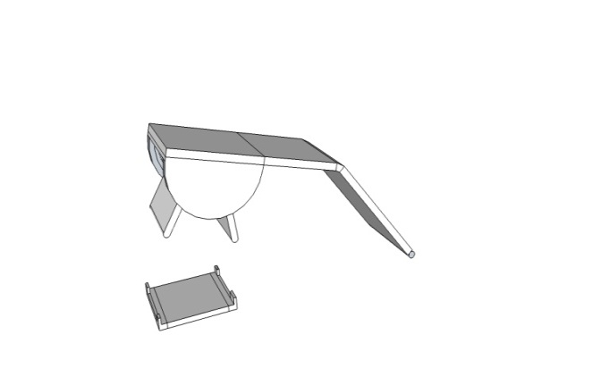
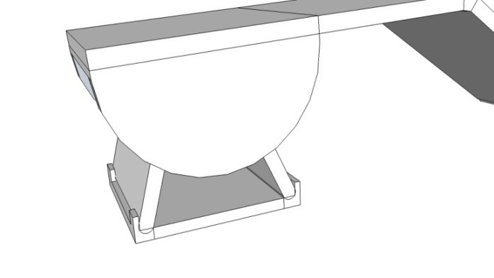
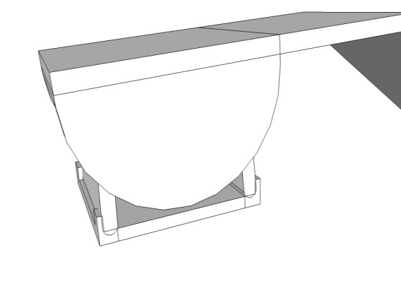
Background
Problem
Statement
Achievements & Progress
Questions
Team
Goals
Dispensing
Mixed Model
Needle Breakage
First prototype
Pros:
Fixes bent sides
Cons:
Difficult to use
Second Prototype
Pros:
Fixes Bent Sides
Easy to Use
Cons:
Takes up space

Slide 8
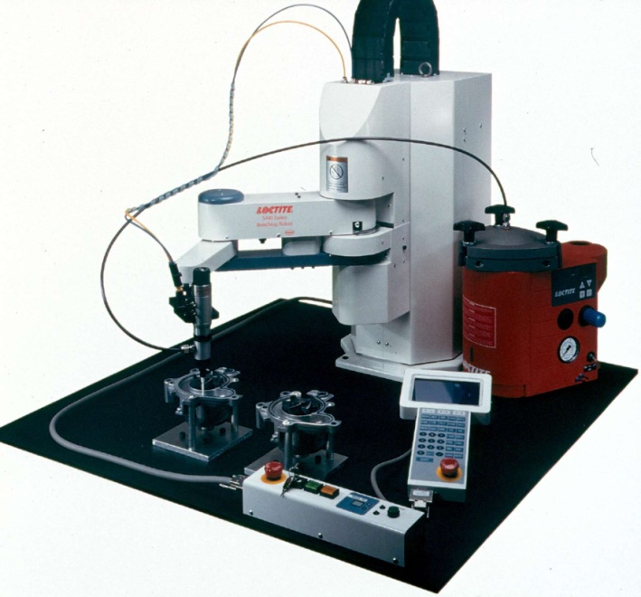
Background
Problem
Statement
Achievements & Progress
Questions
Team
Goals
Dispensing
Mixed Model
Loctite Dispensing
The Loctite sealant drips excessively
Heater is not constant, loses heat to environment
Just uses a block of metal which varies ±7F
3 Different Solutions Proposed

Slide 9
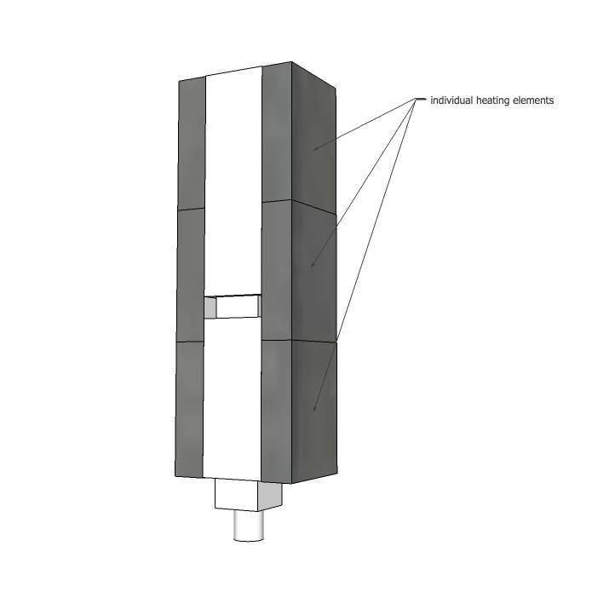
Background
Problem
Statement
Achievements & Progress
Questions
Team
Goals
Dispensing
Mixed Model
Separation
Separating the Heating Material
3 individually heated and powered sections

Slide 10
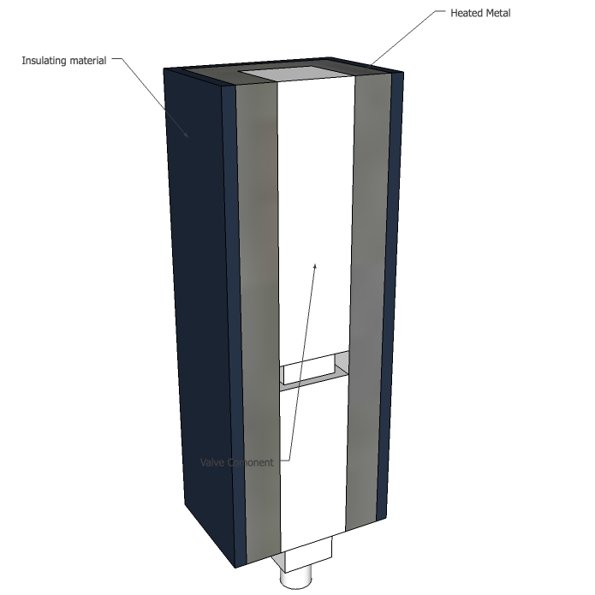
Background
Problem
Statement
Achievements & Progress
Questions
Team
Goals
Dispensing
Mixed Model
Insulation
Insulating material
Wrapped around the heating material
Heating material in one or many sections

Slide 11
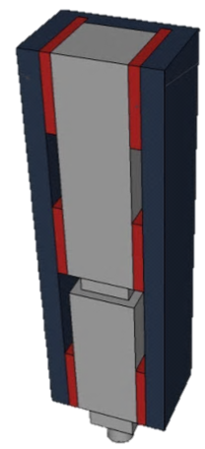
Background
Problem
Statement
Achievements & Progress
Questions
Team
Goals
Dispensing
Mixed Model
Thermoelectric Technology
Insulation material preventing heat loss
Plates create a quick temperature response
Flexible to respond in different situations to reach the best viscosity

Slide 12
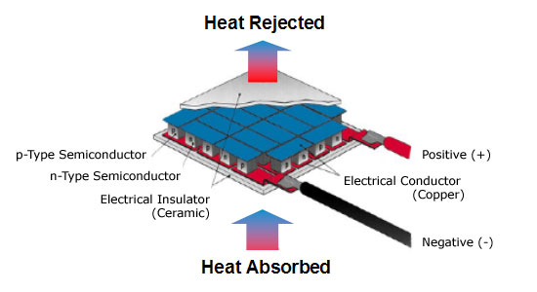
Background
Problem
Statement
Achievements & Progress
Questions
Team
Goals
Dispensing
Mixed Model
Comparison of the 3 possible solutions
 | Thermoelectric | Insulation | Separations
Pro | Change temperature fast, Cool base to stop excess, Inexpensive, Lots of size options | Easy to add on, Stops loss of heat, Varies temperature less | Simple, Cools base to stop excess
Con | Complicated to setup, Requires space, Lots of wires needed | Not a total solution | Temp change is slow, still looses heat to the environment, still varies in temperature, more wires and more space

Slide 13
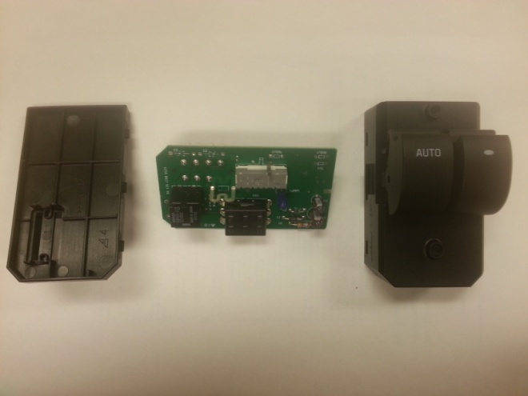
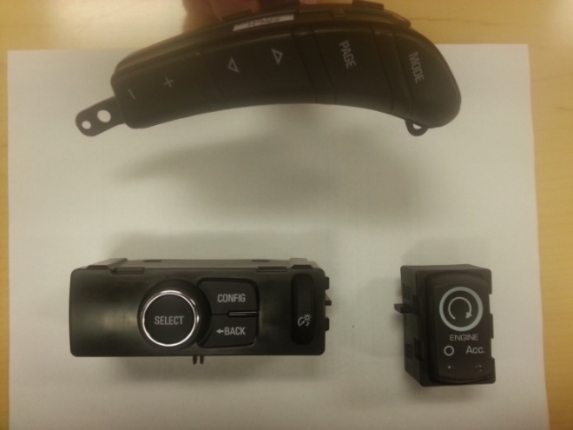
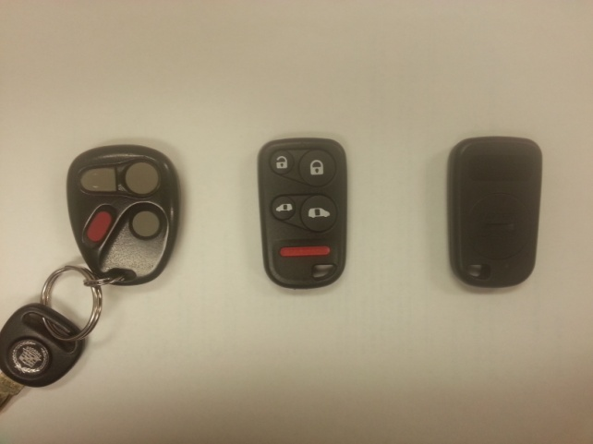
Background
Problem
Statement
Achievements & Progress
Questions
Team
Goals
Dispensing
Mixed Model
Products deducted into families
Power Window Switches
Switches
Transmitters

Slide 14
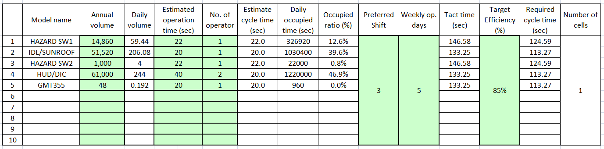
Background
Problem
Statement
Achievements & Progress
Questions
Team
Goals
Dispensing
Mixed Model
Gathered Data and created various documentation
Cycle Time Estimation Sheets
Takt Time Calculations
Process Flow Diagrams

Slide 15
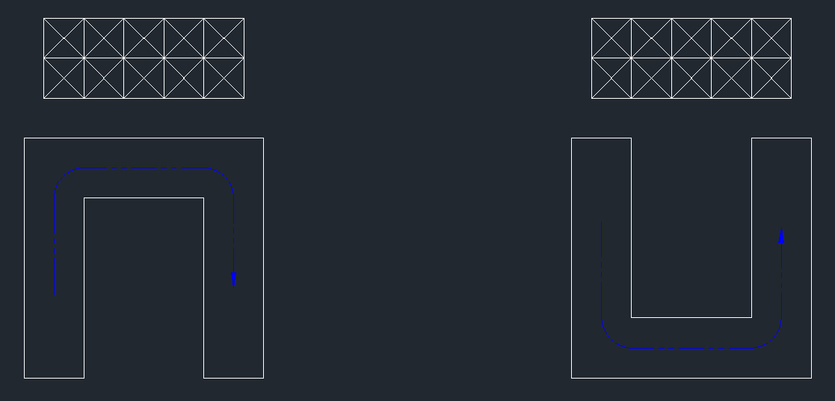
Background
Problem
Statement
Achievements & Progress
Questions
Team
Goals
Dispensing
Mixed Model
Discussed Ways to optimize workbench layout
U-Shape Workbench Design
Positioning of materials in relation to workbench
Enables quick access to parts
Comparison of Workbenches

Slide 16
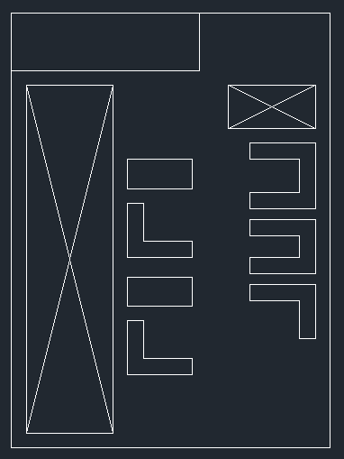
Background
Problem
Statement
Achievements & Progress
Questions
Team
Goals
Dispensing
Mixed Model
Rail Delivery System
Utilization of empty overhead space
Rail System delivering kits to the workbench
Kit to assemble system
Current Layout

Slide 17
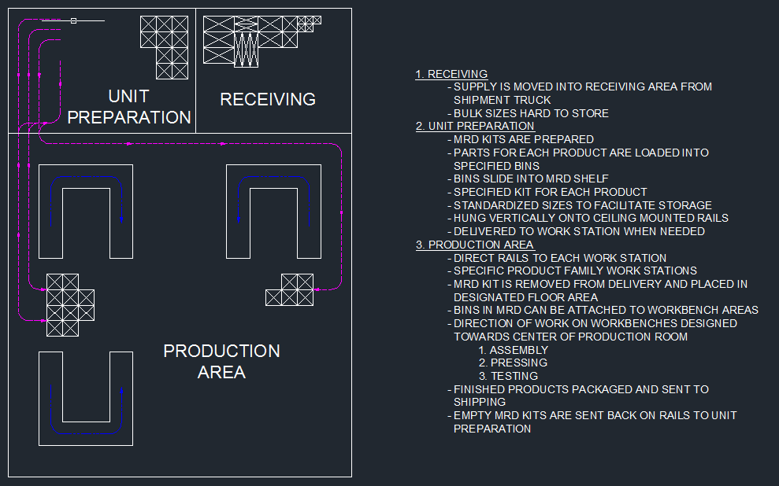
Background
Problem
Statement
Achievements & Progress
Questions
Team
Goals
Dispensing
Mixed Model
Rail Delivery System

Slide 18
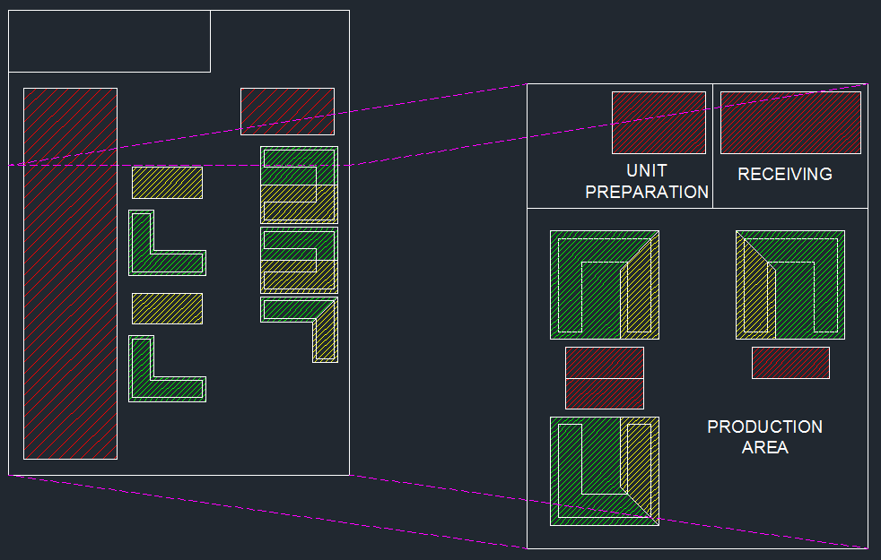
Background
Problem
Statement
Achievements & Progress
Questions
Team
Goals
Dispensing
Mixed Model
Comparison of Layouts
Same Scale

Slide 19
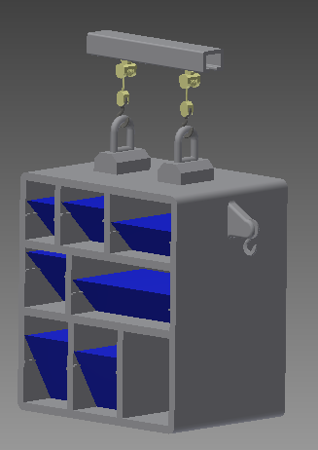
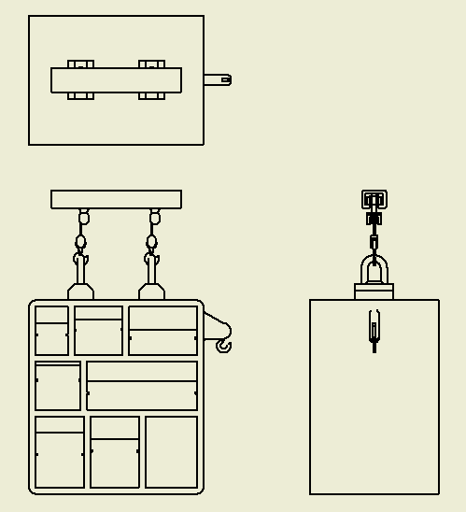
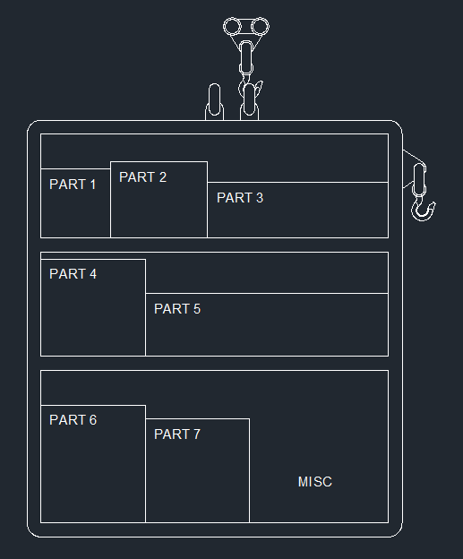
Background
Problem
Statement
Achievements & Progress
Questions
Team
Goals
Dispensing
Mixed Model
Kit to Assemble
Specific product in unit
Bins are racked so they can be easily removed
Hook used to hang bulk parts

Slide 20
Background
Problem
Statement
Achievements & Progress
Questions
Team
Goals
Dispensing
Mixed Model
Challenges and Obstacles
Communication
Difficult to contact and communicate effectively with sponsor
Collecting information
Custom made machines
Confidentiality
Prohibited to disclose confidential information and risk jeopardizing company

Slide 21

Background
Problem
Statement
Achievements & Progress
Questions
Team
Goals
Dispensing
Mixed Model
Thank you for listening!
Questions?

