Slide 1
An Introduction to Satnogs
Jeff Luszcz
N2TIQ
jeffluszczdev@gmail.com
This work is licensed under a Creative Commons Attribution 4.0 International (CC-BY 4.0)

Slide 2
What is Satnogs?
Satnogs is an Open Source software system that allows users to schedule “Observations” of Satellites and capture the radio signals they transmit (https://satnogs.org )
It uses SDRs or radios to receive (and transmit if desired!) to and from these Satellites
Common observations include Weather Satellite pictures, digital telemetry, voice and CW
Notes:
A SDR is a Software Defined Radio, a piece of electronics that allows a computer to listen to signals in the radio spectrum

Slide 3
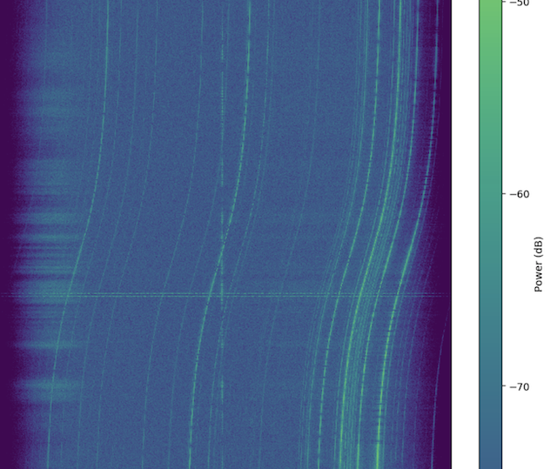
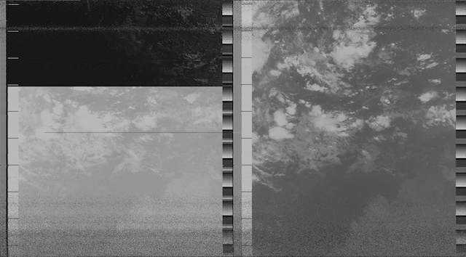
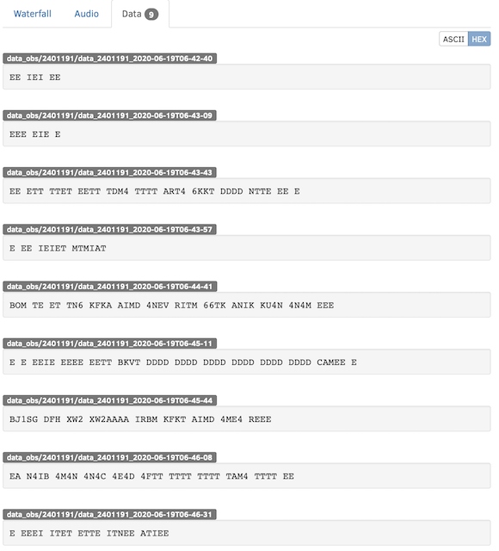
What can you receive?
Weather Satellite Images
Voice (FM, SSB, Digital)
CW
Telemetry (fsk, cw, etc..)
Waterfall data / audio
Notes:
The lower left image is a image from a weather satellite. It contains two views of the same area. One in Infrared light, the other in regular light.
The upper right image is a Waterfall, showing received radio signals over time. The signal that is being listened to is straight up and down. The curved lines are other radio signals likely on the ground. They are curved since the radio retunes itself to listen to the main signal and to reduce the effects of the Doppler effect.
The lower right image is numbers and data decoded from a Telemetry signal from the satellite. Typically telemetry are values like Battery levels, etc..

Slide 4
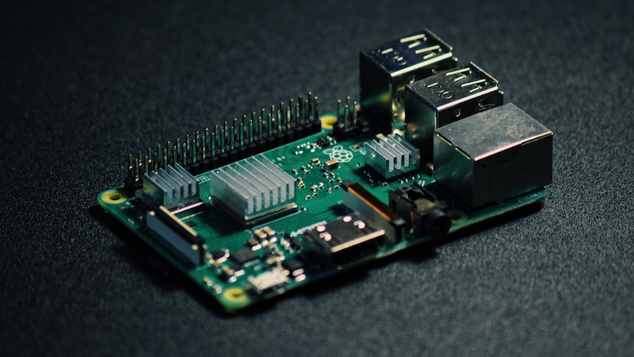
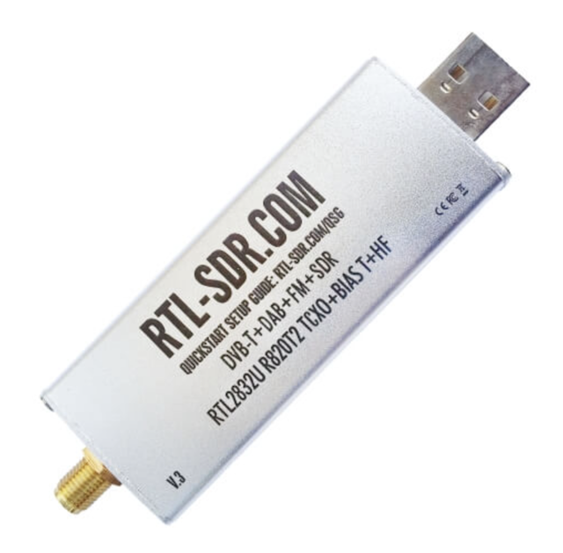
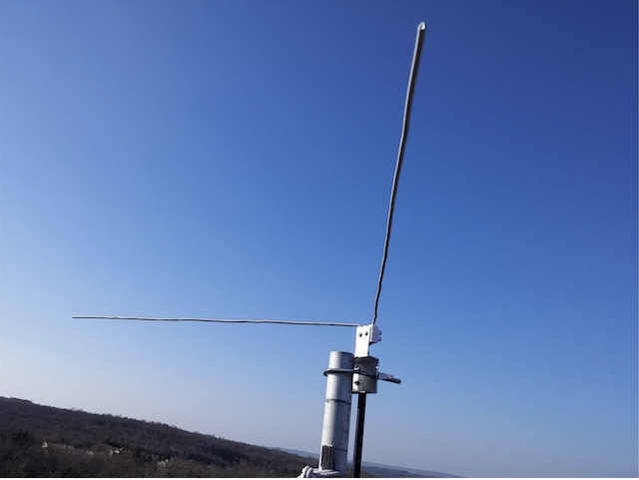
What do you need to start?
A Raspberry Pi 3 or better
A SDR dongle ($20 online)
A receiving antenna
A Network connection (ethernet or wifi)
Satnogs Operating System disk image

Slide 5
Getting and installing the Software
Install Satnogs OS from ISO disk image
https://wiki.satnogs.org/Raspberry_Pi
Write it to SD card and boot your pi
Configure your PI using raspi-config
Get a Ground station ID from Satnogs
Configure the Satnogs client using command line
Change your password from the default pi/pi !
Set system time in UTC

Slide 6
SDR and other radios
Satnogs reference receiver is the standard R820T SDR (~ $21 online)
There is support for other SDRs like Airspy, Funcube dongle, etc…
Some ham transceivers are supported through the rigctld project (for both receive and transmit!)

Slide 7
Pick an Antenna
OK to Good:
Omni directional vertical
Yagi pointed straight up
V-dipole (rabbit ears or homemade v-dipole)
Better:
QFH (lots of online plans!)
Turnstile (lots of online plans!)
Best:
Rotator based antennas

Slide 8
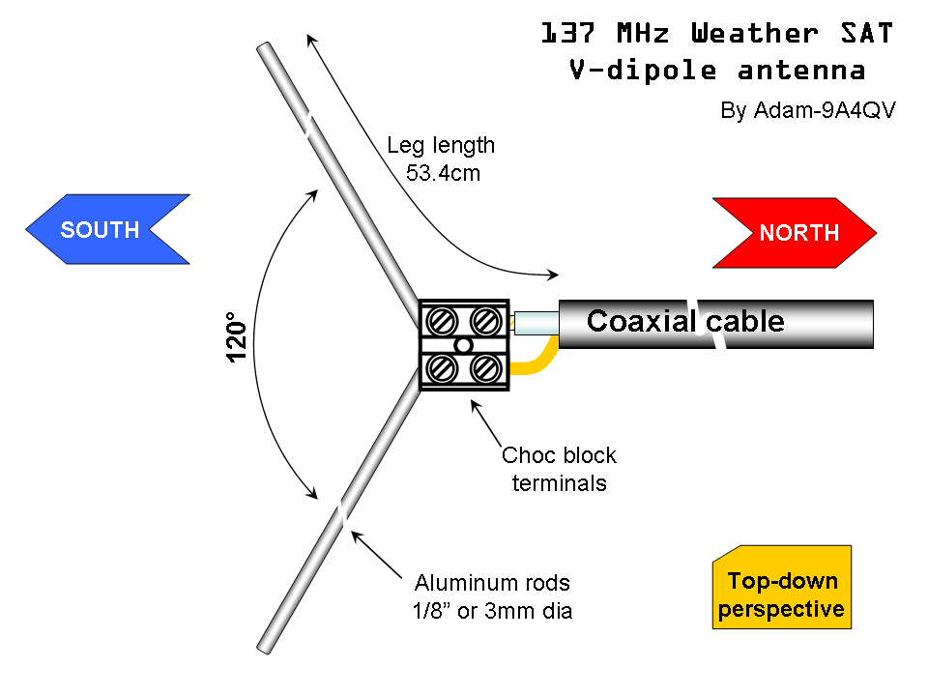
NOAA Weather Satellites Easy Ant.
https://www.rtl-sdr.com/simple-noaameteor-weather-satellite-antenna-137-mhz-v-dipole/
Can be junk boxed for free
Works best outside, but can
work inside with good clear
view

Slide 9
Using Satnogs
Log in
Select your Ground Station
Schedule Future Passes
Filter for your designed Satellite, time or elevation, etc…

Slide 10
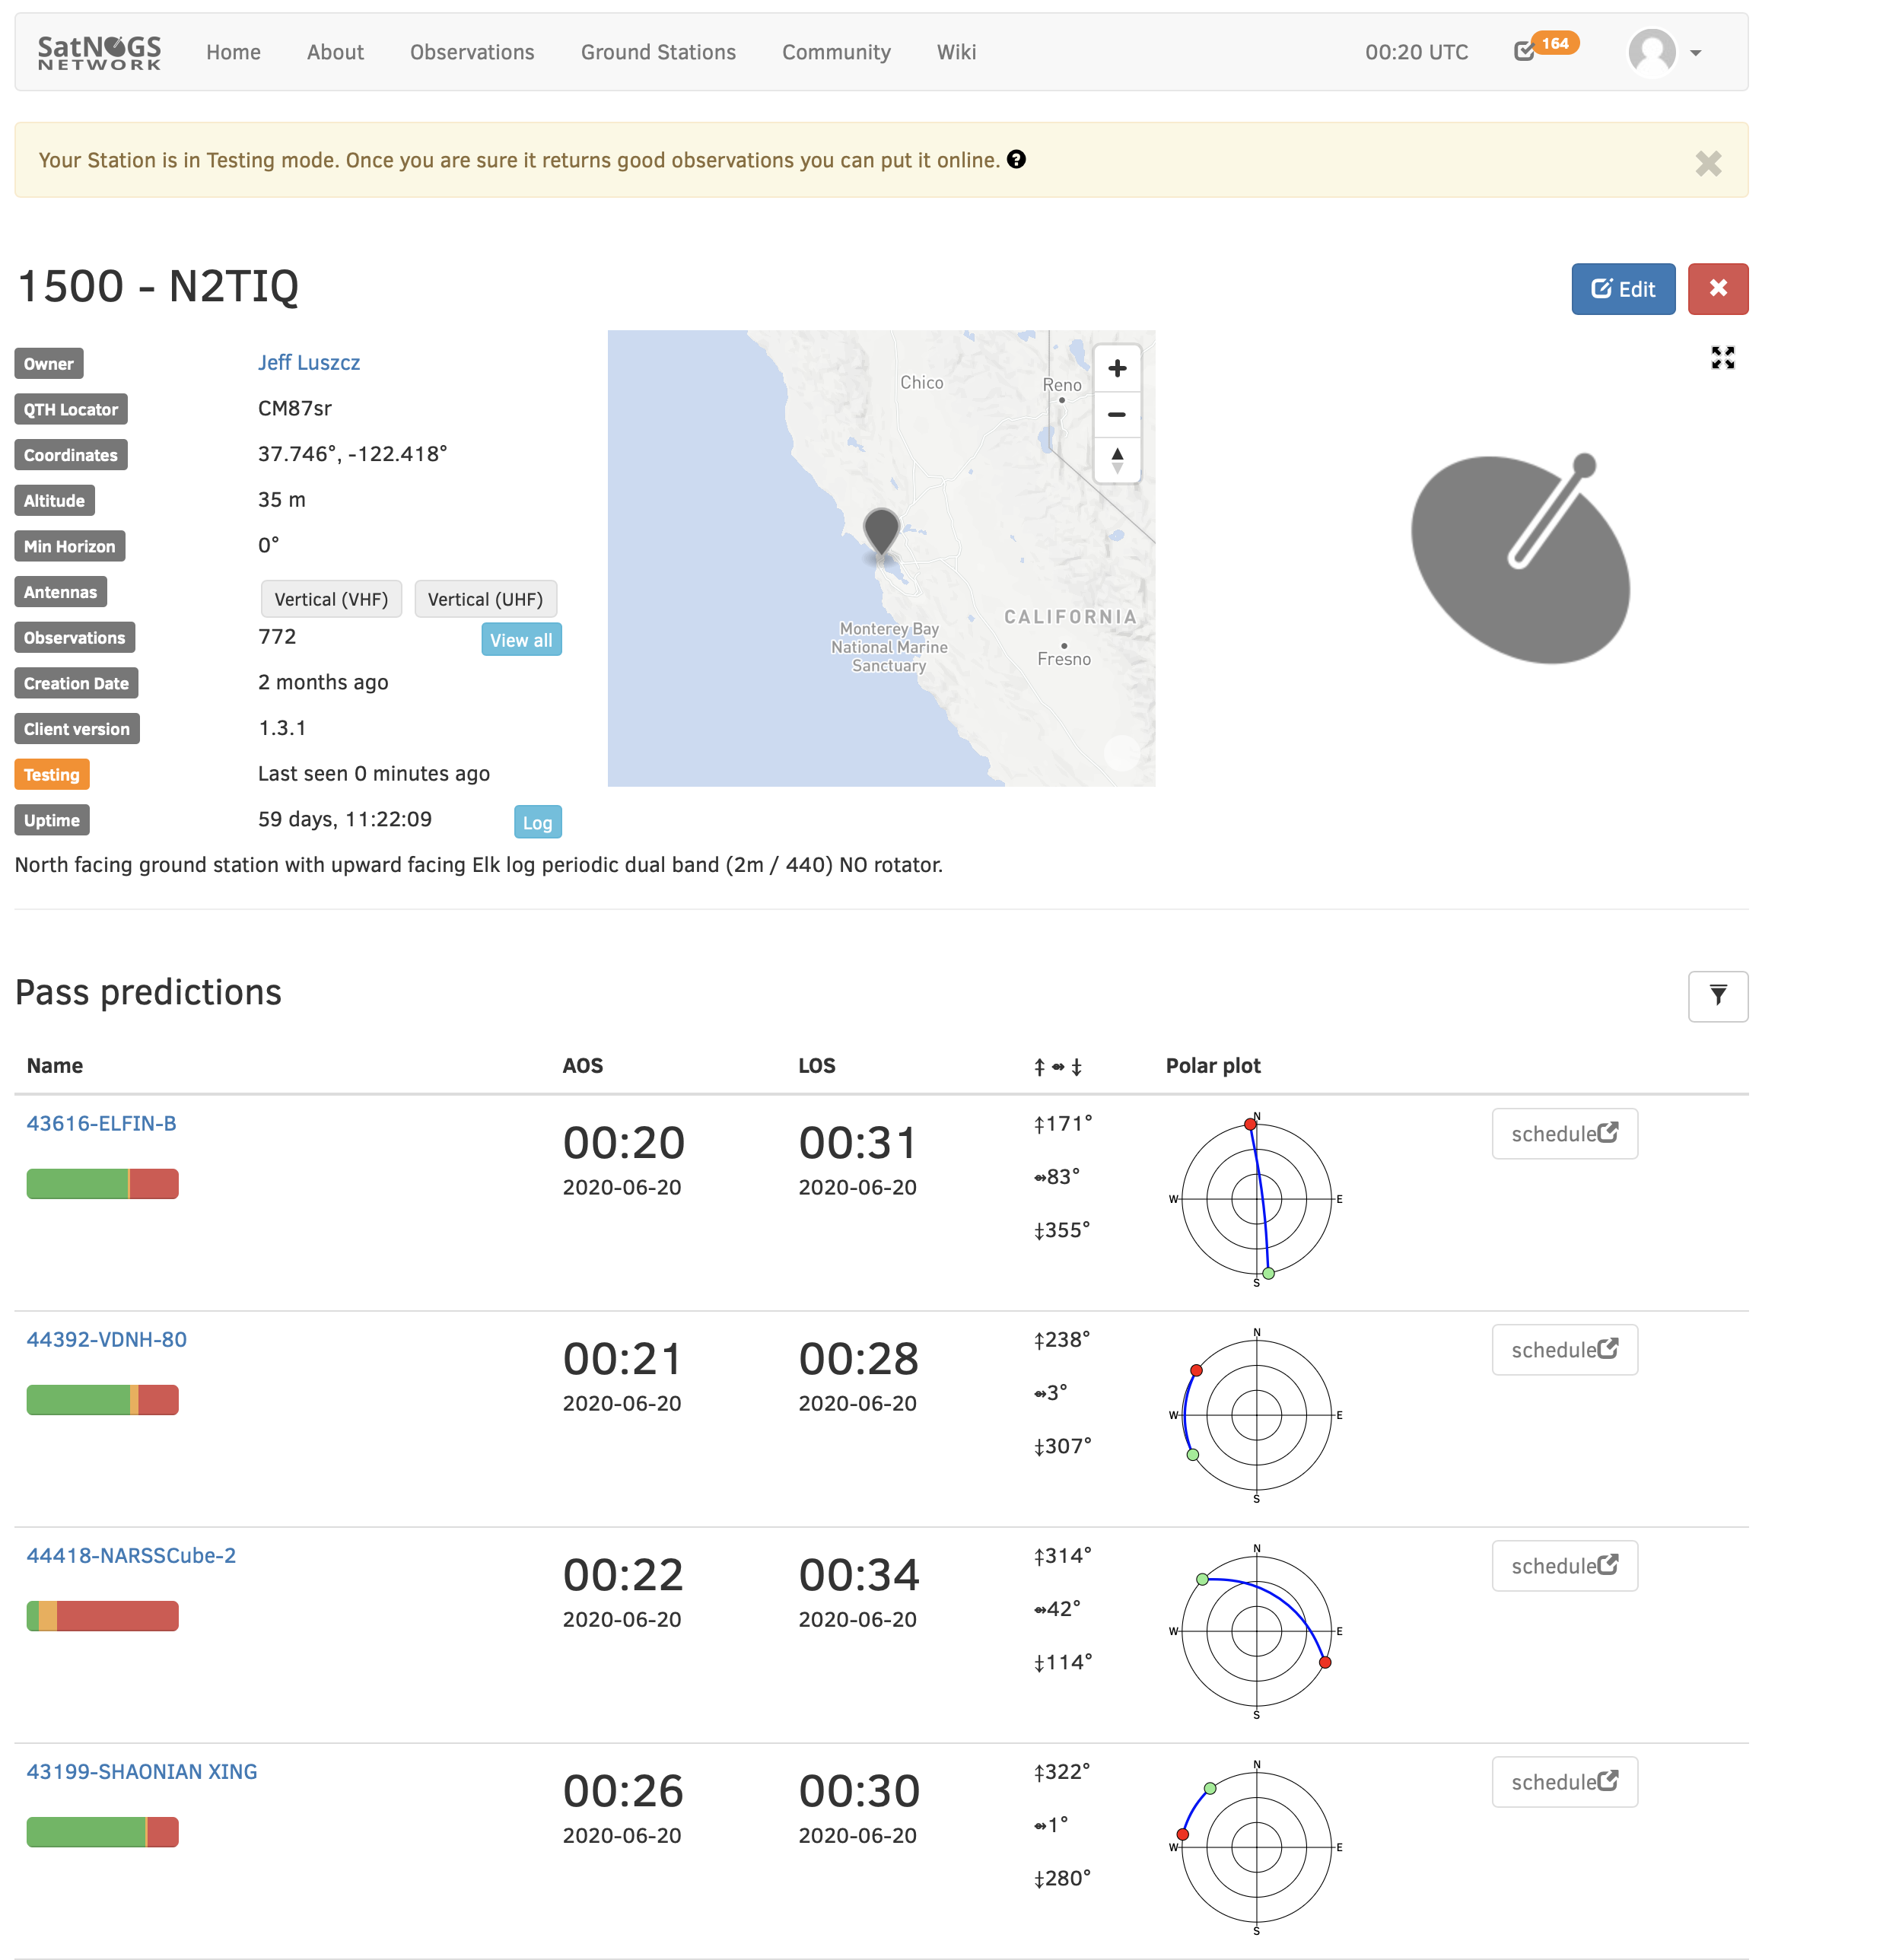

Slide 11
Understanding the Waterfall
You want to see a good signal running straight up and down in the waterfall
Other transmitters (typically from the ground) will appear as a large “S” that goes across the waterfall
The waterfall covers the entire pass from start to finish.
The Highest elevation of the pass is typically in the middle

Slide 12
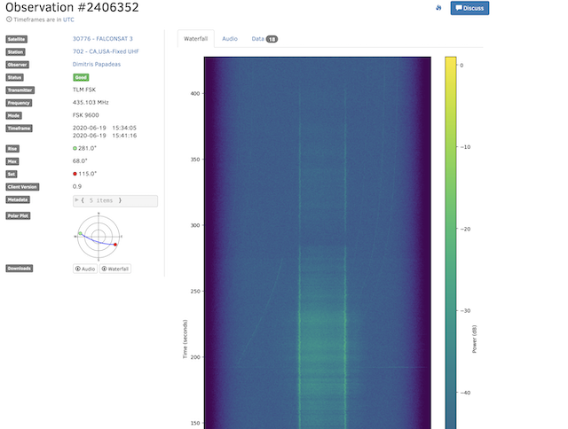
Understanding the Waterfall

Slide 13
Tips and Tricks
Omni directional setup how to is very helpful
https://wiki.satnogs.org/Omnidirectional_Station_How_To
High passes give high satisfaction!
Figure out your Lat/Long/Alt for best results (apps help)
Figure out your gain for your SDR using their process (likely end up with a value of 25-35)
PPM error value discovery is fun but not needed to get started
My Pi hung every 24-48 hours due to Wifi power management problem, googled a fix, all ok now!

Slide 14
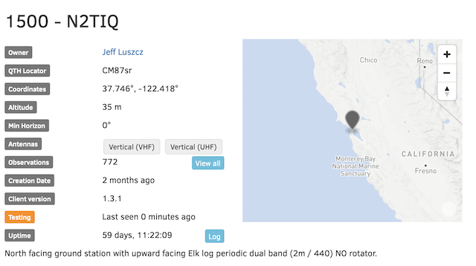
Live Demo (if we have time)

Slide 15
Q & A

Slide 16
Thanks!
Please feel free to follow up to
Jeffluszczdev @ gmail dot com
Twitter:
@jeffluszcz
Ham Radio Homepage:
http://N2TIQ.com

