Slide 1


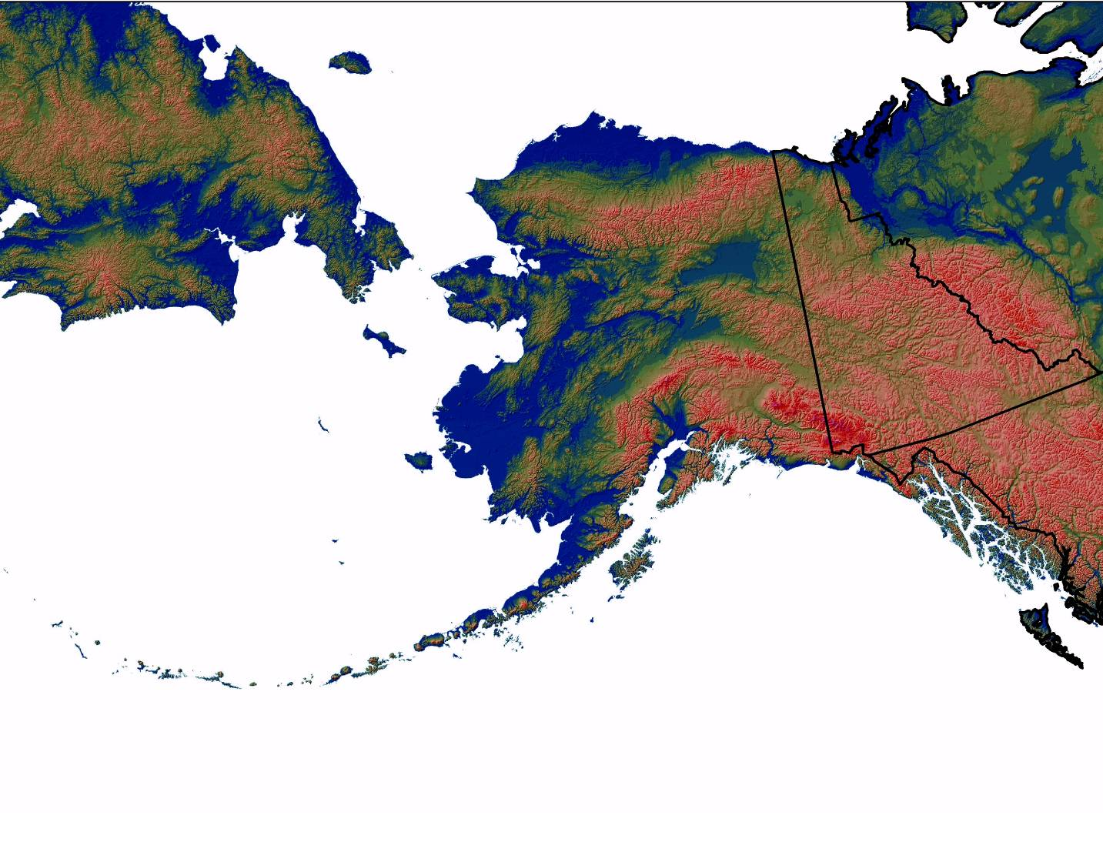
Alaska Chapter

Slide 2
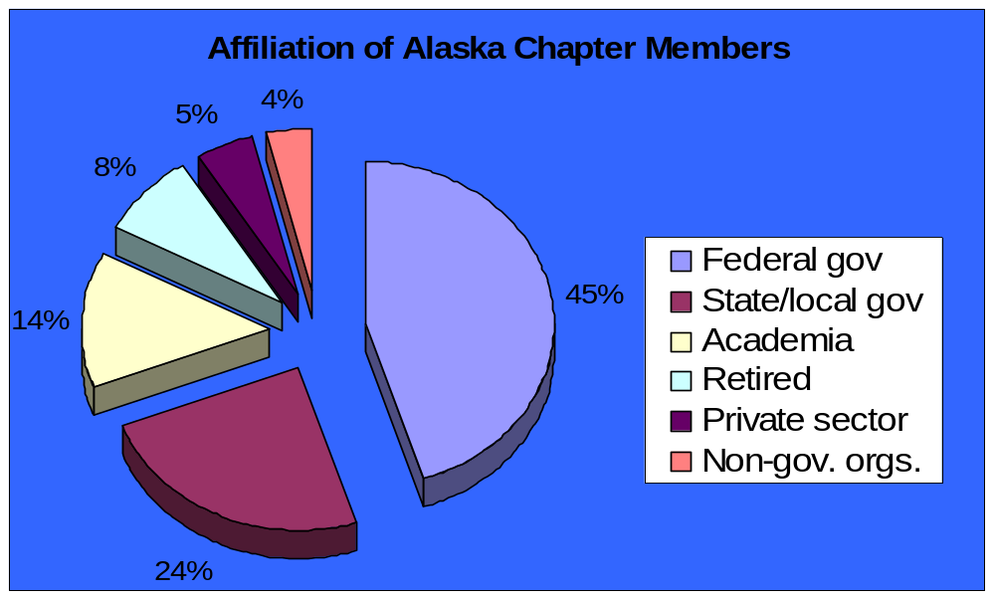
Alaska Chapter founded in 1971 with 64 charter members
271 members in February 2007
(4 charter and 1 TWS life members)

Slide 3
Alaska Chapter active at
Section and national level
Northwest section:
Michael Goldstein (Past president)
Sanjay Pyare (President)
NWS representative to TWS Council:
Wini Kessler (2001-07)
Ellen Campbell (2007-present)

Slide 4
Recent bylaw changes:
Chapter members must be TWS members
Added non-voting Student Chapter representative on the Executive Board
Added electronic voting on website for biennial elections to Executive Board (paper ballots still allowed)—50% turnout in April 2006!
Questions to clarify workload for proposed position statements

Slide 5
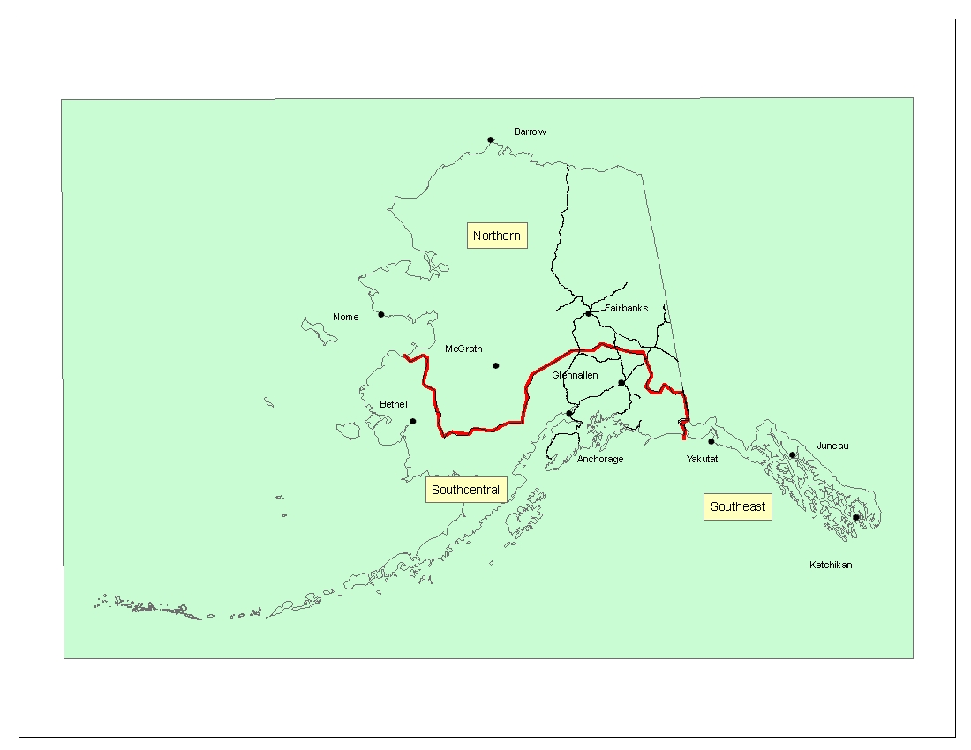
Notes:
Regions define the 3 major issues (oil, predator control, logging)

Slide 6
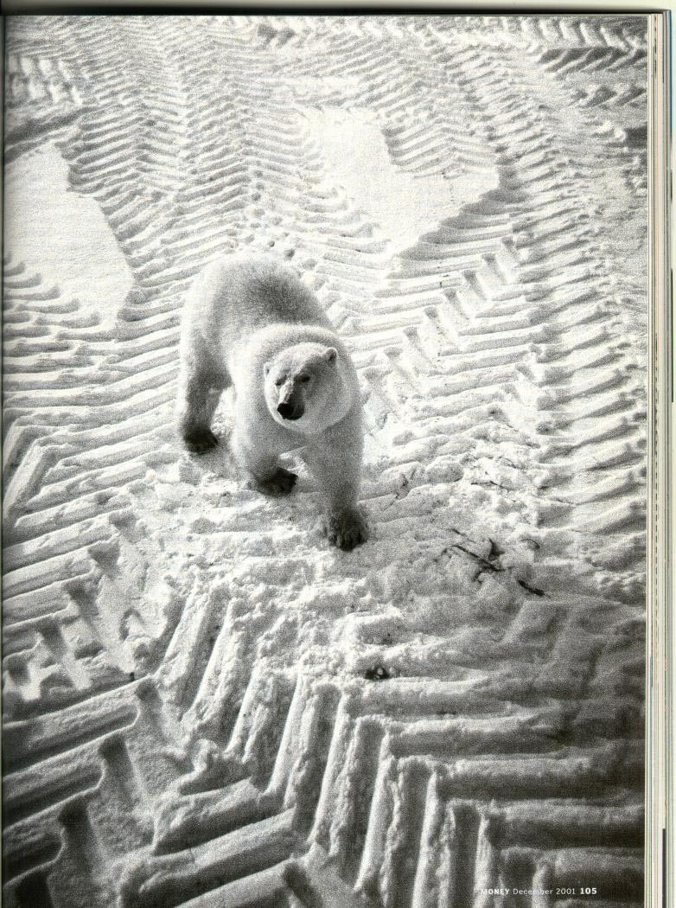
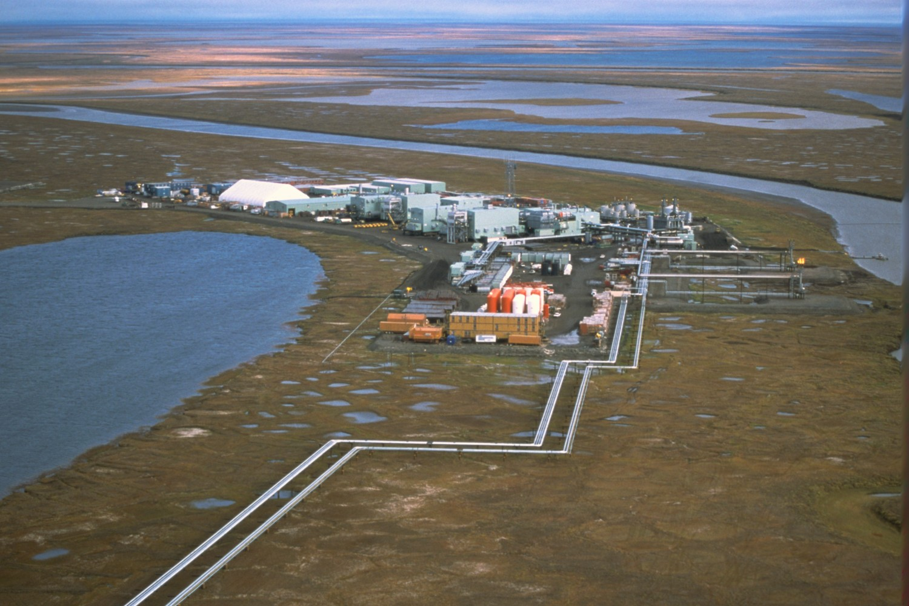
Joel Bennett
Money magazine, Dec. 2001
Energy exploration and development (broader issue of climate change)
Geographic and political landscapes shape major issues

Slide 7
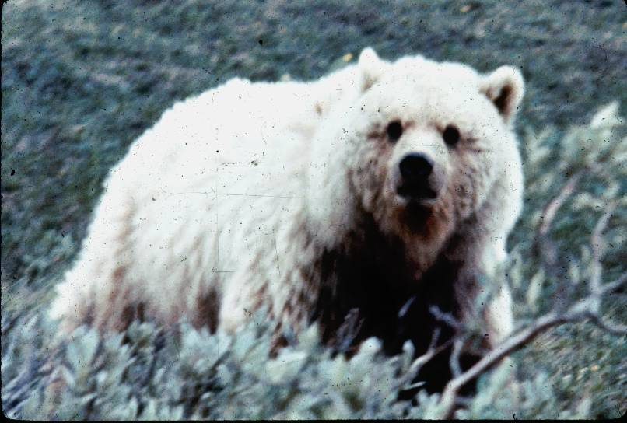
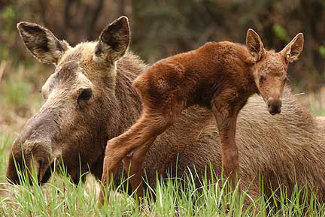
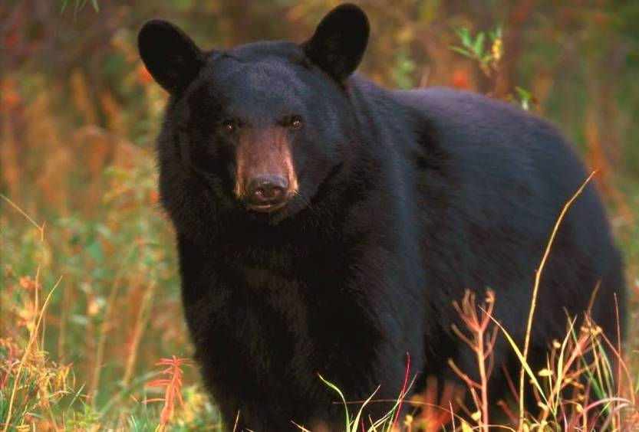
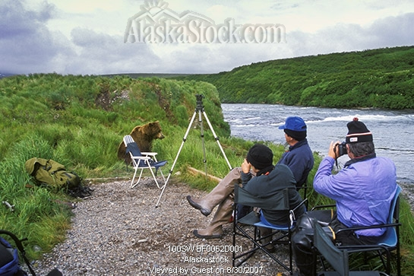
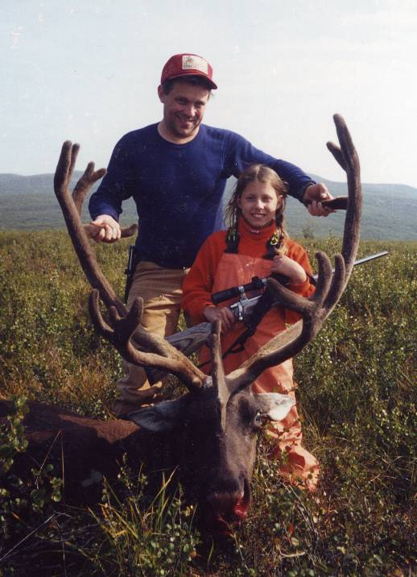
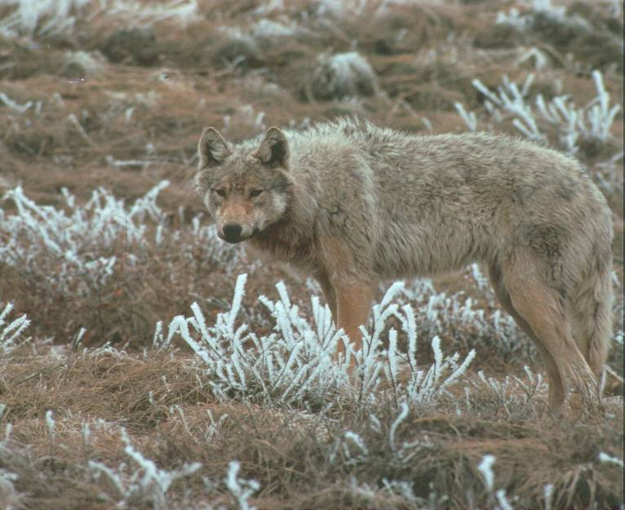
ADF&G photos except viewing
Predator management for ungulate production
Geographic and political landscape shapes major issues
Notes:
Feeding people in Alaska will gain in importance as fuel prices drive up the cost of imported foods

Slide 8
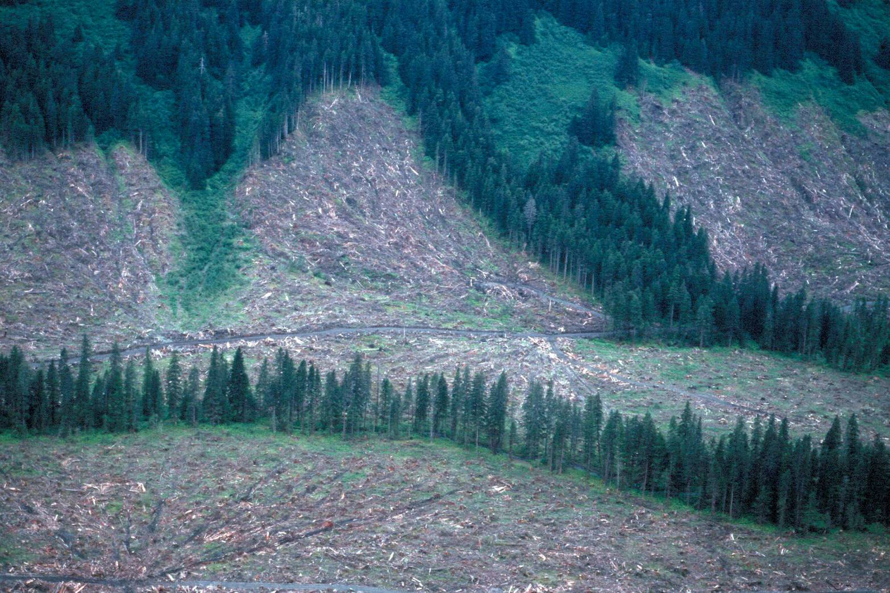
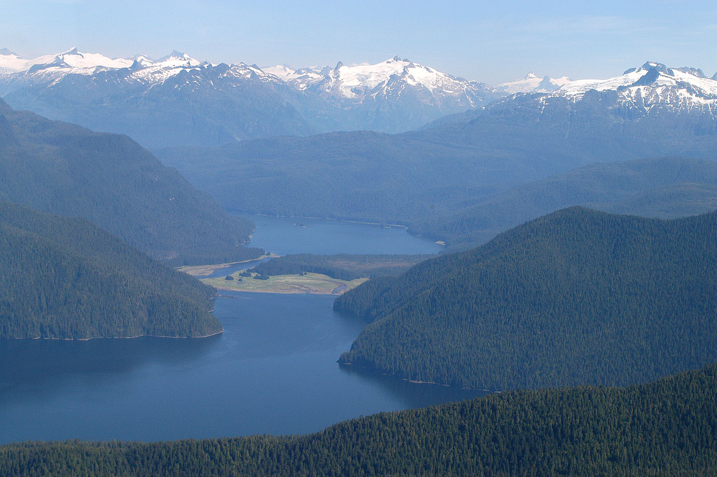
John Schoen
Logging old growth in coastal rain forest
Geographic and political landscape shapes major issues

Slide 9
ANCSA (1971)
Alaska Native Claims Settlement Act
Discovery of Prudhoe Bay field in 1968
National effort to build trans-Alaska oil pipeline required title or easement
44 million acres selected from public domain (BLM) and a $962 million settlement to 13 Alaska Native regional corporations (12 based in Alaska)
More than 200 village corporations established (surface rights)

Slide 10
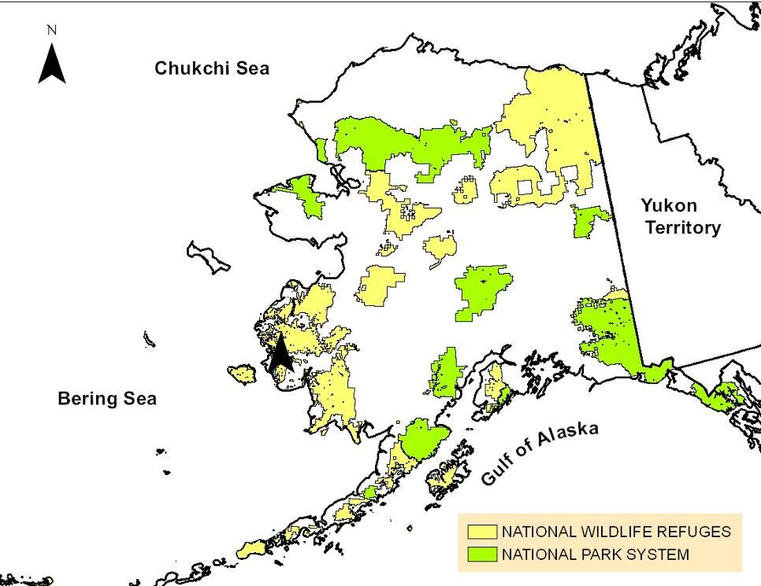
ANILCA (1980)
Alaska National Interest
Lands Conservation Act
Created 10 national parks, preserves, and monuments and expanded 3 existing units (area is 60% of national system)
Created 9 national wildlife refuges and expanded existing 7 refuges (area is 85% of national system)
Tripled the area of federally-designated Wilderness in U.S.
Subsistence as a founding purpose (hunting by rural residents in most park units)

Slide 11
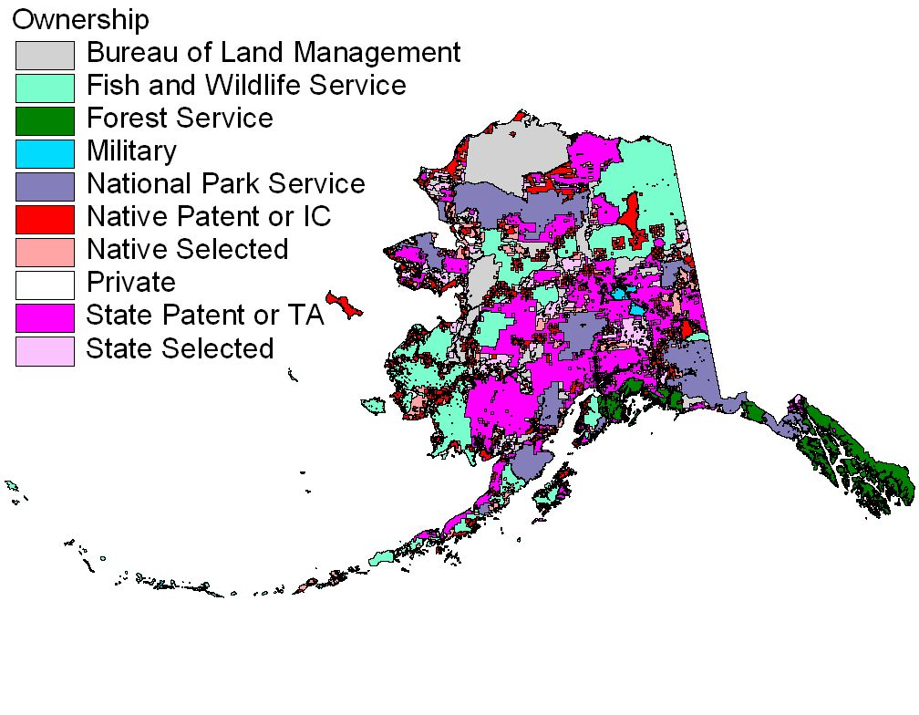
Geographic and political landscape

Slide 12
Alaska Chapter projects 2005-07EJT
Drafted national letter opposing removal of protection of the Teshekpuk Lake area in the Northeast Section of the National Petroleum Reserve – Alaska
Technical review on sale of bear parts
Drafted national position on old growth forests
Letter to Alaska House of Representatives opposing ATV access in pipeline road corridor north of Yukon River (hunting and viewing)
Held first “meet and greet” open house with Alaska Legislature in the state capitol
Notes:
We focus Chapter activities on state and federal policy because of huge area and importance of wildlife management to human nutrition, culture, and the economy

Slide 13
Current project:
Student recruitment and retention
Up to 10 graduates per year get the $32 upgrade from student to regular membership
Up to $1000 per year for travel awards to participate in Chapter meeting
Plans underway for raffle at each Chapter meeting to raise funds for travel award to national meeting

Slide 14
Current trends, future issues for AK
Exploration and development of energy (oil, natural gas, coal) and minerals will increase
Rising cost of fossil fuels will dramatically affect import cost of consumer goods, especially food (intensive management of wild game, game ranching, expansion of local agriculture and forest management)
Climate change will require expedited adaptation by humans (fire, biological pests)
Water will become one of our greatest assets
Alaska Chapter collaboration with BC, YT, NT
Notes:
Alaska will likely develop a professional relationship with Canadian a “western boreal and arctic section”

Slide 15
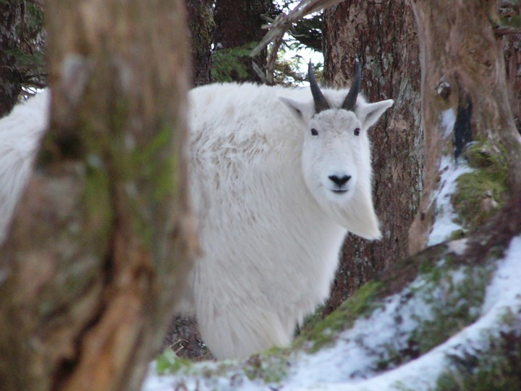
Thanks for your vote of confidence and recognition of Alaska this past year!
Photo by Neil Barten

