Slide 1
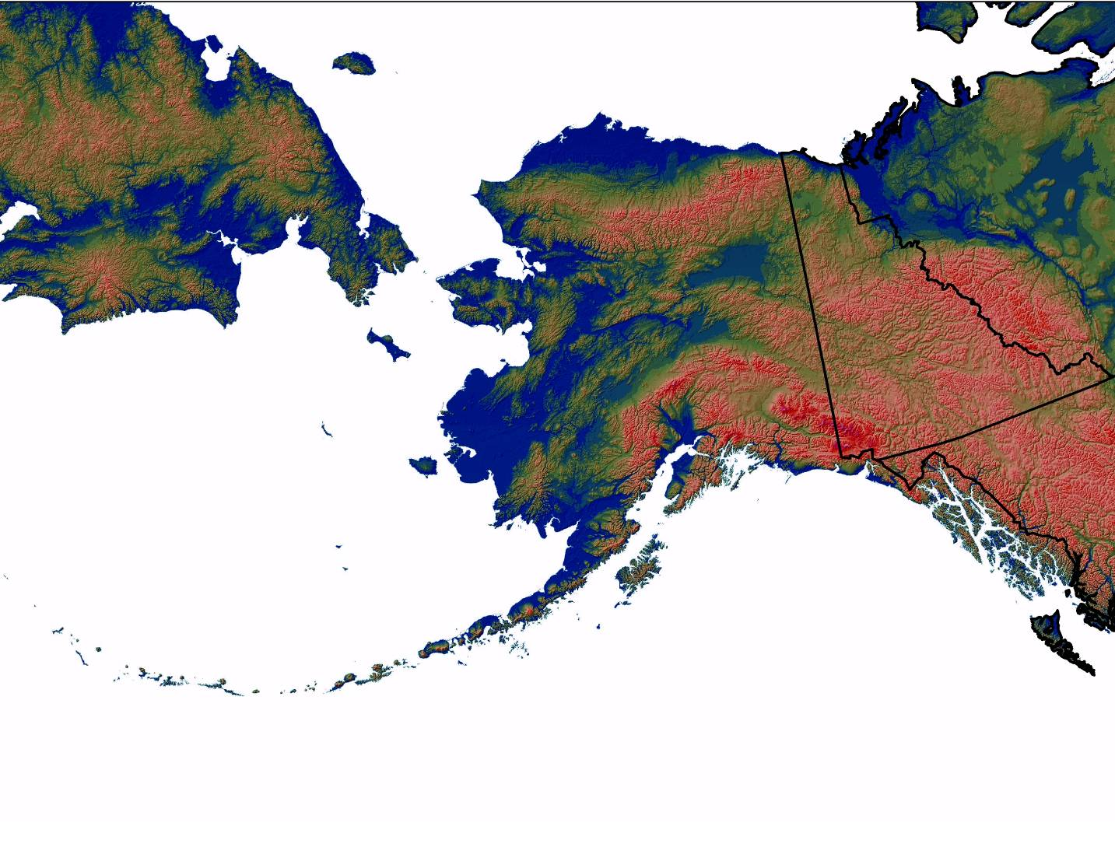
The Alaska Chapter welcomes TWS members to Anchorage!

Slide 2
Alaska Chapter founded 1971
(64 charter members)
Currently 213 members including
4 charter (1 life) + 2 charter returning!
Federal government 92
State & Local government 49
Academia 28
Retired 17
Private sector 10
NGO 8

Slide 3
Alaska Chapter members are active at Section and national levels
NW Rep to Council (Wini Kessler)
NWS President (Michael Goldstein)
NWS President-Elect (Sanjay Pyare)
Special project assignment in Bethesda (Eric Taylor)

Slide 4
Recent bylaw changes:
Chapter members must be TWS members
Added non-voting Student Chapter representative on the Executive Board
Added electronic voting on website for biennial elections to Executive Board (paper ballots still allowed)—50% turnout in April 2006!
Questions to clarify workload for proposed position statements

Slide 5
Alaska Chapter projects 2005-06
Technical reviews:
Sale of bear parts (completed)
Bear predation management to benefit moose populations (being reviewed by members)
Bear baiting (being drafted)

Slide 6
Alaska Chapter projects 2005-06
Drafted national position on old growth forests (in review)
Drafted national letter opposing removal of protection of the Teshekpuk Lake area in the Northeast Section of the National Petroleum Reserve – Alaska
Membership drive since June: 187 to 213 (and counting)

Slide 7
This meeting was made possible by many volunteers…
Arrangements Committee
Gino Delfrate (President 2000-02)
Howard Golden (President-Elect)

Slide 8
Arrangements Sub-committees
Audio Visuals and Computers | Aaron | Christ
Field Trips | Ian | Martin
 | Mike | Rehberg
Fund Raising | Becky | Kelleyhouse
 | Glenn | Stout
Local Information | Jerry | Hupp
 | Wayne | Eberhardt
Meals and Entertainment | Cindi | Jacobson
 | Dave | Tessler
Notes:
Thank volunteers

Slide 9
Media Relations | Grant | Hilderbrand
 | Todd | Rinaldi
Merchandise | Ellen | Campbell
 | Deborah | Rudis
Photography Contest | Judy | Jacobs
Student Activities | Nancy | Tankersley
 | Kris | Hundertmark
Student Quiz Bowl | Tim | Peltier
 | Lisa | Saperstein
Volunteers* | Liz | Solomon
Notes:
Thank volunteers

Slide 10
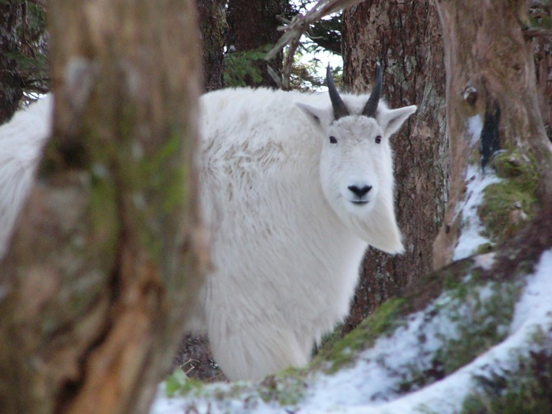
Enjoy your stay in Alaska!
Photo by Neil Barten

