Slide 1


Jeff Levesque Syracuse University IST-652
Classifying Wikipedia Articles

Slide 2

Proposal Topic
Can classification analysis predict the category of Wikipedia articles?

Slide 3

Topic Questions
Using the python wikipedia package, can enough articles be scraped?
What category labels will be used for training?
Will prediction generate a better than random chance?
Is more data needed, or possible an alternative algorithm?

Slide 4

Data Collection
Wikipedia articles were scraped twice, once for a listing of the top 1000 articles, another time to scrape the content.

Slide 5
Scraping Ranking Data
"articles": [
{
"views": 65843652,
"rank": 1,
"article": "Main_Page"
},
{
"views": 2132787,
"rank": 2,
"article": "Special:Search"
},
{
"views": 366380,
"rank": 3,
"article": "Harry_Potter_and_the_Cursed_Child"
},
]
Top 1000 articles per month collected, for duration of 3 years
List of the top 1000 article names, with ranking, and corresponding pageviews reported per month in a single json file
Since data was aggregated from 08/01/2016 until today. Therefore, 25 json files was created.
The example on the right only show the top 3 instead of 1000 to reduce space

Slide 6
Scraping Content Data
for item in articles:
article = item['article']
repls = {':': '--colon--', '/': '--fslash--'}
filename = reduce(lambda a, kv: a.replace(*kv), repls.items(), article)
filepath = 'data/wikipedia/articles/{}.txt'.format(filename)
try:
if not path.isfile(filepath):
search_count[filename] = {}
with open(filepath, 'w') as txtfile:
# article content
summary = wikipedia.WikipediaPage(title=article).summary
txtfile.write(summary)
Using the json aggregated files with top 1000 articles, the wikipedia package was used to scrape the corresponding content, to be stored into it’s own text file
https://pypi.org/project/wikipedia/

Slide 7
Labelling Data
To perform classification analysis, labels were needed to be appended to a chosen dataset.
Without labelling, only clustering techniques could be used
The first collected dataset for 2016-08-01 was labelled
Since a single json file contained 1000 articles, 1000 articles were manually labelled with an added “category” attribute.
Some articles required to be manually opened in a browser for greater context prior to labelling
During git branching + committing the file was lost. So, a second time only covered labelling the first 500 articles.
"articles": [{
"rank": 3,
"views": 366380,
"article": "Harry_Potter_and_the_Cursed_Child",
"category": "other"
}, {
"rank": 4,
"views": 351115,
"article": "Antoninus_Pius",
"category": "politics"
}, {
"rank": 5,
"views": 216073,
"article": "Okto",
"category": "tv_movie"
}]
tv_movie
celebrity
music
sports
politics
science + technology
geography
other

Slide 8
Vectorizing Articles
To perform natural language processing, each article was split into a bag of words.

Slide 9
Counting + Stemming Words
#
# article word count
#
# @sklearn_tfidf, is required by the
# TfidfVectorizer.fit_tranform.
#
words = summary.split()
for word in words:
stemmed = ps.stem(re.sub(alpha_regex, '', word).lower().strip())
if stemmed in search_count[filename]:
search_count[filename][stemmed] += 1
else:
search_count[filename][stemmed] = 1
Each article could contain any number of words, some being very similar to one another.
Therefore, similar words were stemmed.
This reduced the complexity of the bag of words
For example, study, studying, studied, studies, student, could be compressed to a single stem word.
The stemming + counting logic was nested within a loop iterating through all articles

Slide 10
TFIDF
Once the collection of words was vectorized, term frequency inverse document frequency (tfidf) was computed.
This normalizes the counts of word frequency, relative to other words.
Therefore relevant interesting words are weighted higher, whereas uninteresting words are weighted less.
The implementation was very straight forward using sklearn.
# initialize tokenizer
myTfidf = TfidfVectorizer()
# calculate tf-idf for each word
myTfs = myTfidf.fit_transform(corpus)
# store sparse matrix locally
sparse.save_npz(outfile, myTfs)

Slide 11
Optional endpoint
Optional endpoint capable of storing data in mongodb for later modeling, and prediction with svm or svr

Slide 12
Pet Project
login = requests.post(
'https://{}:{}/login'.format(endpoint, port),
headers={'Content-Type': 'application/json'}, data={'user[login]': user, 'user[password]': password})
token = login.json['access_token’]
payload = {
'properties': {
'session_name': filename,
'collection': 'ist-652-wikipedia',
'dataset_type': 'file_upload',
'session_type': 'data_append',
'model_type': 'svm',
'stream': 'True'
}, 'dataset': [search_count]
}
endpoint = 'https://{}:{}/load-data'.format(endpoint, port)
headers = {'Authorization': 'Bearer ' + token, 'Content-Type': 'application/json'}
requests.post(endpoint, headers=headers, data=json.dumps(payload))
A pet project on AWS is capable of handling SVM, and SVR analysis
Web-Interface
Programmatic rest endpoint
The web-interface is largely working
Discovered a bug during this project, where rest endpoint not accessible
In the next few months corresponding bug may be resolved:
https://github.com/jeff1evesque/machine-learning/issues/3284
If the dataset was reformatted, it could be submitted via the browser.
For modeling + prediction endpoints:
https://jeff1evesque.github.io/machine-learning.docs/latest/index.html

Slide 13
Training SVM
The sklearn was used to train a sparse matrix representing the collection bag of words.

Slide 14
Feature Reduction
features = [10, 20, 50, 300]
for num in features:
csquared = chi_squared(X, y, k=num)
#################
def chi_squared(X, y, k=5):
'''
feature reduction using chi-squared.
'''
ch2 = SelectKBest(chi2, k=k)
X_new = ch2.fit_transform(X, y)
return(X_new)
Supplied words from many wikipedia articles dramatically increases the feature set
Chi-squared was used to help reduce the dimensionality iteratively with differing values top feature selection.

Slide 15
Pre-training
# data
X = tfidf
y = [a['category'] for a in word_frequency['articles’]]
#
# generate svm
#
# @test, provides basepath to store the confusion matrix, and
# error rate results.
#
svm_fit(X, y, test='data/wikipedia/test')
The earlier tfidf matrix was used as the feature set, and trained against the category labels
Specifically each article name, was converted to a corresponding category label using list comprehension
The combination of the tfidf and categories was supplied to a custom svm function wrapper

Slide 16
Training SVM
# fit svm
clf = SVC(probability=True)
# train + test
if test:
X_train, X_test, y_train, y_test = train_test_split(
X,
y,
test_size=test_size,
random_state=42
)
# fit + predict
clf.fit(X_train, y_train)
pred = clf.predict(X_test)
Under the hood of the earlier function call was a very simple svm implementation
2/3 of the supplied data was used for training, and 1/3 was used for validation.
random_state was used as a seed to ensure consistency of generating values

Slide 17
SVM Prediction + Results
Using fitted svm model for prediction

Slide 18
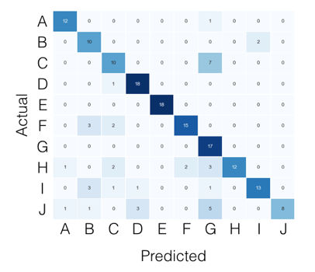
Confusion Matrix
# fit + predict
clf.fit(X_train, y_train)
pred = clf.predict(X_test)
# error rate: computed with confusion matrix
labels = clf.classes_
# report: confusion matrix + error rate
cm = confusion_matrix(y_test, pred, labels)
error = 1-sum(np.diagonal(cm)/cm.sum())
The confusion matrix is comparison of the actual values in the test dataset against what was predicted.
Ultimately, the values should coincide, therefore, an idea matrix would contain only values along the diagonal.
So, the success rate would be anything on the diagonal, while the error rate would be its inverse.

Slide 19
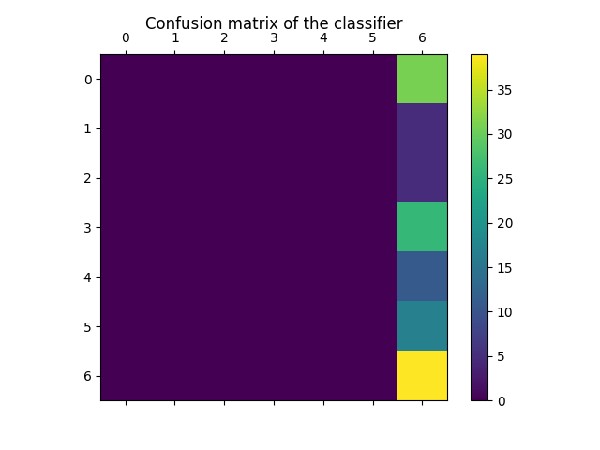
Our Confusion Matrix
Since our svm prediction was executed within a loop, multiple confusion matrices were computed:
features = [10, 20, 50, 300]
for num in features:
csquared = chi_squared(X, y, k=num)
svm = svm_fit(
csquared,
y,
test='data/wikipedia/test',
suffix=num
)

Slide 20

Interpreting CM
For each value of k, the confusion matrix returned the same unbalanced result.
Each error rate was identical at 0.70
Similar attempts in R produced worse results

Slide 21
Conclusion
Similar NLP studies perform data on 20,000 articles, instead of roughly 260 articles used for training against 7 categories
Dataset was unbalance. Some categories had 50 articles, while others had 7 or 8.
Poor and inconsistent labelling of training data
Current political family figure could be labelled as celebrity, while previous individuals labelled as politics
Large amount of top traffic were associated with wikipedia endpoints, not articles.
Musical artists labelled as music, while movie + film stars labelled as celebrity
Implementing other techniques, including random forest, or naïve bayes would provide additional comparisons
Given 7 different categories, random chance suggests about 14% accuracy.
Results at 30% accuracy is bad, though double the expected chance rate
Though the accuracy was double random chance, it still may have been a result of unbalance distribution

