Slide 1

IST 736 - Text Mining
Financial Analysts on Twitter & Market Sentiment
By Jeff Levesque, Kent Appiah & Seán Hayes

Slide 2

Problem Definition
Do the opinions of Financial Analysts on Twitter impact market sentiment and volatility?
There are many Financial Analysts on Twitter with large audiences who they speak to directly on a daily basis offering investment advice
How much of the sentiment being portrayed by these tweets is influencing the market?
If Jim Kramer tweets a lot of negative tweets in a day to his 1.1m followers, does the volatility in the market reflect that sentiment?

Slide 3
Data Sources
Financial Analysts on Twitter
@jimcramer – Jim Cramer
  Host of Mad Money on CNBC
  1.1 million followers with over 95,000 tweets
@ReformedBroker – Josh Brown
  Analyst on CNBC’s Halftime Report and CEO Ritholtz Wealth Management
  1 million followers with over 88,000 tweets
@TheStalwart – Joe Weisenthal
  Host of What Did You Miss? on Bloomberg TV
  170,000 followers with over 320,000 tweets
@LizAnnSonders – Liz Ann Sonders
  Chief Investment Strategist for Charles Schwab
  70,000 followers with over 8,000 tweets
@SJosephBurns – Steve Burns
  Founder of NewTraderU.com
  160,000 followers with over 100,000 tweets

Slide 4
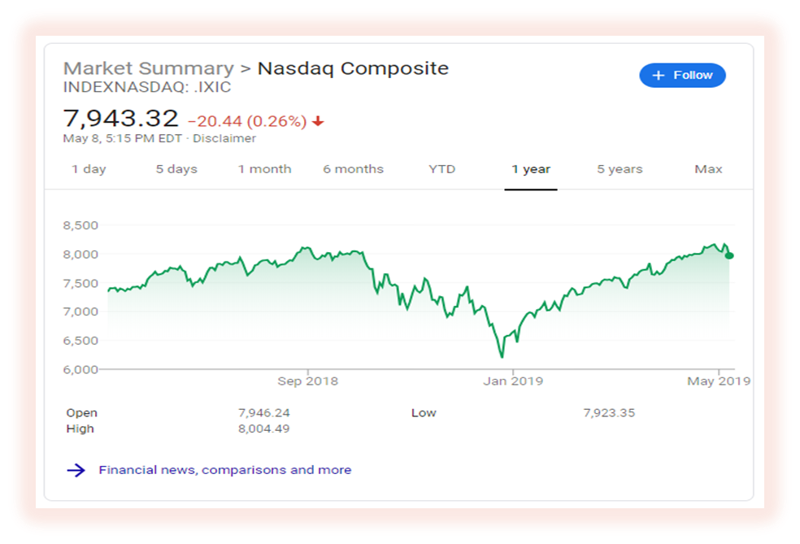
Data Sources
Stock Market
Nasdaq Index (quandl api)
  Queried with maximum date range of twitter dataset.

Slide 5
Data Sources
CBOE Volatility Index aka the Fear Index
URL: http://www.cboe.com/products/vix-index-volatility/vix-options-and-futures/vix-index/vix-historical-data
The VIX is considered a reflection of investor sentiment
The VIX is constructed from the price inputs of the S&P 500 index options, it provides a measure of market risk and investors' sentiments
The higher the VIX is up, the higher the levels of investor anxiety and market volatility
The daily high, low and closing prices are available historically back to 2004
On May 6th, President Trump tweeted about the Trade War with China and the VIX rose by as much as 46.1% intra-day, while the Dow Jones Industrial Average plunged by as much as 471 points

Slide 6
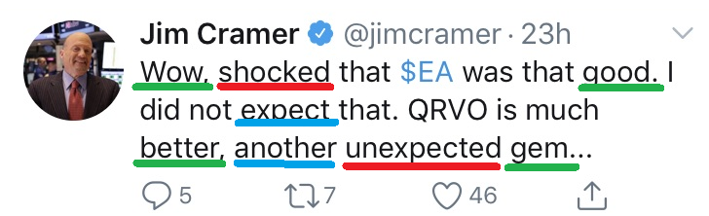
Modeling – Vader Sentiment Analysis
Scoring the Sentiment of Tweets
Using Vader Sentiment Analysis, we scored the Positivity, Neutrality, and Negativity of each tweet from our Analysts daily
We developed an overall sentiment score weighed from the 3 metrics
We then aggregated all the sentiment scores for the day, developing our own Twitter Financial Analysts Sentiment Index so it could be compared to the VIX
Individual sentiment indices were created for all analysts to see which analysts had the greatest correlation with the VIX

Slide 7
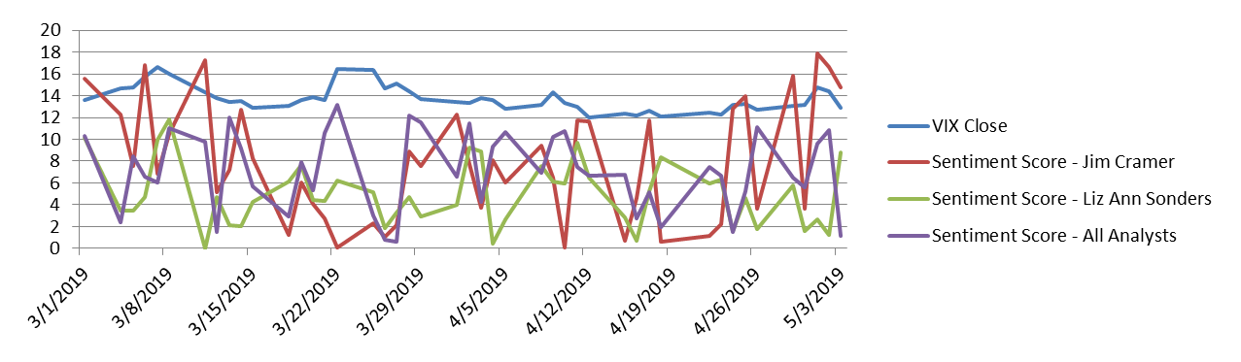
Correlation analysis
Plotting the Indices
Correlation Analysis
Correlation analysis was performed on which Analysis or if the Overall Index had the greatest correlation with the VIX
 | VIX Close | Sentiment Score - Jim Cramer | Sentiment Score - Liz Ann Sonders
VIX Close | 1
Sentiment Score - Jim Cramer | -0.376442198 | 1
Sentiment Score - Liz Ann Sonders | -0.03832354 | 0.171062416 | 1

Slide 8
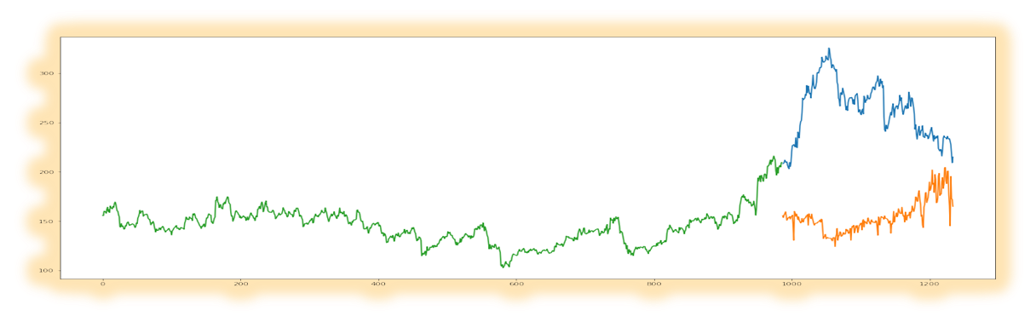
Modeling - Classification
To perform classification, numeric Nasdaq index values converted to a fixed label scale.
  0: index increased from previous day
  1: decreased, or unchanged from previous day
Using vectorized tweets, naïve bayes is compared against svm.

Slide 9
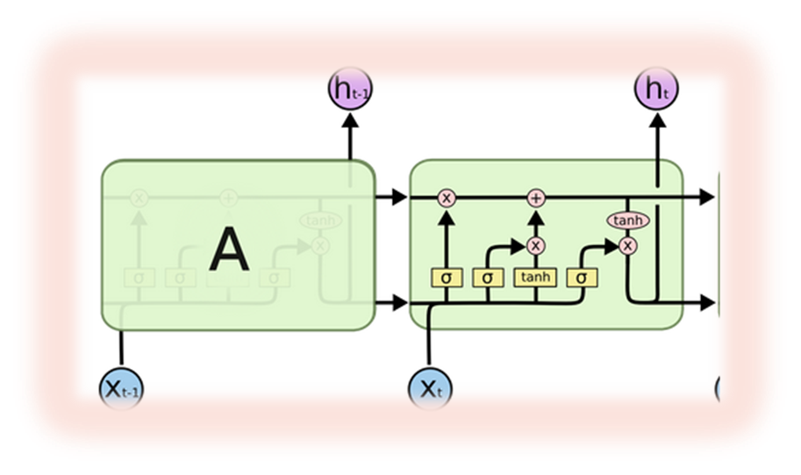
Modeling – Time Series
Each vader sentiment score will be plotted alongside Nasdaq index
Each vader sentiment score will undergo arima and LSTM neural network

Slide 10
Conclusions
Information theory summary
  Quantification, storage and communication of information
  Investors’ sentiments are continuously priced into market prices
    Period volatility tracked by the VIX
      VIX increases when negative information are flowing around; vice versa
  Information entropy
    Information on low-probability events are more valuable than information on high-probability events
  Application examples:
    Thompson Reuters
    Bloomberg, LP

