Slide 1
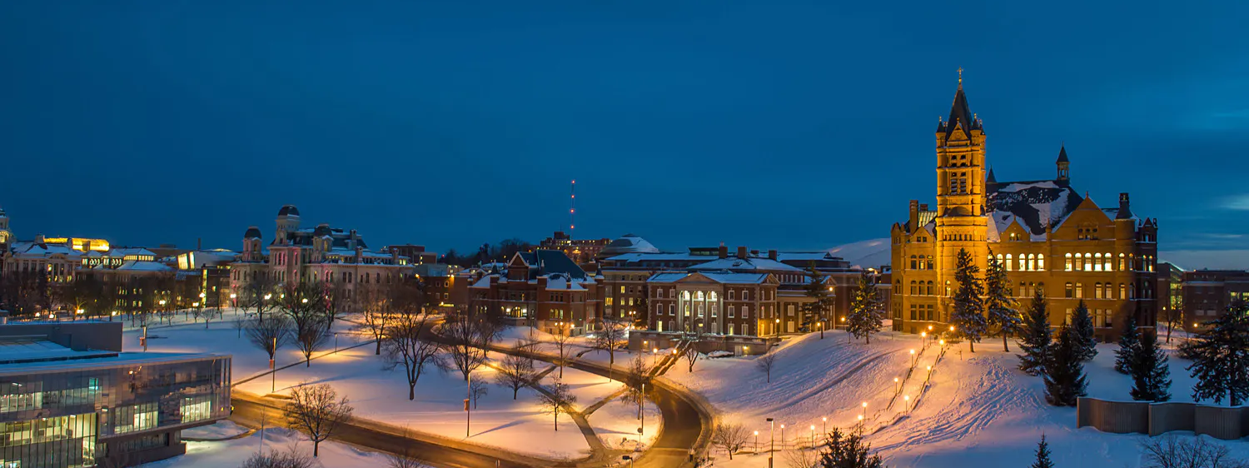
MS Applied Data Science Portfolio Presentation: Jeff Levesque

Slide 2

Introduction
Showcase coursework that demonstrate learning achievements

Slide 3
Learning Goals
Collect, store, and access data by identifying and leveraging applicable technologies
Create actionable insight across a range of contexts (e.g. societal, business, political), using data and the full data science life cycle
Apply visualization and predictive models to help generate actionable insight
Use programming languages such as Rand Python to support the generation of actionable insight
Communicate insights gained via visualization and analytics to a broad range of audiences (including project sponsors and technical team leads)
Apply ethics in the development, use and evaluation of data and predictive models (e.g., fairness, bias, transparency, privacy)

Slide 4
Capstone Projects
Course | Capstone Project | Skills
FIN-654 Financial Analytics | Asset/Portfolio Analysis | Python, R, time series analysis, financial analysis, Shiny Dashboard
IST-664 Natural Language Processing | Chatbot | Python, MongoDB / Hadoop, Jupyter Notebook, Time series analysis, Classification analysis, Natural language processing
IST-736 Text Mining | Stock Market Sentiment Analysis | Topic modeling, Sentiment analysis, Time series analysis, Classification analysis, Signal analysis, Data mining, AWS, Jupyter Notebook

Slide 5
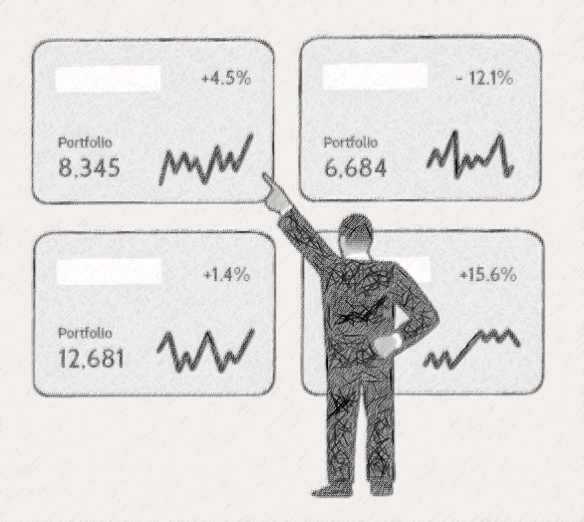
FIN-654
Asset Analysis: visualization using Shiny Dashboard

Slide 6
Objective
Minimum Requirement
Utilize R, perform financial analysis for decision-making, visualize results using Shiny dashboard
Desired Goal
Reuse R code from previous course assignments with supplement python code to perform financial analysis, and machine learning visualized through Shiny dashboard

Slide 7
Portfolio: Dataset
Method
Final Dataset
World’s Biggest Data Breaches & Hacks
Privacy Rights Clearinghouse
The two datasets were merged into a dataframe in python, then inner joined with a list of stock ticker symbols obtained using the quandl API
blw
dal
fb
gpn
mar
ms
sti

Slide 8
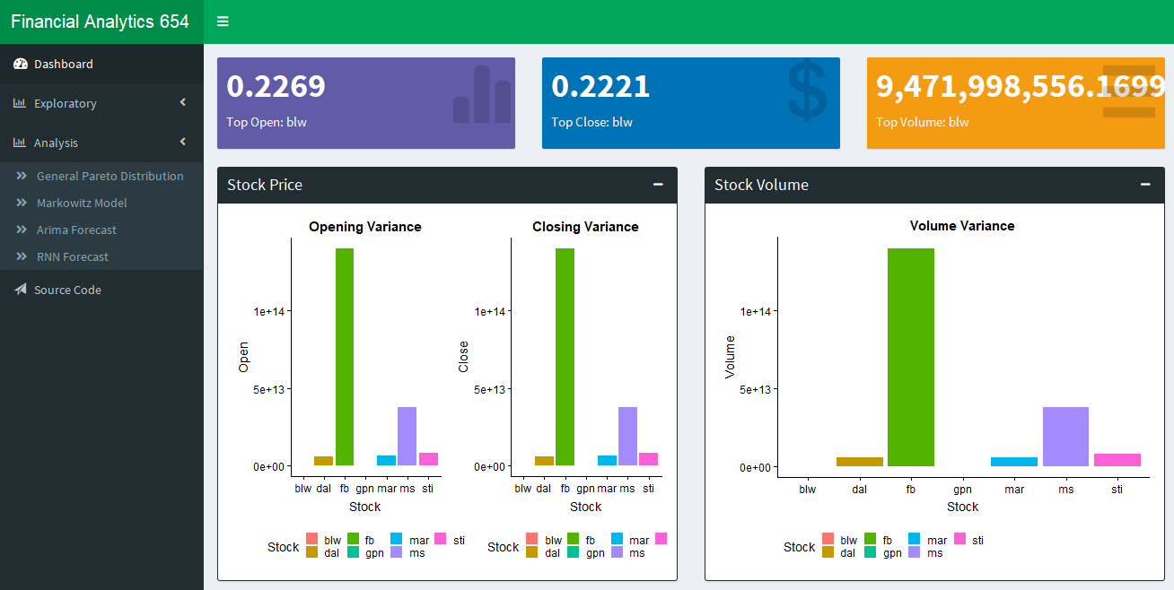
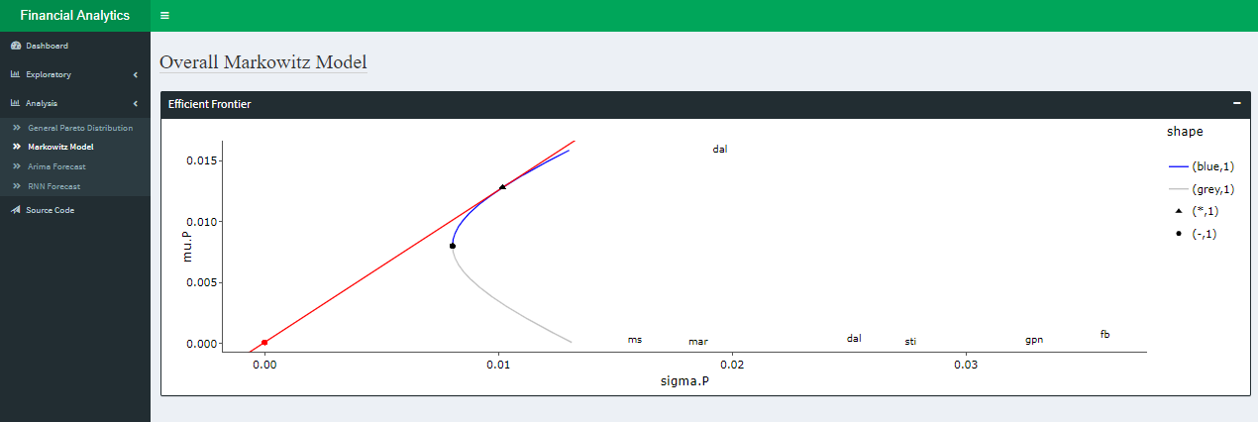
Shiny Dashboard
Variance
Markowitz Model

Slide 9
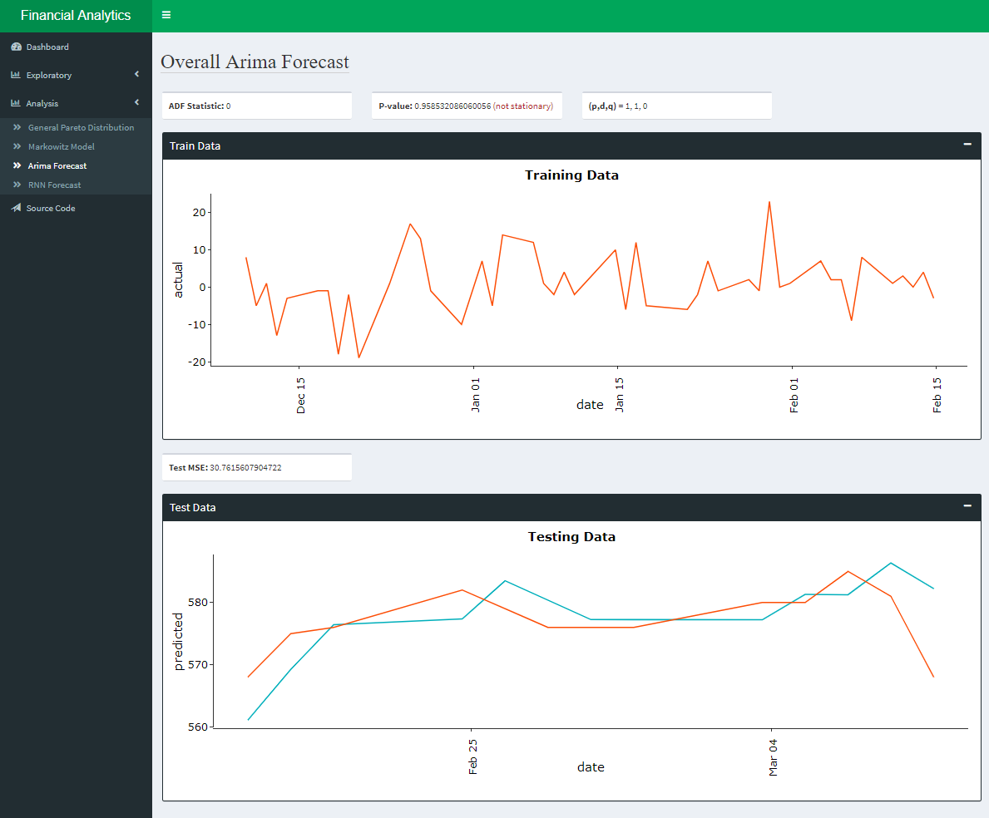
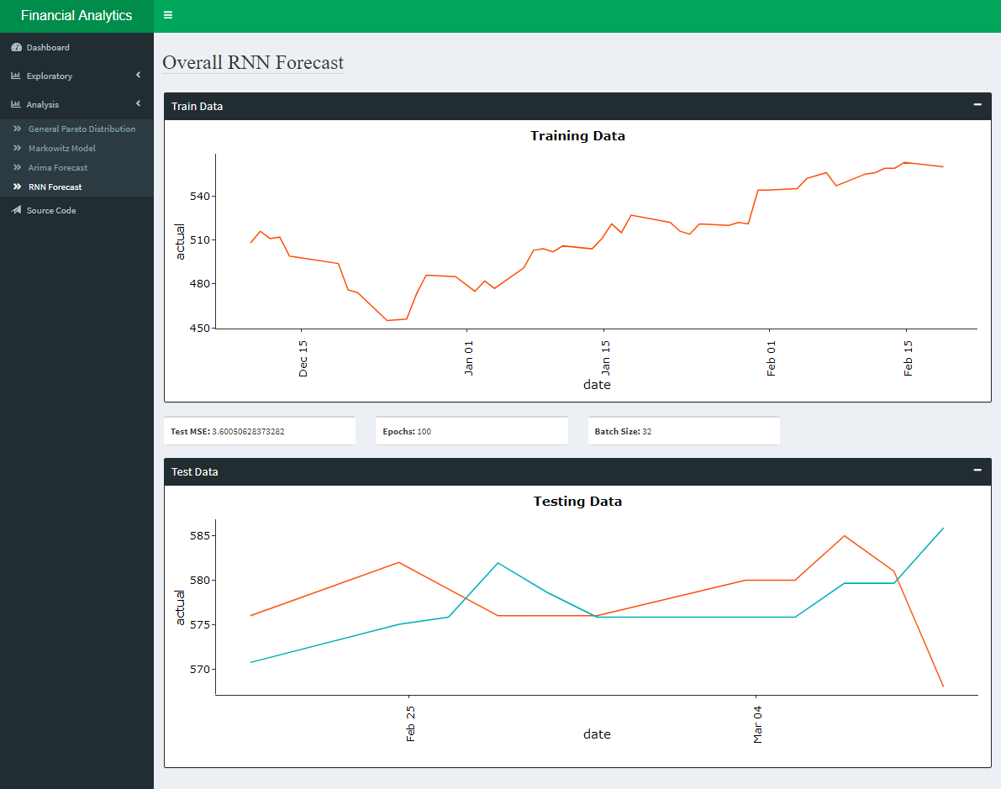
Shiny Dashboard
Arima Model
Neural Network

Slide 10
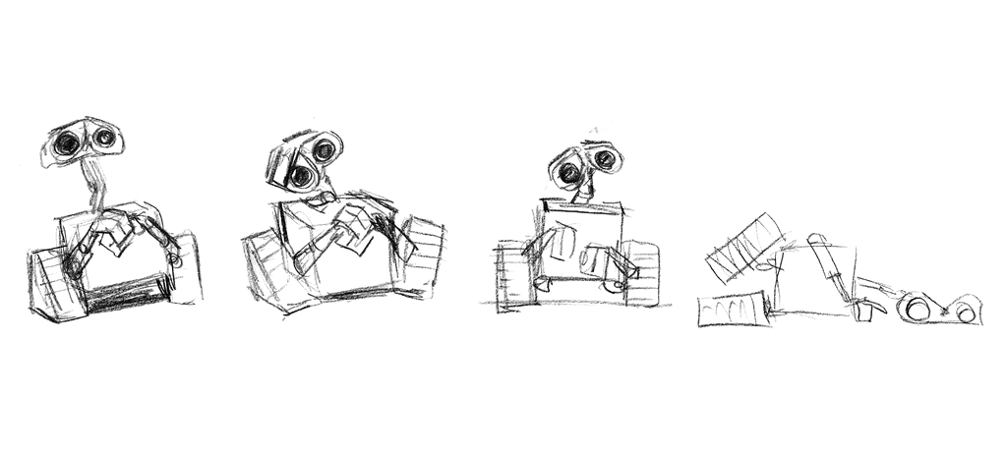
IST-664
Ensembled Chatbot: classifiers with neural network

Slide 11
Objective
Minimum Requirement
Question Classifier
Desired Goal
Question Classifier → Topic Classifier → Sub Topic Classifier → Specialized RNN/NMT
Obtained Goal
Question Classifier → Topic Classifier → Specialized RNN/NMT

Slide 12
Portfolio: Dataset
QuestionAnswerCMU: question-answer pair to train question classifier
Used entire NSF Graduate Research Fellowship Carnegie Mellow University dataset
dataset with question and answer columns
StackOverflow: list of postings grouped by channels used to train classifier to label questions
original dataset 75GB reduced to 200MB
filter only verified answer posts
filter top 10 channels
Sample 20% remaining
Reddit: json data used to train RNN based NMT chat agent
one month (12/2005) of reddit data (12/2005 – 05/2006 available)
mapreduce every comment id with parent comment id

Slide 13
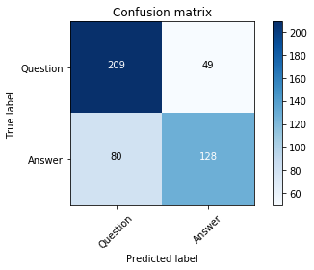
Classifier: question-answer
Random Forest
Roughly 72% accurate
Train time 5.05 seconds
Prediction: 0.29 seconds

Slide 14
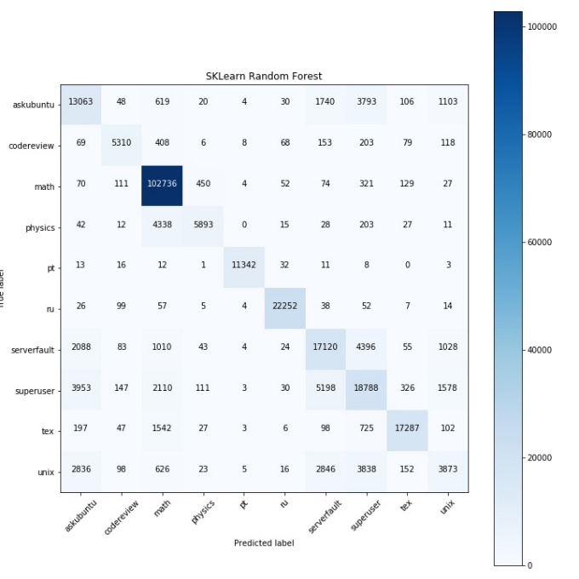
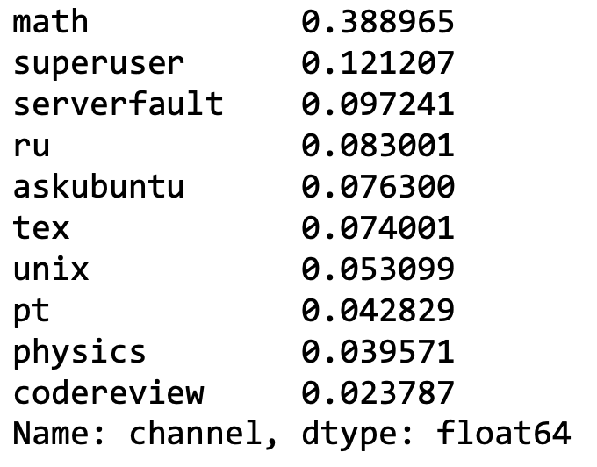
Classifier: question-label
Random Forest (73.5%)
Labels

Slide 15
RNN: NMT chatbot
Execution
Result
root@development:/vagrant# python3 run.py
Starting interactive mode (first response will take a while):
> hey, where is billy?
/usr/local/lib/python3.5/dist-packages/sklearn/base.py:251: UserWarning: Trying to unpickle estimator DecisionTreeClassifier from version 0.20.1 when using version 0.20.0. This might lead to breaking code or invalid results. Use at your own risk.
UserWarning)
/usr/local/lib/python3.5/dist-packages/sklearn/base.py:251: UserWarning: Trying to unpickle estimator RandomForestClassifier from version 0.20.1 when using version 0.20.0. This might lead to breaking code or invalid results. Use at your own risk.
UserWarning)
hey jimmy, maybe checkout ['math']
>
NMT generated response with ‘bleu’ score less than 12
NMT response suppressed
question-label classifier (fallback) response returned
Discussion
NMT uses ‘bleu’ scoring scale for responses
change default ‘bleu’ metric to ‘accuracy’
Our codebase arbitrarily suppresses NMT response when bleu best_score < 12
never spent time investigating NMT scoring configuration
ingested data in mongodb should be sufficient quantity for at least low quality NMT chatbot

Slide 16

IST-736
Market Prediction: using sentiment analysis

Slide 17

Follow-up
AWS Integration: streaming data

