Slide 1
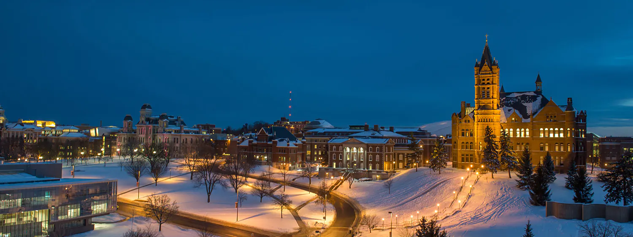
MS Applied Data Science Portfolio Presentation: Jeff Levesque

Slide 2

Learning Goals
Showcase coursework that demonstrate learning achievements

Slide 3
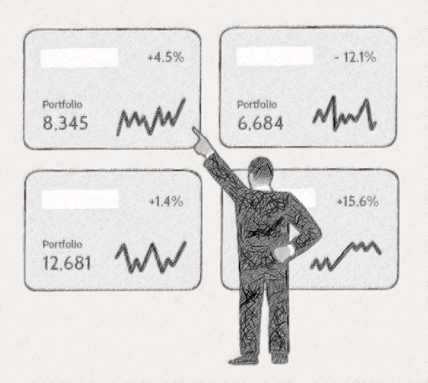
FIN-654
Asset Analysis: visualization using Shiny Dashboard

Slide 4
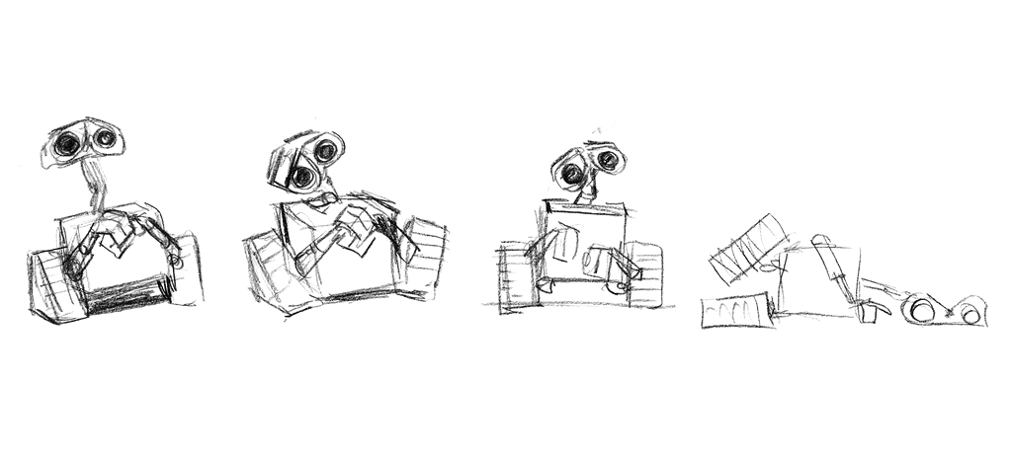
IST-664
Ensembled Chatbot: classifiers with neural network

Slide 5

IST-736
Market Prediction: using sentiment analysis

Slide 6

Follow-up
AWS Integration: streaming data

