Slide 1

Learning Outcome
Jeff Levesque
Applied Data Science
Syracuse University

Slide 2
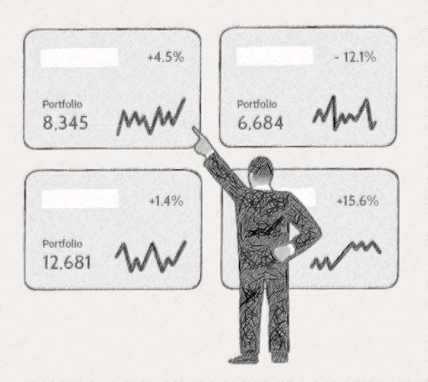
FIN-654
Asset Analysis: visualization using Shiny Dashboard

Slide 3
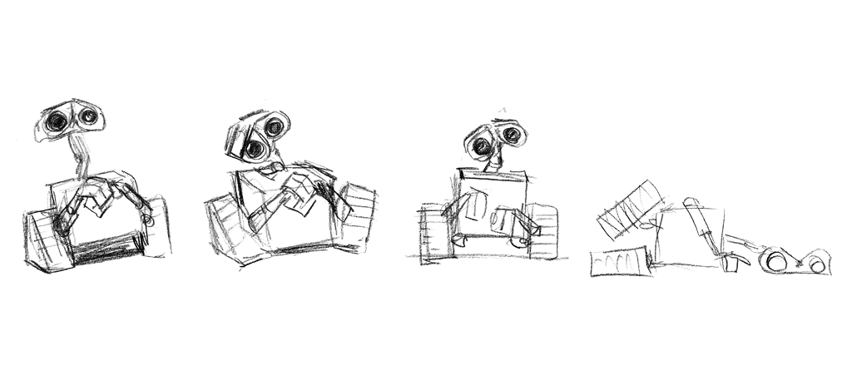
IST-664
Ensembled Chatbot: classifiers with neural network

Slide 4

IST-736
Market Prediction: using sentiment analysis

Slide 5

Follow-up
AWS Integration: streaming data

