Slide 1

MS Applied Data Science Portfolio Presentation: Jeff Levesque

Slide 2

Introduction
Showcase coursework that demonstrate learning achievements

Slide 3
Learning Goals
Collect, store, and access data by identifying and leveraging applicable technologies
Create actionable insight across a range of contexts (e.g. societal, business, political), using data and the full data science life cycle
Apply visualization and predictive models to help generate actionable insight
Use programming languages such as Rand Python to support the generation of actionable insight
Communicate insights gained via visualization and analytics to a broad range of audiences (including project sponsors and technical team leads)
Apply ethics in the development, use and evaluation of data and predictive models (e.g., fairness, bias, transparency, privacy)

Slide 4
Capstone Projects
Course | Capstone Project | Skills
FIN-654 Financial Analytics | Asset/Portfolio Analysis | Python, R, time series analysis, financial analysis, Shiny Dashboard
IST-664 Natural Language Processing | Chatbot | Python, MongoDB / Hadoop, Jupyter Notebook, Time series analysis, Classification analysis, Natural language processing
IST-736 Text Mining | Stock Market Sentiment Analysis | Topic modeling, Sentiment analysis, Time series analysis, Classification analysis, Signal analysis, Data mining, AWS, Jupyter Notebook

Slide 5
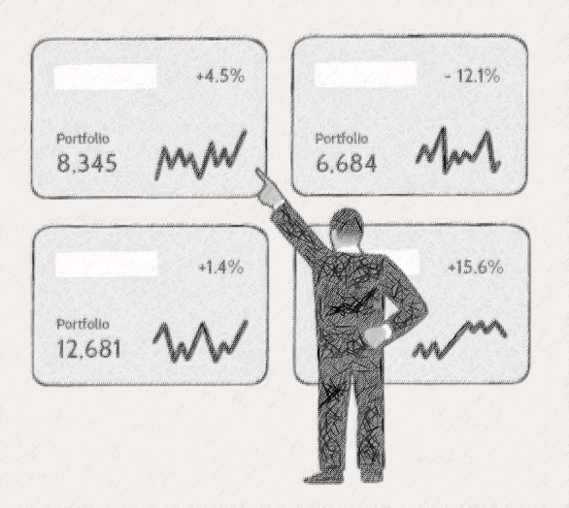
FIN-654
Asset Analysis: visualization using Shiny Dashboard

Slide 6
Portfolio: Dataset
Method
Final Dataset
World’s Biggest Data Breaches & Hacks
Privacy Rights Clearinghouse
The two datasets were merged into a dataframe in python, then inner joined with a list of stock ticker symbols obtained using the quandl API
blw
dal
fb
gpn
mar
ms
sti

Slide 7
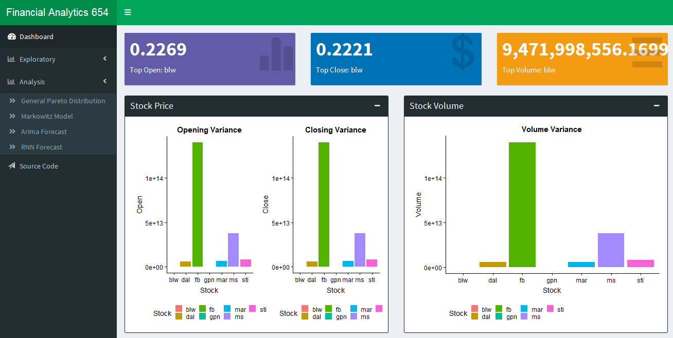
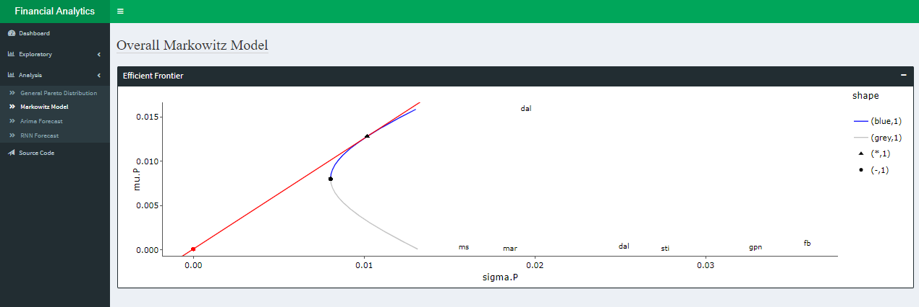
Shiny Dashboard
Variance
Markowitz Model

Slide 8
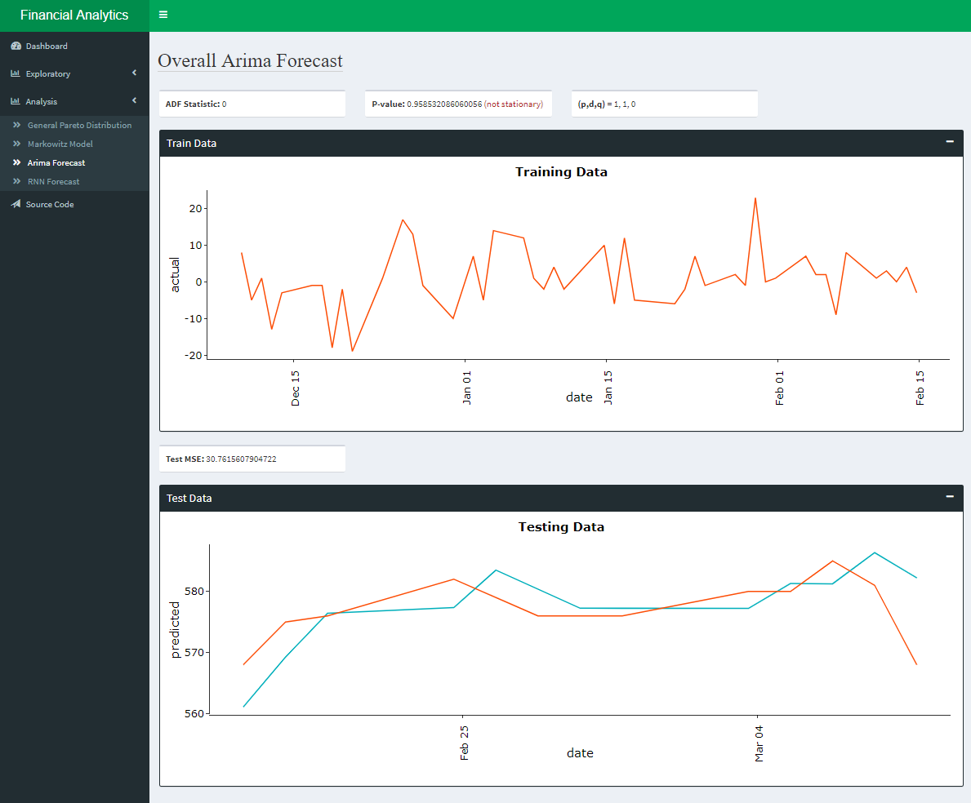
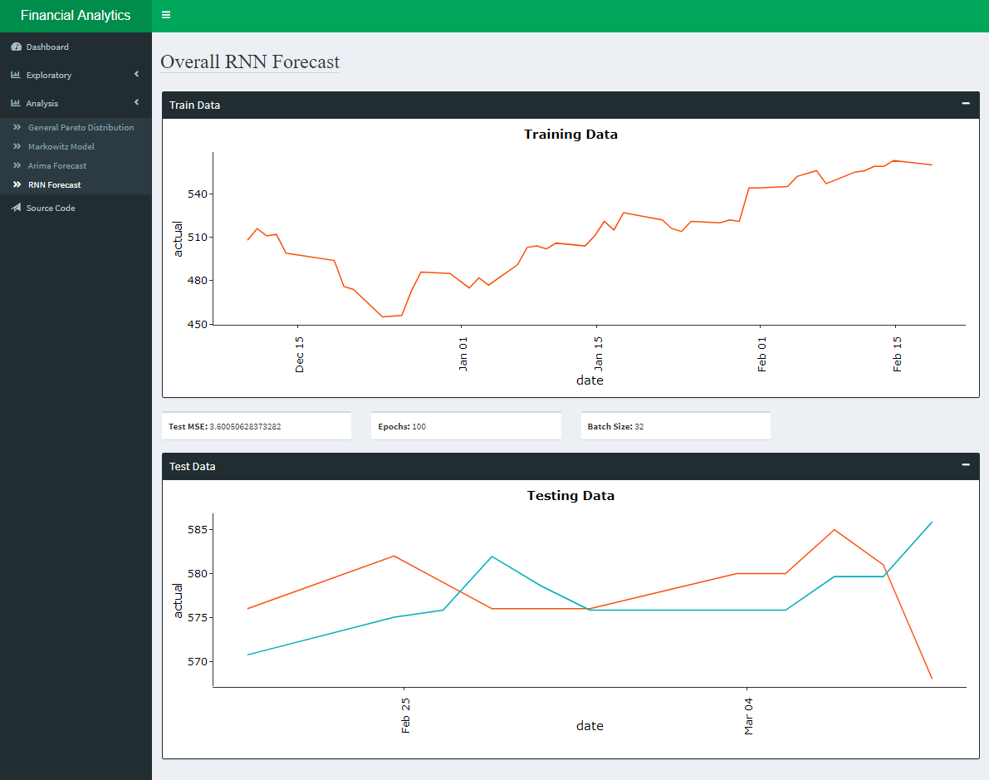
Shiny Dashboard
Arima Model
Neural Network

Slide 9
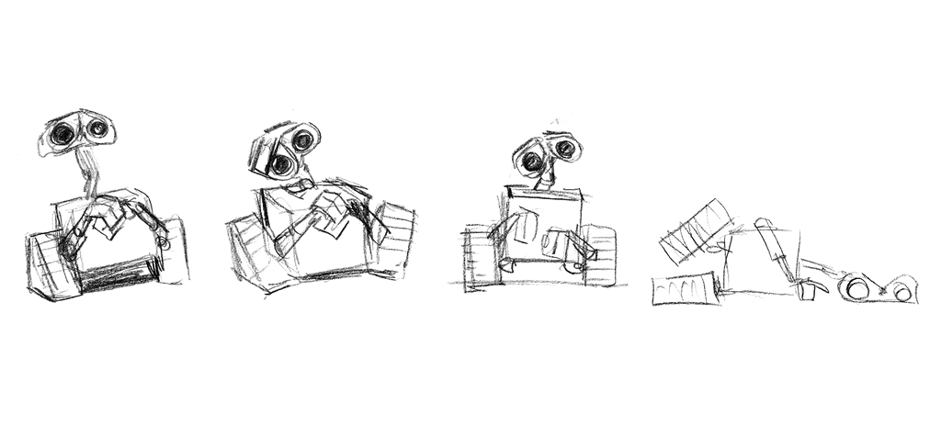
IST-664
Ensembled Chatbot: classifiers with neural network

Slide 10

IST-736
Market Prediction: using sentiment analysis

Slide 11

Follow-up
AWS Integration: streaming data

