Slide 1

Learning Outcome
Jeff Levesque
Applied Data Science
Syracuse University

Slide 2

FIN-654

Slide 3
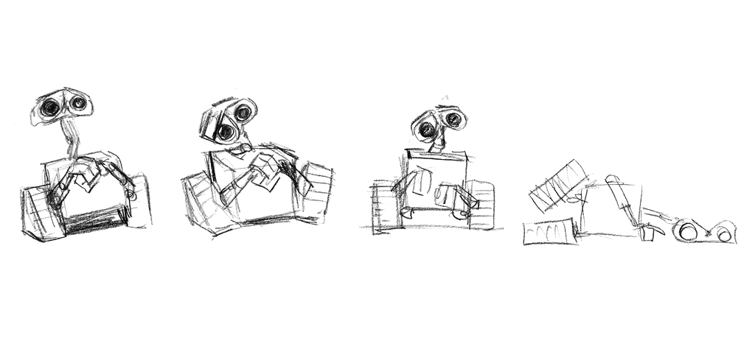
IST-664

Slide 4

IST-736

