Slide 1

2020年 富邦金控儲備幹部 - 簡報專題 報告人: 賴奕辰
Kaggle Competition
Santander Customer Transaction Prediction

Slide 2
Outline
Project Description
EDA & Feature Engineering
Modeling
Result
Conclusion & Improvement

Slide 3
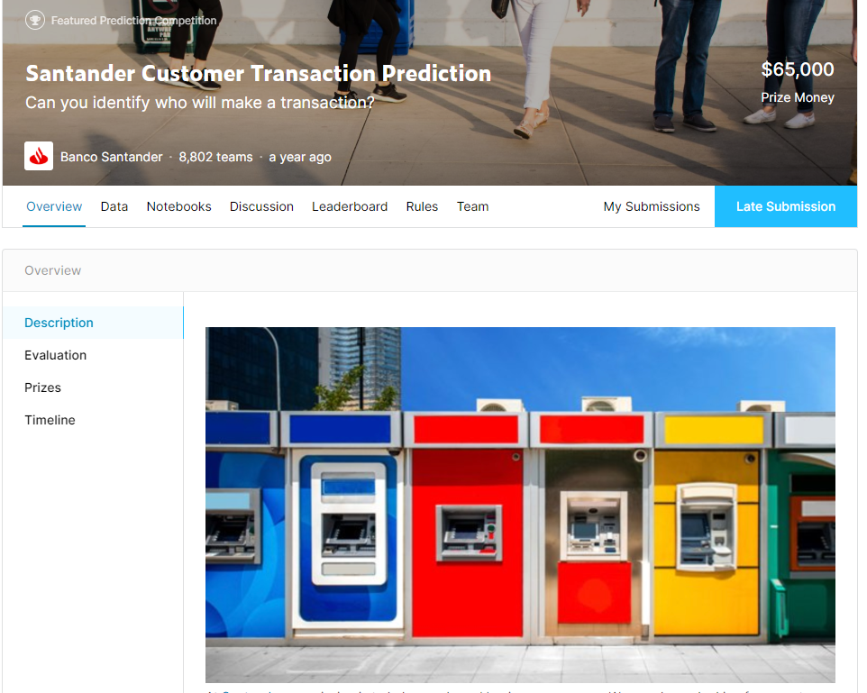
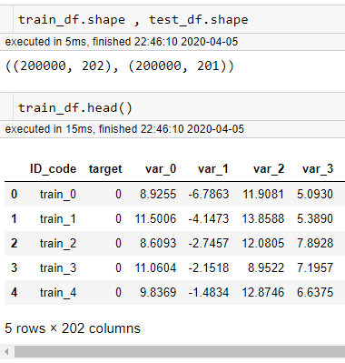
Project Description
Purpose :
Predict who will make a transaction
Evaluation :
Use AUC to evaluate the performance.
Data Set :
Train_data : 20W sample , 202 feature (With Target)
Test_data : 20W sample , 201 feature
資料來源 : https://www.kaggle.com/c/santander-customer-transaction-prediction/data

Slide 4
EDA
Describe the data (Min Max Mean etc.)
Check the Nan Value on each feature.
Check the ratio between 1 and 0 (Buy or not).
Check the distribution on each feature between 1 and 0
Check the statistic indicator on each feature between 1 and 0
Use PCA to decomposition the component into 2-D graph

Slide 5
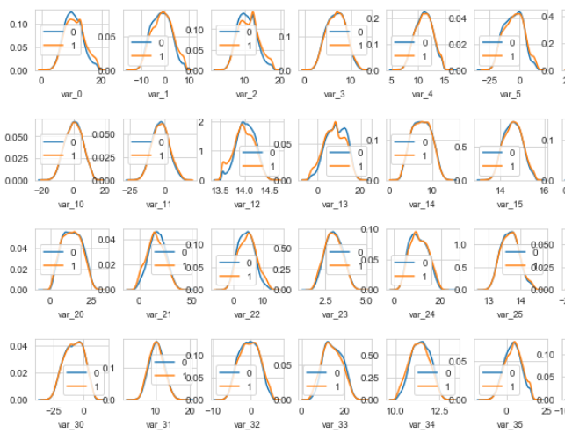
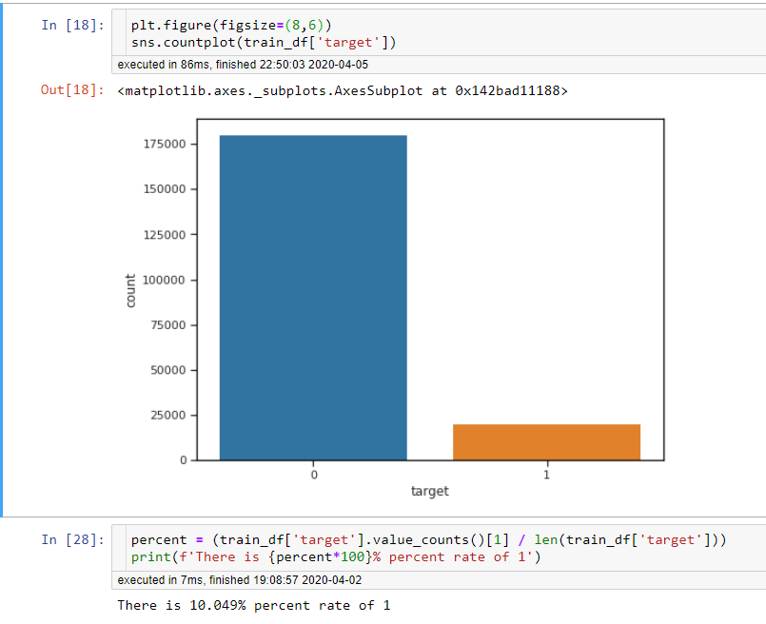
EDA
Check the ratio between 1 and 0 (Buy or not).
We can see only 10% customer will make a transaction
Check the distribution on each feature
It show var_0 , var_2 ,var_12 have different distribution between 1 and 0 , It might help us to distinguish people who will buy or not

Slide 6
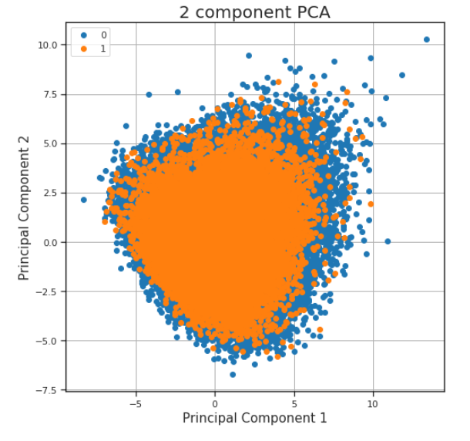
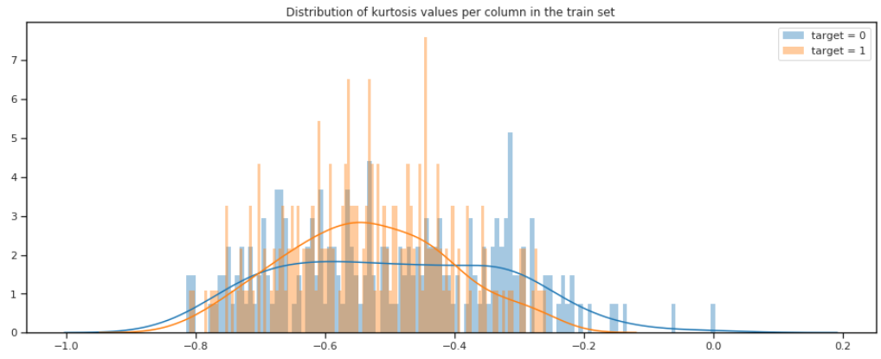
EDA
Check the statistic indicator on each feature between 1 and 0
PCA 2-D graph
Target 1 and 0 have different distribution in Kurtosis distribution.
It can give machine more information to separate the target.
It shows all feature might cant perfectly split 1 and 0 into two spaces.
So we might need to generate some feature

Slide 7
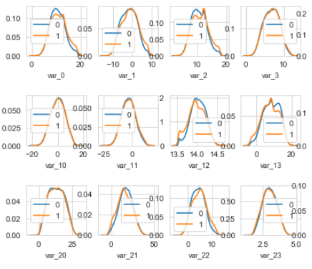
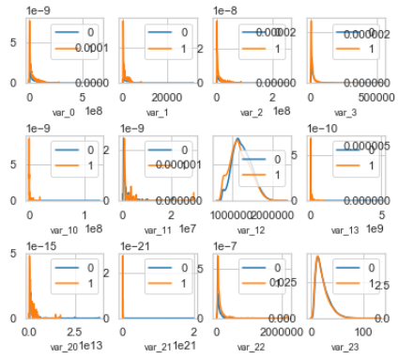
EDA
I figure out all feature's distribution are close to normal distribution.
It actually doesn't make sense. In real word normal distribution is not too common.
In general, We always use log transform to let the distribution close to normal (It is common in Financial analysis).
I guess the feature might did it before , So I use exmp1 to transform back to the original distribution.

Slide 8
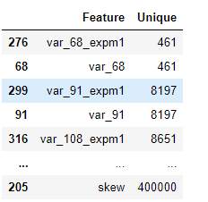
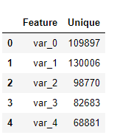
Feature Engineering
3. Add counts and variable on each feature
Reason :
Because we don’t know the feature name in this data set , So we can only guess what it might be.
For instance, It might have occupation in the feature. But it transform into float , and we know same occupation might have similar consuming behavior.
Generate some statistic indicator
Skew , Kurt , Std , Mean , Medium etc.
Reason :
EDA shows target will have different distribution on different statistic indicator.
2. Use expm1 transform on each feature
Reason :
All the feature’s distribution are close to normal distribution, It actually doesn’t make sense. Try to get back original data distribution.
Sort by unique
We can see var_68 only have 461 values , So it might meaning some category data. Not float before.

Slide 9
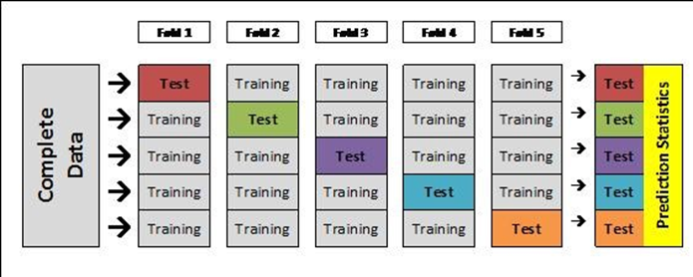
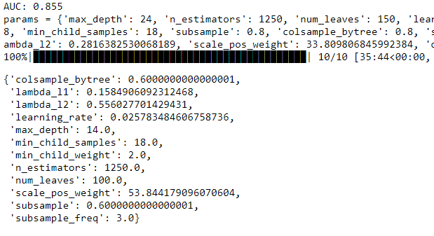
Modeling
Model Select
Training Method
Hyper parameter tuning
Lightgbm
O-O-F
(Out Of Fold)
HyperOpt
How o-o-f work
資料來源 :https://stackoverflow.com/questions/40368467/cross-validation-extracting-the-model-values-out-per-row

Slide 10

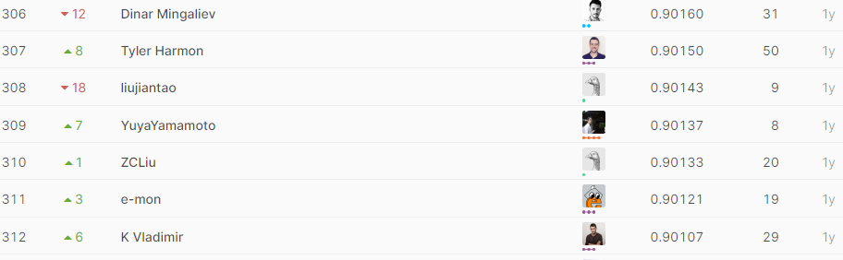



Result
Final AUC : 0.9015 on Kaggle Public Score
AUC Score
Raw data
Add Statistic
Add Expm
Add Count & Var
Kaggle
0.89983
0.89891
0.90048
0.90152
Private Score : 307 / 8749 (4%)

Slide 11
Conclusion & Improvement
Despite of using raw data and sample Lightgbm model, It can also get a pretty good result. I tried several complex way to improve the AUC, but not actually work.
It is hard to use error analysis to improve the model because we don't know each feature actually mean.
Feature Engineering
Model
Hyper parameter
Use grouping method to create more useful data.
For instance, Kmeans Auto-encoder etc.
Try using different model.
For instance, CNN DNN Catboost Xgboost etc.
Ensemble Several model.
For instance, Stacking Blending etc.
Tuning more parameter.
Finally, I think this competition's processing can't mapping on real cases at all.

Slide 12
Conclusion & Improvement
I think this competition is very different from real project.
1. Feature is not explainable
In real cases, Create feature or transform feature need a reason. This competition De-identification not only on sample but also on feature. It makes many processing become useless and make feature engineering like playing lottery.
2. Feature after transformation
We know from EDA. All feature's distribution is normal distribution. It doesn't make sense. And it will make contestants to guess original distribution in order to improve there AUC score. But it doesn't really improve the model. In real cases it doesn't make sense and pointless.
3. Cant analysis specific feature
Because of De-identification, We can do the transform on specific feature. For example , if we know income will affect consumer behavior, but we need to transform income to normal distribution. In this case, we need to transform all feature to get that result. It will create to many useless feature or waste computing resources.

Slide 13
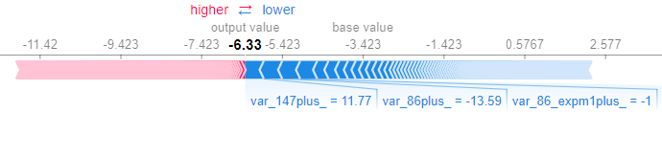
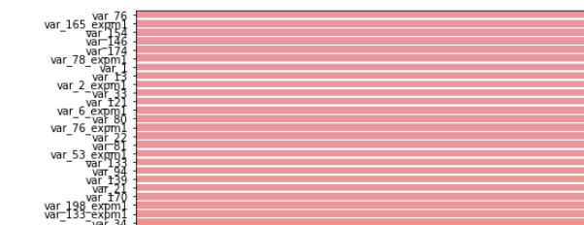

Conclusion & Improvement
4. Error analysis is hard to execute
Because of De-identification on feature, When we doing error analysis will get nothing. For example, We don't even know the importance select from model is reasonable or not, so as shap analysis.
5. Can use magic way to get 0.922 (1%) AUC score
After looking the kernel from kaggle, I realize almost top1% people use a magic way to get 0.922 AUC. And they even don't know why…… (The paper Link Below) This is a big problem! Because it tell use this model have the best performance, but it can only use on this data set. And it cant explain anything about its output.
Shap analysis
Model importance
AUC 0.922 : https://github.com/btrotta/kaggle-santander-2019/blob/master/Readme.pdf

Slide 14
Thanks
Q & A

