Slide 1
Educational Outcomes for Deaf and Hard-of-Hearing Children in the Denver Public Schools
Jeff Coady

Slide 2
Research Question
The State of Colorado instituted newborn hearing screening in 1997
Early identification means that services can be provided sooner so that children won’t fall behind before they start school
Does this actually work?

Slide 3
Research Question
All students take the Colorado Student Assessment Program (CSAP) achievement tests in grades 3-10
Does early intervention translate to better education outcomes, as measured by CSAP reading scores?

Slide 4
Neither the State nor DPS publishes average scores by grade
Percent Unsatisfactory, Partially Proficient, Proficient, or Advanced
They also don’t reveal what the cutoffs are for those categories

Slide 5
2014 Results
DHH students score well below their hearing peers
 | Statewide | DHH
A | 7 | 0
P | 65 | 27
PP | 18 | 28
U | 10 | 43
NS | 0 | 2

Slide 6
Data Collection
Data were provided by DPS to the Colorado Home Intervention Program (CHIP) at CU-Boulder
One-year Data Linkage grant (CDC) to tie early childhood results to school-age achievement

Slide 7
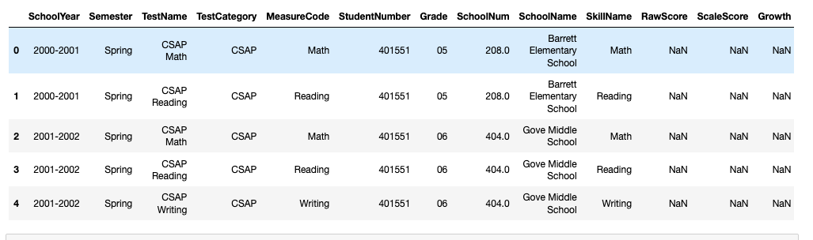
Data Wrangling &
Statistical Summary
Test Score data – 289,456 rows, 14 columns representing 643 kids and 2543 unique tests

Slide 8
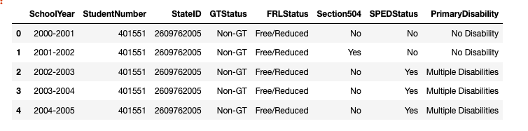
Demographic data, also from DPS

Slide 9
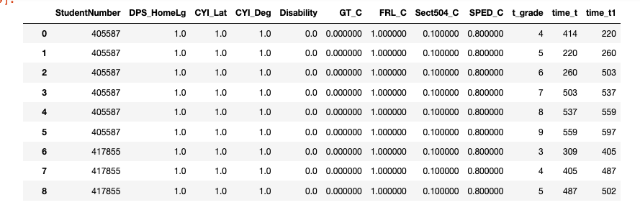
Fill in Missing Values (where possible)
Remove NaN values
Convert Data Types
One-hot Encoding
A lot of pivoting and merging tables
Scaling & Transforming matrices for ML task

Slide 10
Clean-Up Interesting Points
338 children with at least 1 CSAP score, average 4.37, reduced to 833 consecutive scores from 204 students
English, Spanish, Arabic, Burmese, Vietnamese & Somali
9 students had more than 2000 test scores reported (max = 2975)

Slide 11
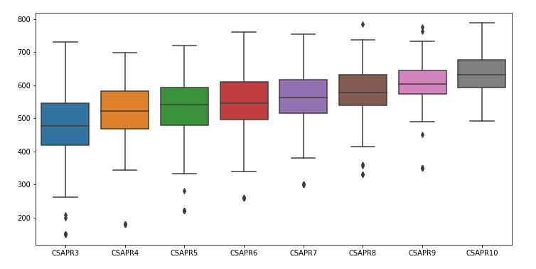
Data Visualization
CSAP Reading Scores by grade

Slide 12
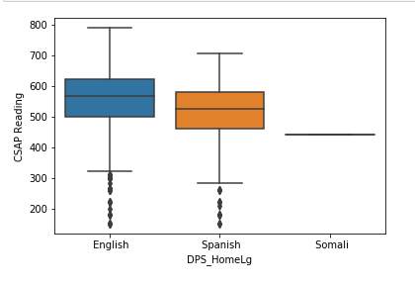
CSAP Scores by Home Language

Slide 13
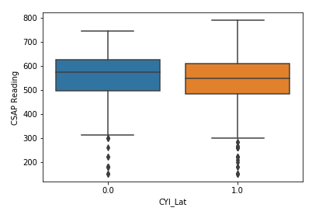
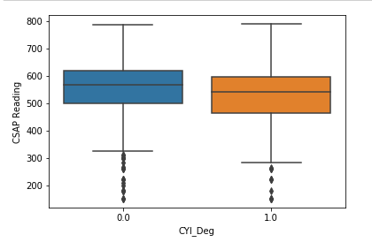
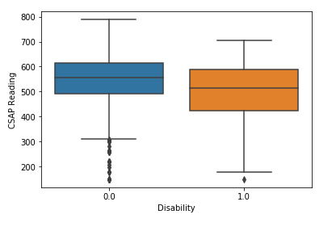
CSAP Scores by Hearing & Disability Status

Slide 14
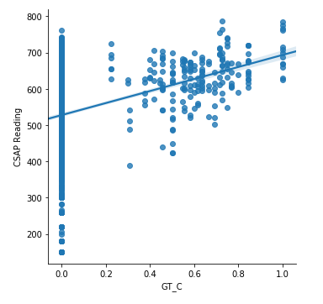
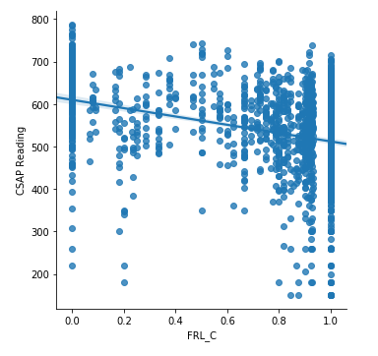
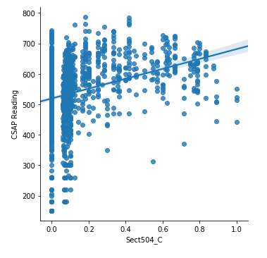
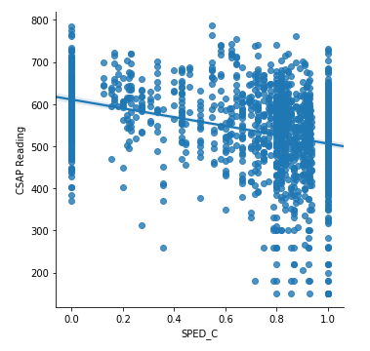
Gifted/Talented, Free/Reduced Lunch, Section 504, Special Ed

Slide 15
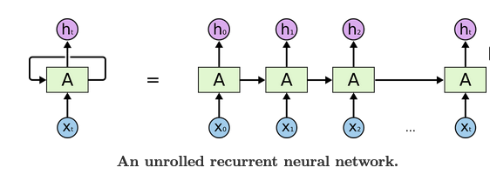
Modelling
Long Short-Term Memory (LSTM) model
  A type of Recurrent Neural Network (RNN)
  Nodes take input and send output, but also have loops that allow information to persist
  Natural fit for sequences and lists (time-series data)

Slide 16
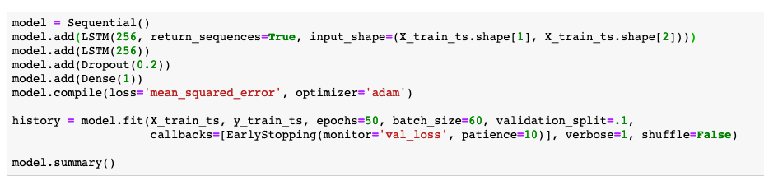
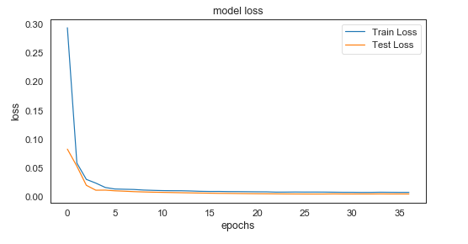
LSTM

Slide 17
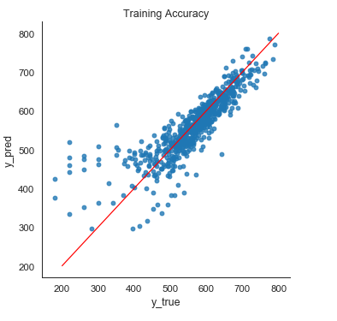
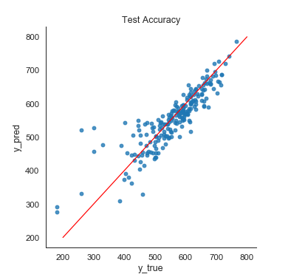
Train R² = 0.7234
Test R² = 0.7595

Slide 18
Conclusions & Caveats
The LSTM model predicted 76% of the variance in CSAP scores using demographic information and the previous CSAP score
Still need to add in early childhood standardized testing results
Which variables were good predictors?

