Slide 1
Marker frame template.
m
Marker frame mask.
f
b
c
m
Coding region.
Binary determination region.
p
Bits width (in pixel).
Ce
A base unit. A Ce is defined as the side
length of a cell.
s
p
f
Fringe width (= 1 Ce).
b
Border width (= 1 Ce).
c
Coding width (= 6 Ce).
m
Margin size (in pixel).
1 Ce
s
Cell size (in pixel).
A cell (A probe).
1 Ce
The spacing between cell and cell.

Slide 2
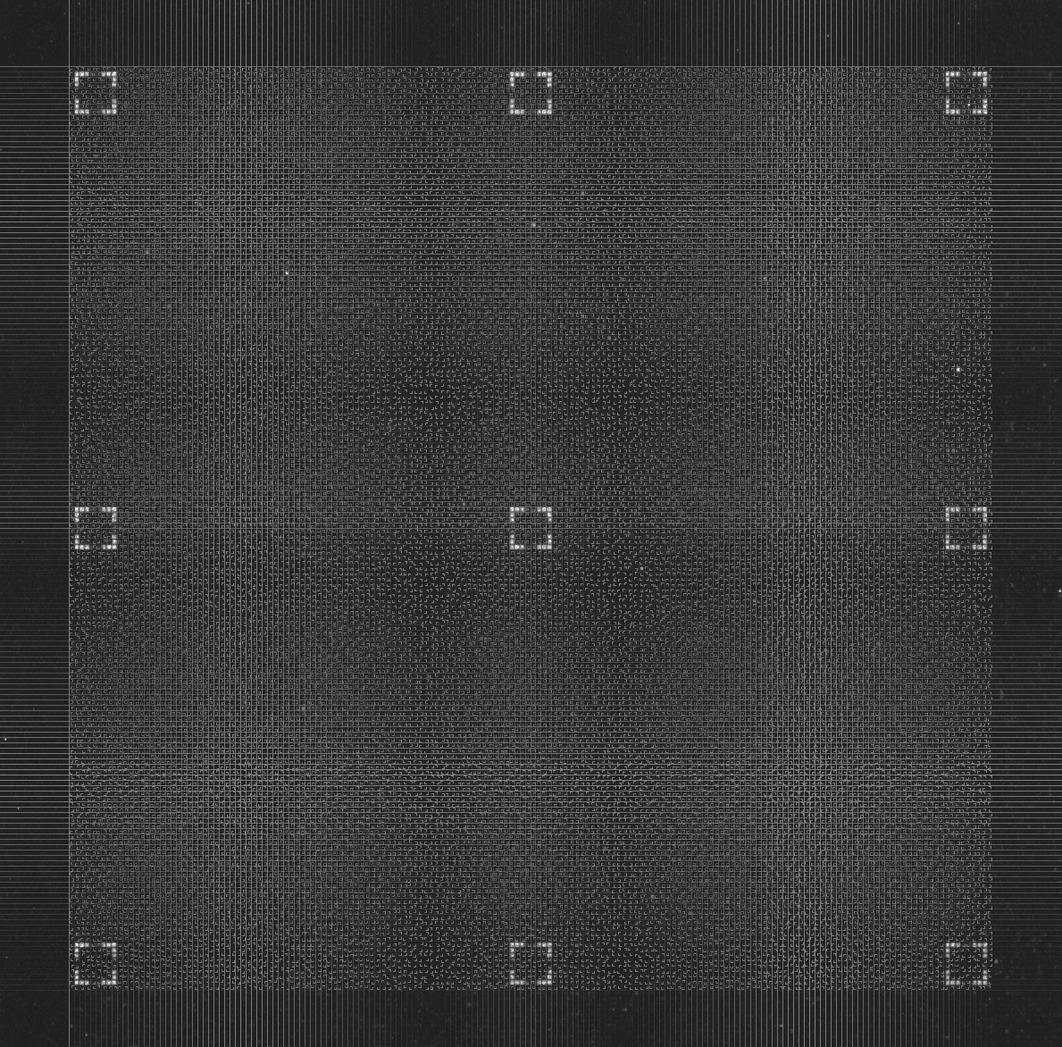
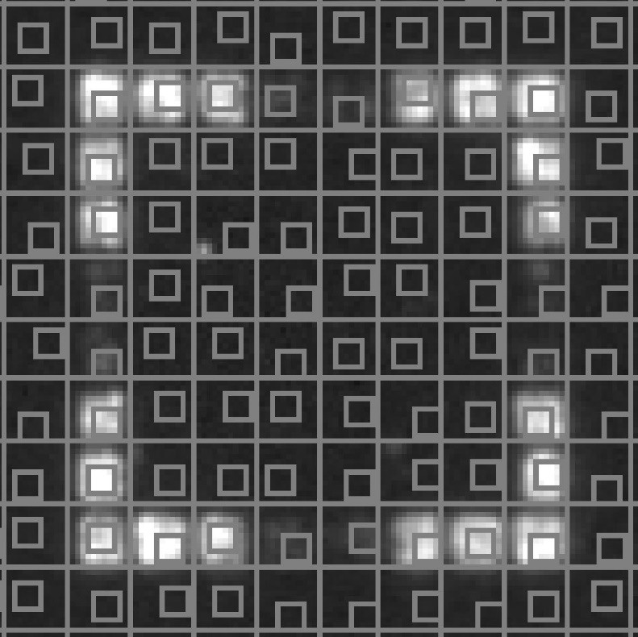
the most representative region in this cell.
A cell

Slide 3
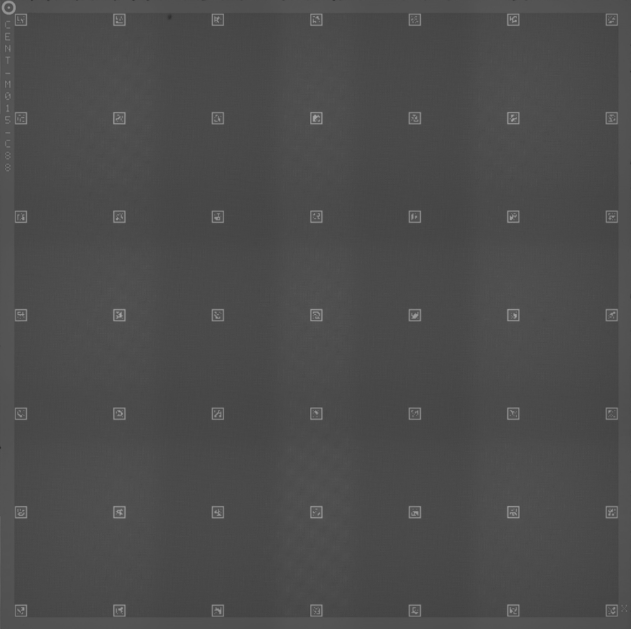
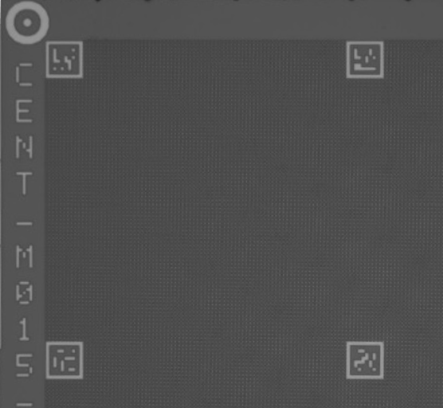
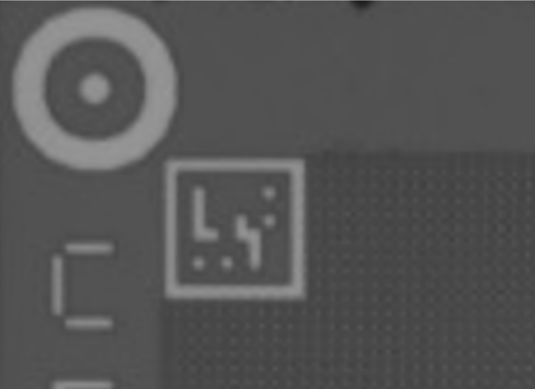
Chip
Chip Tray
ArUco
AM1
AM3
Marker
Marker
Chip

Slide 4
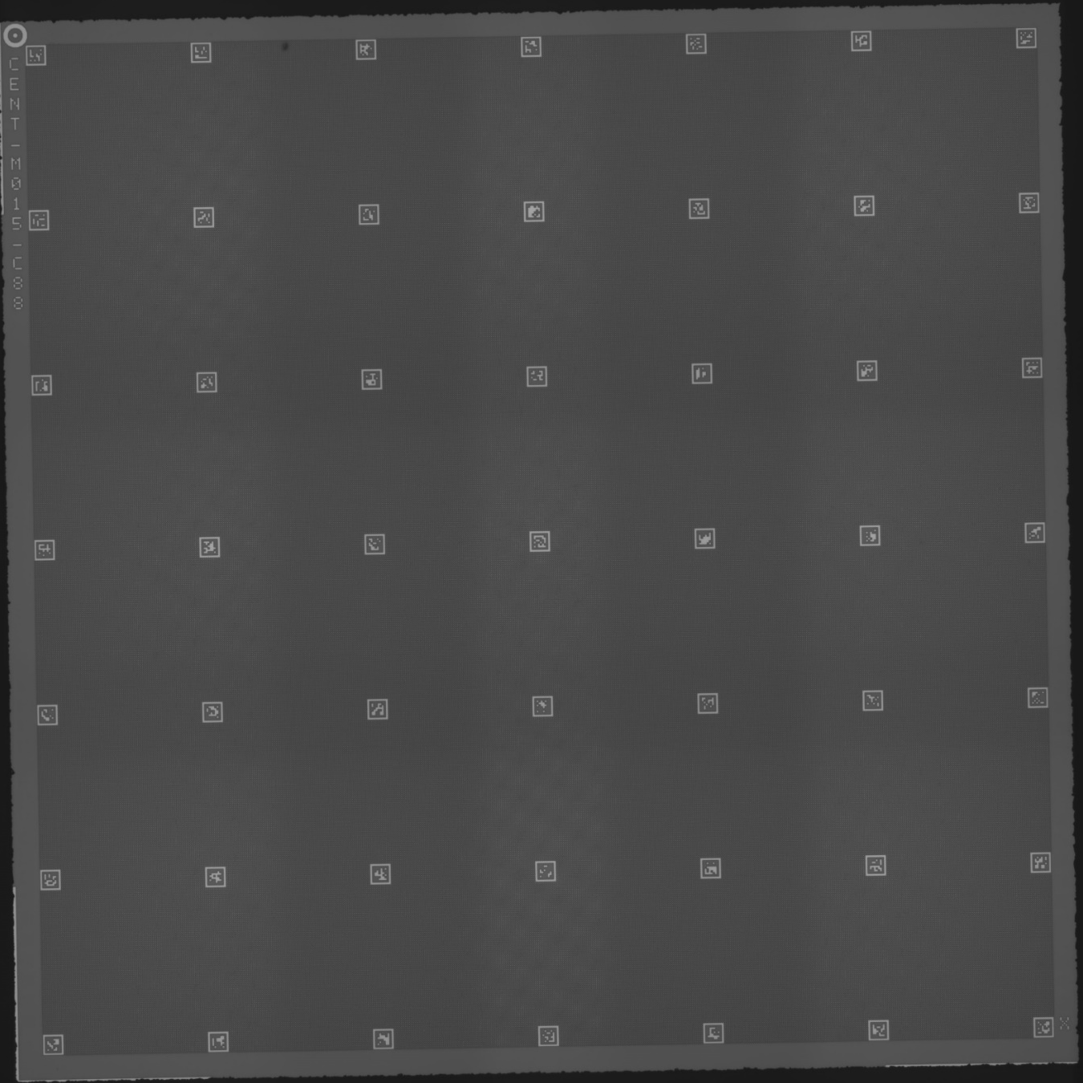

Slide 5
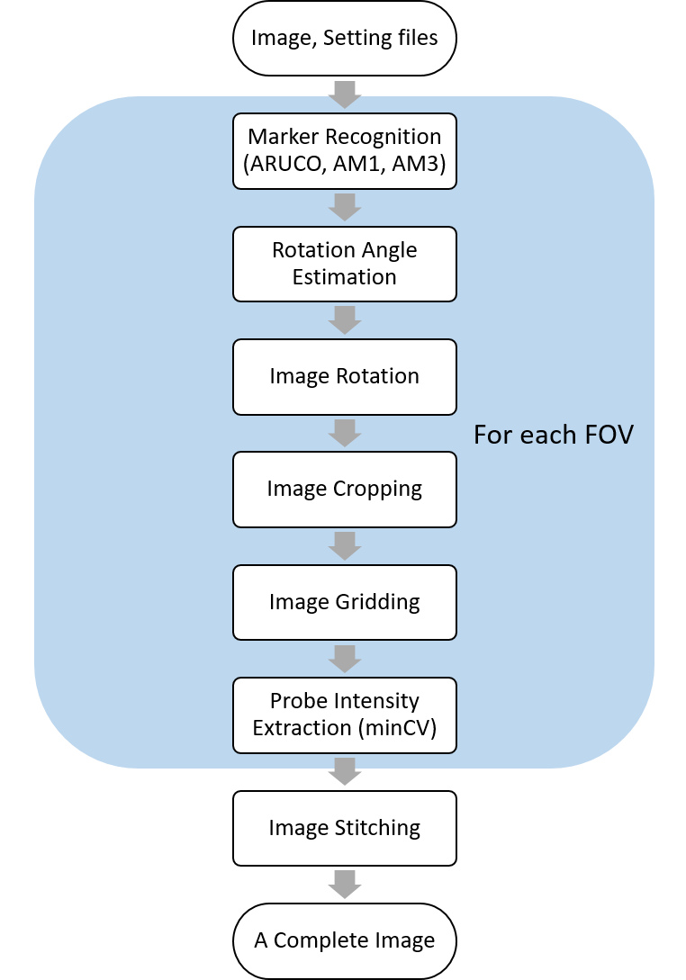
Image, Setting files
Marker Recognition (ARUCO, AM1, AM3)
Rotation Angle Estimation
Image Rotation
Image Cropping
Image Gridding
Probe Intensity Extraction (minCV)
Image Stitching
A Complete Image
For each FOV

Slide 6
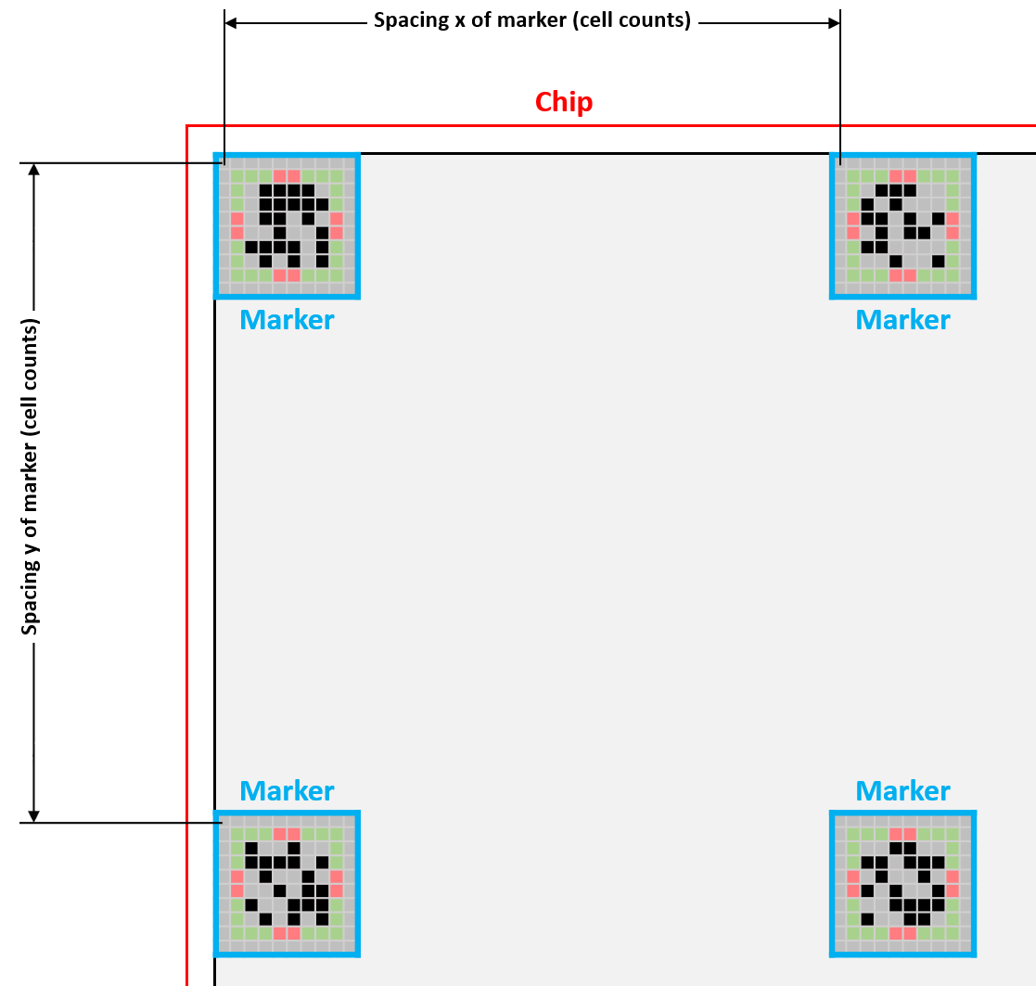
Spacing x of marker (cell counts)
Chip
Marker
Marker
Spacing y of marker (cell counts)
Marker
Marker

Slide 7
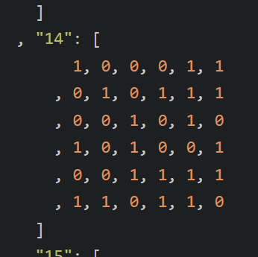
aruco_frame_template.tiff
aruco_frame_mask.tiff

